Slide 1

JAVA INSTALLATION STEP BY STEP DOCUMENT

Slide 2
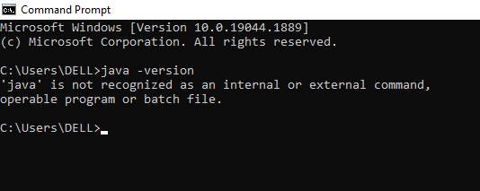
How to check if java is already installed in our system or not?
Firstly, search for cmd.
In Command Prompt (cmd) you can check by using the given command.
Java –version and press enter
If it shows like this you don’t have java installed in your system.

Slide 3
Java Installation steps:
If you find you don’t have java installed in your system or laptop. Lets follow the given steps below to install Java.
Please give the below link in your browser to go to download page
https://www.oracle.com/java/technologies/downloads/#java17
(here we are downloading 17th version).

Slide 4
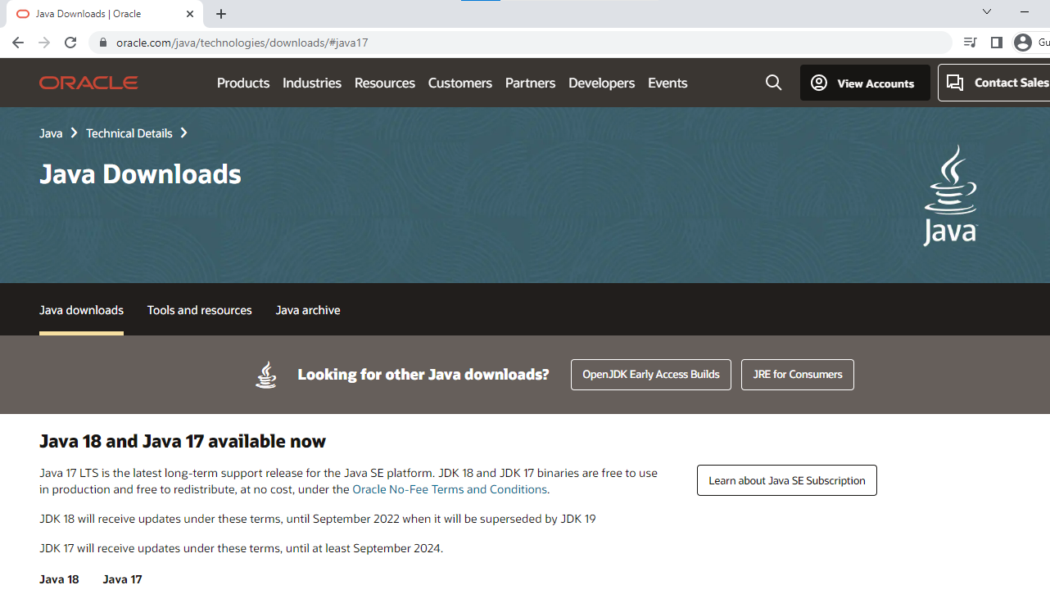
.
After directing to the above link you will see page as shown

Slide 5
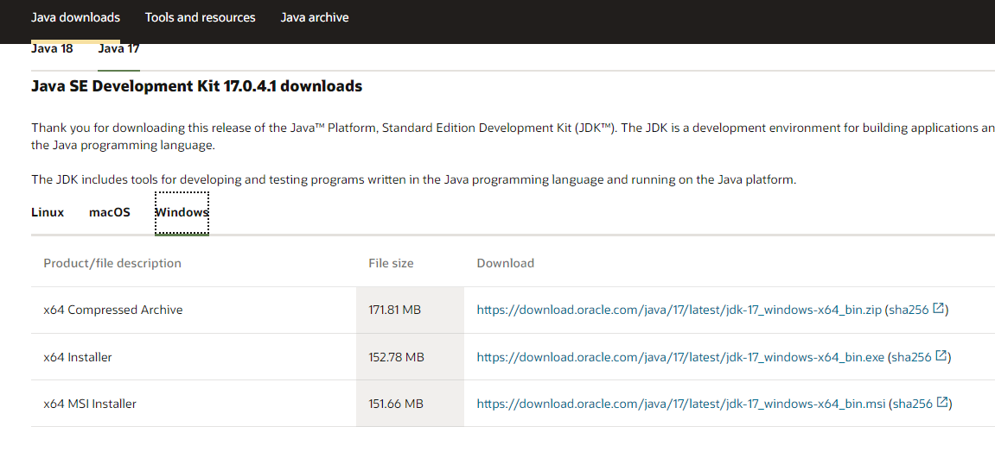
Depending upon the OS we are using we have to select

Slide 6
NOTE: It is recommended to use .exe file to download in our requires OS.
I’m showing for windows OS.
I am installing the file which was given in the below image.

Slide 7
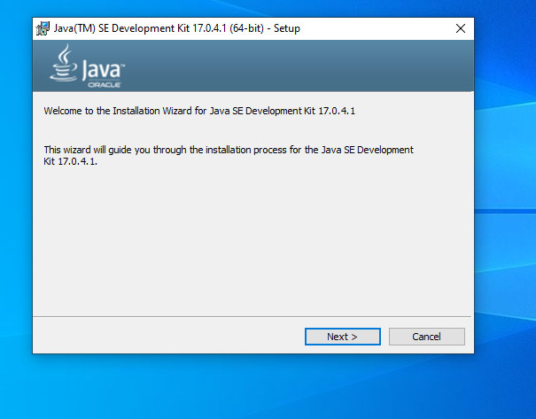
After downloading exe file. You can open it by double clicking it.
Then you will be asked for permissions. You have to select YES.
Then you will be directed to this. You have to select next for further installing process.

Slide 8
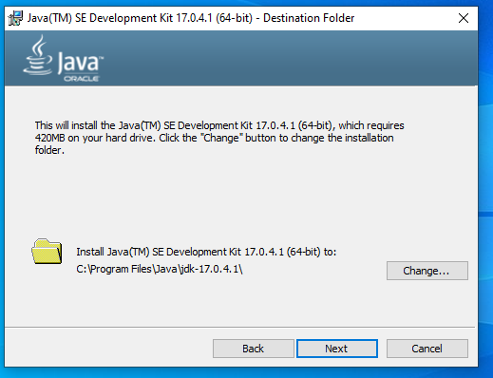
After clicking Next you will be asked for location in our pc to download jdk.
You can change to your desired location and selct NEXT.

Slide 9
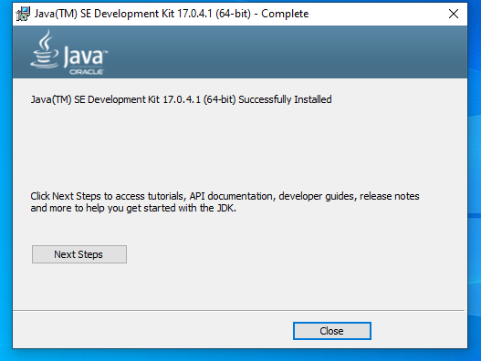
You will be directed to a message like java version successfully installed.
Then you can close the above

Slide 10
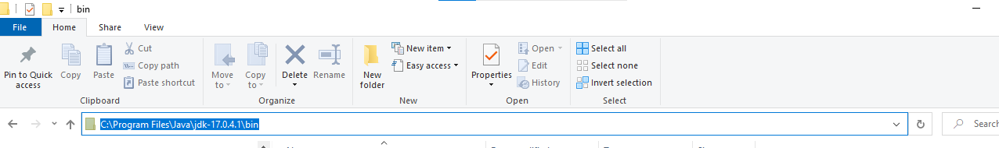
After clicking close copy the bin path where we have installed our JDK
Image added for your reference

Slide 11
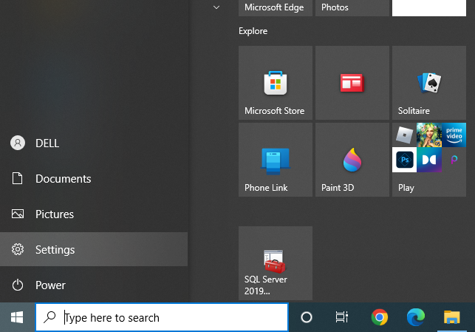
After copying the bin path open settings in our system
Image added for your reference.

Slide 12
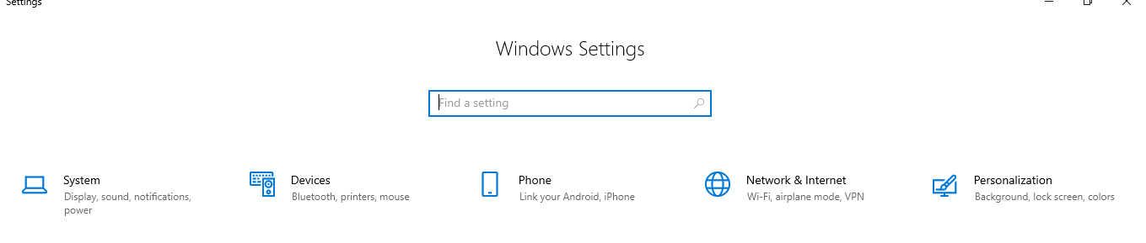
Select System in windows settings
Image added for your reference.

Slide 13
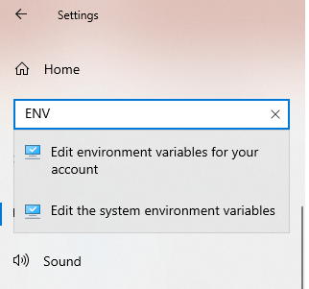
After opening system setting search for environment variables and select EDIT THE SYSTEM SETTING ENVIRONMENTS.
Select the 2nd option from the reference image

Slide 14
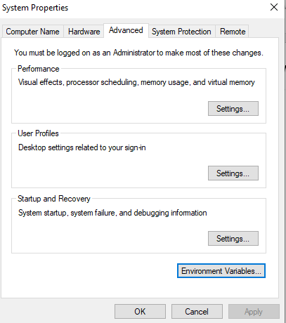
Then you will get a window like this.
Select Environment variables from the window.
Reference image added.

Slide 15
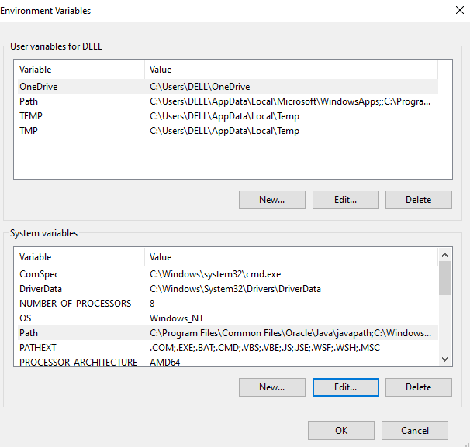
You will get a window like this for Environment Variables.
Select path in system variables and select EDIT as shown in the above image.

Slide 16
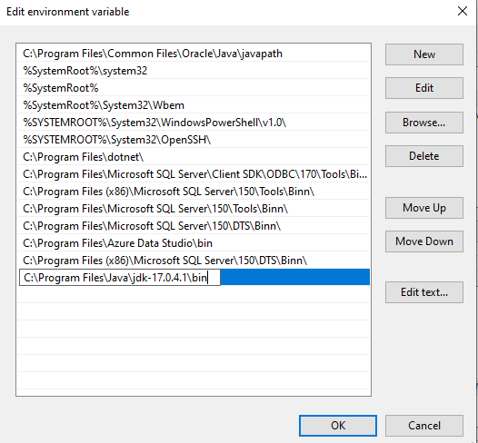
In Edit Environment Variable window select new and add path upto bin and click OK.
Image added for reference.

Slide 17
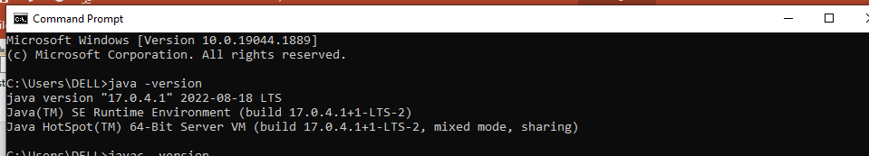
Your Java Installation process is completed.
Restart your PC.
You can check whether it is installed or not by using command prompt.
If our Java version is installed. Command Prompt will give the version like this.
If you have any doubts regarding installation. Please reach us without any hesitation.

Slide 18
Thank you.
HAPPY LEARNING

