Slide 1
Social Media Impact
On
Crypto-Currency
Project By(CSCI 5502)
Vishwanath Kulkarni
Venkat Arigela
Mahesh Parab
Priyanka Umesh Pandit Tailapur

Slide 2
INTRODUCTION
Social media versus value of cryptocurrency
Famous personalities influence on value of cryptocurrency
Dashboard introduction for prediction visualization

Slide 3
CHALLENGES
Social media data is a huge mess
Difference in price value formats
Data pre-processing based on time and data
Real time prediction of the volatile value
Synchronizing geographically distributed tweets

Slide 4
MOTIVATION
Prediction of the crypto-currency values
Index creation for important person on the variance of crypto-currency
Application on other currencies
Analysis of the impact of a ban by various countries

Slide 5
MILESTONES

Slide 6
Week 1 - Setting up the environment
Week 2,3 - Collecting & Pre-processing Data
Week 4,5 - Model Design and Development
Week 6 - Model Testing
Week 7 ,8 - Evaluations and Analysis and Changes
Week 9 - Documentation and Reporting

Slide 7
DATA COLLECTION & PREPROCESSING

Slide 8
DATA COLLECTION & PREPROCESSING
Multiple Tweets datasets - performed sentiment polarity and subjectivity analysis, tweets count normalization
Bitcoin dataset - Performed outlier removal, bitcoin price normalization
Converted both datasets to time-series data

Slide 9
OUR APPROACH

Slide 10
TOP USER PREDICTION
Popularity index is assigned to each user based on many factors
Retweets
Likes
Replies
Timeframe
Impact index

Slide 11
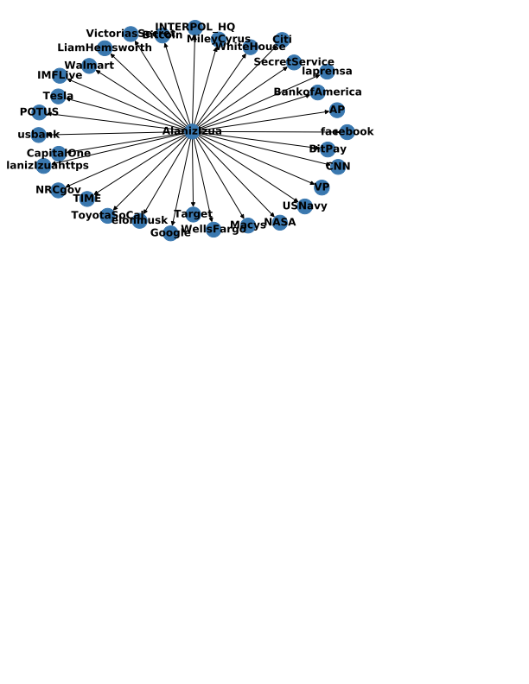
INFLUENTIAL USER PREDICTION
PageRank algorithm
Directed Graph creation with 10 error rate
25 minutes for obtaining weighted graph from
35K records
Updating graph takes less time

Slide 12
DEVELOPMENT ENVIRONMENT

Slide 13
ENVIRONMENT SETUP
Data Architecture Pipeline on GCP
Flask Framework running on VM instances of GCP
Exposed API Endpoints from prediction models

Slide 14
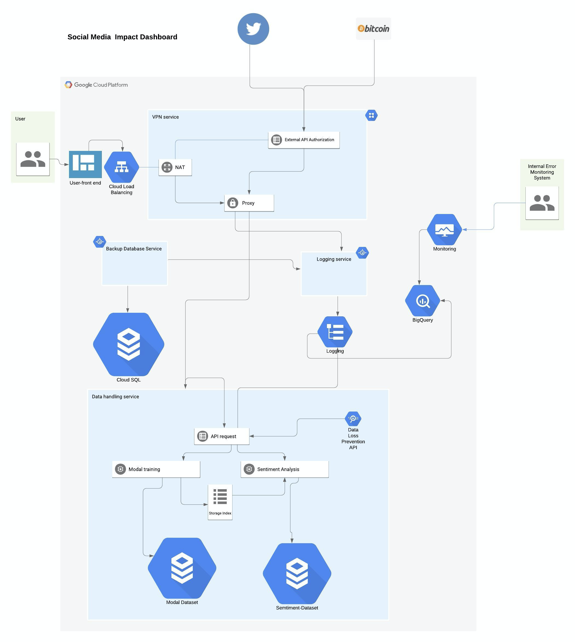
DATA PIPELINE ARCHITECTURE

Slide 15
MODEL DEVELOPMENT & TRAINING

Slide 16
MODEL DEVELOPMENT
Trained an LSTM model on the merged and pre-processed dataset
Experimented with different hyperparameters and lookback sizes to improve model performance

Slide 17
MODEL TESTING
Model performed well on the validation set. Obtained a loss to mean ratio of 5%
Model performed poorly on live Tweets obtained from the Twitter API
Could not satisfactorily train model with newer Tweets due to Twitter API restrictions

Slide 18
DATA INTEGRATION & VISUALIZATION

Slide 19
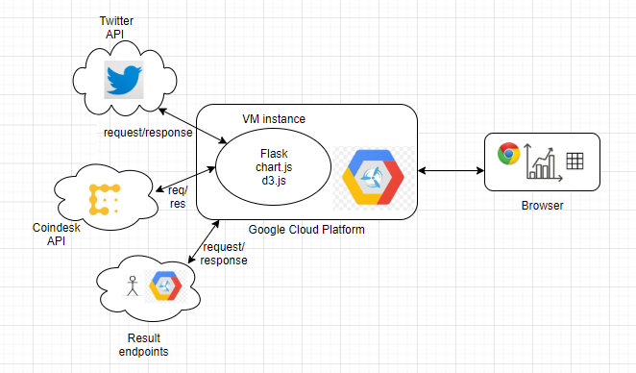
VISUALIZATION ARCHITECTURE

Slide 20
DATA INTEGRATION
Live Twitter Data using the Embedded Twitter APIs
Twitter Hashtag Timeline for #bitcoin

Slide 21
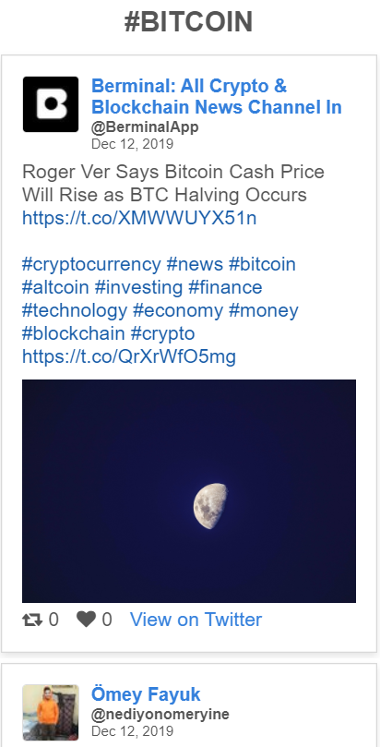
DATA VISUALIZATION - TWITTER

Slide 22
DATA INTEGRATION
Live Bitcoin Data from Coin Market APIs
D3 Data Visualization

Slide 23
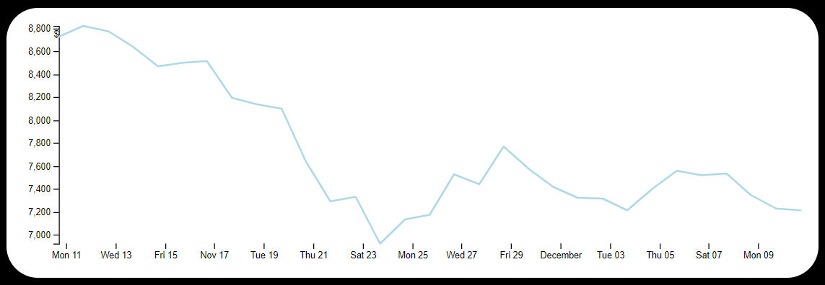
DATA VISUALIZATION - BITCOIN VALUE

Slide 24
DATA INTEGRATION
Top Users and Popular Users for #bitcoin
Usage of exposed API endpoints from prediction model

Slide 25
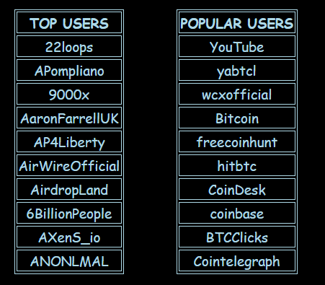
DATA VISUALIZATION - TOP/POPULAR USERS

Slide 26
DATA INTEGRATION
Predicted Values and Actual Values for determining the accuracy of the model

Slide 27
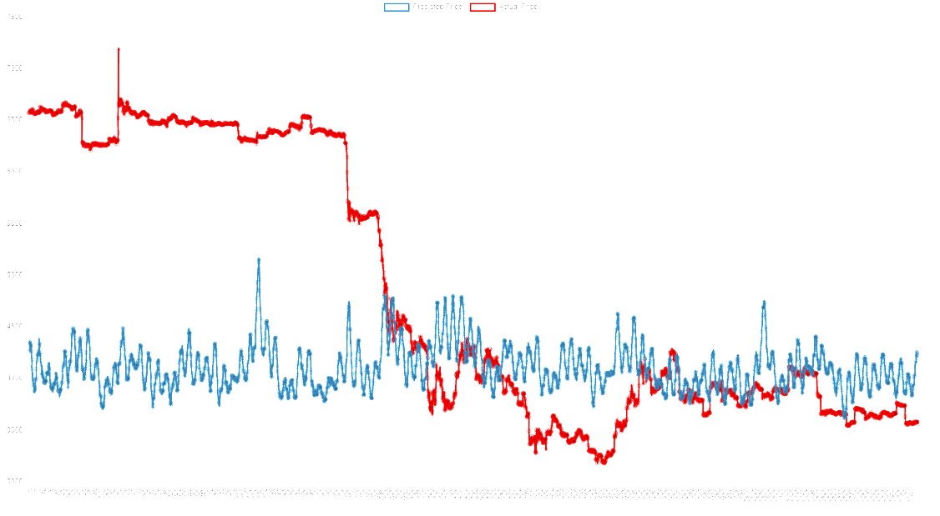

DATA VISUALIZATION - MODEL ACCURACY

Slide 28
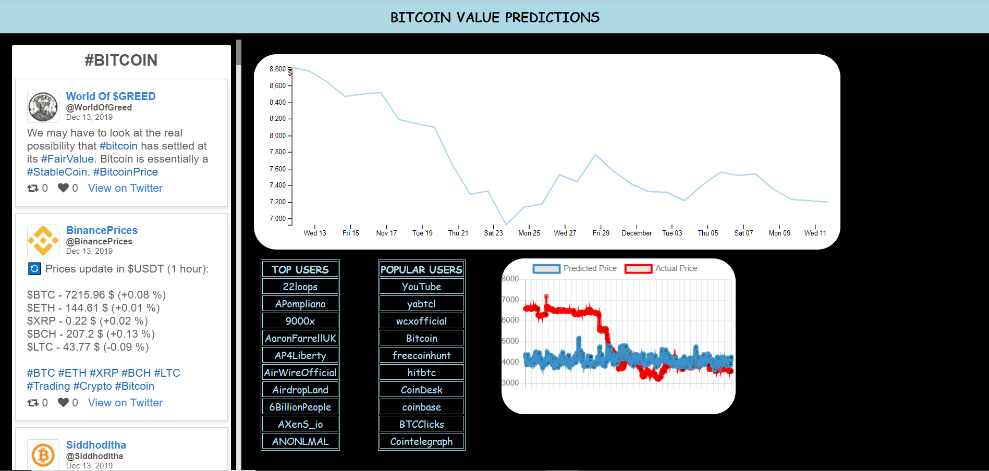
DATA VISUALIZATION

Slide 29
THANK YOU

