Slide 1
TEAM: ALPHABYTE
PS:EXISTING PUMPS IN THE FARM TO RUN BY SOLAR POWER AND AUTO CONTROLLED BY MOBILE

Slide 2
PROBLEMS FACED BY FARMERS
1. Non-availability of power sources.
2. Wastage of water due to manual operation of pumps (overflow).
3.Maintenance of solar panel (if installed).

Slide 3
BASIC DISADVANTAGE OF SOLAR MOTORS
Fetched power is low
Efficiency decreases – dust accumulation.
Existing pump → AC (converter required)
(Although nowadays, mostly DC operated motors are manufactured)

Slide 4
HOW AUTOMATION IS DONE..
Mobile App
Hardware Installation

Slide 5

1-MOBILE APP:
What it does?
Fetches ip for interfacing the app with hardware.
Operates motor on/off.
Analyze data of sensors using THINGSPEAK platform.

Slide 6
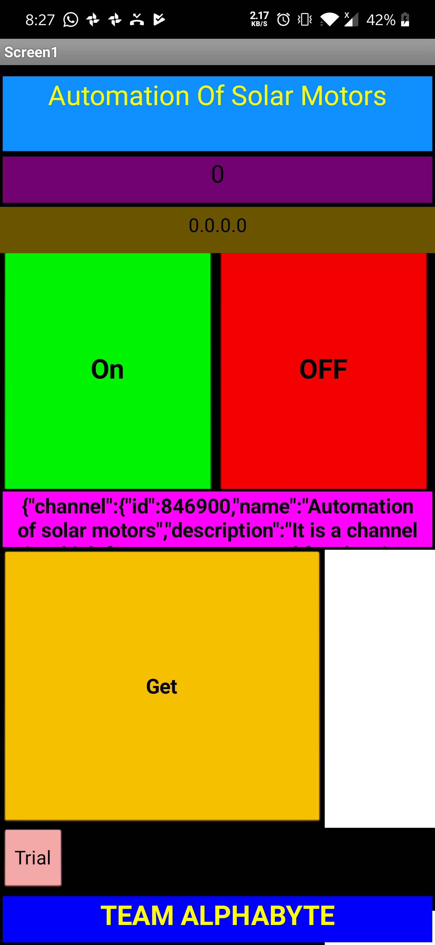
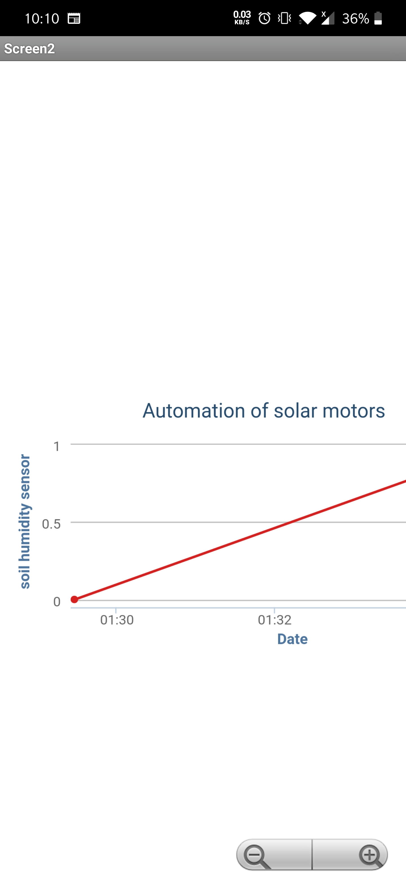

Slide 7
2-HARDWARE INSTALLATIONS
Solar panel
Current doubler circuit.
Rechargeable battery.
Motor.

Slide 8
HARDWARE COMPONENTS
1.NODE MCU
2.LDR
3.SOIL MOISTURE SENSOR
4.RELAY SWITCH MODULE
5.SOLAR PANEL
6.PUMP

Slide 9
THANK YOU.

