Slide 1
Elizabeth Arden vs. Estee Lauder
A financial analysis utilizing the DuPont tree
By: Vishwanath Akuthota, Sharoz, &Ariane Seifert

Slide 2

Company intros
Elizabeth Arden, Inc., incorporated on September 28, 1960, is a global beauty products company with a portfolio of fragrance, skin care and cosmetics brands. The main concentration of company is on designer fragrances.
The company began in 1946 when Estée Lauder and her husband Joseph Lauder began producing cosmetics in New York City. The company consists of four main business segments; Skin Care, Make Up, Fragrance, and Hair Care.

Slide 3
ROE affected by 3 points
Operating efficiency—(measured by NPM)
Asset use efficiency (measured by total asset turnover)
Financial leverage (measured by equity multiplier)
ROE = Profit Margin (Profit/Sales) * Total Asset Turnover

Slide 4
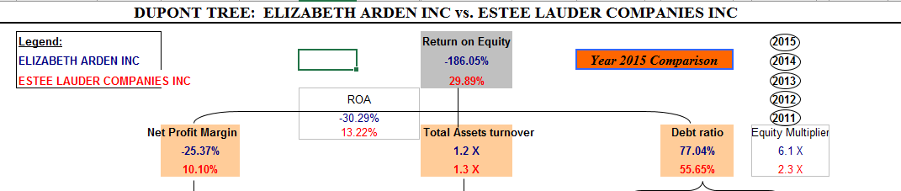
G:\MBA\MBA 640 managerial finance\2Team01redone.xlsm

Slide 5
Five year trends
ROE
Equity multiplier
NPM

Slide 6
Expenses
COGS for both companies-significantly more for EA (65.61%), (19.49%) for EL (3x as much)
Combined COGS & Operation expenses
Operational expenses 15%difference between the 2 companies

Slide 7
Expenses continued
Other non-operating expenses ; similar percentages (0.02%)EA, (0.00)EL
Taxes EA (0.65%), EL (4.33%)
Interest EA(3.05%), EL (0.42%)
Sales ; both 100%

Slide 8
Liabilities
CL (within 1 year) EA (27%), EL (26%); very similar
LL (greater than 1 year) EA (57%), EL (30%); significantly less/tied to debt ratio of companies (EA debt ratio 77.04%/EL (55.65%)
Current ratio—similar at 2.0%for EA and 2.1% for EL
Quick ratio almost double for EL (0.8x for EA; 1.5 for EL

Slide 9
Liabilities continued
TIE , negative for EA (-6.4%) , +35.1% for EL
Op PM also negative , -19.48% for EA, +14.90% for EL
Problematic both TIE & Op PM are negative for EA

Slide 10
Total Asset Turnover
Asset turnover linked to expenses, sales, total assets, total liabilities and common equity.
Asset Turnover = Sales or Revenues / Total Assets
Asset turnover ratios indicate that the firms generate ($1.2) & ($1.3) revenue for every $1 of the assets the company owns.

Slide 11
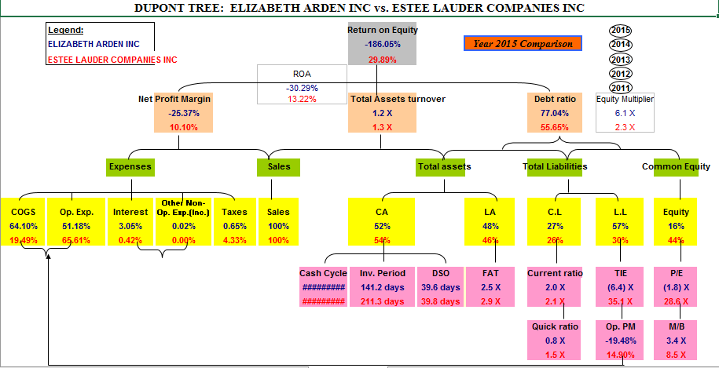
Total Asset Turnover cont.,

Slide 12
Current Assets & Long Term Assets
Current assets (less than 1 year)
RDEN (52%)
EL (54%)
Long term assets (more than 1 year)
RDEN (48%)
EL (46%)
Cash Cycle
RDEN 126.4 days
EL 140.6 days
CCC = DIO + DSO – DPO
The higher number of days of cash conversion cycle means it will take longer for a company to convert resource inputs into cash flow.

Slide 13
Inventory Period
RDEN 141.2 days
EL 211.3 days
Inventory Period = 365 × Average Inventory / Annual Cost of Goods Sold
or
Inventory Period = 365 / Inventory Turnover
Estee Lauder Companies Inc takes 70.1 days more to convert its inventory (products) into sales.
Days of Sales Outstanding (DSO)
RDEN 39.6 days
EL 39.8 days
DSO ratio = accounts receivable / average sales per day
Both companies take almost same amount of time to collect cash from credit sales

Slide 14
Fixed Asset Turnover
RDEN 2.5 x
EL 2.9 x
Fixed asset turnover= Net sales/ Net property, plant, equipment
If a company has a high fixed asset turnover ratio, it shows that the company is efficient at managing its fixed assets.
Estee Lauder Companies Inc has a fixed asset ratio of 2.9 which means that for every $1of fixed asset it would generate $2.9 revenue.

Slide 15
Common Equity
RDEN 16%
EL 44%
Price to Earnings ratio
RDEN (1.8) x
EL 28.6 x
P/E ratio = price per share / earnings per share (EPS)
Where EPS = earnings/total shares outstanding
Book to Market ratio
RDEN 3.4x
EL 8.5x
Book to market= book value of firm / market value of firm
This ratio is calculated to find out the value of a company by comparing the book value of a firm to its market value.
Book value is calculated by company’s historical costs or account value, and market value is determined by its market capitalization in the stock market.

Slide 16
Reference
www.sec.gov
https://corporate.elizabetharden.com/
http://www.reuters.com/finance/stocks/companyProfile?symbol=RDEN.O
http://www.elcompanies.com/Pages/Our-Company.aspx
http://marketrealist.com/2015/08/business-overview-estee-lauder/

