Slide 1
Thoughts on RO Membranes
Preamble to Molecular Simulation
For Discussion with Prof. P. K. Ghosh
20th May 2015
V. H. Dalvi

Slide 2
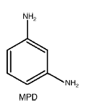
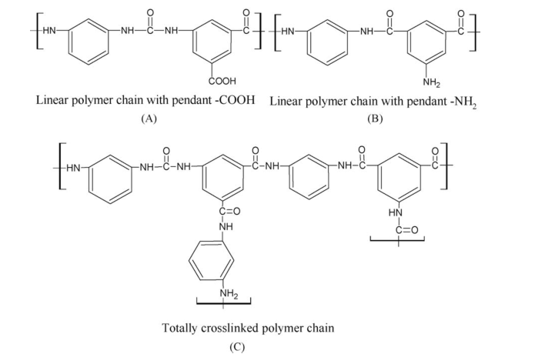
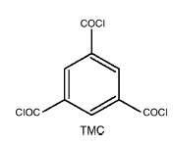
Chemical Composition
Interfacial Polymerization
+
Trimeosyl Chloride in 0.1% w/v organic solution e.g. isoparaffin.
Some Diamine in ~2% w/v aqueous solution
Yong et al, JMS (2006)
Poly Amide Linkages
Liu et al, JMS (2006)

Slide 3
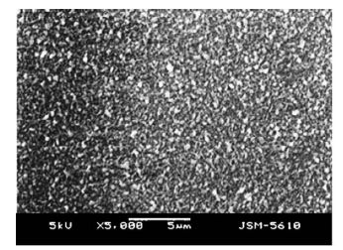
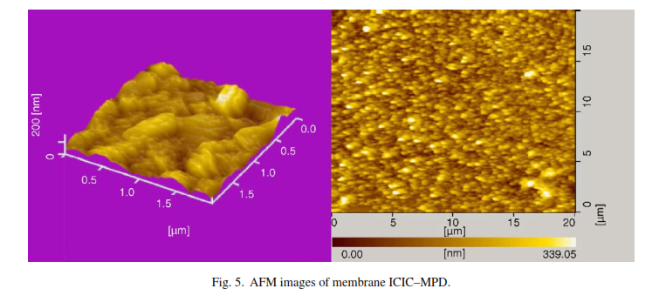
Result
SEM
AFM showing 200 nm sized features
Peaks and Valleys
Liu et al, JMS (2006)
Yong et al, JMS (2006)

Slide 4
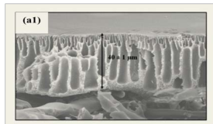
Result
SEM
Ghosh et al, 2011
http://www.barc.gov.in/publications/nl/2011/2011070808.pdf

Slide 5
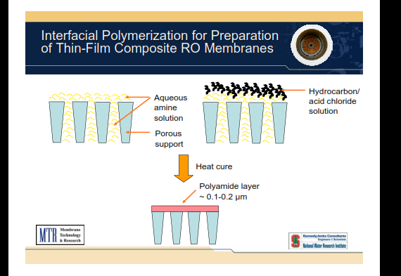
Nice Illustration
http://web.stanford.edu/group/ees/rows/presentations/Pinnau.pdf

Slide 6
Curing
Some groups have reported curing at 80oC (e.g. Yong et al 2006, Liu et al 2006)
Some have simply washed with hexane after letting membrane sit in contact with organic solution (e.g. Xie et al J. Membrane Science 2012)
Notes:
From http://ajbasweb.com/old/ajbas/2012/June/382-391.pdf: Higher TMC concentration i.e. more unreacted COOH groups i.e. greater hydrophilicity and better water permeation fluxes. More diamine concentration i.e. greater diffusion of diamine into organic layer ie. Rougher surface.

Slide 7
Interfacial Polymerization
TMC in Organic
Diamine in Aqueous

Slide 8
Interfacial Polymerization
Interface Viewed From “Top”
Random Appearance/Exit of TMC
Random Appearance/Exit of Diamine

Slide 9
Interfacial Polymerization
Interface Viewed From “Top”
$$Ar{\left(COCl\right)}_{3}+NH_{2}−R−NH_{2}→Ar{\left(COCl\right)}_{2}C\left(=O\right)N\left(H\right)RNH_{3}^{+} Cl^{−}$$
HCl liberated neutralizes nearest available Lewis base
Occasional Condensation
Site Unavailable for Further Reaction
(This will not be the case for polyesters)

Slide 10
Interfacial Polymerization
$Ar{\left(COCl\right)}_{2}C\left(=O\right)N\left(H\right)RNH_{3}^{+} Cl^{−}+NH_{2}−R−NH_{2}→Ar{\left(COCl\right)}_{2}C\left(=O\right)N\left(H\right)RNH_{2}$+$NH_{2}−R−NH_{3}^{+}Cl^{−}$
Interface Viewed From “Top”
Subsequent diamine molecules could either regenerate the active site:
Site Available for Further Reaction
Regeneration could also happen by another strong base added to the aqueous phase (though such a base would preferentially remain in the bulk and regenerate acidified amines)

Slide 11
Interfacial Polymerization
Or react with the remaining active sites of TMC
Interface Viewed From “Top”

Slide 12
Interfacial Polymerization
Final Structure can be predicted from a stochastic model.
Another layer on top of first layer can be modelled with reduced diffusion for diamine
Interface Viewed From “Top”

Slide 13
Reasons for Rough Interface
Differential Diffusion of Diamine into Organic Phase (Less Likely)
Due to changes in interfacial tension. As skin forms, interfacial tension reduces causing interface to curve to increase contact area (very likely).
Roughness could form during drying as vapours of liquid leave the surface non-uniformly (less likely).

Slide 14
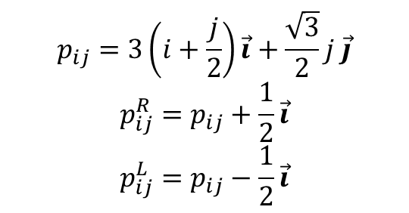
Indexing Hexagonal Grids
Each vertex as three coordinates (i, j, R/L)
-1,6
Neighbours of R vertex:
(i, j, L), (i, j+1, L), (i+1, j-1, L)
Neighbours of L vertex:
(i, j, R), (i, j-1, R), (i-1, j+1, R)
-1,5
0,5
R
-1,4
0,4
1,4
L
R
-1,3
0,3
1,3
L
L
R
R
-1,2
0,2
1,2
L
L
R
-1,1
0,1
1,1
L
R
L
R
L
R
-3,0
-2,0
-1,0
0,0
L
R
1,0
2,0
3,0
L
R
0,-1
L
R
1,-1
0,-2
1,-2
$$p_{ij}=3\left(i+\frac{j}{2}\right)\vec{i}+\frac{\sqrt{3}}{2}j \vec{j}$$
$$p_{ij}^{R}=p_{ij}+\frac{1}{2}\vec{i}$$
$$p_{ij}^{L}=p_{ij}−\frac{1}{2}\vec{i}$$
0,-3
1,-3
0,-4
1,-4

Slide 15




Indexing Hexagonal Grids
$$(i−m,j+2n)$$
Each vertex as three coordinates (i, j, R/L)
$$(i,j+n)$$
-1,6
Neighbours of cell (i,j):
i-1, j+2
i+1, j-2
i, j+1
i, j-1
i-1, j+1
i+1, j-1
$$(i−m,j+n)$$
-1,5
0,5
R
-1,4
0,4
1,4
-1,2
L
R
-1,3
0,3
1,3
-1,1
L
L
R
0,1
0,2
1,2
L
R
-1,2
L
R
-1,1
0,0
L
R
L
R
0,1
L
R
1,1
0,-1
1,-1
-3,0
-2,0
-1,0
0,0
L
R
1,0
2,0
3,0
L
R
1,-2
0,-1
L
R
1,-1
Boundaries of cell (i,j):
(i, j, L) – (i, j, R)
(i-1, j+2, L) – (i-1, j+2, R)
(i, j, L) – (i-1, j+1, R)
(i, j, R) – (i, j+1, L)
(i-1, j+2, L) – (i-1, j+1, R)
(i-1, j+2, R) – (i, j+1, L)
0,-2
1,-2
0,-3
1,-3
0,-4
1,-4
$$p_{ij}^{C}=p_{ij}+\frac{\sqrt{3}}{2}\vec{j}$$

Slide 16
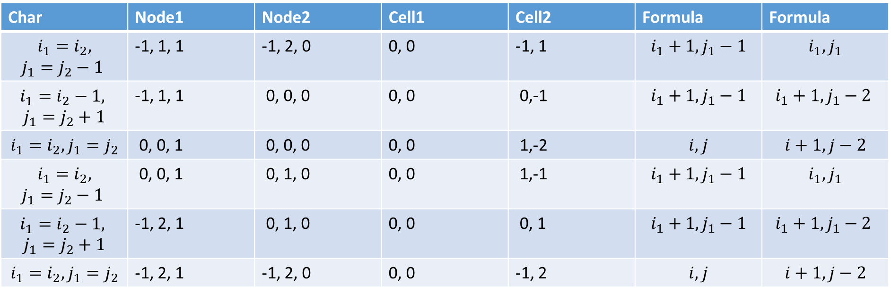
Indexing Hexagonal Grids
Each vertex as three coordinates (i, j, R/L)
-1,6
-1,5
0,5
R
-1,4
0,4
1,4
-1,2
L
R
-1,3
0,3
1,3
-1,1
L
L
R
0,1
0,2
1,2
L
R
-1,2
L
R
-1,1
0,0
L
R
L
R
0,1
L
R
1,1
0,-1
1,-1
-3,0
-2,0
-1,0
0,0
L
R
1,0
2,0
3,0
L
R
1,-2
0,-1
L
R
1,-1
Char | Node1 | Node2 | Cell1 | Cell2 | Formula | Formula
$$i_{1}=i_{2},$$ $$j_{1}=j_{2}−1$$ | -1, 1, 1 | -1, 2, 0 | 0, 0 | -1, 1 | $$i_{1}+1,j_{1}−1$$ | $$i_{1},j_{1}$$
$$i_{1}=i_{2}−1,$$ $$j_{1}=j_{2}+1$$ | -1, 1, 1 | 0, 0, 0 | 0, 0 | 0,-1 | $$i_{1}+1, j_{1}−1$$ | $$i_{1}+1, j_{1}−2$$
$$i_{1}=i_{2}, j_{1}=j_{2}$$ | 0, 0, 1 | 0, 0, 0 | 0, 0 | 1,-2 | $$i, j$$ | $$i+1, j−2$$
$$i_{1}=i_{2},$$ $$j_{1}=j_{2}−1$$ | 0, 0, 1 | 0, 1, 0 | 0, 0 | 1,-1 | $$i_{1}+1,j_{1}−1$$ | $$i_{1},j_{1}$$
$$i_{1}=i_{2}−1,$$ $$j_{1}=j_{2}+1$$ | -1, 2, 1 | 0, 1, 0 | 0, 0 | 0, 1 | $$i_{1}+1, j_{1}−1$$ | $$i_{1}+1, j_{1}−2$$
$$i_{1}=i_{2}, j_{1}=j_{2}$$ | -1, 2, 1 | -1, 2, 0 | 0, 0 | -1, 2 | $$i, j$$ | $$i+1, j−2$$
0,-2
1,-2
0,-3
1,-3
0,-4
1,-4

