Slide 1
Introduction to Docker

Slide 2
Module Objectives
Docker overview
Understand Docker's architecture
Discuss core resources within Docker
Images
Registry
Container
Container provisioning workflow
CI/CD workflow

Slide 3
Docker Overview

Slide 4
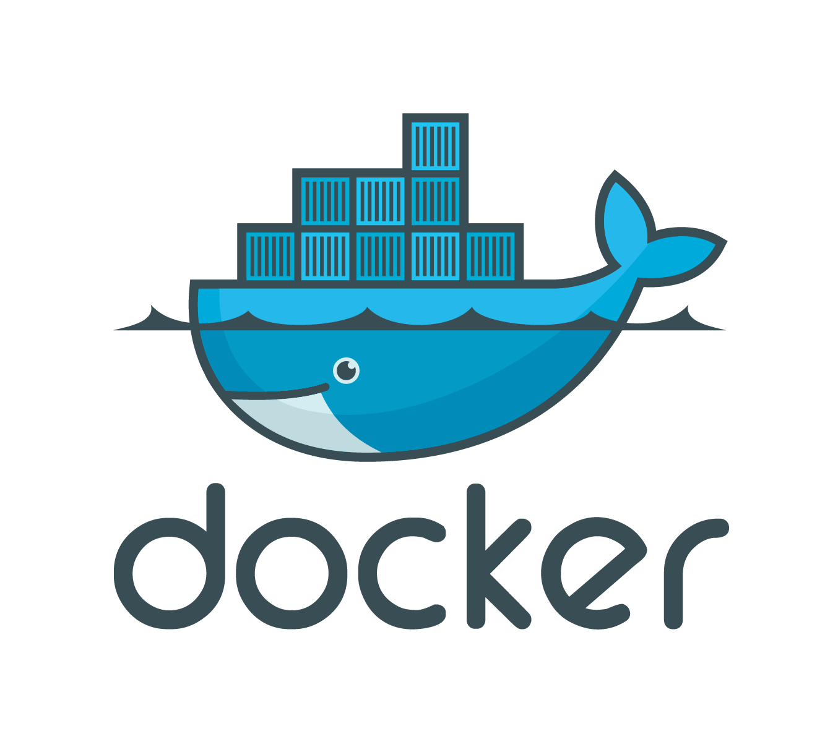
What is Docker?
Open lightweight platform for developing, shipping, and running applications utilizing containerization technologies and workflow management tools

Slide 5
Why Docker?
Faster delivery of applications
Deploy and scale easily
Achieve high density workloads
Open platform and broad ecosystem
Notes:
Docker containers can run almost anywhere - from personal machines, virtual machines, to data centers and clouds.
This allows developers to focus on producing code on their machines and sysadmins to focus on deploying the
Container on the other environments without prohibiting each other’s workflow.
Its lightweight containers allow for quick scaling and small footprint.
We will take a look at the basic components of Docker, and how it delivers the solutions mentioned above.
Source:
https://docs.docker.com/v1.8/introduction/understanding-docker/

Slide 6
Docker Architecture

Slide 7
Docker Architecture
Client-server Architecture
User interacts with client to issue commands
Client talks to Docker daemon running on (same or remote) server
Communicates via sockets or RESTful API
Notes:
Docker’s high level architecture is rather simple. Users speak with client (local or remote) to issue commands and the client communicates with the Docker daemon via
Sockets or REST API.
Source:
https://docs.docker.com/v1.8/introduction/understanding-docker/

Slide 8
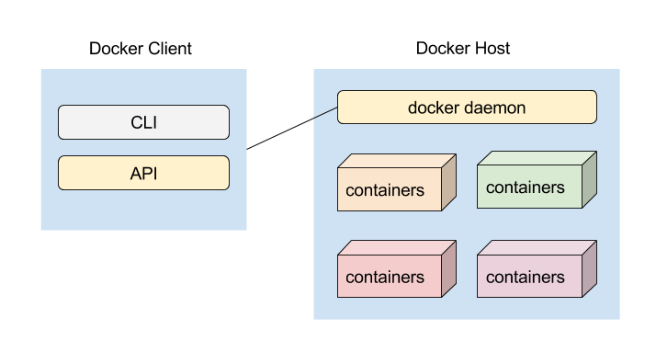
Client-server Architecture
Notes:
In this diagram, user requests to run a docker container and the request is sent to the Server via a RESTful API or CLI.
The client consists of the docker binary (primary user interface to Docker). It accepts commands from user and communicates with Docker daemon.
The server (Docker host) does most of the work in building and running your Docker containers.
Before we move on to the next workflow, we must understand several other key Docker components.

Slide 9
Building Blocks

Slide 10
Docker Components
Images
Registries
Containers
Underlying Technologies

Slide 11
Docker Images
An image is the foundational building block of a container
Images are read-only
Consists of series of layers
Each layer can create, update, and remove files
Multiple images can share layers amongst themselves
Leverages Union File Systems to "merge" each layer to present a single unified file system to a container
Images can be built in 2 different ways:
Manually
Automated with a Dockerfile
Notes:
Docker images are read-only templates that is used when building a container.
Images consist of series of layers (file systems) that are logically joined by what’s known as
Union File System. When a change is made to a file on an image, rather than replacing
The entire image itself, only the layer(s) affected are replaced or new layers are added.
This is what makes Docker containers very light and fast.
There are some variants of UnionFS that Docker can utilize:
AUFS, btrfs, vfs, and DeviceMapper
Source: https://docs.docker.com/v1.8/introduction/understanding-docker/

Slide 12
Docker Registries
Stores Docker images
“Push” or “Pull” images to registry
Public and private registry available via “Docker Hub”
Public: available for anyone to search and download
Private: exclusive to you and your users - sign up for storage plan
Notes:
Docker registries are simply a place where the images are stored.
Users can push or pull images to and from the registry just like a code-base.
Docker provides a registry called Docker Hub where users can utilize it as a public or private registry.
Source:
https://docs.docker.com/v1.8/introduction/understanding-docker/

Slide 13
Docker Containers
Runtime instances of Docker image
Created by ‘docker run’ command
Holds everything needed for app to run
Following components make up a container
Operating System
User added files
Metadata
Notes:
Source:
https://docs.docker.com/v1.8/introduction/understanding-docker/

Slide 14
Underlying Technologies
Written in Go
Namespaces isolate process, network, etc
Cgroups manages resource allocation
Union File Systems combines separate file systems to logically form a single file system
Copy on Write for containers & images
Notes:
Docker is written in the language ‘Go’ developed by Google announced in November 2009.
Its goal is to be easier to use than C, and includes garbage collection, structural typing, and memory safety features.
According to docker, ‘Go’ was chosen because it was a ‘neutral’ language and had exactly what they needed
Including the following:
1. Good asynchronous primitives
2. Low-level interfaces (syscalls, manage processes)
3. Extensive standard library and data types
4. Good development environment and workflow
Several types of namespaces are utilized by Docker.
This includes PID, NET, IPC, MNT, and UTS namespaces.
Cgroups allows sharing of hardware resources to containers, thus proves to be a good utility for
Multi-tenant host. It can limit / isolate CPU, memory, disk I/O, etc.
Docker utilizes copy on write technology for containers and images to optimize
Disk space and performance of start times.
Sources:
https://en.wikipedia.org/wiki/Go_(programming_language)
http://www.slideshare.net/jpetazzo/docker-and-go-why-did-we-decide-to-write-docker-in-go/22-Why_Go3_it_has_what

Slide 15
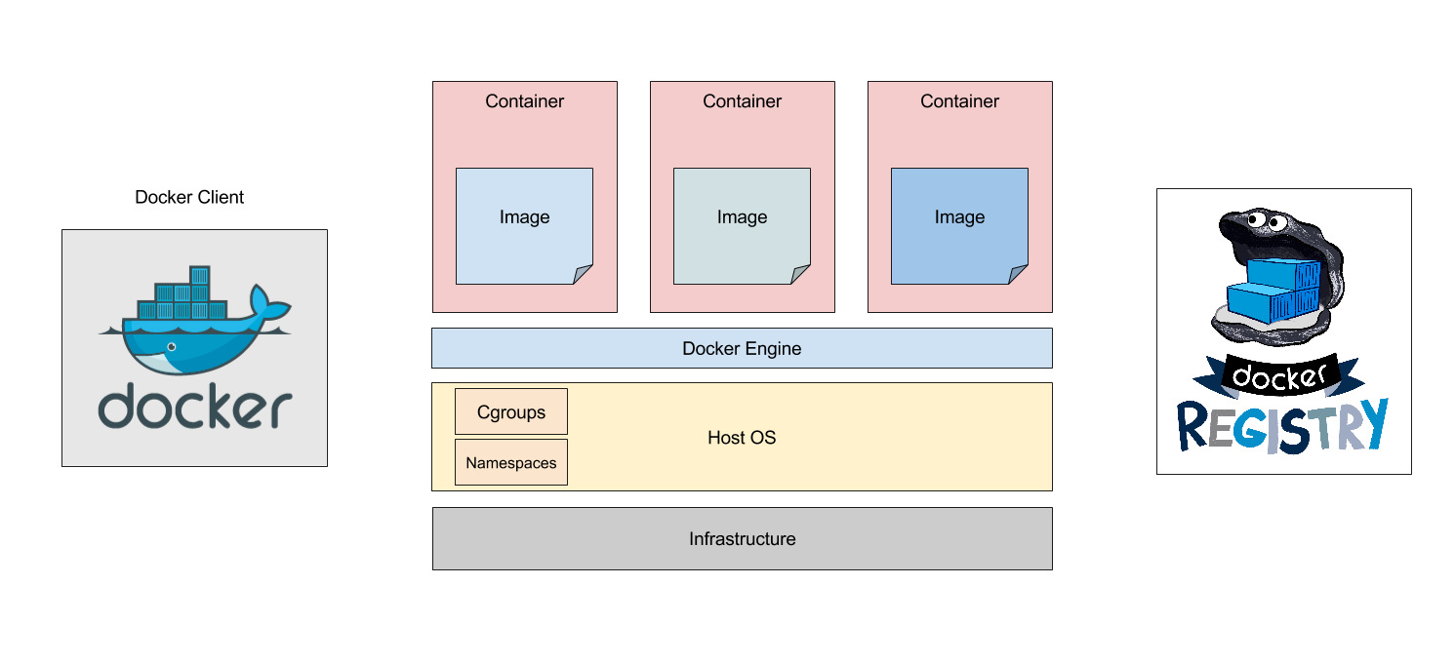
Technology Overview
Notes:
This is the time to go over the building blocks of docker - including inter-related components.
Container provisioning workflow is next, so there is no need to go into so much depth here.
Mention the different components and the stack they fit into.

Slide 16
Container Provisioning Workflow

Slide 17
Simple App on Container
Observe workflow of the following sample command
$ docker run hello-world
Notes:
Source:
https://docs.docker.com/v1.8/introduction/understanding-docker/
https://docs.docker.com/engine/getstarted/step_two/

Slide 18
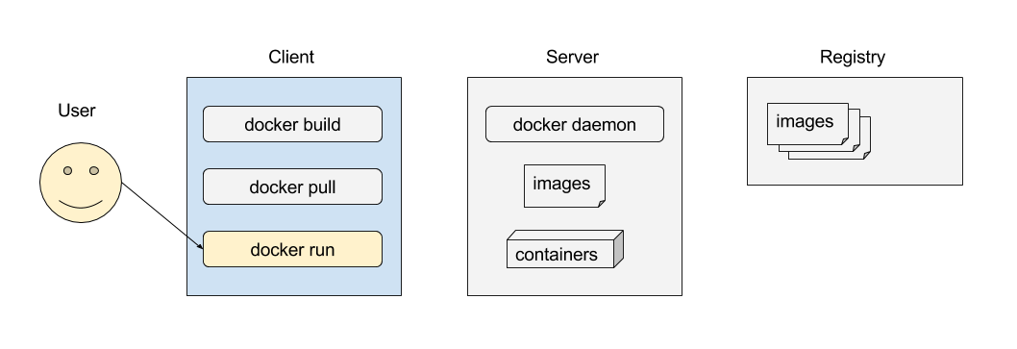
Issue Command on Client
Notes:
The user runs the ‘docker’ binary with the ‘run’ option.
Run option requires one mandatory parameter:
Docker image to build container from

Slide 19
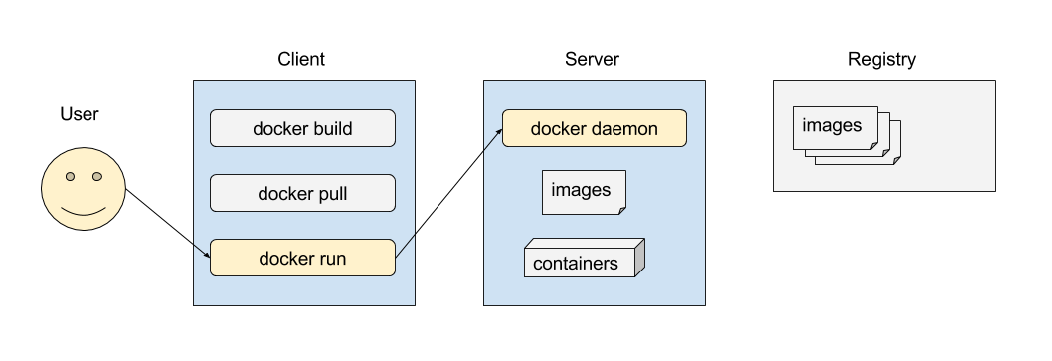
Pass Message to Docker Host
Notes:
After receiving the ‘docker run’ command, the client passes the message to the Docker daemon which resides on the host.

Slide 20
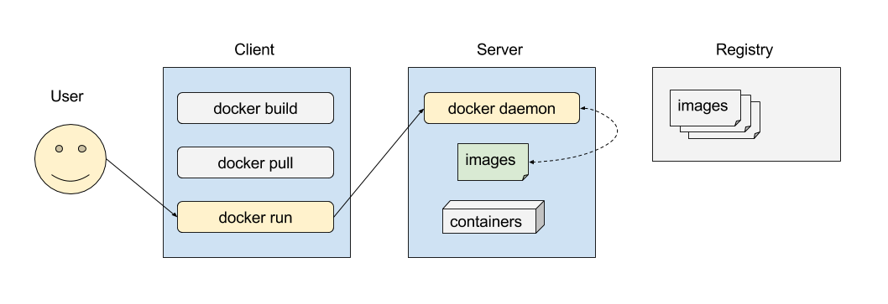
Check Image Availability
Notes:
The Docker host checks locally to see if the requested image is available.
In this case, the local copy of the ‘images’ is not the appropriate ‘hello_world’ image we are looking for.

Slide 21
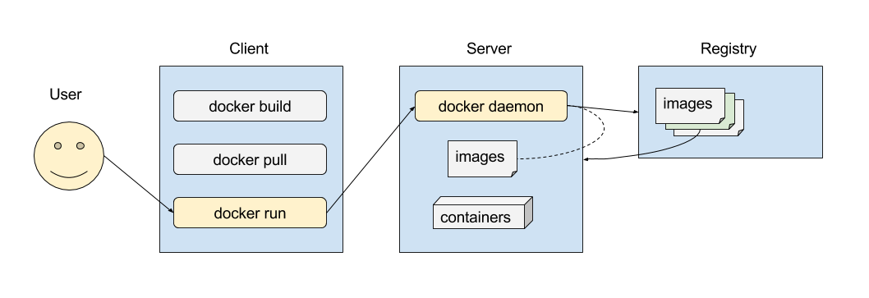
Download Missing Image
Notes:
If the requested image is not available, server contacts the registry for the required image.
In this example of the hello_world image, the server contacts ‘Docker Hub’ which has the Image as a sample.

Slide 22
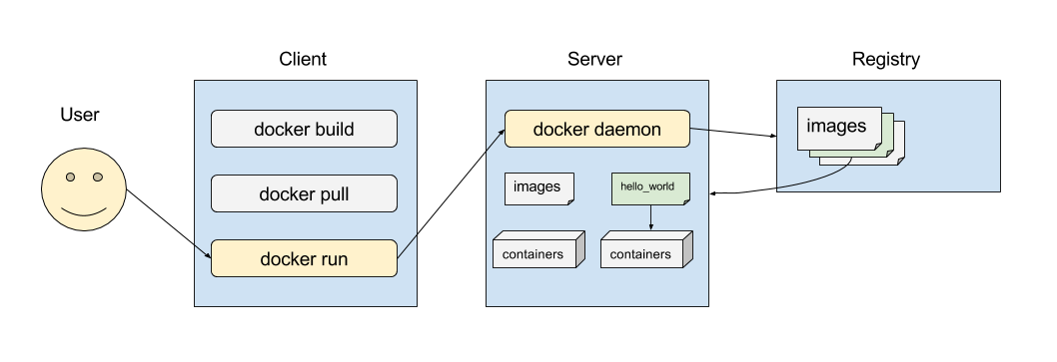
Create Container
Notes:
Docker engine uses the downloaded ‘hello_world’ image and creates the container.

Slide 23
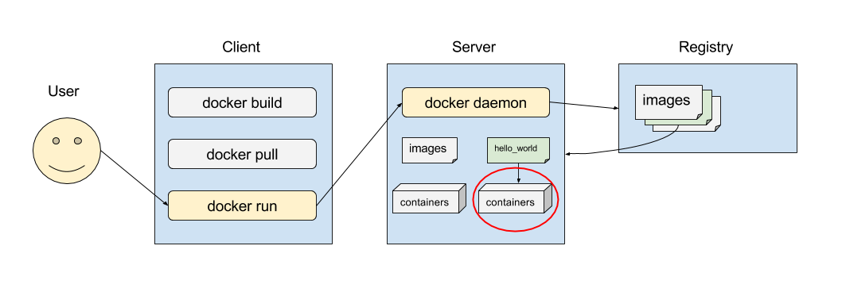
Allocate Read-Write Layer
Notes:
We will take a closer look at the container to see its underlying technology

Slide 24
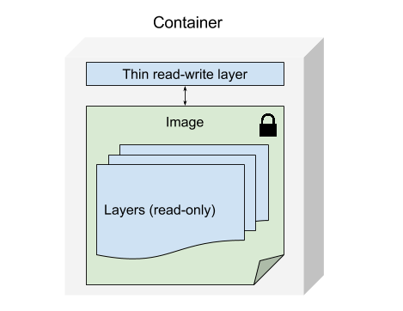
Allocate Read-Write Layer
Notes:
The read-write layer is where all changes are stored for the container.
The base image and its layers remains unchanged and are read-only. (Hence the lock icon)
This means that multiple containers can share access to same image and
have their own state.
Docker storage driver stacks the layers together for a coherent and unified view.
Source:
https://docs.docker.com/engine/userguide/storagedriver/imagesandcontainers/

Slide 25
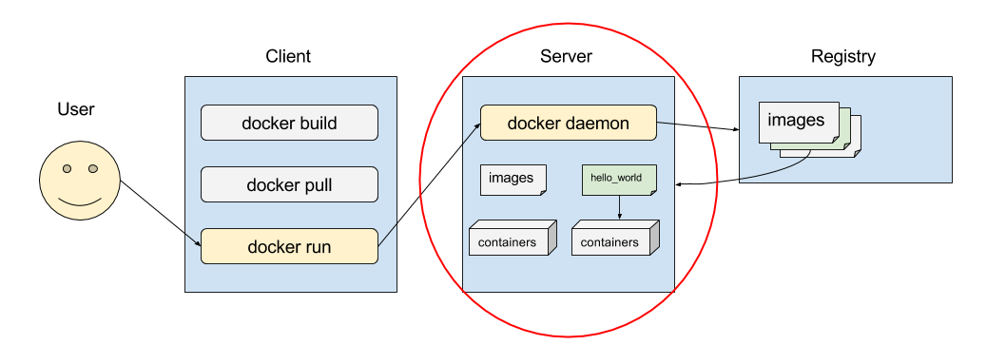
Allocate Network
Notes:
Next, we will take a closer look at the server to observe how networks are provisioned in a container

Slide 26
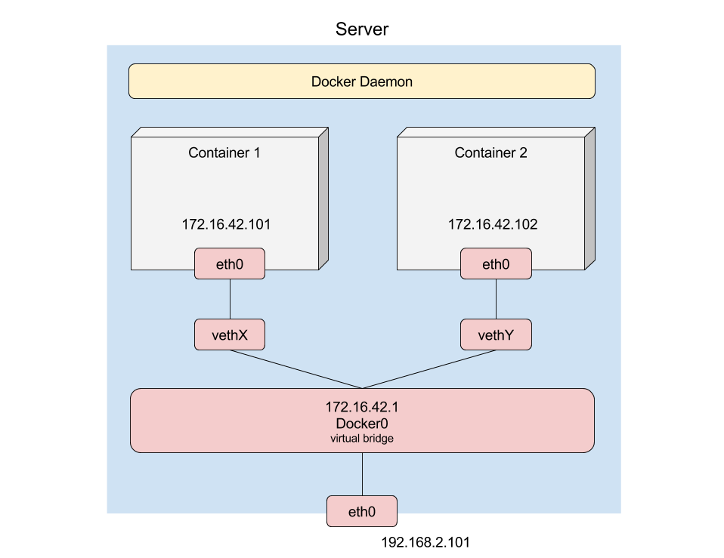
Allocate Network
Notes:
When Docker is launched, it creates a virtual ethernet bridge called ‘docker0’ on the host.
It chooses an address from an available private subnet and MAC address is generated from a pre-defined range based on the IP address.
When a container is created, veth pair is created in the host’s network namespace and binds to the Docker0 bridge.
This allows all containers to communicate with each other - this is a default behavior and can be changed.
What about security you ask?
One can set Docker options to drop all connections from other containers via iptables. Dockerfiles can be later
Specified to create dedicated “links” in order to allow cross-container communication. See docs for more info.
With regards to setting up networks in a container, the network files themselves inside the container should be left alone,
And leave the configuration up to Docker settings - which will update the container using a virtual file overlay.
“How can Docker supply each container with a hostname and DNS configuration, without having to build a custom image with the hostname written inside?
Its trick is to overlay three crucial /etc files inside the container with virtual files where it can write fresh information. You can see this by running mount inside a container”
-docs.docker.com
Source:
https://docs.docker.com/v1.5/articles/networking/

Slide 27
Execute Process
Process can be specified from Docker client
$ docker run -t -i ubuntu:14.04 /bin/bash
root@ubuntu1404:/#
Notes:
The next step after networking is complete is to execute the application on the container.
-t option assigns terminal inside the container
-i represents interactive connection that grabs STDIN of the container
/bin/bash specifies command to run on the container
The next line shows user logged in to the container and can now interact with it.
However, as for our hello-world example, we did not specify a command as you will see in the next slide.

Slide 28
Execute Process
In our example, command is specified in Dockerfile
$ docker run hello-world
hello-world Dockerfile
FROM scratch
COPY hello /
CMD ["/hello"]
Notes:
In the command ‘$ sudo docker run hello-world’ we do not specify a process to run.
However, we can take a look at the dockerfile of the hello-world repository to see what it is configured to run.
FROM: Specify image to use for container
COPY: copies file from specified <src> <dst>
In this case, it is copying ‘hello’ to ‘/’ directory.
CMD: Default command to run when container is started
Source:
https://github.com/docker-library/hello-world/blob/85fd7ab65e079b08019032479a3f306964a28f4d/hello-world/Dockerfile

Slide 29
Stream Output to Docker Client
$ docker run hello-world Hello from Docker! This message shows that your installation appears to be working correctly. To generate this message, Docker took the following steps: 1. The Docker client contacted the Docker daemon. 2. The Docker daemon pulled the "hello-world" image from the Docker Hub. 3. The Docker daemon created a new container from that image which runs the executable that produces the output you are currently reading. 4. The Docker daemon streamed that output to the Docker client, which sent it to your terminal.
Notes:
Lastly, the output from the container is streamed to the Docker client by the Docker daemon.
That’s nice, but what can I use Docker for?
Next we will go over a CI/CD workflow for a real-world example.

Slide 30
CI/CD Workflow
Notes:
In this segment, we will go over a sample workflow of how one can utilize Docker features
for continuous integration.

Slide 31
Continuous Integration Pipeline
Docker accelerates CI/CD practice
Guarantees repeatable deployment
Portable across environments
Quick to launch and deploy
Notes:
Source for the sample workflow:
https://www.docker.com/sites/default/files/RA_CI%20with%20Docker_08.25.2015.pdf

Slide 32
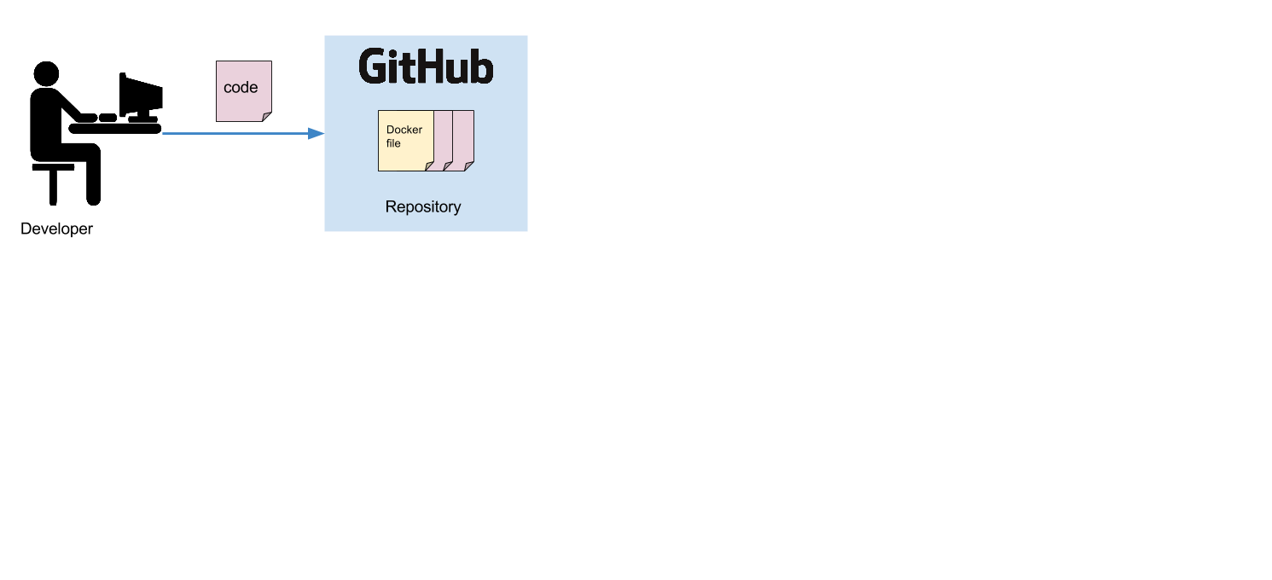
Developer commits code
Notes:
The process begins by developer committing code to the repository.
The repository consists of the Dockerfile already to instruct Docker to build a particular container environment
For the application.

Slide 33
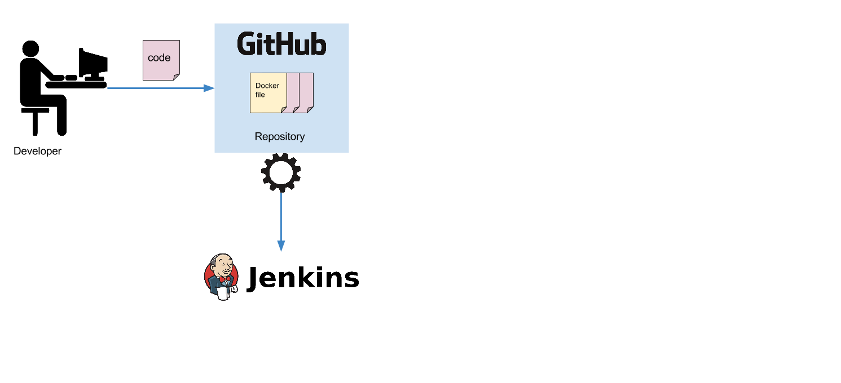
GitHub notifies Jenkins
Notes:
GitHub notifies Jenkins of the new commit via ‘webhook’ plugin (indicated by the gear).

Slide 34
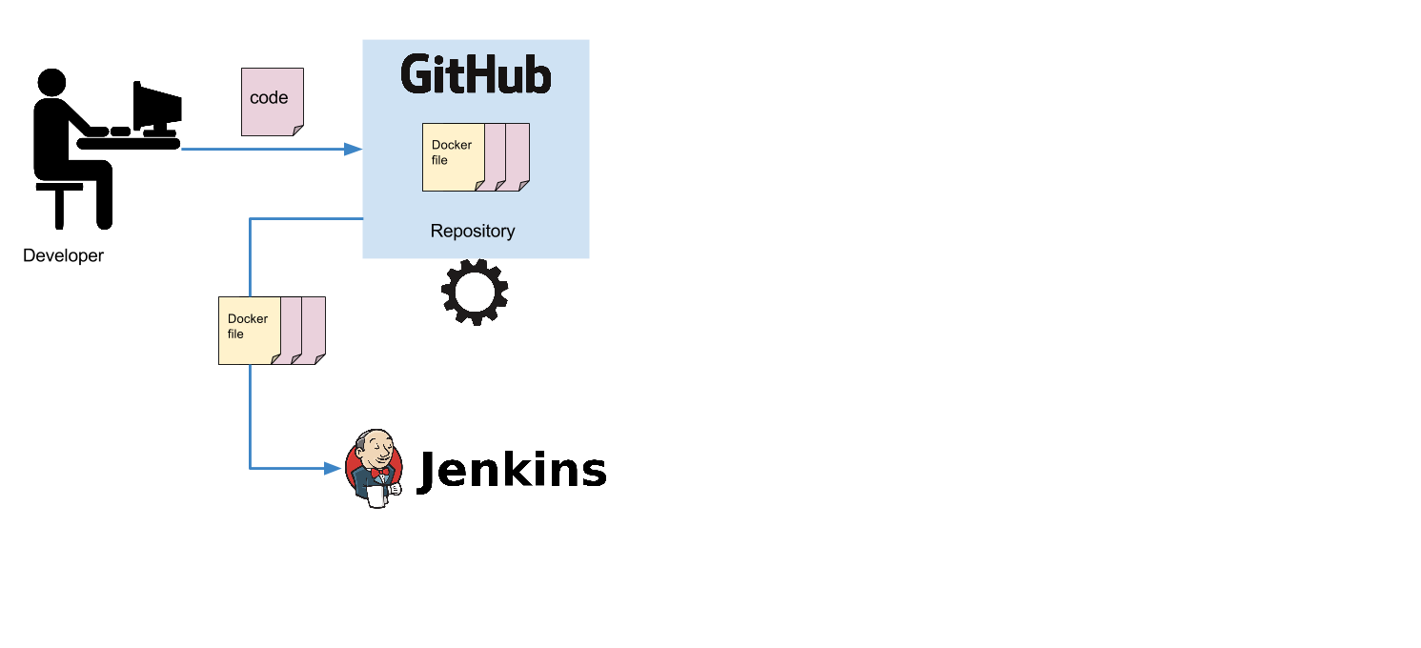
Jenkins pulls from GitHub
Notes:
Jenkins pulls the Dockerfile, application code, and test code.

Slide 35
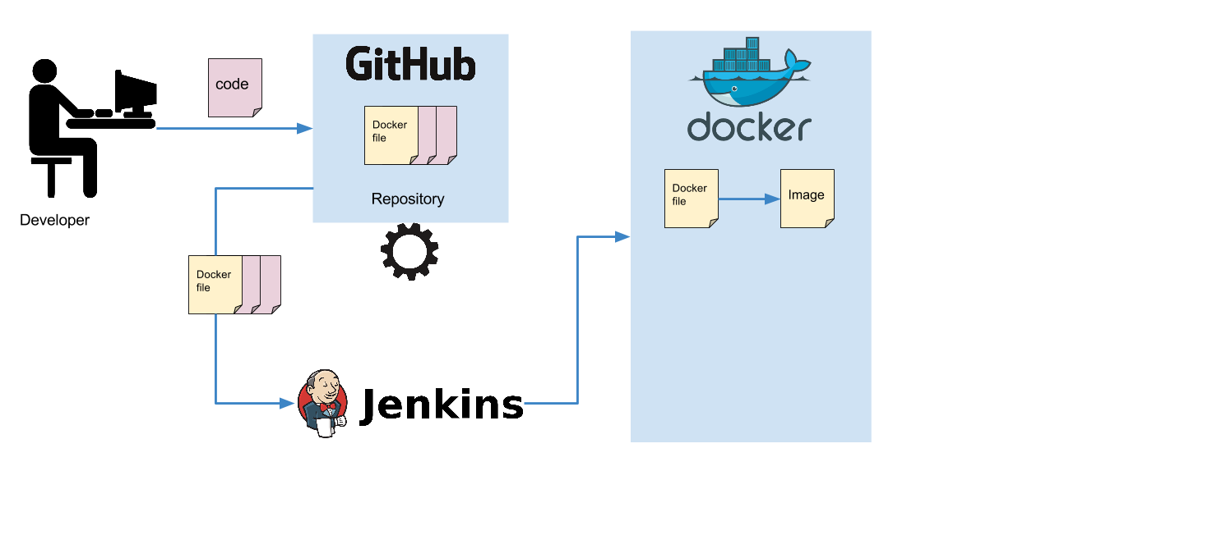
Jenkins builds Docker image
Notes:
Jenkins takes the Dockerfile and builds the specified Docker image

Slide 36

Instantiate Docker Container
Notes:
Docker is instructed to create the container on the Jenkins slave node

Slide 37
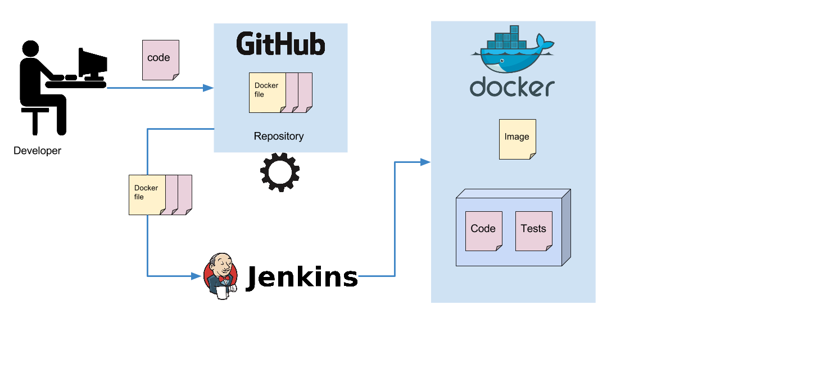
Execute tests
Notes:
Jenkins runs some tests on the fresh environment with your code!

Slide 38
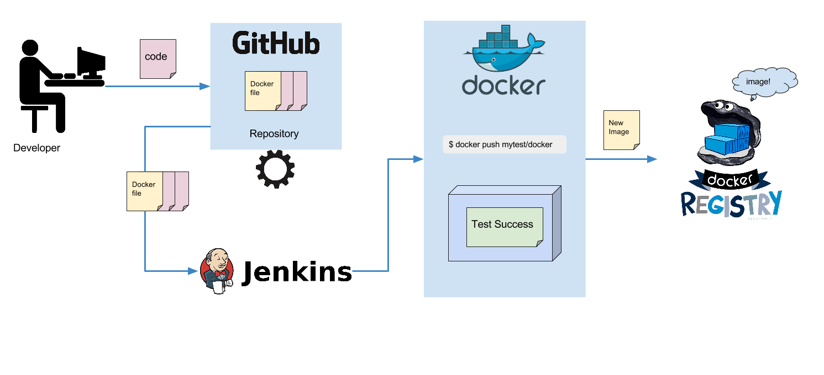
Push image to Docker registry
Notes:
If test is successful, new image will be created and pushed to the docker registry where it will be engulfed by the docker oyster. (animals in diagram not to scale) ←- [LULZ]
From here, the registry can push out the new image to deployment, and or notify other systems of a new image version.
Source:
https://docs.docker.com/registry/introduction/

Slide 39
Summary

Slide 40
Docker
Open platform to build, ship, and run distributed applications anywhere
Microservices
Client-Server architecture
Images, Registries, Containers
Notes:
Docker is an open platform that enables developers to quickly build their program
without worrying about dependency issues or breaking another service.
Microservices approach enables quicker innovation - and Docker is a key platform to
achieve this.
Docker embodies client-server architecture which means users simply interact with the
Docker binary that sends commands to the Docker registry which does the heavy-lifting of
fetching images, creating logical file systems, creating networks, and launching the container.

