Slide 1
Container Orchestration
Orchestration is the automated arrangement, coordination, and management of complex computer systems, middleware and services
https://en.wikipedia.org/wiki/Orchestration_(computing)

Slide 2
Module Objectives
Container orchestration definition and features
Different container orchestration implementations
How to choose container orchestration tool

Slide 3
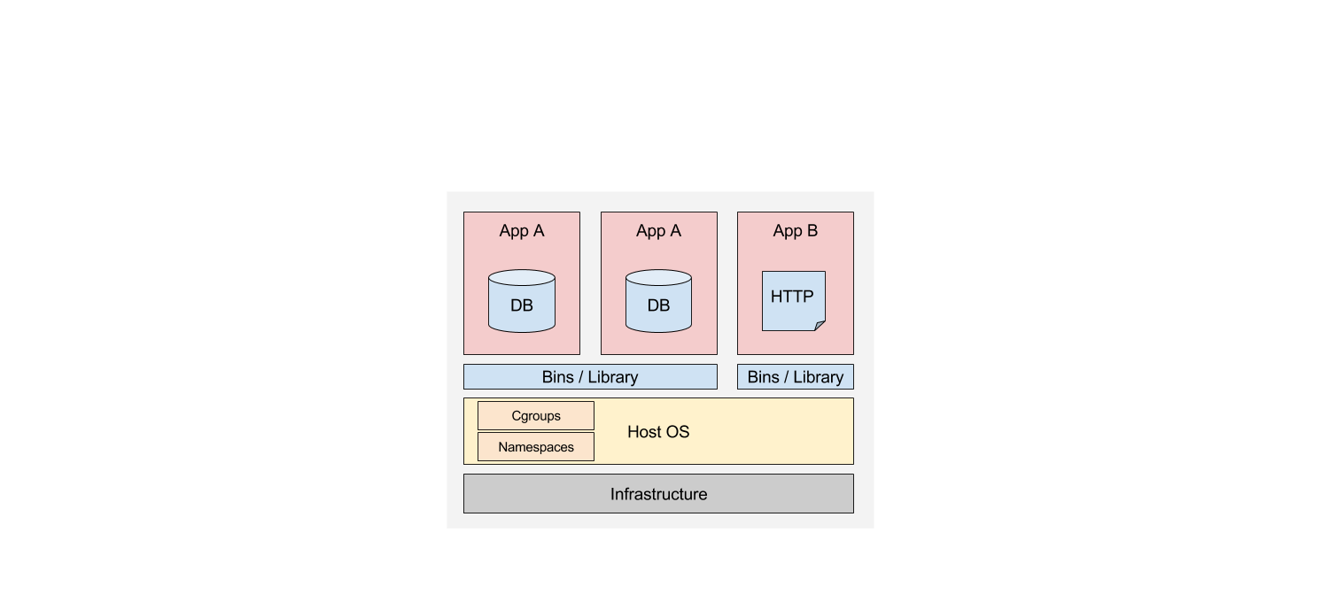
Why Container Orchestration
Notes:
Managing a simple application is easy enough to accomplish with just Docker tools.

Slide 4
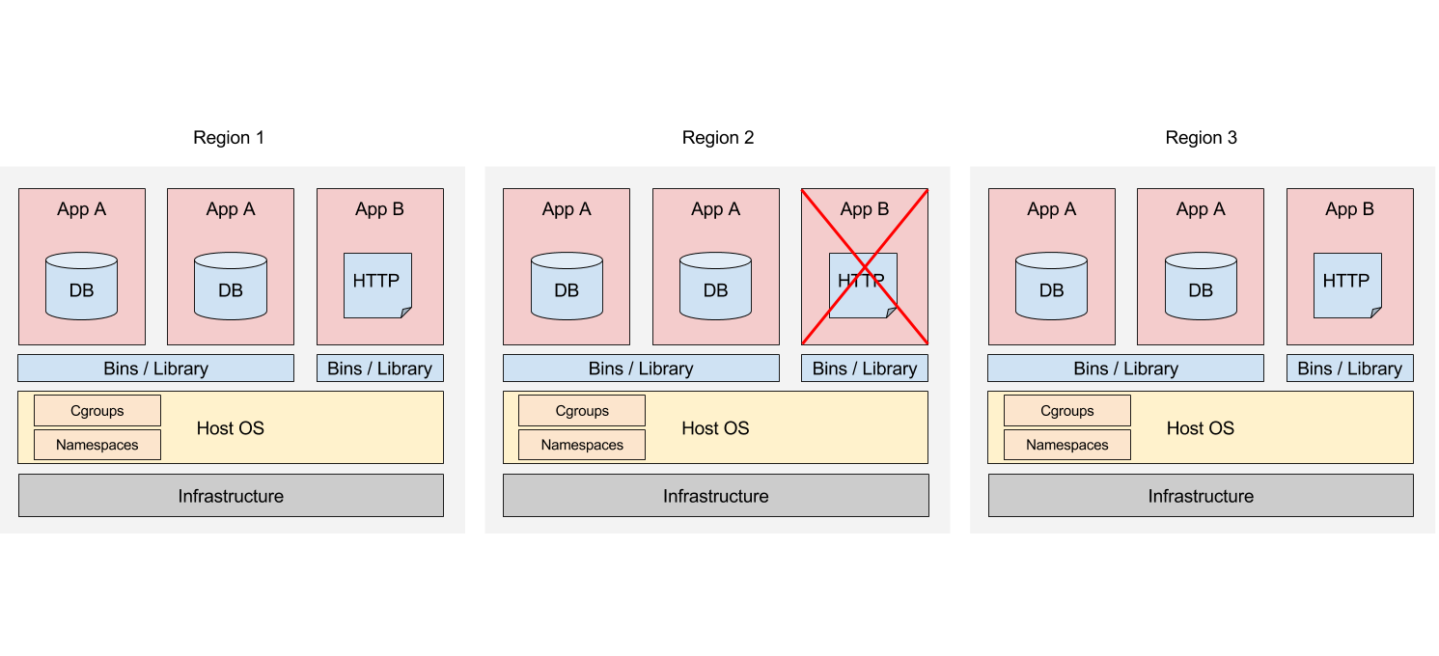
Why Container Orchestration
Notes:
What if you had a more complex application?
What if a service or an entire container fails?
What if you want a more logical separation of groups of containers that perform interrelated tasks?
Imagine that your app spans across dozens of regions with requirements such as
Replication, high availability, load balancing, monitoring for every service.
It quickly becomes apparent that you need a container orchestration platform to manage containers at an
Application level rather than a machine level.

Slide 5
Container Orchestration Definition
Is an ability to coordinate the containers in the clusters
When clusters consist of multiple nodes
When complex containerized applications are deployed
Controls different aspects of containers lifecycle
Placement and initial deployment
Scaling and replication
Allows moving from from a host-centric infrastructure to a container-centric infrastructure
Notes:
Q: Is it only for multi-node clusters?
A: Container Orchestration is also applicable for a single node cluster, for example, when the same unified tools should be used for development/test/production environments.
Q: Is it only for complex applications?
A: Container Orchestration is also applicable for individual containers, for example, when the same unified tools should be used for development/test/production environments. Also such features as auto-replication, auto-scaling, auto-healing, volume management, networking are also useful for individual containers.
In general there are two schools/paradigms of container orchestration:
* Old classical school, when container orchestration is imperative and flow-based: "if then, then that"
* New school uses a declarative container orchestration when one defines a desired state and a container orchestration tool takes care how to achieve the desired state from the current observable state.
The last paradigm looks more promising (at least in terms of popularity), so we will focus primarily on "new school" tools and their features.

Slide 6
Container Orchestration Features, Part 1
Managing multiple containers as one entity
Container placement
Container scaling
Container replication
Volume management
Container networking
Service discovery
Notes:
These features represent common needs of containerized applications running in production. However it is not necessary for each container orchestration tool to implement all of the features from the list.

Slide 7
Container Orchestration Features, Part 2
Monitoring and auto-healing
Load balancing
Authentication and authorization
Rolling updates
CLI/GUI clients, APIs
Notes:
These features represent common needs of containerized applications running in production. However it is not necessary for each container orchestration tool to implement all of the features from the list.

Slide 8
Container Orchestration Features

Slide 9
Feature: Managing multiple containers as one entity
Logically group a set of containers into one entity
Co-locate main application with its helpers for preserving the one-application-per-container model, or
Define a complex multi-tier application as a set of smaller entities working together
Notes:
Such entities can be organized in hierarchy, for example
* Example of grouping a main application and its helpers into one entity is a Kubernetes Pod
* Example of defining a complex multi-tier application is a Kubernetes Service, which contains a set of Kubernetes Pods

Slide 10
Feature: Container Placement
Algorithm to select a specific host for a specific container or a set of containers using different rules, including
Current load of the hosts
Co-location constraints
Availability constraints
Container placement can be triggered
Manually by user or API call
Automatically by auto-scaling, auto-replication, or auto-healing
Notes:
Co-location constraint example: the main application and its helpers (each in a separate container) should be placed to the same host
Availability constraint example: each copy of web application container should be placed on a separate host

Slide 11
Feature: Container Replication
Ensures that a specified number of equivalent containers ("replicas") are running at the time
If there are too many containers, the surplus will be stopped
If there are too few, new will be started
Can be used also for logical groups instead of individual containers

Slide 12
Feature: Container Scaling
Automatically scale the number of containers based on:
CPU utilization
Other application-provided metrics
Can be used also for logical groups instead of individual containers
Notes:
* Do not confuse a container scaling with a cluster scaling. The latter is an ability to add new hosts to a working cluster.

Slide 13
Feature: Volume Management
Containers are stateless
Files in a container are ephemeral, so when a container crashes and gets restarted, the changes to the files will be lost
For containers running in a logical group it is often necessary to share files between those containers
Volume is a persistent storage for a container
Can be mounted at the specified paths within the container's file system
Can be shared with multiple containers
Container can use multiple volumes
May have its own lifecycle
Notes:
Volume is a file system abstraction. Examples of volume types (implementations):
* A directory on the host file system
* NFS disk
* iSCSI disk
* RBD (Ceph) volume
* Volume in AWS, Microsoft Azure, or Google Cloud Platform

Slide 14
Feature: Service Discovery
Naming and DNS resolution
Generated name or ID for a container
Assign an internal name to a container in the internal DNS server
Containers define endpoints
Define how container should communicate with clients or other containers
Containers can discover endpoints and establish a connection
Notes:
Discovery mechanisms:
* Environment variables injection
* DNS names

Slide 15
Feature: Monitoring and Auto-Healing
Resource usage monitoring (CPU, RAM)
At containers level
At logical groups level
At cluster level
Health checks and auto-healing
Container status defined by liveness/readiness probes
Automated actions for failed probes
Can be used also for logical groups instead of individual containers
Notes:
Examples of health checks:
* HTTP check (execute HTTP method for the specified URL and analyze the returned HTTP status code)
* TCP check (check if the specified port is open)
* Container execution test (execute the specified command in the container and analyze its exit code)

Slide 16
Feature: Load Balancing
Used in conjunction with container replication, scaling and service discovery
Load balancer is a dedicated service that knows live replicas
Load balancer's endpoint is exposed to clients
Different methods for balancing the load
DNS round-robin
IP/VIP round-robin

Slide 17
Feature: Rolling Updates
At some point, a deployed application should be updated
Usually by providing a new image
There are different updating scenarios
Minimize the application downtime
Rolling update
Ensure that only a certain number of old replicas may be down while they are being updated
Ensure only a certain number of new replicas may be created above the specified number

Slide 18
Container Orchestration Tools

Slide 19
Container Orchestration Implementations
Container orchestration tools
Docker Swarm
Mesosphere Marathon
Kubernetes
Container orchestration services
Amazon EC2 Container Service (ECS)
Azure Container Service (ACS)
Google Container Engine
Notes:
Open source tools that can be used for on-premises cluster. The list is not complete, there are other tools like Rancher (http://www.rancher.com), but we focus on most popular tools
Docker Swarm (https://docs.docker.com/engine/swarm/key-concepts/)
Mesosphere Marathon (https://mesosphere.github.io/marathon/)
Kubernetes (http://kubernetes.io/)
Container orchestration is available as a service in Amazon Web Services (AWS), Microsoft Azure, and Google Cloud Platform (GCP) correspondingly:
Amazon EC2 Container Service (ECS) (https://aws.amazon.com/ecs/)
Azure Container Service (ACS) (https://azure.microsoft.com/en-us/blog/azure-container-service-preview/)
Google Container Engine (https://cloud.google.com/container-engine/)

Slide 20
Docker Swarm
Docker Engine 1.12 Release Candidate 1
Includes Swarm Mode feature
Might be subject to non backward-compatible changes
Prior v1.12.0-rc1 one should use standalone Docker Swarm
Supports only Docker containers
Docker Machine can be used to create a Swarm cluster
Features
Auto-scaling
Service discovery and load balancing
Rolling updates
Notes:
Docker Swarm standalone (https://docs.docker.com/swarm/)
SwarmKit (https://github.com/docker/swarmkit) enables Docker Swarm mode (https://docs.docker.com/engine/swarm/)
Standalone Docker Swarm and SwarmKit are written in Go.
Docker Discovery service supports multiple discovery backends, such as
* static file with list of nodes (does not support replication)
* distributed distributed key/value store (recommended) leveraging libkv (https://github.com/docker/libkv) and Consul, Etcd, or ZooKeeper as a backend
Docker Machine (not a cloud orchestration tool) allows installing Docker Engine on virtual hosts, and manage the hosts with 'docker-machine' commands. Using 'docker-machine' you can start, stop, inspect, and restart a virtual host, upgrade the Docker client and daemon, and configure a Docker client to talk to your host.

Slide 21
Mesosphere Marathon
Based on the Apache Mesos
Supports Mesos (AppC) and Docker containers
Runs on Linux, Windows, OS X
JSON REST API and Web UI
Features
High availability
Stateful applications / persistent storage volumes
Placement
Service discovery and load balancing
Health checks
Notes:
Apache Mesos (https://mesos.apache.org/)
* "distributed system kernel, built using the same principles as the Linux kernel, only at a different level of abstraction"
* abstracts CPU, memory, storage, and other compute resources away from physical or virtual machines
* provides APIs for resource management and scheduling across entire datacenter
* written in C++
Mesosphere Marathon (https://mesosphere.github.io/marathon/)
* written in Scala

Slide 22
Kubernetes
Supports Docker containers
Google Container Engine built on Kubernetes
Notes:
Read more in the module "Kubernetes overview"

Slide 23
Amazon EC2 Container Service (ECS)
Supports Docker containers
Uses a managed cluster of Amazon EC2 instances
Integrated with Amazon services:
Elastic Load Balancing (ELB)
Elastic Block Store (EBS)
Identity and Access Management (IAM)

Slide 24
Azure Container Service (ACS)
Supports Docker containers
Uses a managed cluster of Azure Compute instances
Built on Apache Mesos
Provides Docker Swarm and Apache Mesos API endpoints
Will provide support for Windows containers soon

Slide 25
Google Container Engine
Supports Docker containers
Uses a managed cluster of Google Compute instances
Built on Kubernetes
The same management interface for on-premises, hybrid, or public cloud
Integrated with Google Cloud Platform:
Google Cloud Logging
Google Cloud VPN

Slide 26
Different aspects to compare
Supported types of containers (Linux, Windows, or both)
Adoption
Number of companies
Number of contributors
Services and support
Integration with public clouds
Kubernetes works with Google Container Engine
Docker Swarm and Apache Mesos works with Azure Container Service
Features
Notes:
How many companies use (Slide 16: Container Orchestration in Numbers):
* Kubernetes - 43%
* Docker Swarm - 29%
* Mesos (including Mesosphere Marathon?) - 18%
Features
Kubernetes vs Docker Swarm: there is an opinion, that Docker Swarm is an effort by Docker to extend the existing Docker API to make a cluster of machines look like a single Docker API, and the node API is insufficient for a cluster API. Specifically, Kubernetes has Pods, a basic unit for scheduling. Docker Swarm still operates with containers on that level. There is an ongoing discussion to change the first order container object within the Docker API from a single container to a pod of containers (https://github.com/docker/docker/issues/8781).

Slide 27
Appendix

Slide 28
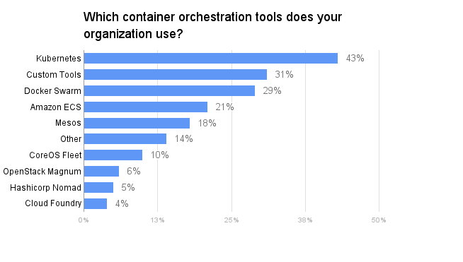
Container Orchestration in Numbers
Source: https://clusterhq.com/assets/pdfs/state-of-container-usage-june-2016.pdf
Notes:
Survey conducted in 2016 by DevOps.com and ClusterHQ
https://clusterhq.com/assets/pdfs/state-of-container-usage-june-2016.pdf

