Slide 1
Operating Systems / Data Structures

Slide 2
What happens when we turn on computer?

Slide 3
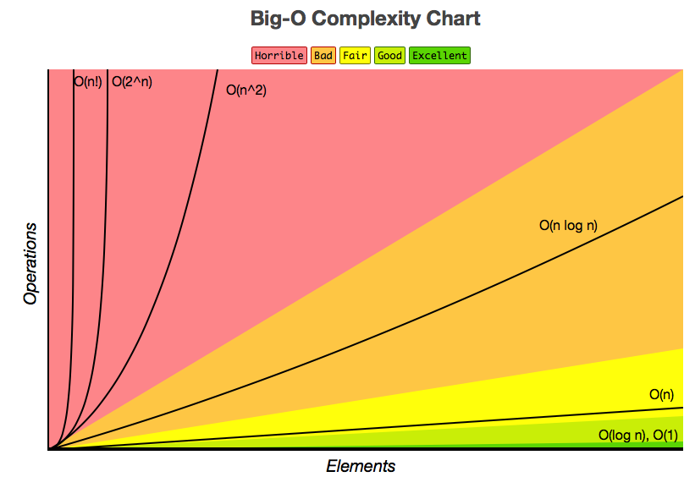
Big-O Complexity Chart - http://bigocheatsheet.com

Slide 4
Common Data Structure Operations - http://bigocheatsheet.com
Data Structure | Time Complexity |  |  |  |  |  |  |  | Space Complexity
 | Average |  |  |  | Worst |  |  |  | Worst
 | Access | Search | Insertion | Deletion | Access | Search | Insertion | Deletion
Array | Θ(1) | Θ(n) | Θ(n) | Θ(n) | O(1) | O(n) | O(n) | O(n) | O(n)
Stack | Θ(n) | Θ(n) | Θ(1) | Θ(1) | O(n) | O(n) | O(1) | O(1) | O(n)
Queue | Θ(n) | Θ(n) | Θ(1) | Θ(1) | O(n) | O(n) | O(1) | O(1) | O(n)
Singly-Linked List | Θ(n) | Θ(n) | Θ(1) | Θ(1) | O(n) | O(n) | O(1) | O(1) | O(n)
Doubly-Linked List | Θ(n) | Θ(n) | Θ(1) | Θ(1) | O(n) | O(n) | O(1) | O(1) | O(n)
Skip List | Θ(log(n)) | Θ(log(n)) | Θ(log(n)) | Θ(log(n)) | O(n) | O(n) | O(n) | O(n) | O(n log(n))
Hash Table | N/A | Θ(1) | Θ(1) | Θ(1) | N/A | O(n) | O(n) | O(n) | O(n)
Binary Search Tree | Θ(log(n)) | Θ(log(n)) | Θ(log(n)) | Θ(log(n)) | O(n) | O(n) | O(n) | O(n) | O(n)
Cartesian Tree | N/A | Θ(log(n)) | Θ(log(n)) | Θ(log(n)) | N/A | O(n) | O(n) | O(n) | O(n)
B-Tree | Θ(log(n)) | Θ(log(n)) | Θ(log(n)) | Θ(log(n)) | O(log(n)) | O(log(n)) | O(log(n)) | O(log(n)) | O(n)
Red-Black Tree | Θ(log(n)) | Θ(log(n)) | Θ(log(n)) | Θ(log(n)) | O(log(n)) | O(log(n)) | O(log(n)) | O(log(n)) | O(n)
Splay Tree | N/A | Θ(log(n)) | Θ(log(n)) | Θ(log(n)) | N/A | O(log(n)) | O(log(n)) | O(log(n)) | O(n)
AVL Tree | Θ(log(n)) | Θ(log(n)) | Θ(log(n)) | Θ(log(n)) | O(log(n)) | O(log(n)) | O(log(n)) | O(log(n)) | O(n)
KD Tree | Θ(log(n)) | Θ(log(n)) | Θ(log(n)) | Θ(log(n)) | O(n) | O(n) | O(n) | O(n) | O(n)

Slide 5
Array Sorting Algorithms - http://bigocheatsheet.com
Algorithm | Time Complexity |  |  | Space Complexity
 | Best | Average | Worst | Worst
Quicksort | Ω(n log(n)) | Θ(n log(n)) | O(n^2) | O(log(n))
Mergesort | Ω(n log(n)) | Θ(n log(n)) | O(n log(n)) | O(n)
Timsort | Ω(n) | Θ(n log(n)) | O(n log(n)) | O(n)
Heapsort | Ω(n log(n)) | Θ(n log(n)) | O(n log(n)) | O(1)
Bubble Sort | Ω(n) | Θ(n^2) | O(n^2) | O(1)
Insertion Sort | Ω(n) | Θ(n^2) | O(n^2) | O(1)
Selection Sort | Ω(n^2) | Θ(n^2) | O(n^2) | O(1)
Tree Sort | Ω(n log(n)) | Θ(n log(n)) | O(n^2) | O(n)
Shell Sort | Ω(n log(n)) | Θ(n(log(n))^2) | O(n(log(n))^2) | O(1)
Bucket Sort | Ω(n+k) | Θ(n+k) | O(n^2) | O(n)
Radix Sort | Ω(nk) | Θ(nk) | O(nk) | O(n+k)
Counting Sort | Ω(n+k) | Θ(n+k) | O(n+k) | O(k)
Cubesort | Ω(n) | Θ(n log(n)) | O(n log(n)) | O(n)

Slide 6
Data Structure Basics - https://gist.github.com/TSiege/cbb0507082bb18ff7e4b

