Slide 1



Storytelling Case Study: Airbnb, NYC
Vishwanath Rajasekaran

Slide 2
Objective:
Airbnb is an online platform using which people can rent accommodations.
Airbnb has incurred a huge loss in revenue during the COVID-19 period
Post COVID-19 pandemic, the people have started travelling again, and now Airbnb is aiming to bring up the business again and ready to provide services to customers.

Slide 3
Background
For the past few months, Airbnb has seen a major decline in revenue.
Now that the restrictions have started lifting and people have started to travel more, Airbnb wants to make sure that it is fully prepared for this change.
So, analysis has been done on a dataset consisting of various Airbnb listings in New York.

Slide 4
Data Preparation
Cleaned data to remove any missing values and duplicates.
Dropped insignificant columns.
Identified outliers

Slide 5
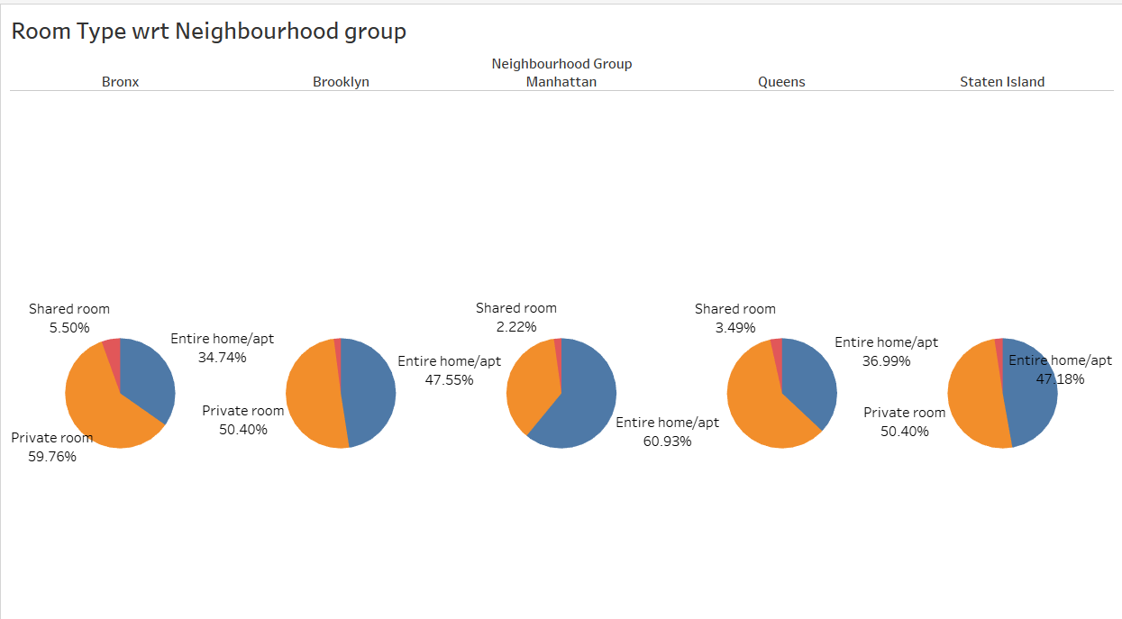
Room type with respect to Neighbourhood group
Manhattan and Brooklyn are top neighbourhood groups and mostly people prefer to book the entire home or private room.
Manhattan has highest number of home/apt properties, i.e. 60.93% of total listed properties.
Maximum number of private rooms are available in Bronx i.e. around 59.76% of total listed properties.
Very less number of shared rooms are available in each Neighbourhood group.

Slide 6
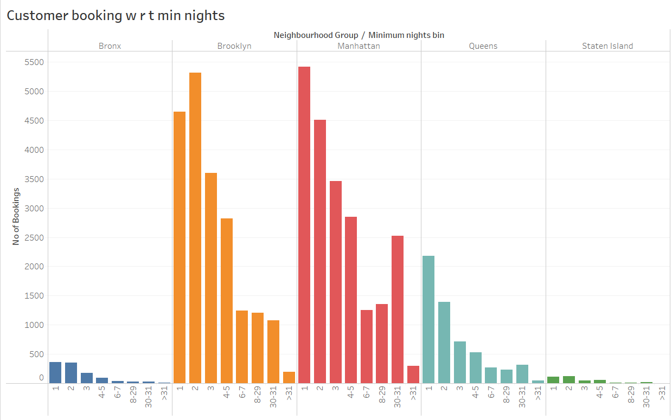
Customer Booking with respect to minimum nights
The listings with Minimum nights 1-5 have the most number of bookings. We can see a prominent spike in 30 days, this would be because customers would rent out on a monthly basis.
After 30 days, we can also see small spikes, this can also be explained by the monthly rent taking trend.
Manhattan &Queens have higher number of 30 day bookings compared to the others. The reason could be either tourists booking long stays or mid-level employees who opt for budget bookings due company visits

Slide 7
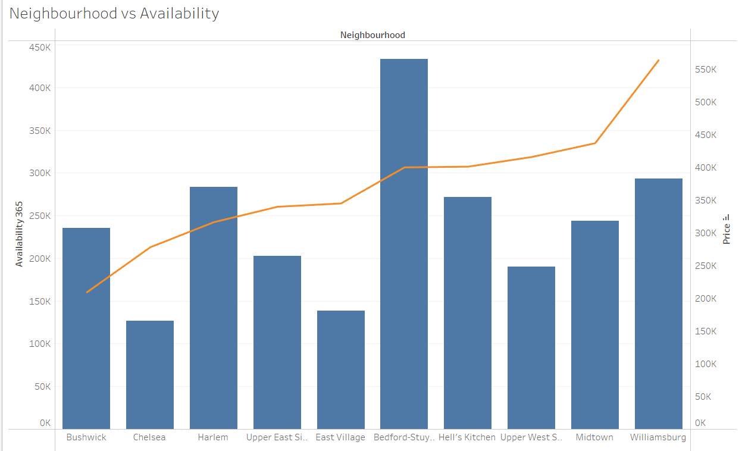
Neighbourhood vs Availability
Availability of Bedford is highest and its price is on the lower side. It is a good choice for customers.
After Bedford, Harlem follows the same trend.
Chelsea’s availability low but it is costly.
On the other hand, William’s price is high and has average availability.

Slide 8
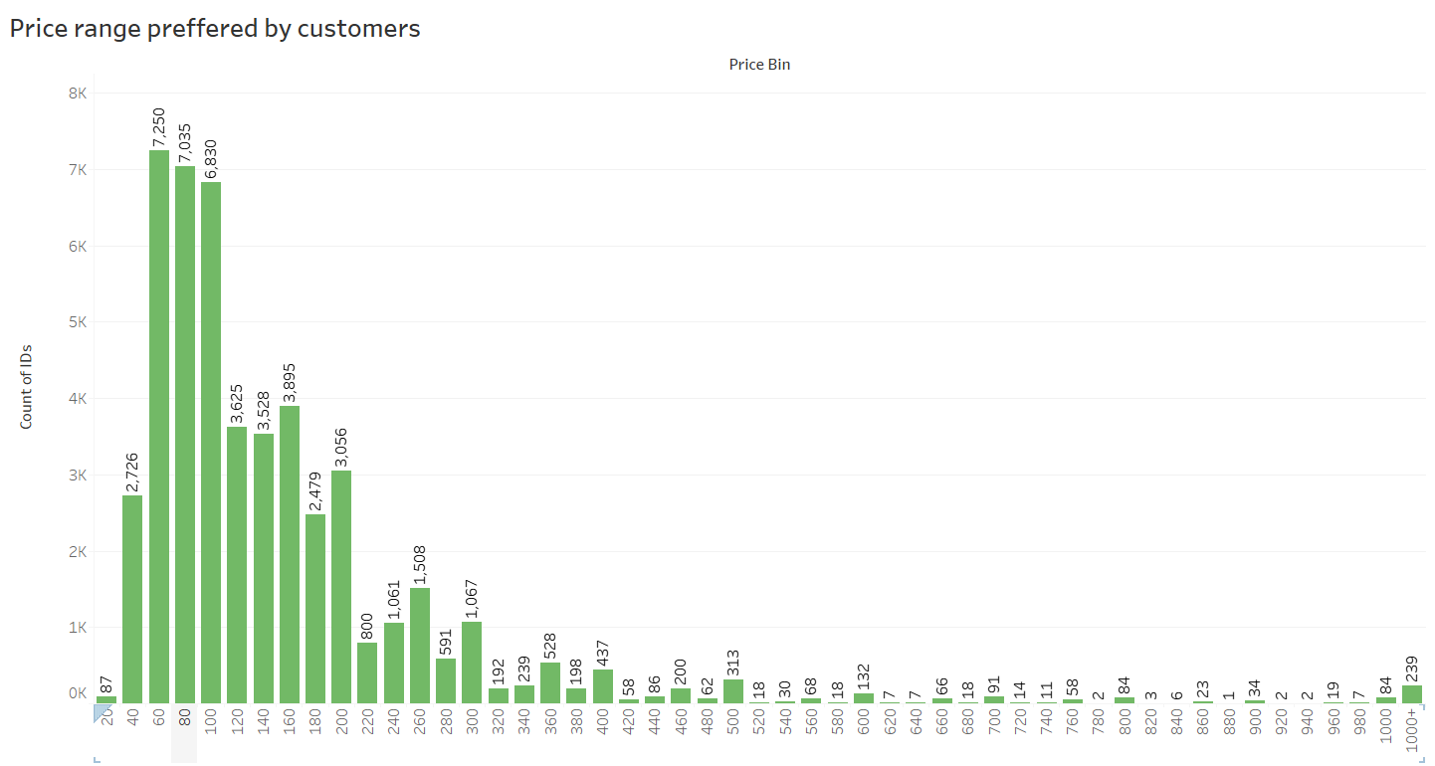
Price range preferred by Customers
We have taken pricing preference based on volume of bookings done in a price range.
From both the graphs, the favourable price range is $60 - $200. This is the price range most preferred by most customers.

Slide 9
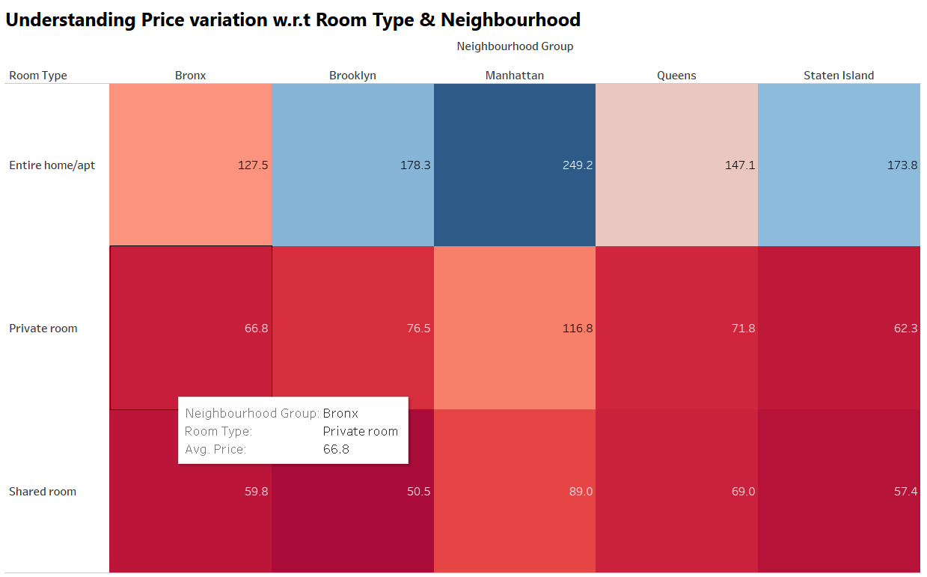
Understanding Price variation w.r.t Room Type & Neighbourhood
The 'Entire home/apt' room type in Manhattan is the most expensive at $250, much higher than the overall average.
‘private rooms’ of Manhattan & Brooklyn has the highest average.
‘Shared Room' type is the cheapest in Brooklyn with $50.5.

Slide 10
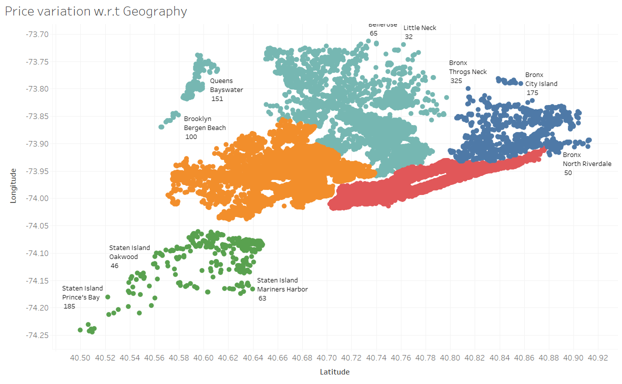
Price variation with respect to Geography
We see that, Airbnb has good presence in Manhattan, Brooklyn & Queens.
Listings are maximum in Manhattan & Brooklyn owing to the high population density and it being the financial and tourism hub of NYC. Staten Island has the least number of listings, due to its low population density and very few tourism destinations.

Slide 11
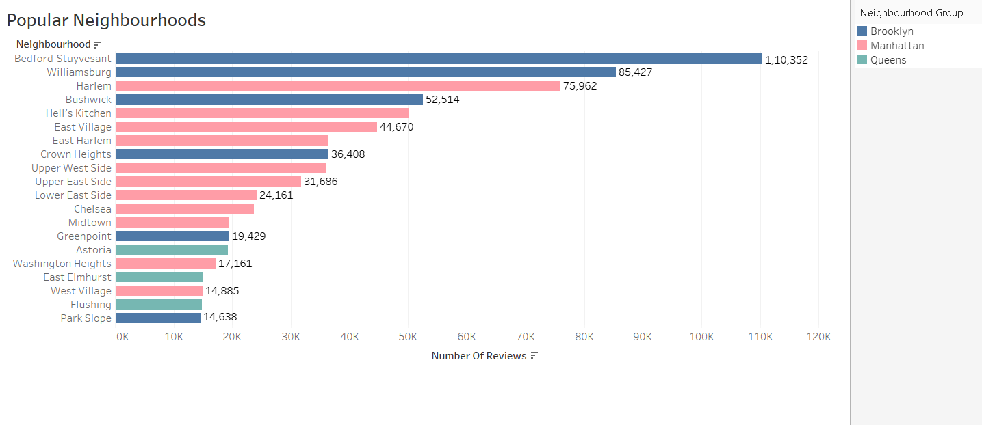
Popular Neighborhoods
We see that Bedford-Stuyvesant from Brooklyn is the highest popular with 1,10,352 no of reviews in total followed by Williamsburg.
Harlem from Manhattan got the highest no of reviews followed by Hell’s kitchen.
The higher number of customer reviews imply higher satisfaction in these localities.

