Slide 1

Web & Social Media Analytics
Capstone Project
Submitted By
Vishwanath Rajasekaran
Harsh Kushwaha
Srishti Sri

Slide 2
Introduction
With a growing trend towards digitization and prevalence of mobile phones and internet access, more consumers have an online presence and their opinions hold a good value for any product-based company, especially so for the B2C businesses. The industries are trying to fine-tune their strategies to suit the consumer needs, as the consumers leave some hints of their choices during their online presence.
In the retail e-commerce world of online marketplace, where experiencing products are not feasible. Also, in today’s retail marketing world, there are so many new Phones are emerging every day. Therefore, customers need to rely largely on product reviews to make up their minds for better decision making on purchase. However, searching and comparing text reviews can be frustrating for users. Hence we need better numerical ratings system based on the reviews which will make customers purchase decision with ease.

Slide 3

GOAL
In this capstone project, we will be solving a problem in the mobile phone industry of the US, one of the major smartphones markets in the world.
By analyzing the sentiment of the reviews, we can find the features of the phones that have resulted in positive/negative sentiments. This will help companies include or improve those particular features while developing a new product.
Comparing the competitors' pricing and their market shares will help companies decide the price of their products.
Before purchasing any product, we all look at similar products in various brands. This data will help the companies know their major competitors in the market.

Slide 4
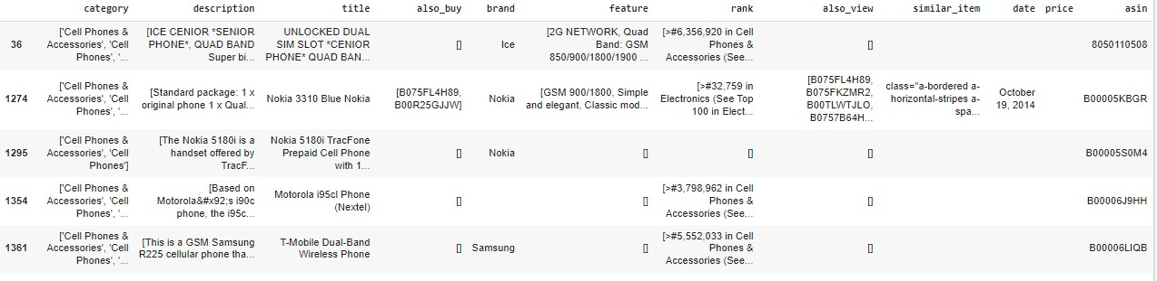
DATA COLLECTION
Phone metadata: This data contains the product information and is independent of the consumer/reviewer activity and includes description, price, sales-rank, brand info, and co-purchasing links etc. The original data was in json format. The json was imported and decoded to convert json.
The sample dataset is shown below:

Slide 5
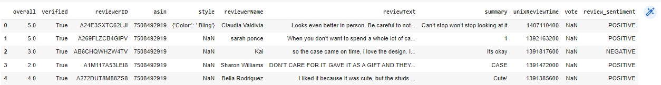
DATA COLLECTION
Phone data : This contain Contains the consumer activity information.
The sample dataset is shown below:

Slide 6
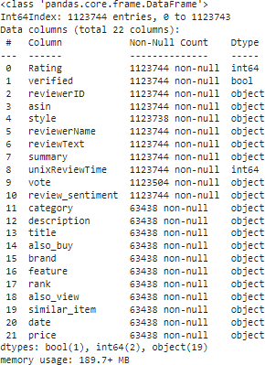
DATA WRANGLING
Merging Dataframes: Phone reviews and meta datasets in json and csv files were saved in different dataframes and two dataframes were merged together using left join and “asin” was kept as common merger.
Final merged data frame description is shown below:

Slide 7


DATA WRANGLING
We will be categorizing only Phone data for our analysis
Also we will be segregating Phone data from the merged dataset by filtering Phone from title
Final phones dataset has 45562 row.

Slide 8
Handling Duplicates, Missing Values
34 Duplicate records from meataphone and 3452 from phone are dropped .
Image column has been dropped from Phone dataset.
Review , style,Summary,vote column having null values was filled by bfill method.
Summary and reviewText columns was merged and created a new column review_text. After that both the columns were dropped.
unixReviewTime was converted to datetime '%m %d %Y format and created a new column Date&Time.
By splitting Rating feature into good and bad rating we have creating new feature rating class.

Slide 9
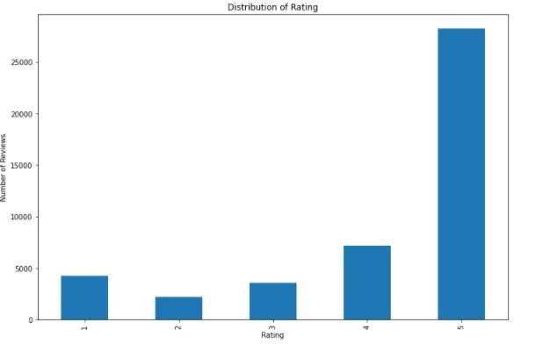
Rating Distribution
We have seen 25K+ people have given 5 rating which is overall highest.

Slide 10

Descriptive Statistic Summary
25213 customer gives ratings and mean of the ratings is 4.1, which means that customers prefer to give high ratings for products. To be able to predict the ratings reasonably, we classified them as 'good' and 'bad' above.
According to the statistics on rating stars:
4246 customers give 1 star
2178 customers give 2 stars
3565 customers give 3 stars
7202 customers give 4 stars
28229 customers give 5 stars
6424 customers give bad ratings
38996 customers give good ratings

Slide 11
Preprocessing Text: TEXT ANALYTICS
Since, text is the most unstructured form of all the available data, various types of noise are present in it and the data is not readily analyzable without any pre-processing. The entire process of cleaning and standardization of text, making it noise-free and ready for analysis is known as text preprocessing. In this section, the following text preprocessing were applied.
Removing accented characters Accented characters/letters were converted and standardized into ASCII
characters.
Expanding Contractions Contractions are shortened version of words or syllables. They exist in either written or spoken forms. Shortened versions of existing words are created by removing specific letters and sounds.
In case of English contractions, they are often created by removing one of the vowels from the word.
Removing Special Characters :One important task in text normalization involves removing unnecessary and
special characters.
Lemmatization:The process of lemmatization is to remove word affixes to get to a base form of the word.
The base form is also known as the root word, or the lemma, will always be present in the dictionary.
Removing stopwords: Stopwords are words that have little or no significance. They are usually removed from text during processing so as to retain words having maximum significance and context. Here we have used given text file to remove sop words.
Building a Text Normalizer Based on the functions which we have written used and with additional text correction techniques (such as lowercase the text, and remove the extra newlines, white spaces, apostrophes), we built a text normalizer in order to help us to preprocess the new_text document. After applying text normalizer to ‘the review_text’ document, we applied tokenizer to create tokens for the clean text.

Slide 12
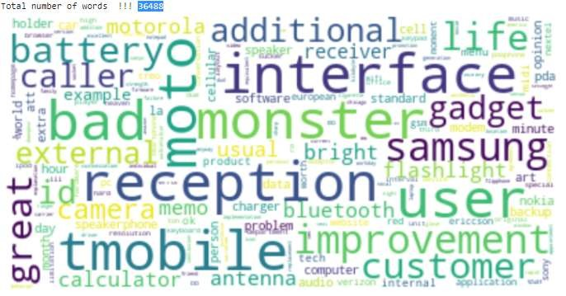
Preprocessing Text: TEXT ANALYTICS
As a result of that, we had 36488 words in total. After completing all data wrangling and preprocessing phases, we save the dataframe to csv file as a ‘clean_text.csv. After cleaning, we have 45420 observations.
We have used wordcloud package to visualize the cleaned data.

Slide 13
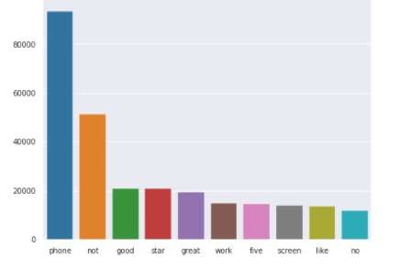
Preprocessing Text: TEXT ANALYTICS
As identified Phone has been the most popular word in the dataset.

Slide 14
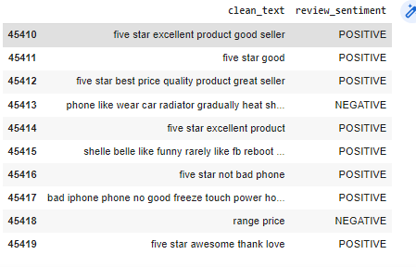
Sentimental Analysis
For Sentimenal Analysis I have used only sentiment review and clean_text column
Now we have a cleandata dataframe as below

Slide 15


Sentimental Analysis
Spliting the dataset into train and test set
Train_pos and train_neg as used for checking positive and negative review
As a next step I have separated the Positive and Negative comments of the training set in order to easily visualize their contained words. After that I cleaned the text from stopwords if any. Now they were ready for a WordCloud visualization which shows only the most emphatic words of the Positive and Negative review.

Slide 16
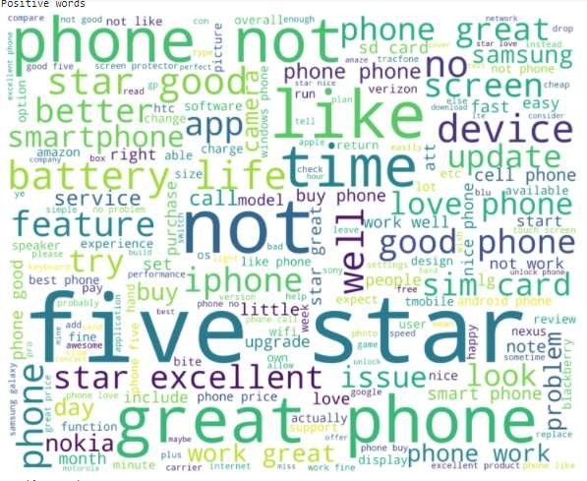
Sentimental Analysis
Positive Word set: good, star, great, look, love

Slide 17
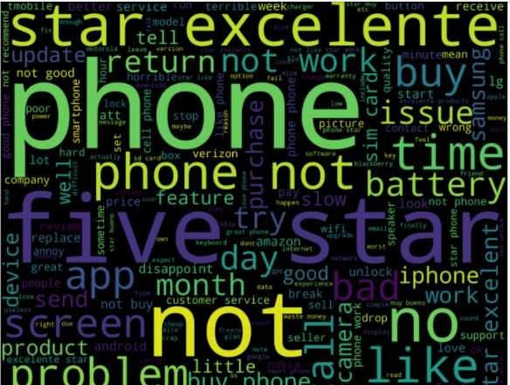
Sentimental Analysis
Negative Word set: bad, problem, not, return, issue, replace, phone

Slide 18
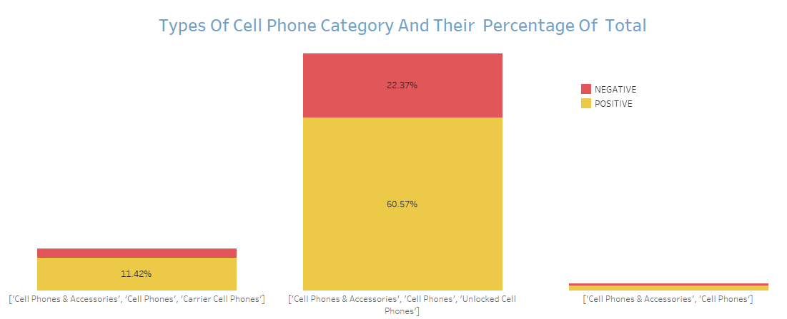
EXPLORATORY DATA ANALYSIS (EDA)
After collecting data, wrangling data then exploratory analyses were carried out. The following insights were explored through exploratory analyses.
Unlocked Cell Phones are seeming to be most likely used by customer having 60.57% positive reviews of the total number of reviews.

Slide 19
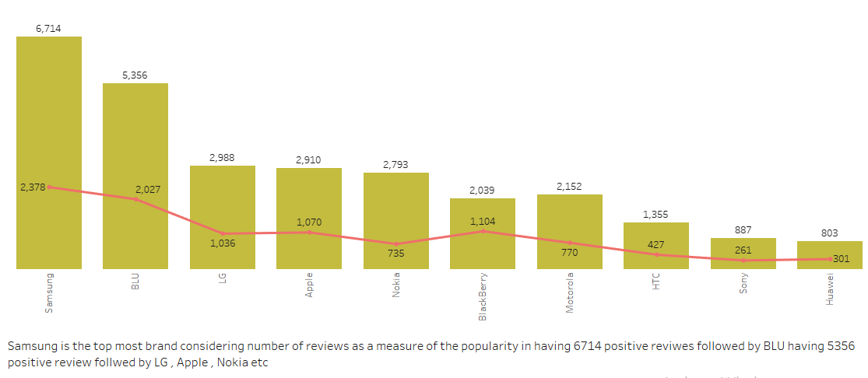
EXPLORATORY DATA ANALYSIS (EDA)
Samsung is the topmost brand likely used by customer having a total of 6714 positive reviews and also its competitor is BLU having not much difference in terms of positive review.
Also, Apple , LG and Nokia are the next Rivals companies of Samsung having almost same number of positive comments from the customer

Slide 20
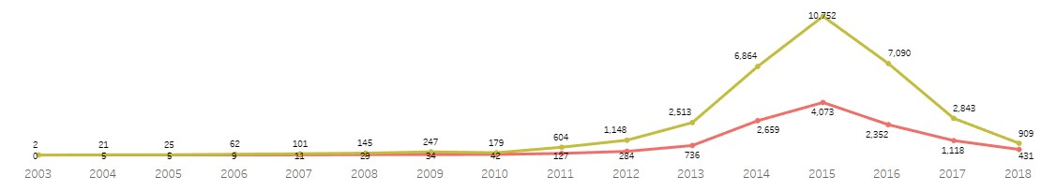
EXPLORATORY DATA ANALYSIS (EDA)
If we have a look on the yearly stats in terms of reviews, we can observe after 2012 people are likely most interested in giving reviews(bad or good) to their purchased items and seems there is sudden increase in the number of comments in 2015 around 14k + in total.
This might be because people are more aware of power and benefits of reviews.

Slide 21
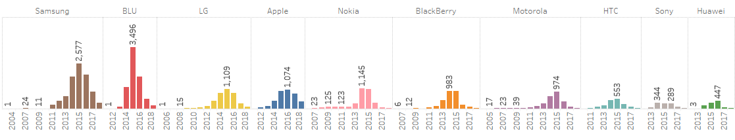
EXPLORATORY DATA ANALYSIS (EDA)
Top 10 brand Yearly Review Stats

Slide 22

MACHINE LEARNING MODEL
In this project, the model needs to predict sentiment based on the reviews written by customers who bought phones. This is a supervised binary classification problem. Python’s Scikit libraries was used to solve this problem. We have used Naive Bayes machine learning algorithms for modelling.
Naive Bayes implements the naive Bayes algorithm for multinomial distributed data, and is one of the two classic naive Bayes variants used in text classification (where the data are typically represented as word vector counts). This algorithm is a special case of the popular naïve Bayes algorithm, which is used specifically for prediction and classification tasks where we have more than two classes.

Slide 23
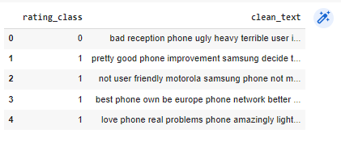
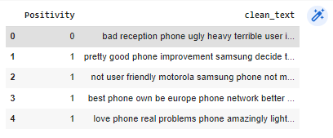
Before splitting data into train and test dataset we have dropped all unnecessary column which are not going to be used in our algo.
MACHINE LEARNING MODEL
Below is review of new dataset formed having only rating_class and clean text.
Later rating_class was re-named to Positivity

Slide 24
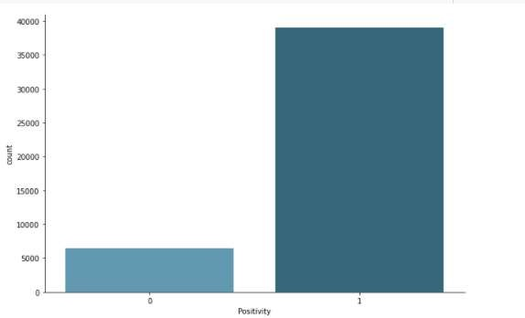
The bar chat below showing a comparison between positive and negative reviews using phone dataset
MACHINE LEARNING MODEL

Slide 25
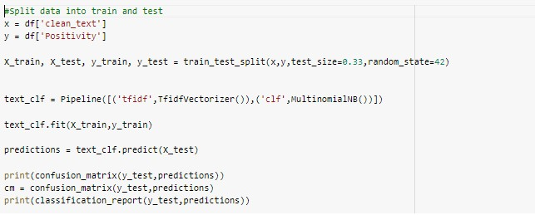
MACHINE LEARNING MODEL
Split dataset set into train and test and using MultinomialNB. Naive Bayes classifier for multinomial models.

Slide 26
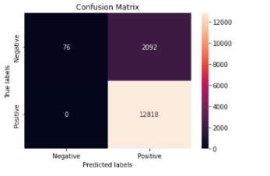
Confusion matrix
True Positives (TP) In our dataset 12818 are the correctly predicted positive review which means that the value of actual class is yes and the value of predicted class is also yes.
False Positives (FP) :When actual class is no and predicted class is yes. Here we have a total of 2092 FP review
True Negatives (TN) :These are the correctly predicted negative values which means that the value of actual class is no and value of predicted class is also no. We have 76 reviews which are correctly predicted as negative.
False Negatives (FN) – When actual class is yes but predicted class in no. We don’t have any review which predicted as negative though in actual it is positive.

Slide 27
Confusion matrix
We got an accuracy of ~86% on the test set.
Accuracy :Accuracy is the most intuitive performance measure and it is simply a ratio of co rrectly predicted observation to the total observations. One may think that, if we have high accuracy then our model is best. In our case being a review is positive has an accuracy of 86%.
Accuracy = TP+TN/TP+FP+FN+TN
Precision : Precision is the ratio of correctly predicted positive observations to the total predicted positive observations. In our case being a review is positive has an precision of 86%.
Precision = TP/TP+FP
Recall (Sensitivity) Recall is the ratio of correctly predicted positive observations to the all observations in actual class - yes. In our dataset we have a recall for positive review as 1.
Recall = TP/TP+FN
F1 score:F1 Score is the weighted average of Precision and Recall. Therefore, this score ta kes both false positives and false negatives into account. We have an f1 score of 92% for positive review.
F1 Score = 2*(Recall * Precision) / (Recall + Precision)

Slide 28
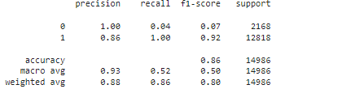
Confusion matrix
Weighted average scores:
The sum of the scores of all classes after multiplying their respective class proportions.
It is the simple mean of scores of all classes. So, macro- average recall is the mean of the recalls of all the classes.

Slide 29

Thank
You

