Slide 1

Data Science Backed Purchase Follow Up
By Vishwanath Holin

Slide 2
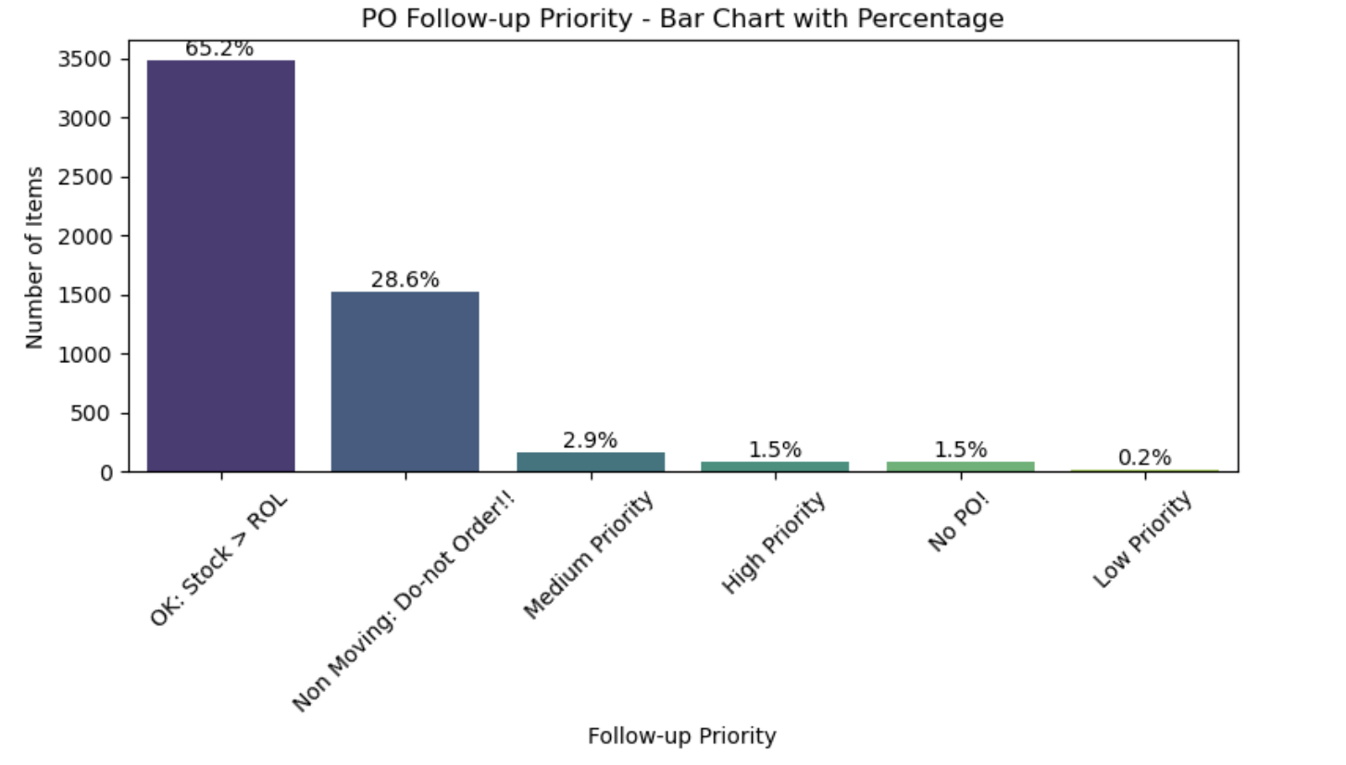

Slide 3
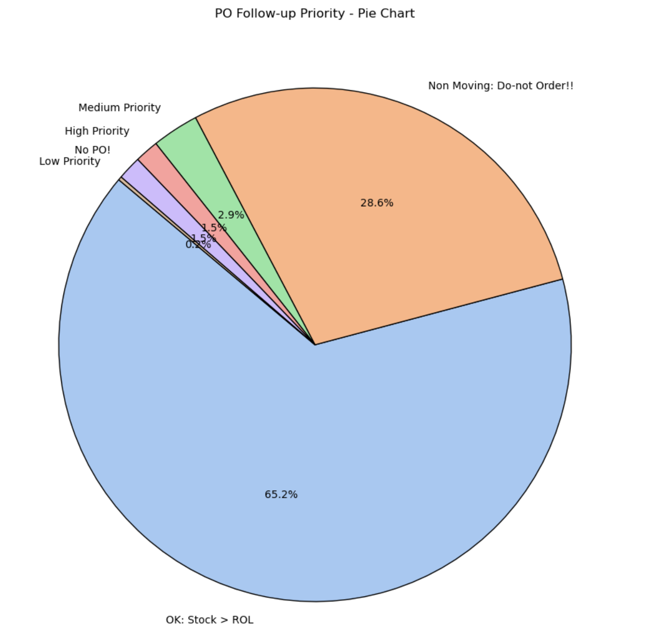
SKUs purchase follow-up prioritization.

Slide 4
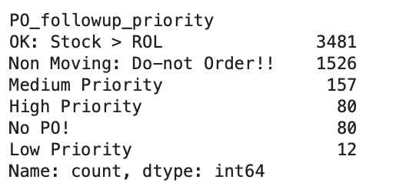

Slide 5
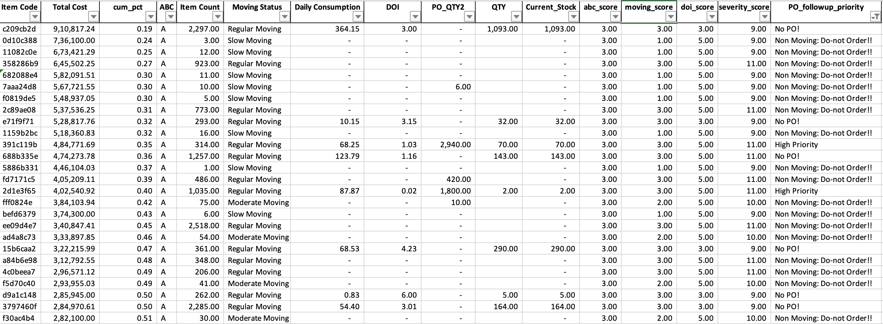

Slide 6

Thank you

