Slide 1


NEXT GEN EMPLOYABILITY PROGRAM
CREATING A FUTURE-READY WORKFORCE
Student Name :
Vishwas S
Student ID :
College Name :
STU678f6ea119d721737453217
Global Academy of Technology

Slide 2
Recipe Sharing Platform with React and ExpressJS Framework
Recipe Sharing Platform with React and ExpressJS Framework
CAPSTONE PROJECT SHOWCASE
Project Title
Recipe Sharing Platform with React and ExpressJS Framework
Abstract | Problem Statement | Project Overview | Proposed Solution | Technology Used | Modelling & Results | Conclusion | Q&A

Slide 3
Abstract
1
The Recipe Sharing Platform is a web application that allows users to discover, create, and share recipes within a community.
2
The platform provides secure user authentication, interactive recipe management, and an engaging user experience.
3
Built using the MERN stack (MongoDB, Express.js, React.js, Node.js), the project aims to deliver a responsive, user-friendly, and feature-rich application.
4
Users can rate, comment, and save their favorite recipes, making the platform a dynamic space for food enthusiasts.

Slide 4


Problem Statement
In the digital era, many individuals struggle to find a reliable and interactive platform to share and discover recipes. Existing platforms often lack an engaging community, efficient search features, and seamless user interaction. Additionally, users may face challenges in managing their own recipes or saving their favorites. This project aims to bridge the gap by providing a robust and intuitive platform for users to explore, create, and manage recipes while interacting with a like-minded community.

Slide 5

Project Overview
The Recipe Sharing Platform is a full-stack web application that enables users to create, browse, and interact with recipes. Users can register and authenticate securely, upload their recipes, and explore a vast collection shared by the community. The platform also allows users to rate recipes, leave comments, and bookmark their favorites. Designed to be fully responsive, the application ensures a seamless experience across various devices.

Slide 6
Proposed Solution
To address the identified problems, this project will implement the following key features:
User Authentication: Secure login and registration system.
Recipe Management: Create, edit, and delete personal recipes.
Recipe Discovery: Search and browse recipes from other users.
Comments and Ratings: Enable user engagement through comments and ratings.
Favorite Recipes: Allow users to save and manage favorite recipes.
Responsive Design: Ensure usability across desktops and mobile devices.
By leveraging the MERN stack, the platform will provide a fast, scalable, and modern web experience with a focus on performance and user interaction.

Slide 7
Technology used
The project is built using the MERN stack, which includes:
MongoDB – NoSQL database for storing user and recipe data.
Express.js – Backend framework to handle API requests.
React.js – Frontend library for creating an interactive UI.
Node.js – Runtime environment for handling server-side logic.

Slide 8
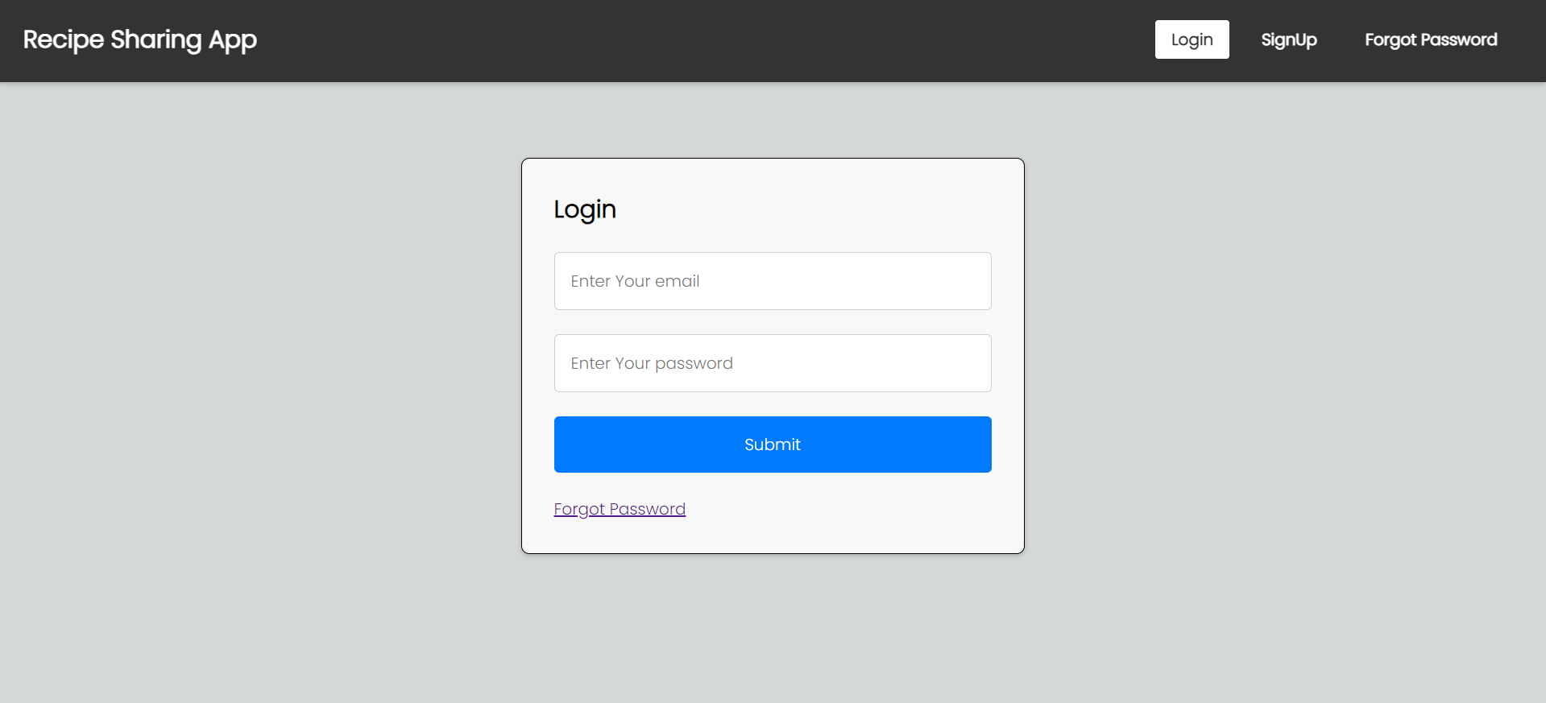
Modelling & Result

Slide 9
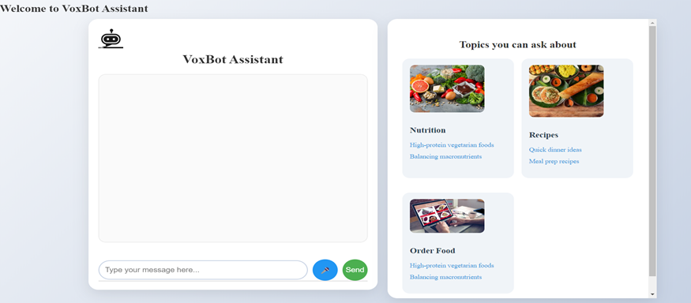
Modelling & Result

Slide 10
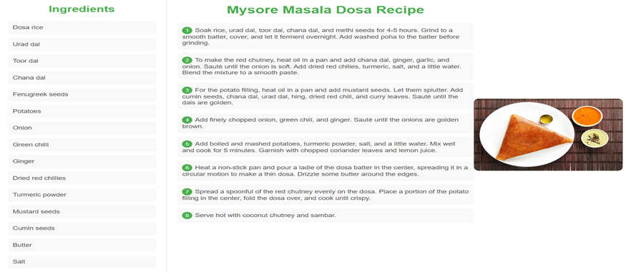
Modelling & Result

Slide 11

Conclusion
The Recipe Sharing Platform aims to provide an engaging and efficient solution for food lovers to share and discover recipes. By incorporating user authentication, interactive recipe management, and community-driven features, the platform fosters an enjoyable and user-friendly experience. The use of the MERN stack ensures a scalable and modern approach to web development, making the platform both robust and accessible.

Slide 12


Notes:
Thank You !!

