Slide 1

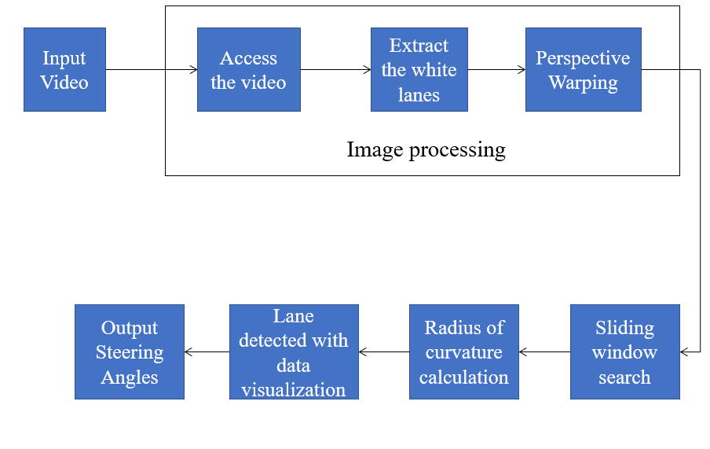
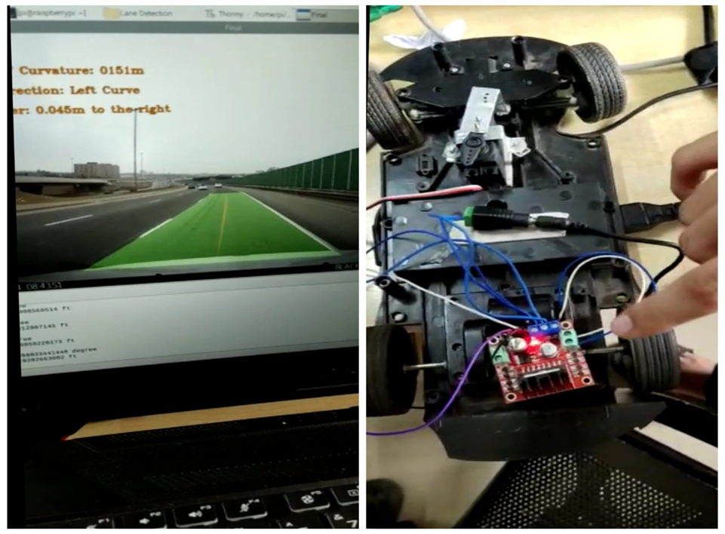
Lane Detection with Steer Assist
Rajendra G Kanbargi, Prajwal Vakkund, Tejaswini N, Vishwas Raju Banagar
Under the guidance of Prof. R M Shett.
School of Electronics and Communication Engineering
rajendragkanbargi@gmail.com , prajwalvakkund1906@gmail.com
Problem statement
Methodology
Results
To design and implement lane detection with steer assist for an autonomous vehicle.
Access the video of road with lane.
2. Image processing is performed on input video.
3.Perspective Warp is performed to get Bird’s view
4. Sliding window approach is used to detect lanes and their curvature.
5. Radius curvature of lane and steering angle is calculated.
6. Steering angle is feed to the prototype , to steer the steering of prototype for given steering angle.
Objectives
● To significantly improves safety by making sure the vehicle is centered inside the lane lines.
● To control the steering wheel to take gentle curves on highways without any driver input.
● Lane detection involves determining the location of the lane boundaries in a single image without strong prior knowledge regarding the lane position. ● To describe the path for self-driving cars and to avoid the risk of getting in another lane.
Fig 1: Lane Detected with Curve direction
Fig2: Car steering is steered to the detected curve direction(Left/Right)
Contributions
Methods
1.Image processing using open cv simulating with raspberry pi
2.Increase the safety of the driver .
To ensure road safety and to have better control over an autonomous car, we have designed lane detection with steer assist.
Conclusions
Literature survey
● Real Time Lane Detection for Autonomous Vehicles ”Abdulhakam.AM.Assidiq, Othman O. Khalifa, Md. Rafiqul Islam, Sheroz Khan.
● “ Autonomous Vehicle And Real Time Road Lanes Detection And Tracking ”,Vincent Lapointe, Herve Pollart Opal-RT Technologies Inc, Montreal, Canada
In Intelligent Transportation Systems, lane detection has proven to be an effective strategy for preventing accidents. It is possible to determine an optimal driving direction for the smart car based on the driving lane, these capabilities contribute greatly to enhancing driving safety of autonomous driving.
Minor Project-2021-22

