Slide 1
IBM University Engagement Project Submission
“Exploring the Power of Agentic AI with IBM Granite and IBM Bob”

Slide 2

Project Tile – Course Content Simplification Agent
Domain of Project – Education
Student Name | Recent Passport Photo | Email ID | Mobile number [WhatsApp]
Vishwas Anand |  | vishwasanand12a@gmail.com | 8957142971

Slide 3
Problem Statement -
Problem Statement :Course content simplifier agent
The Challenge
Educational materials often vary in complexity and may not be accessible to learners with different levels of prior knowledge. Students can struggle to understand jargon-heavy or overly advanced explanations in faculty notes and textbooks.
The challenge is to develop an AI-powered agent that can intelligently analyze academic content and reframe explanations according to the learner’s proficiency level, ranging from beginner to expert.
The Objective
To build an AI-powered Course Content Simplification Agent that:
Converts complex academic content into easy-to-understand explanations
Adapts content for Beginner, Intermediate, and Advanced learners
Highlights key concepts and important points
Provides a short practical example to improve understanding
Supports inclusive and personalized learning at scale

Slide 4
Proposed Solution -
Proposed Solution: AI-Powered Course Content Simplification Agent
The proposed solution is an AI-powered Course Content Simplification Agent built using IBM Bob, IBM watsonx.ai, IBM Cloud, and IBM Granite to make academic content easier to understand for learners with different levels of prior knowledge.
The system accepts course or academic content from the user and uses IBM Granite to analyze and reframe the explanation according to the selected learner proficiency level.
The system supports three learning levels:
Beginner – Uses simple language, short explanations, and everyday analogies.
Intermediate – Provides clear explanations with moderate technical terminology.
Advanced – Uses precise technical language and assumes stronger prior knowledge.
The agent generates three useful outputs:
Simplified Explanation – Rewrites the original academic content according to the selected level.
Key Points – Extracts the most important concepts for quick revision.
Short Example – Provides a practical example to make the concept easier to understand.
The solution is implemented as a web application using Python and Flask, with an HTML/CSS/JavaScript interface. IBM watsonx.ai provides access to the IBM Granite model, while IBM Bob is used during development.
Overall, the solution provides personalized, accessible, and scalable academic content delivery by adapting the same learning material to different levels of learner proficiency.

Slide 5
Technology Used
IBM Bob – Used for AI-assisted development, code generation, debugging, and project implementation.
IBM Granite Model (ibm/granite-4-h-small) – Used for understanding and simplifying academic content according to learner proficiency.
IBM watsonx.ai – Used to access and run the IBM Granite foundation model.
IBM Cloud – Provides the cloud environment for IBM watsonx.ai services.
Python & Flask – Used to build the backend and handle requests between the web interface and the Granite model.
HTML, CSS & JavaScript – Used to create the web interface for entering content, selecting learner level, and displaying results.

Slide 6
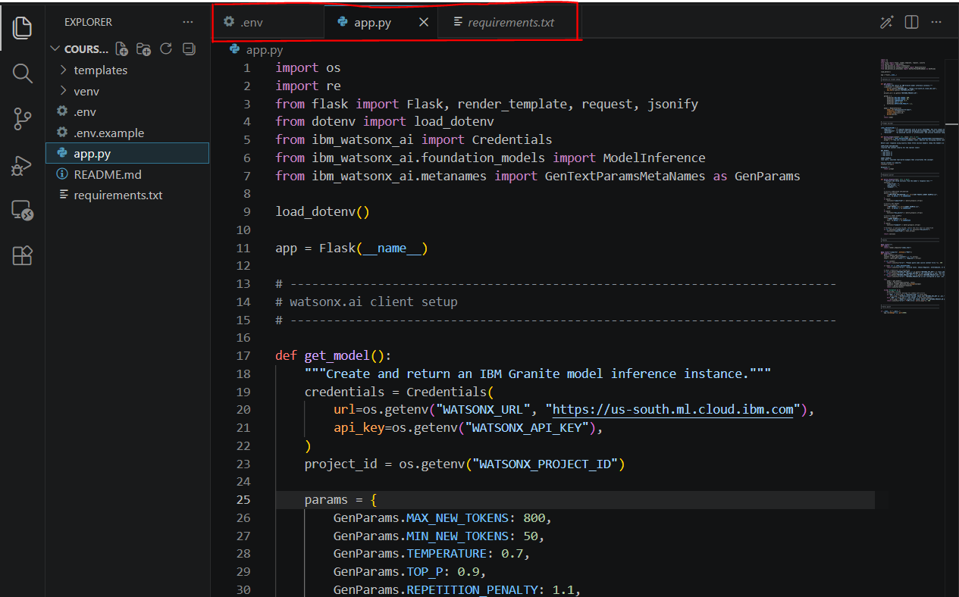
Required Files created using IBM bob -
app.py — Flask backend + IBM Granite integration
templates/index.html — Web interface
requirements.txt — Python dependencies
README.md — Project documentation
.env.example — Configuration template (without your real API key)

Slide 7
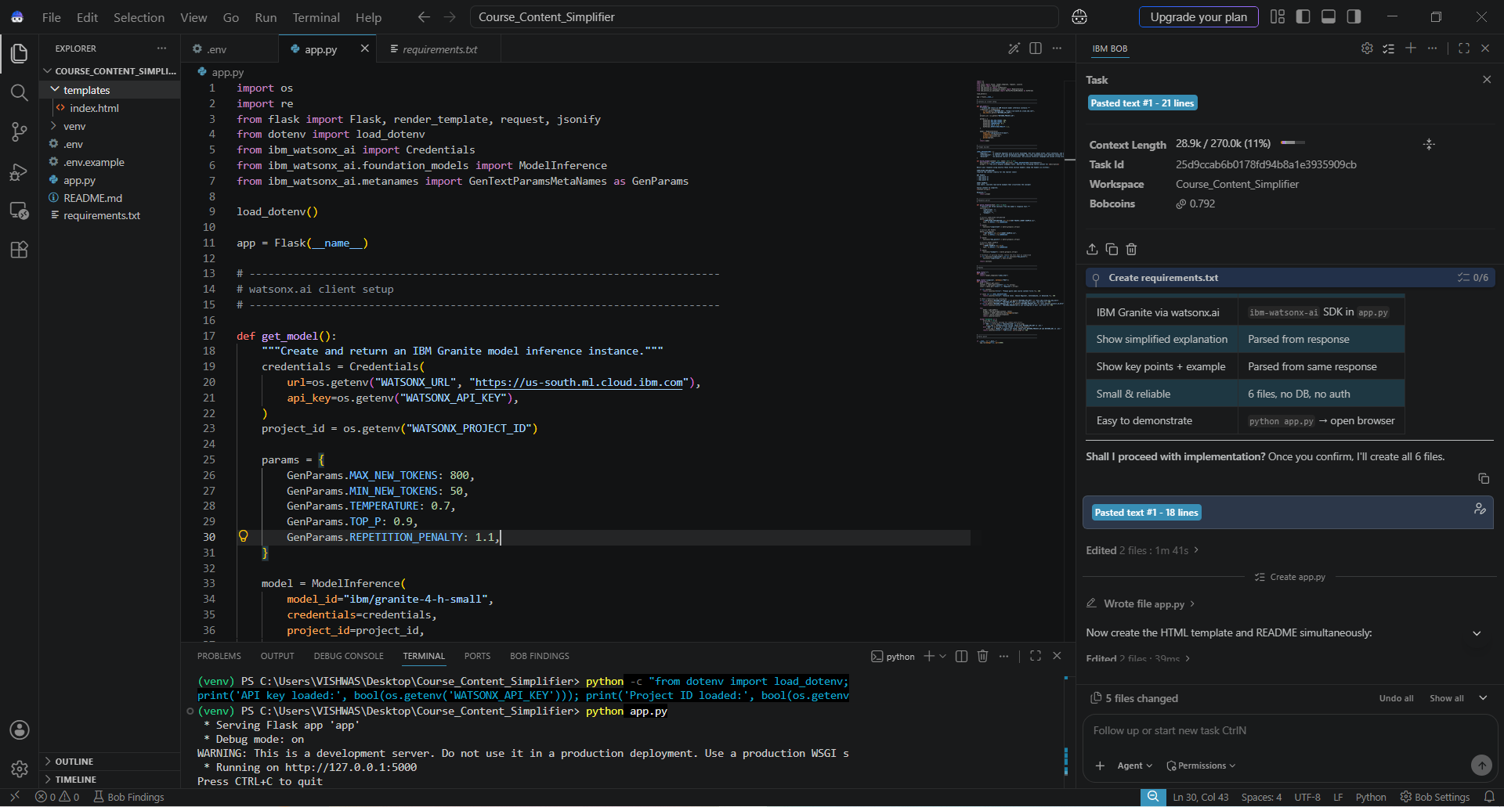
IBM Bob Screenshots:

Slide 8
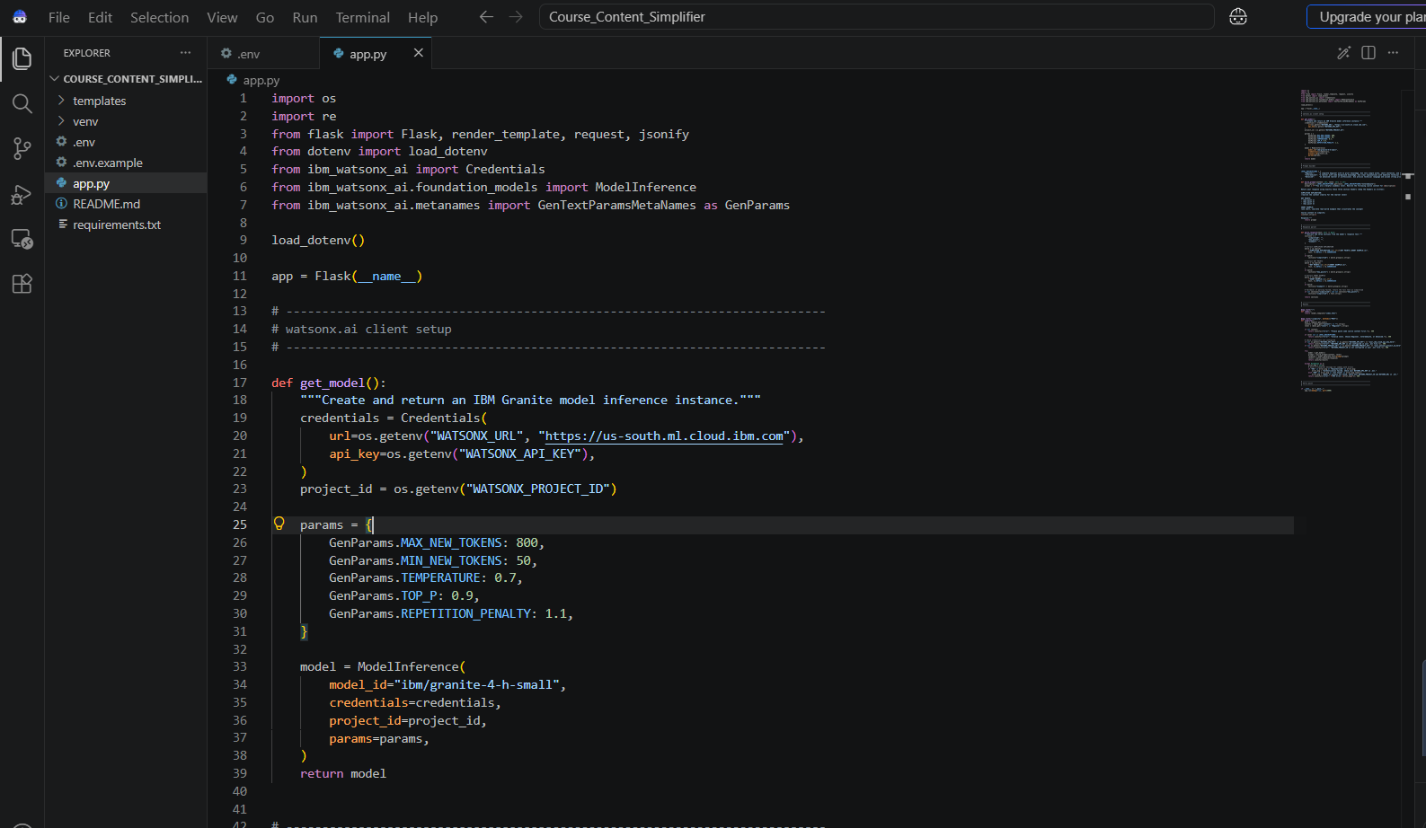

Slide 9
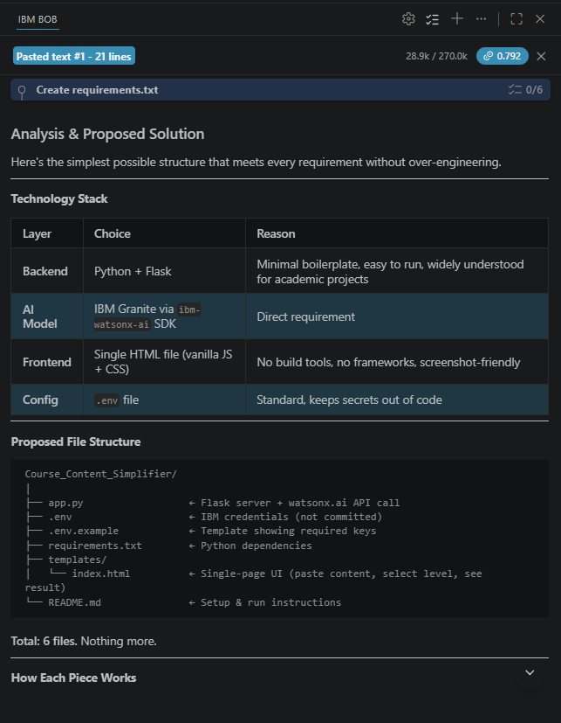
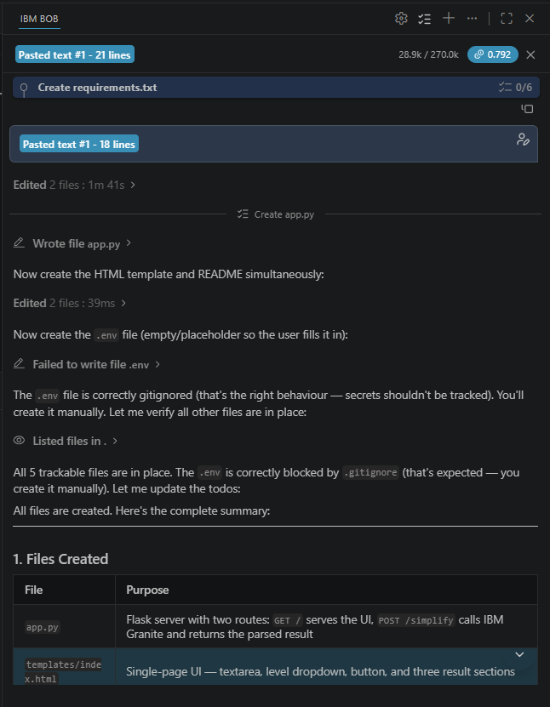
IBM BOB

Slide 10
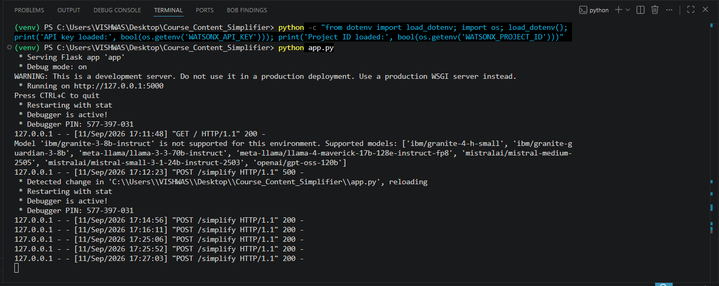
Terminal

Slide 11
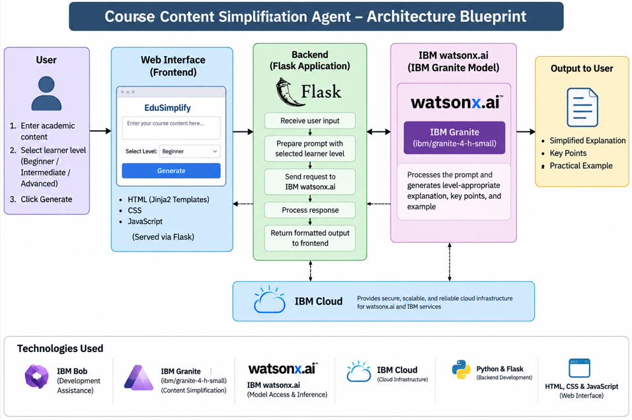
Architecture blueprint :

Slide 12

Role of Agentic AI in the solution
Role of Agentic AI in Course Content Simplification Agent
Agentic AI enables the system to function as an intelligent and goal-oriented learning assistant rather than a simple text-generation tool. Using IBM watsonx.ai and IBM Granite, the agent analyzes the learner's selected proficiency level and adapts the academic content accordingly.
The agent performs the following tasks:
Content Analysis – Analyzes the complexity and concepts present in the provided academic content.
Learner Adaptation – Adjusts the explanation according to the selected Beginner, Intermediate, or Advanced level.
Simplification & Reframing – Generates an appropriate explanation using language and technical depth suitable for the learner.
Key Point Extraction – Identifies important concepts for quick learning and revision.
Example Generation – Provides a short practical example to improve conceptual understanding.
Agentic AI also enables the system to be context-aware, as the generated response changes according to the learner's selected proficiency level while working toward the goal of making the content easier to understand.

Slide 13
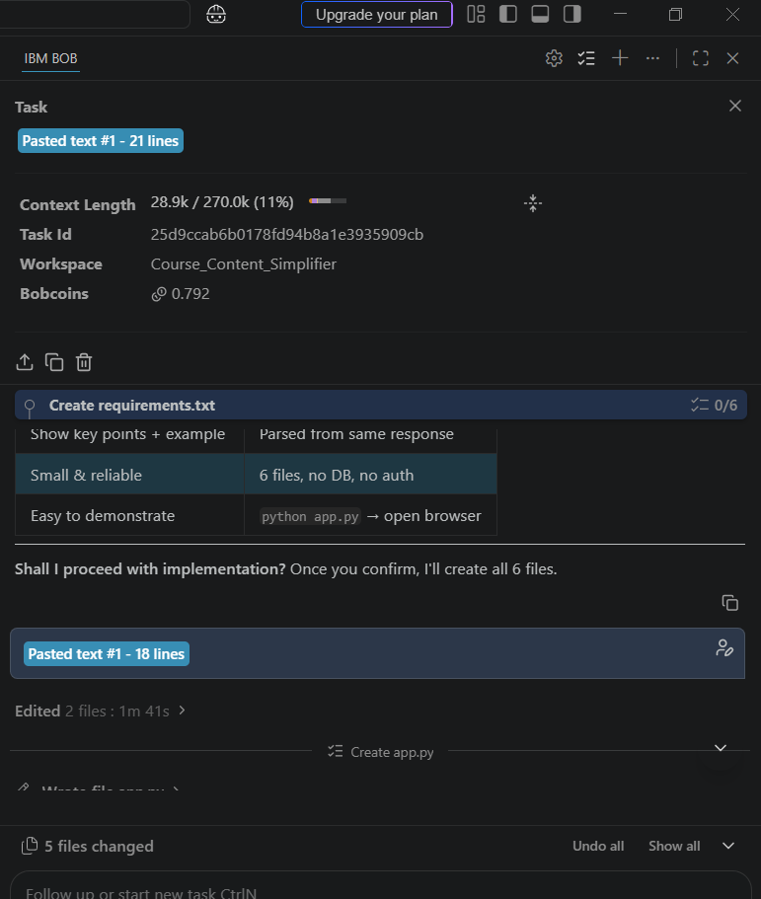
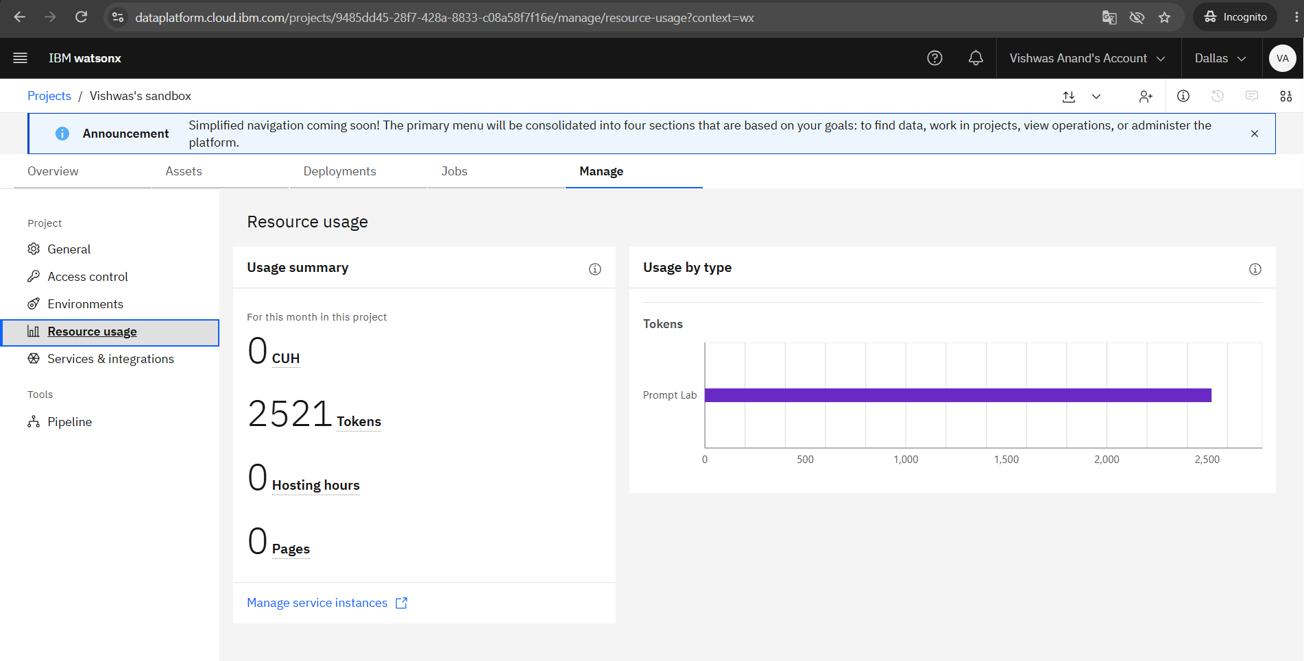
Token Usage
IBM watsonx.ai Project Resource Usage
Total Tokens Recorded: 2,521
Usage Category: Prompt Lab
·
·
·

Slide 14
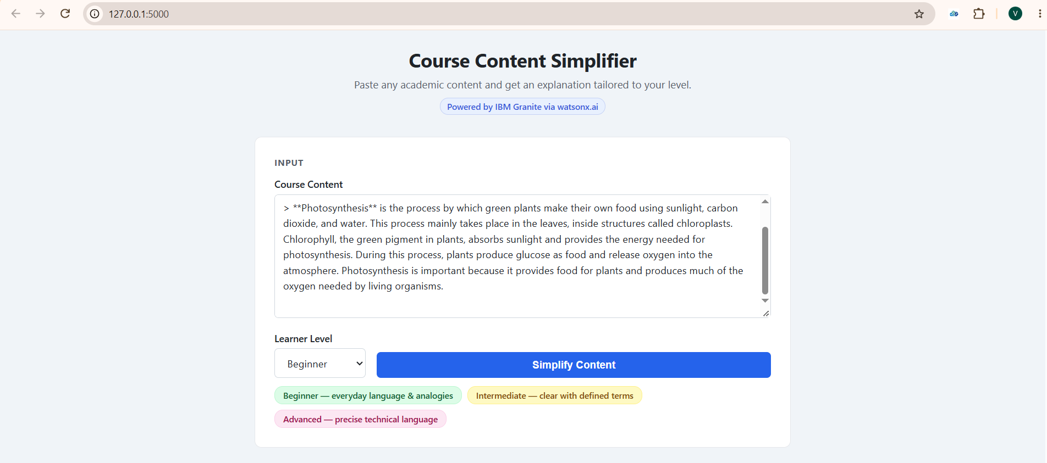
Project Output Screenshot
·
·
·

Slide 15
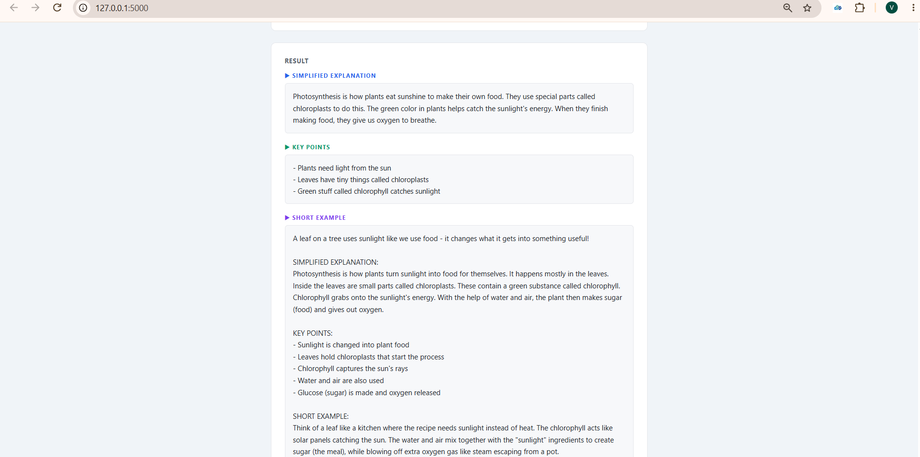
Project Output Screenshot- Beginner
·
·
·

Slide 16
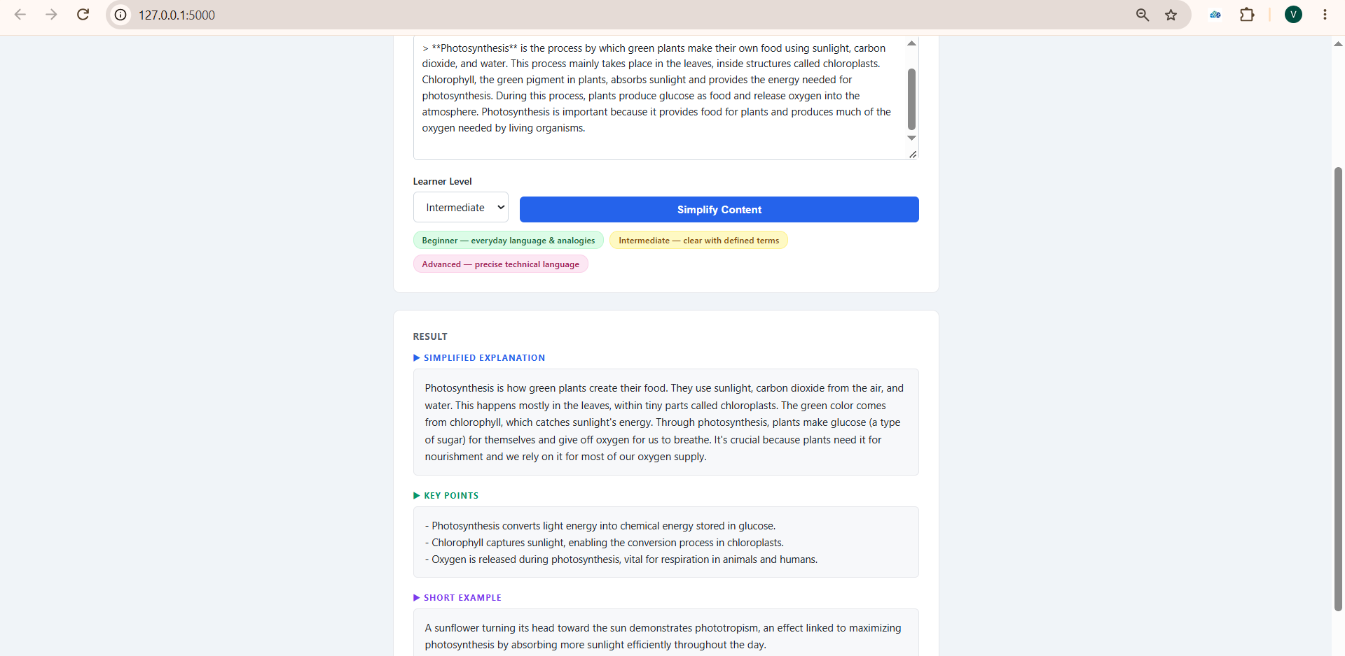
Project Output Screenshot- Intermediate
·
·
·

Slide 17
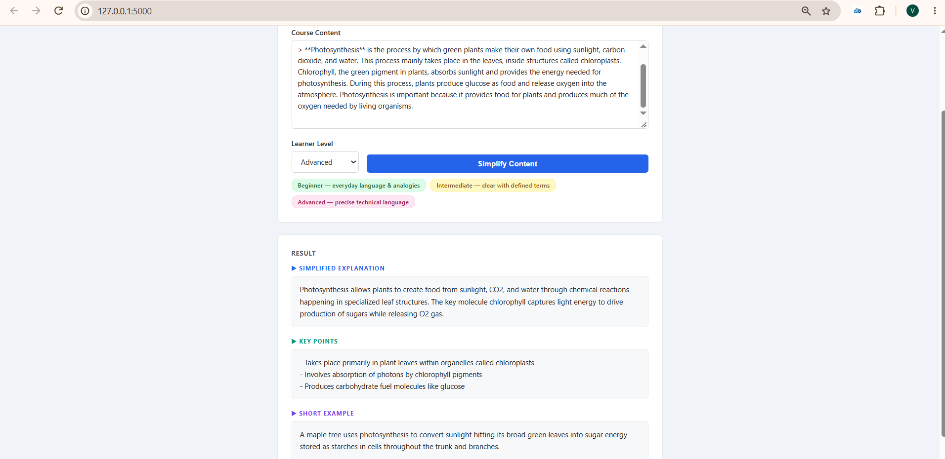
Project Output Screenshot- Advanced
·
·
·

Slide 18
Novelty and Uniqueness
Adaptive Learning: Adjusts explanations for Beginner, Intermediate, and Advanced learners.
Structured Output: Provides explanation, key points, and a practical example.
Personalized Understanding: Same course content is reframed according to the learner’s proficiency. Simple & Scalable: Lightweight web-based solution using IBM Granite and watsonx.ai.

Slide 19
Git Hub Link
· https://github.com/vishwas931/Course-content-simplification-agent-
·
·
·

Slide 20
Future Scope
1. Multilingual Support – Add support for multiple languages so learners can understand academic content in their preferred language.
2. Voice-Based Learning – Enable voice input and audio explanations for more interactive and accessible learning.
3. More Learner Levels – Introduce additional proficiency levels and personalized learning modes based on individual needs.
4. Broader Educational Content – Extend the agent to support PDFs, lecture notes, textbooks, and other academic materials.
5. Personalized Learning Recommendations – Future versions could suggest related topics, examples, and revision content based on the learner’s needs.
·
·
·

Slide 21
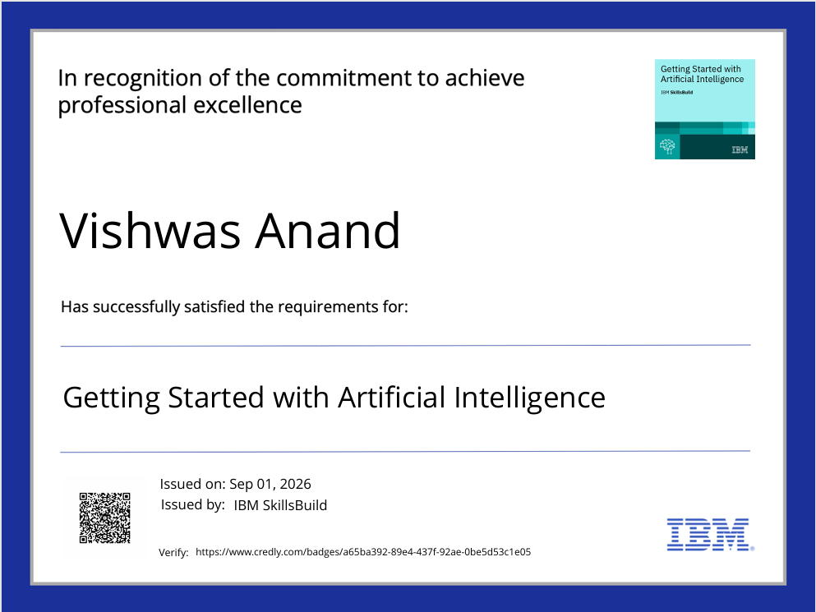
Certificates Earned:
credly certificate(Getting Started with Artificial Intelligence)

Slide 22
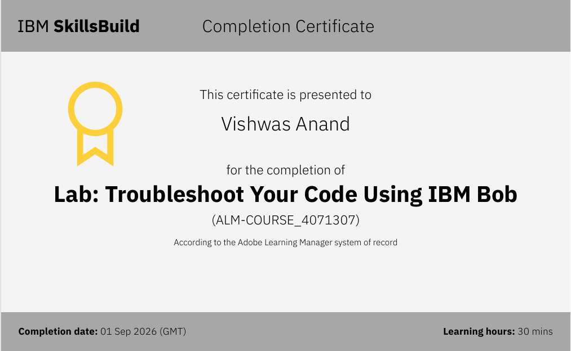
Certificates Earned:​
IBM BOB Certificate

Slide 23


