Slide 1
QUIC/UDP will replace HTTP over TCP
Vishwas Gowdihalli Mahalingappa
Rutgers University - New Brunswick
vg421@scarletmail.rutgers.edu

Slide 2

ABSTRACT
QUIC/UDP will replace HTTP over TCP in the near future.
The preferred protocol for networked communication of Google services during the past few years has been QUIC.
QUIC has been globally deployed at Google on thousands of servers and is used to serve traffic to a range of clients including a widely used web browser (Chrome) and a popular mobile video streaming app (YouTube).
It is estimated that 7% of Internet traffic is now QUIC.
It is critical to comprehend QUIC since it will be the Internet's future.

Slide 3
INTRODUCTION
QUIC Integration and Advantages: QUIC, built on UDP with encryption, operates at the application layer without necessitating OS upgrades. It offers performance benefits over TCP due to streamlined connection handshake and multiplexing.
Efficient Handshake: Unlike TCP's 3-way handshake, QUIC establishes connections with a single packet, incorporating TLS negotiation, reducing latency with zero-handshake connections 75% of the time.
Multiplexing Benefits: QUIC's multiplexing of client-server communication mitigates head-of-line blocking, enhancing congestion control and error correction. Google's testing showed latency reductions in searches and fewer YouTube rebuffers.

Slide 4
INTRODUCTION
Impact on Traffic: Google's adoption of QUIC, influencing a significant portion of Internet traffic, suggests its potential as a widespread protocol, offering notable improvements in user experience and traffic optimization.
Future Adoption: With Google's support, other corporations are expected to adopt QUIC, indicating its trajectory towards becoming a standard protocol.
Migration Support: Drawing parallels to the HTTP to HTTPS transition, the paper advocates for migrating from TCP to QUIC, emphasizing long-term benefits despite initial transition difficulties.

Slide 5
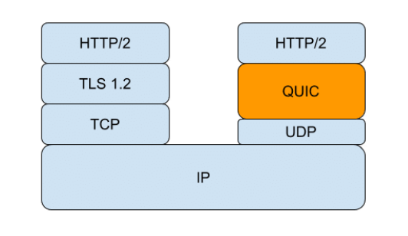
INTRODUCTION

Slide 6
QUIC
QUIC Development: Initially called "Quick UDP Internet Connections," QUIC is now a general-purpose transport protocol developed by Google, introduced in 2012 and standardized by the IETF in May 2021.
Adoption and Application: QUIC, utilized in "HTTP/3," offers low-latency internet transportation, benefiting gaming, streaming, and VoIP services, while aiming to enhance web performance.

Slide 7
COUNTERCLAIMS
Cost of Implementation: Implementing QUIC requires extensive hardware and software upgrades, particularly challenging for small and medium businesses due to limited resources, potentially making the investment in QUIC outweigh its benefits.
Packet Recovery: Unlike TCP, QUIC lacks a robust mechanism for recovering lost packets due to its UDP foundation, raising concerns about its reliability in maintaining data integrity and consistency during transmission.

Slide 8
COUNTERCLAIMS
Infrastructure Transition Challenges: Transitioning to QUIC involves significant complexities, particularly in adapting existing infrastructure, which may not seamlessly support the new protocol, leading to compatibility issues and potential disruptions in service.
Firewall Limitations: QUIC poses challenges for firewalls, as they struggle to inspect and control QUIC sessions effectively due to its encryption setup, leading to reduced security and potential performance concerns in analyzing session setups through deep packet inspection

Slide 9
THE ARGUMENT
Cost-Benefit Analysis: While the initial cost of migrating to QUIC may seem significant, parallels can be drawn from the migration to HTTPS, where the shift favored HTTPS-based websites in SEO, urging small enterprises to make the switch, indicating that the benefits outweighed the initial costs.
Packet Recovery and Performance: Although QUIC utilizes UDP, which lacks TCP's packet recovery mechanism, it features a faster recovery mechanism and potential implementation of Forward Error Correction methods, as evidenced by ongoing IETF drafts, suggesting promising advancements in mitigating packet loss issues.

Slide 10
THE ARGUMENT
Infrastructure Enhancement: Despite the challenges in fundamentally improving internet infrastructure, the advantages of QUIC over TCP warrant consideration for replacing current infrastructure, emphasizing the potential long-term benefits despite initial investment challenges.
Firewall Compatibility: While connections made using QUIC may pose challenges for firewalls due to operating over UDP, cooperation between firewall teams and the adoption of QUIC protocols can resolve these issues, enabling the speed and efficiency benefits of QUIC while maintaining security standards.

Slide 11
Why QUIC?
Enhanced Security: Unlike TCP, QUIC mandates encrypted communication, ensuring privacy and security. This encryption, while beneficial for cybersecurity, may pose an unnecessary burden if encryption isn't deemed necessary. However, QUIC's speed in creating secure connections surpasses TCP + TLS, offering a breakthrough in connection overhead reduction.
Connection Establishment Efficiency: QUIC's design allows for quicker connection establishment by facilitating the exchange of configuration keys and supported protocols in the initial handshake phase. With zero round-trip time (RTT) connection establishment, QUIC eliminates the need for multiple round trips, enabling faster data transmission compared to TCP.

Slide 12
Why QUIC?
Reliability and Speed: QUIC combines TCP-like features such as congestion control and automated retransmission with UDP's foundation, making it more reliable than pure UDP. Loss recovery is integrated into QUIC, allowing for independent handling of multiple streams and enhancing speed, especially in error-prone links.
Elimination of Head-of-Line Blocking: QUIC addresses the head-of-line blocking problem by introducing streams at the transport layer. If a packet is lost in one stream, only that stream is affected, while packets continue flowing in others. This feature enhances QUIC's robustness to packet loss compared to TCP.

Slide 13
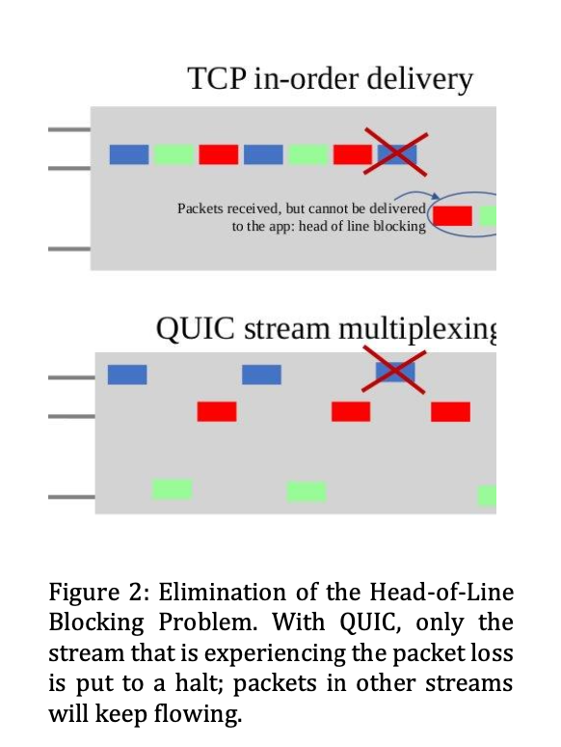
Why QUIC?

Slide 14
QUIC in IPv4
In IPv4, QUIC support expanded significantly up to September 2017.
The number of IPs tripled during this period, with a dynamic version space indicating active development.
Version 35 remained consistent across observations.
Google accounted for 53% of hosts, while Akamai represented approximately 40%.
Starting in September 2017, QUIC support in IPv4 experienced a dramatic increase following Akamai's official rollout announcement.

Slide 15
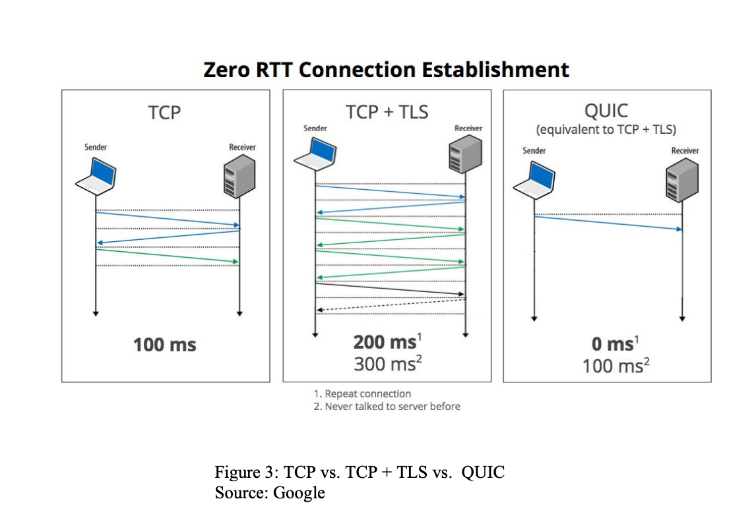
QUIC in IPv4

Slide 16
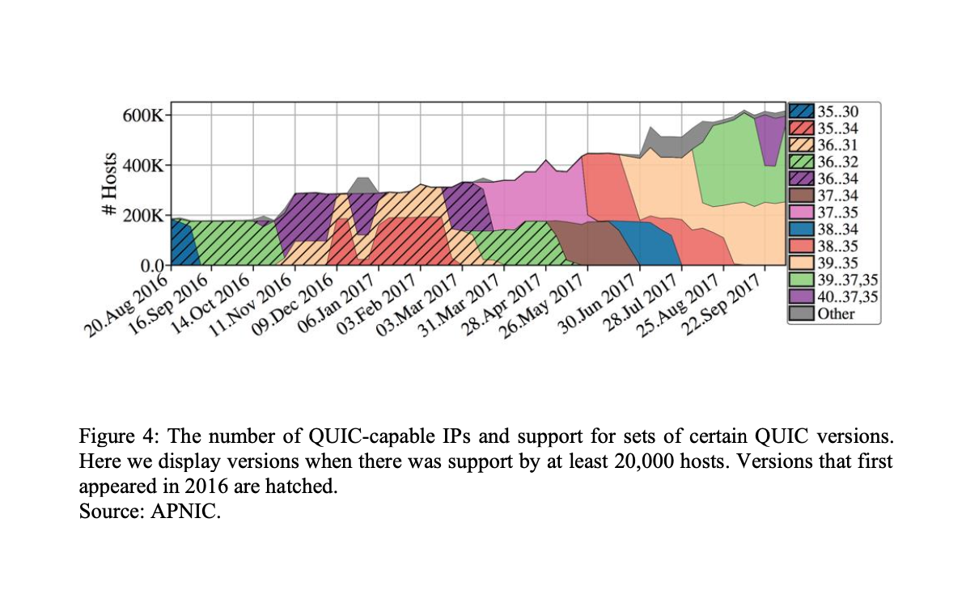
QUIC in IPv4

Slide 17
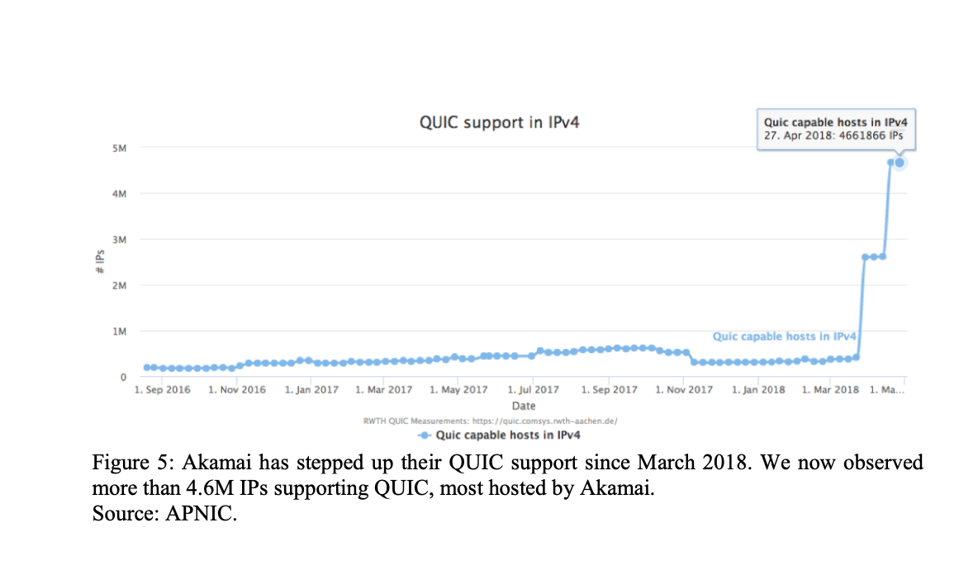
QUIC in IPv4

Slide 18
QUIC in 5G network
Preferable Alternative in 5G Core Network: QUIC is favored over TCP in the service-based architecture of the 5G core network due to its faster connection setup, significantly reducing latency compared to TCP.
Optimized Connection Paradigm: QUIC's optimized long-lived connection paradigm reduces average request latency to less than half that of TCP, suggesting superior performance even in scenarios where long-lived connections are employed.

Slide 19
QUIC in 5G network
Performance in Unfavorable Network Conditions: QUIC demonstrates robust performance in high Packet Loss Rate (PLR), high Round-Trip Time (RTT), and low bandwidth conditions, outperforming TCP notably.
Enhanced Throughput and Latency Reduction: Even in extremely favorable network conditions with a PLR of 0% and RTT of 20 ms, QUIC reduces latency to a third of that of TCP and doubles the throughput, highlighting its efficiency and effectiveness in 5G networks.

Slide 20
CONCLUSION
In conclusion, QUIC, developed by Google, aims to replace outdated standards by leveraging stream multiplexing at the transport layer, enhancing throughput performance, and resolving TCP head-of-line blocking issues.
Understanding QUIC's advantages is crucial as it emerges as a new Internet performance protocol capable of tripling performance when enabled by a browser.
Despite concerns about QUIC's cost-effectiveness, a brief case study on migration highlights its potential benefits.
The shift from HTTP to HTTPS, driven by SEO advantages, saw significant adoption, particularly among mid-sized and small enterprises, demonstrating the potential for widespread adoption of protocols like QUIC once benefits are realized.

Slide 21
REFERENCES
[1] G. Carlucci, L. De Cicco, and S. Mascolo, "HTTP over UDP: An Experimental Investigation of QUIC," in Proceedings of the ACM Symposium on Applied Computing, April 13-17, 2015, pp. 609-614. doi: 10.1145/2695664.2695706
[2] P. Megyesi, Z. Krämer, and S. Molnár, "How Quick Is QUIC?" in 2016 IEEE International Conference on Communications, May 23-27, 2016, pp. 1-6. doi: 10.1109/ICC.2016.7510788
[3] K. Nepomuceno et al., "QUIC and TCP: A Performance Evaluation," in 2018 IEEE Symposium on Computers and Communications (ISCC), June 25-28, 2018, pp. 45-51. doi: 10.1109/ISCC.2018.8538687
[4] Y. Cui et al., "Innovating Transport with QUIC: Design Approaches and Research Challenges," IEEE Internet Computing, vol. 21, no. 2, pp. 72-76, Mar. 2017. doi: 10.1109/MIC.2017.44
[5] M. Thomson and J. Iyengar, "QUIC: A UDP-Based Multiplexed and Secure Transport," [Online]. Available: https://tools.ietf.org/html/draft-ietf-quic-transport-27
[6] E. Newton, "HTTP vs HTTPS and SEO in 2019," 2019. [Online]. Available: https://www.brightedge.com/blog/http-https- and-seo

