Slide 1

Student’s Accounts Management System ( SAMS )
Version 1.0
A project by,
Sujay Kumar Mandal (Leader) M120361CA
Arvind Singh M120352CA
Rakesh Patni M120364CA
Shashank Mishra M120363CA
Vishwash Kumar Sharma M120372CA
Instructor: Mr. Kranti Kumar
Course: Object Oriented Programing

Slide 2
Introduction
Student’s Accounts Management System keeps track of some very essential accounts a college student needs to maintain.
This version includes Attendance Tracker, Class Schedule , Monetary Account Manager, Mess Menu Card , Daily Note Pad & Assignment Reminder.
SAMS is a Green Field project.
SAMS is a non-web based application solely for purpose of student's personal use. It is a single user application with a single login facility.

Slide 3
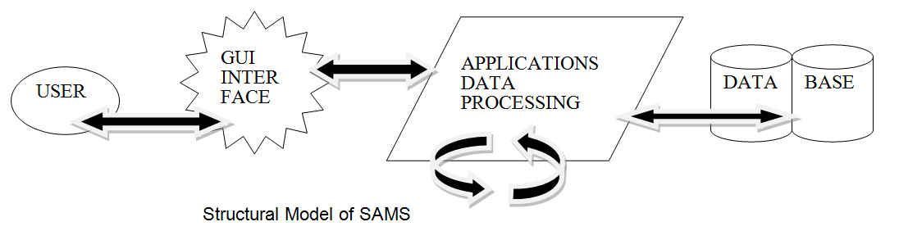
    User has to give password to login.
    User can update any information.
    User able to logout.
    GUI between user & SAMS system.
    SAMS will show the reminders as set on proper date.

Slide 4
Literature Survey
Although many on line and down-loadable account management software are available ,Student account management system ,SAMS, derives its uniqueness from the fact that it is solely meant for the student community of National Institute of Technology, Calicut.
The areas on which it shall focus are : extra expenses , mess routine , class routine , things to remember(reminder), attendance log and diary(everyday notes).

Slide 5
The scope of SAMS solely includes the student community of NITC, hence special focus has been paid to features inherent to NITC- such as drop-downs for assignment reminder and everyday diary , so as to help students keep up with the academics.
The aforementioned features have been included after adequate survey-spanning all different student section( Btech ,MCA , Mtech , PhD, MSc) ,was done. Also feedback has been taken ,on the completion of the documentation (SRS),from the various sections of students, which have largely been positive.

Slide 6
Requirements
    Student should be able to enter his/her everyday attendance for every class that held in a day.
    Student should have an option to view his current attendance any time.
    Class time table should be visible and software should able to tell the classes to be held in the current day.
    There should be an option to make any changes to the existing time table, in case any kind of updating is required.

Slide 7
    There is an option to maintain a monetary account to have a record of the daily expenses of the student.
    There will be a mess menu card that will show the menu of the mess that student has joined.
    Student would also be able to change the menu if there is any need required at any time.
    There should be a daily note pad that would store any special things about the day that student would feel may want to remember for future reference.
    Student would be able to add any kind of reminders.

Slide 8
Work done
Software Requirements Specification
Use case diagrams & descriptions
Entity Relationship Diagram

Slide 9
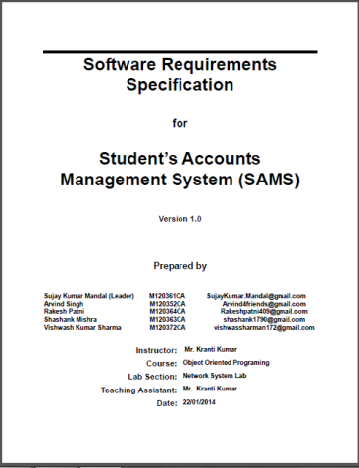
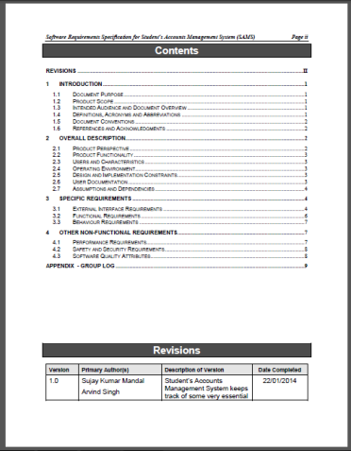
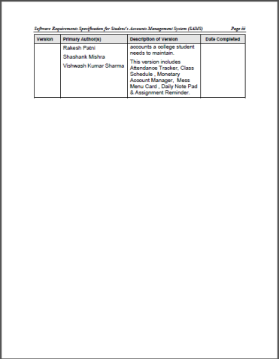
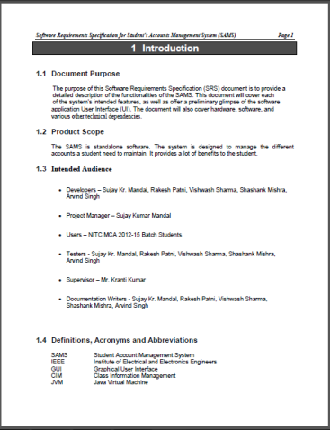
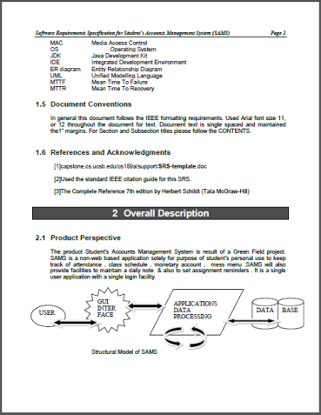
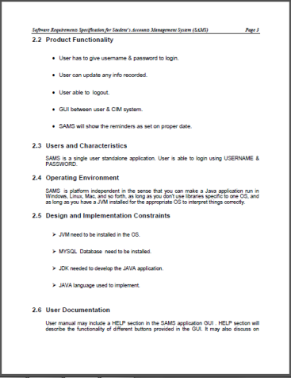
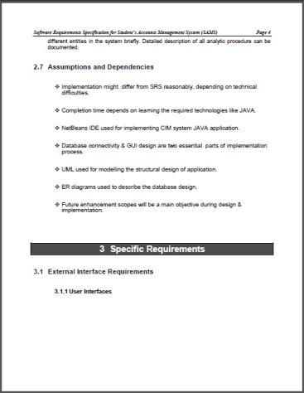
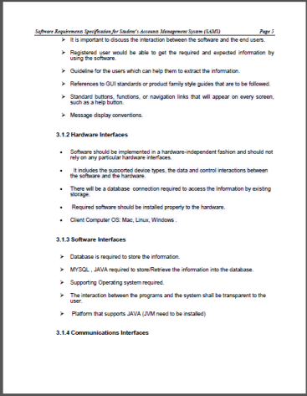
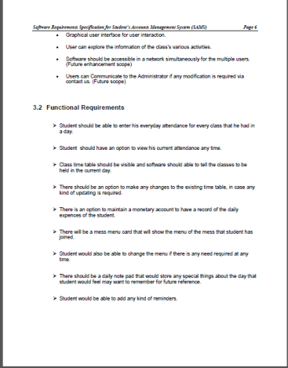
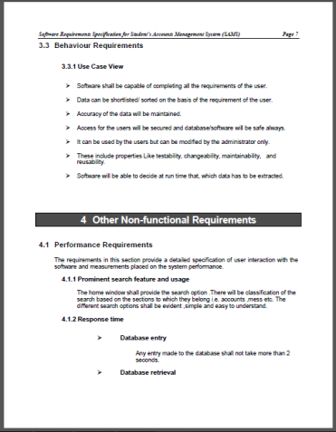
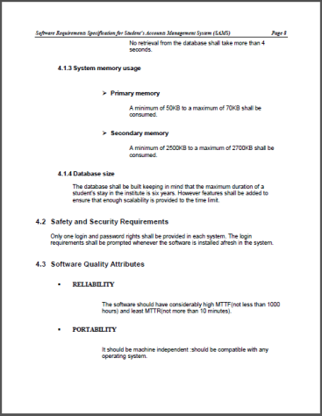
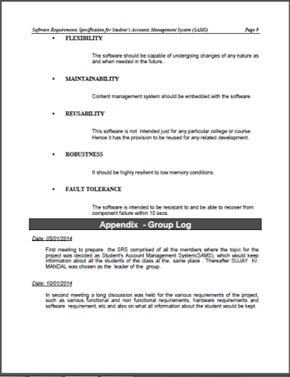
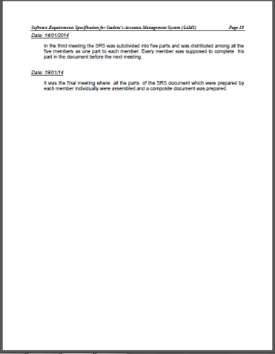
SRS

Slide 10
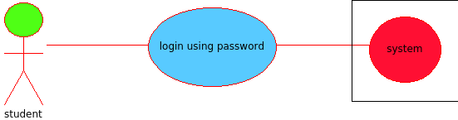
Use Cases
Use Case Student logs into the application software - SAMS
Precondition The system has SAMS and JVM installed in it.
Basic Path 1. User opens the software application.
2. User enters password to login
3. User clicks the login button
Alternate Path N/A
Postcondition User successfully logs into SAMS
Exception Path Login unsuccessful as the password entered by user is wrong

Slide 11
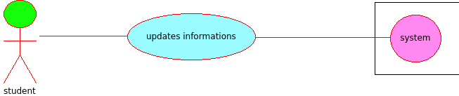
Use Case Student updates basic information in SAMS
Precondition Student is logged into the SAMS
Basic Path 1.Student clicks on the change password link
2.Student enters a new password in the field generated.
3.Student clicks on the confirm button.
Alternate Path 1 1.Student clicks on the class schedule link
2.A new window opens where he clicks on the update link.
3.System generates a form with grids.
4.He finally enters subject names and their respective time slots in the field provided.

Slide 12
Alternate Path 2
1.Student clicks on the mess menu link which opens a new window. He now clicks on the change menu link .
2.System generates a form .
3.He fills the form with the names of food items for each day of the week and clicks on the update button.
Alternate Path 3
Student clicks on the attendance log link and follows it by clicking on change subjects link to enter new subjects in the attendance log. He then clicks on the submit button.
Postcondition 1.Class schedule is successfully stored in SAMS.
2.Mess menu is successfully stored in SAMS.
3.Subjects are successfully updated in attendance log.
Exception Path N/A

Slide 13
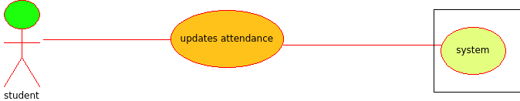
Use Case Student updates attendance in SAMS for a particular day
Precondition 1. Student is logged into SAMS
2. Student has stored subjects for keeping attendance in the attendance log.
Basic Path 1.Student clicks on the attendance log button.
2. Student enters no. of classes taken & attended for each subject on the day in the fields generated.
3. Students then clicks the update button.
Alternate Path N/A
Postcondition Student successfully updates attendance record stored in SAMS
Exception Path N/A

Slide 14
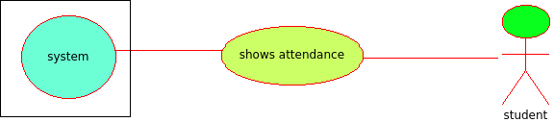
Use Case SAMS shows attendance record for the particular subject
Precondition 1. Student is logged into SAMS
2. Student has stored subjects to keep attendance
Basic Path 1. Student clicks on the attendance log button ,then clicks the check attendance link.
2. He then selects the desired subject from the drop down generated.
3. He then clicks on the submit button.
Alternate Path N/A
Postcondition System displays information about total classes taken, total classes missed, present percentage in the subject for the student.
Exception Path N/A

Slide 15
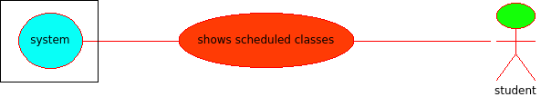
Use Case SAMS shows classes schedule for the particular day
Precondition 1. Student is logged into SAMS
2. Student has stored class time table
Basic Path 1. Student clicks on the class schedule link , then selects a day from the drop down menu of day .
2. System generates an applet containing the classes and their slots for the day.
Alternate Path N/A
Postcondition SAMS shows classes scheduled for that day for the student
Exception Path N/A

Slide 16
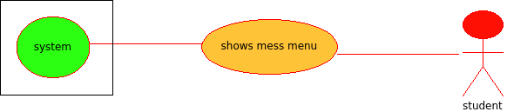
Use Case SAMS shows mess menu for the time on the day to student
Precondition 1. Student is logged in SAMS
2. Student has stored mess menu details in SAMS
Basic Path 1. Student clicks on the mess menu link .
2. He then selects the day and time from the drop downs that appear, and then clicks on the submit button.
Alternate Path N/A
Postcondition SAMS displays the mess menu for the day and the time slot as entered by the user.
Exception Path N/A

Slide 17
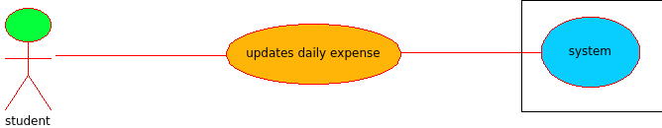
Use Case Student updates daily expense in SAMS for any item in the day
Precondition Student is logged in
Basic Path 1.Student clicks on the expenses link.
2. He then clicks on the add expenses link.
3. A form is generated which he fills .
4.He finally clicks on the update button.
Alternate Path N/A
Postcondition Student successfully updates daily expense record stored in SAMS
Exception Path Update unsuccessful because expense against that item is already entered once in that day

Slide 18
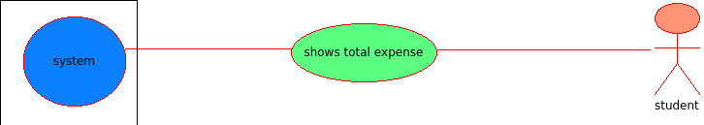
Use Case SAMS shows total expense to student
Precondition Student is logged in SAMS
Basic Path 1. Student clicks on the expenses button
2. He selects the item option from the drop down menu.
3. He then enters the item name whose expense he is interested to know and then clicks on the submit button.
Alternate Path 1.Student selects the period option instead of item from the drop down.
2. He then enters the period of time for which he want to know the expense and then clicks on the submit button.
Postcondition SAMS displays the expense in the order desired by the user.
Exception Path N/A

Slide 19
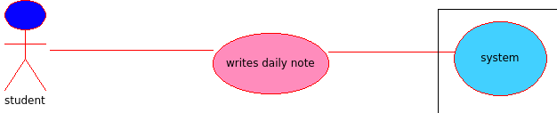
Use Case Student writes daily note in SAMS
Precondition Student is logged in SAMS
Basic Path Student clicks on the diary link .
System generates a notepad an editor on which he types.
He finally clicks on the submit button.
Alternate Path N/A
Postcondition The daily note is stored successfully in SAMS against that date
Exception Path Unsuccessful as student cant store two notes against a single date

Slide 20
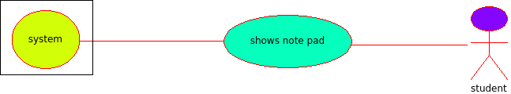
Use Case SAMS shows contents written by student in diary for a desired date
Precondition Student is logged into SAMS
Basic Path Student clicks on the diary button ,and follows this by selecting the desired date from the date grid that appears.
He clicks on the submit button.
Alternate Path N/A
Postcondition The note written on that date is shown if available
Exception Path N/A

Slide 21
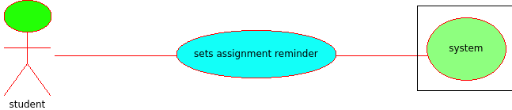
Use Case Student sets assignment reminder in SAMS
Precondition Student is logged into SAMS
Basic Path Student clicks on the reminder link. A new window appears where he clicks on the new reminder link and follows it by entering the details of the reminder in the field that appears.
He also clicks on the deadline button and selects a date .
He finally clicks on the set reminder button.
Alternate Path N/A
Postcondition The reminder is set successfully for that date
Exception Path N/A

Slide 22
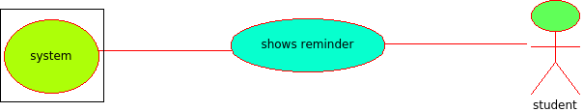
Use Case System shows reminder for the day to student
Precondition Student is logged in SAMS
Basic Path 1. Student clicks on the reminder link.
2. He then selects the date from the date grid that appears .
3. He finally clicks on the submit button.
Alternate Path N/A
Postcondition The reminder is shown if available
Exception Path N/A

Slide 23
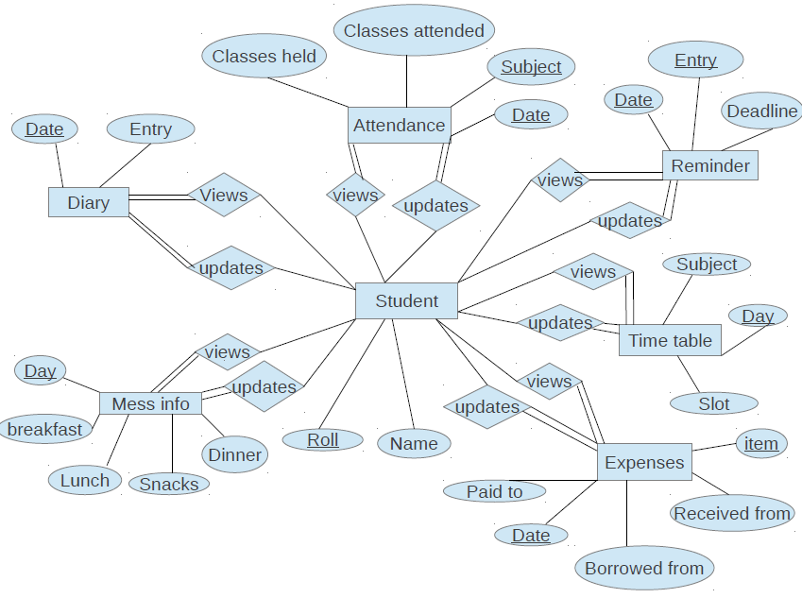
ER Diagram

Slide 24
Plan of work
UML Diagram Designing
Database Design in MySql
Implementation of Use Cases using Java
GUI Designing – Shashank Mishra
Database Connectivity – Vishwash Kr. Sharma
Survey & deployment – Rakesh Patni
Backend Programing – Sujay kr. Mandal & Arvind Singh

Slide 25
Conclusion and future perspective
User manual may include a HELP section in the SAMS application GUI . HELP section will describe the functionality of different buttons provided in the GUI.
New features can be added in SAMS, in order to make it more generic.
SAMS should be accessible in a network simultaneously for the multiple users.
SAMS would become an Android Application.

Slide 26
References
[1]capstone.cs.ucsb.edu/cs189a/support/SRS-template.doc
[2]Used the standard IEEE citation guide for this SRS.
[3]The Complete Reference 7th edition by Herbert Schildt (Tata McGraw-Hill)
[4] Umbrello tool for designing use case diagrams
[5] Head first java , 2nd edition
[6] Netbeans IDE for java

