Slide 1


Network Anomaly Detection using Dynamic Programming
Group 20 -
Simhadri Tanya (BL.EN.U4AIE21119) Srinidhi Kannan (BL.EN.U4AIE21121) Vishwash Sharma (BL.EN.U4AIE21144)

Slide 2
Table of contents
01
02
03
04
Problem Statement & Algorithm Strategy
Literature Survey
Conclusion & Future Scope
Implementation

Slide 3
PROBLEM STATEMENT
Anomaly detection plays a crucial role in ensuring the security and reliability of network systems.
The key objective is to distinguish unusual patterns or events that deviate from normal network behavior, which may indicate malicious activities, network faults, performance issues, or other anomalies.

Slide 4
Algorithm :
Dynamic Programming
Technique :
DP matching principle or Dynamic time Warping

Slide 5

Literature Survey

Slide 6
Paper 1 : Network Traffic Anomaly Detection Based on Dynamic Programming
Here, two sets of data are taken: sample data A = a1 , a2, a3…aI and the actual data B=b1, b2, b3…bJ.
Dynamic time warping algorithm is applied on these datasets to match them and identify any anomalies or deviations from normal behavior.
This is done by finding the minimized residual distance between the vectors using the DP equation and calculating the time-normalized distance.
Based on this distance, anomalies are detected in the network traffic. Real data was taken from IP flows for this analysis. It has provided an accuracy rate more than 94%.

Slide 7
Paper 2 : Efficient Sequence Alignment of Network Traffic
The paper addresses the need for efficient sequence alignment techniques to compare and analyze network traffic data.
Traditional sequence alignment algorithms can be computationally expensive and not well-suited for large-scale network traffic analysis.
The paper discusses the application of TreeAlign to network anomaly detection.
By aligning network traffic sequences efficiently, TreeAlign can help identify patterns and anomalies in network behavior, such as network attacks or unusual traffic patterns.

Slide 8
Paper 3 : Anomaly Detection Using Dynamic Time Warping
The paper provides an overview of the Dynamic Time Warping technique, explaining how it computes the optimal alignment between two sequences by warping one sequence with respect to the other.
The framework involves pre-processing the data, computing the DTW distance between sequences, and defining a threshold to classify instances as normal or anomalous based on the distance measure.
The authors compare the performance of the proposed DTW-based anomaly detection approach with other existing methods and demonstrate its effectiveness in detecting anomalies.
They highlight the ability of DTW to handle variations in sequence lengths and speeds, but also note computational complexities and the need for proper parameter tuning.

Slide 9
IMPLEMENTATION
Use the following functions
1. Calculate distance.
2.Calculate time normalized distance.
3. Detect anomalies.
- Calculate the time normalized distance.
- Check boundary conditions.
- Weighting the coefficients.
4. Analysing.

Slide 10
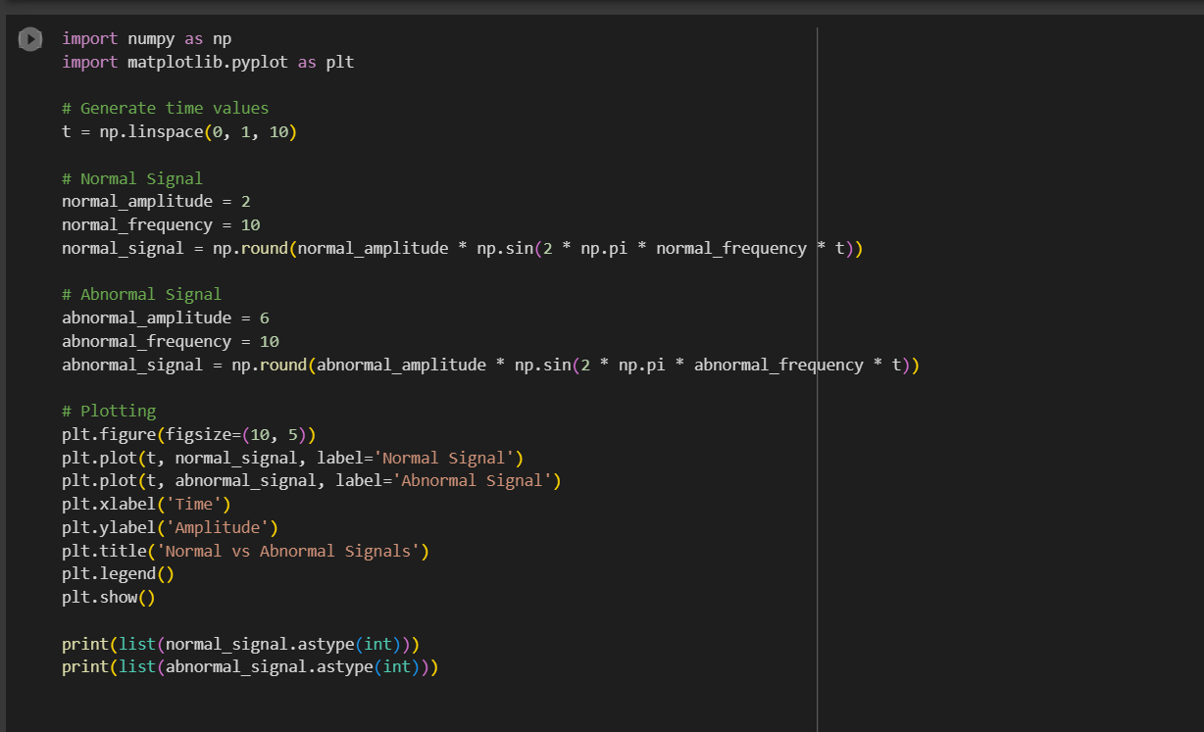
CODE

Slide 11
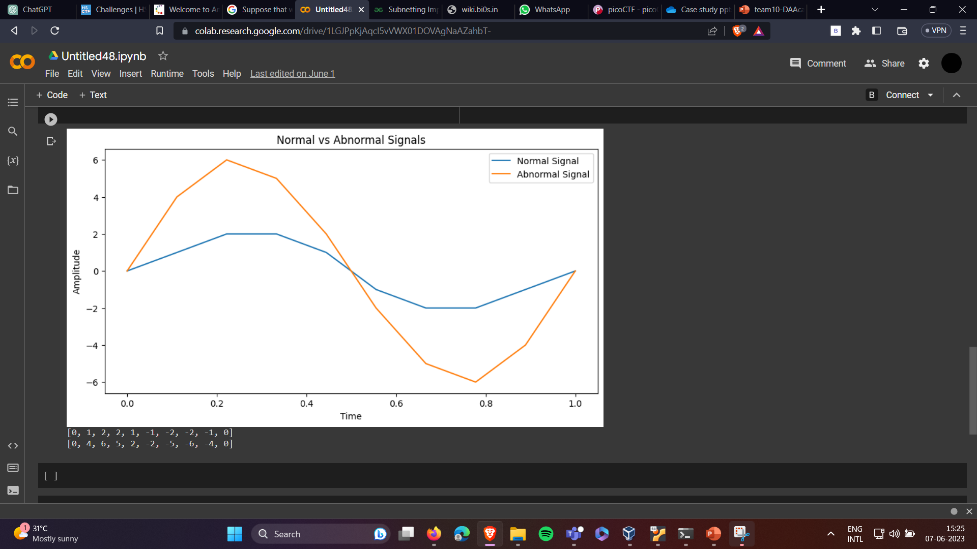

Slide 12
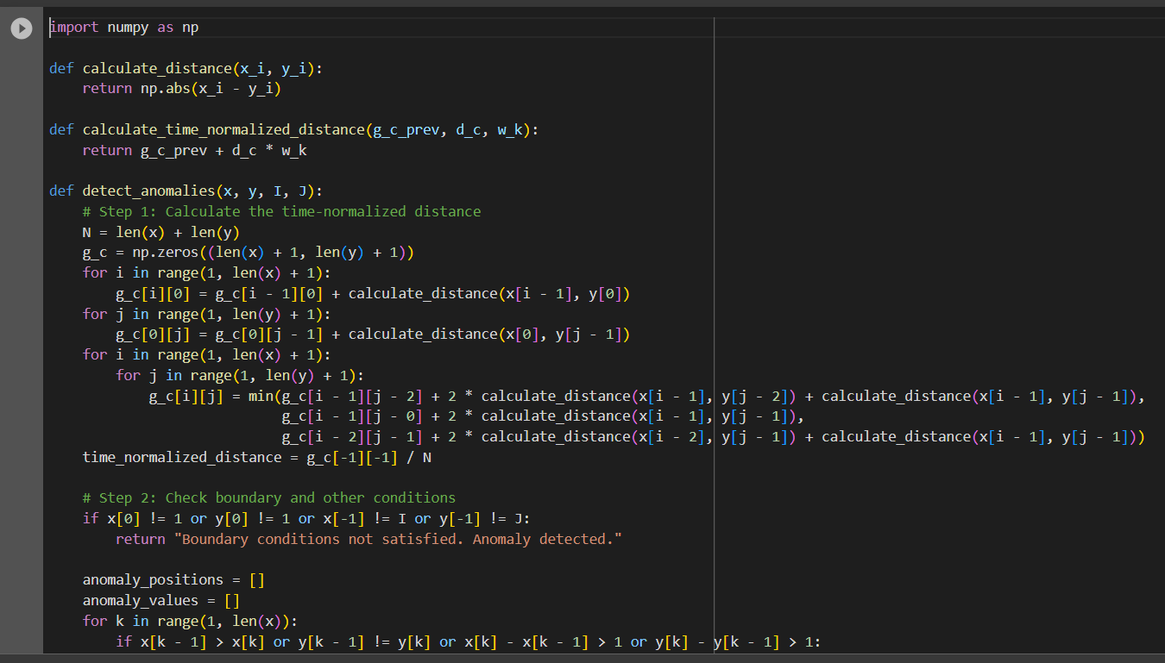

Slide 13
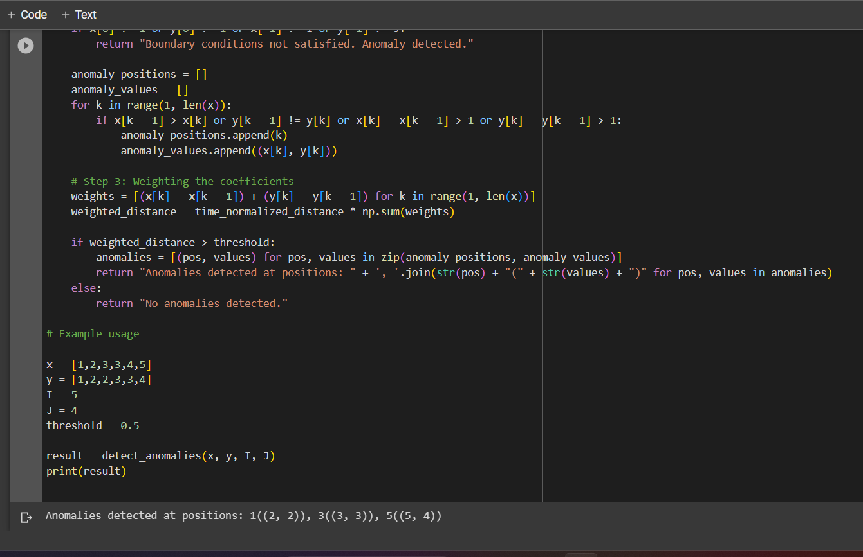

Slide 14
CONCLUSION
This dynamic programming approach provides a systematic method for detecting anomalies in network traffic data.
The threshold and anomaly detection conditions can be adjusted to suit specific network monitoring requirements and provide even more precise results.
Dynamic programming can be combined with machine learning models to improve the accuracy and adaptability of the anomaly detection algorithm.

