Slide 2
Agenda
What is JIRA
JIRA Concepts
Features
Why JIRA
Live Demonstration
Q&A

Slide 3
What is JIRA?
JIRA lets you prioritize, assign, track, report and audit your ‘issues’, from software bugs and helpdesk tickets to project tasks and change requests
More than just an issue tracker, JIRA is an extensible platform that you can customize to match your business processes
JIRA improves productivity by cutting down on time wasted on tracking issues and coordination
JIRA improves quality by ensuring all tasks are recorded down with all the details and followed up till completion

Slide 4







One application. Many uses.
Bugs/Change Requests Tracking
Help-desk / Support / Customer Service Project Management
Task Tracking
Requirements Management Workflow / Process Management

Slide 5
Agenda
What is JIRA
JIRA Concepts
Features
Why JIRA
Live Demonstration
Q&A

Slide 6








































JIRA Concepts: Projects, Issues & Subtasks
Level 1
Project Categories
Projects
Level 2
Components (sub-section)
Versions (milestones)
Issues
Level 3
Issue Types
Issue Types
Level 4
Sub-Tasks
Sub-Tasks
Sub-Tasks
Sub-Tasks

Slide 7















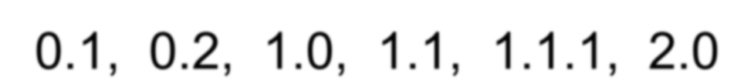

















Example: A Software Development Project
Level 1
Project Categories
Information Technology
Project
Time Tracking Application
Level 2
Components
User Interface, Reports, Workflow
Versions
0.1, 0.2, 1.0, 1.1, 1.1.1, 2.0
Issues
Level 3
New Feature
Bug
Support Ticket
Level 4
Sub-Tasks
Sub-Tasks
Sub-Tasks
Sub-Tasks
Sub-Tasks
Sub-Tasks

Slide 8

















Example: A Helpdesk Environment
Level 1
Project Categories
Information Technology
Project
Desktop Support
Level 2
Components
Operating System, Email, Pricing
Versions
Q1, Q2, Q3
Issues
Level 3
Problem
Issue
Purchase Request

Slide 9

















Example: An Aerospace Engineering Project
Level 1
Project Categories
Aeronautical Division
Project
Jet Fighter
Level 2
Components
Wings, Landing Gear, Fuselage
Versions
Design, Construction, Test Flight
Issues
Level 3
Task
Bug
Verification Request
Level 4
Sub-Tasks
Sub-Tasks
Sub-Tasks
Sub-Tasks
Sub-Tasks
Sub-Tasks

Slide 10
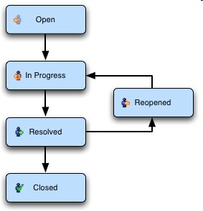
JIRA Concepts - Workflow
Customizable workflows to meet business needs

Slide 11
Agenda
What is JIRA
JIRA Concepts
Features
Why JIRA
Live Demonstration
Q&A

Slide 12
JIRA Features – Issue Creation
Creating tasks, bug reports, feature requests, helpdesk tickets, is a breeze
No need to transcribe issues from emails to Excel worksheet anymore
Issue can be easily created via
Web: Filling the form on the Web page
Email: Sending an email to a preconfigured email address
Allows customizable items for different issues types

Slide 13
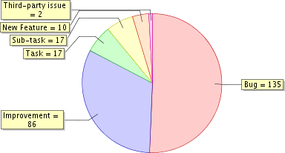
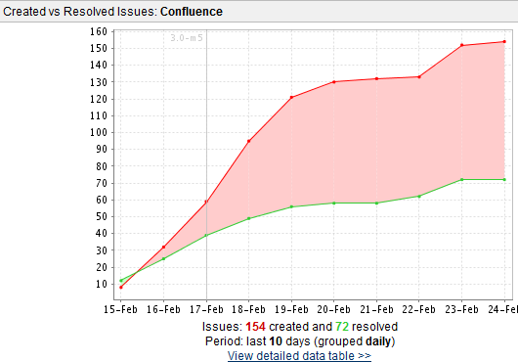
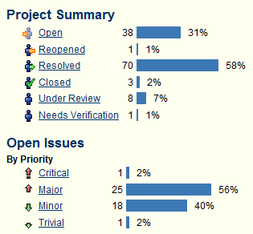
JIRA Features – Reports
JIRA delivers real-time, relevant information in a convenient format
JIRA enables the management to have clear visibility of the situation

Slide 14
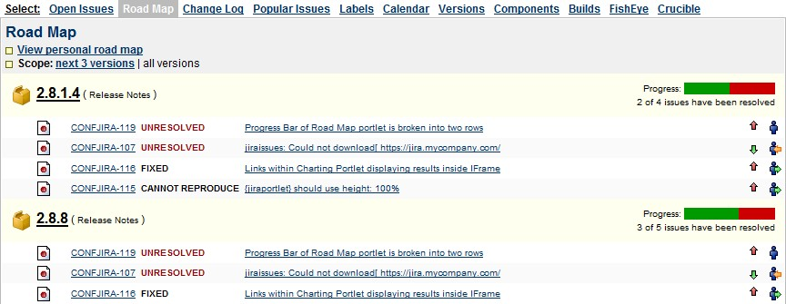
Jira Features – Roadmaps
JIRA enables you to know what is outstanding and when issues are scheduled to be resolved

Slide 15
Jira Features – Notifications
JIRA enables you to receive the information you need, when you need it.
Configurable email alerts as and when issues are updated
Optional emails to remind on overdue tasks
Subscribe to weekly/monthly reports on issue status

Slide 16
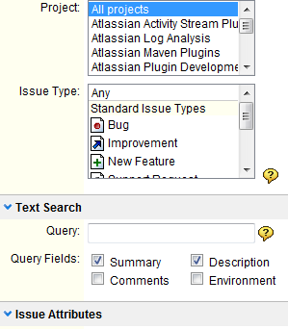
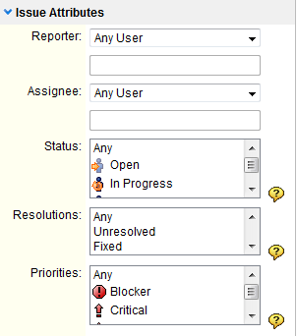
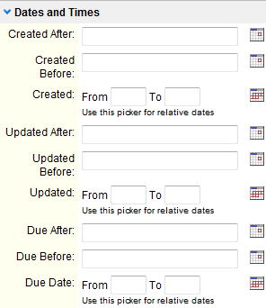
Jira Features – Powerful Search
Find precisely what you are looking for in seconds
Search can be saved as filters and reused
Powerful and flexible searching
Supports searching of customized fields too

Slide 17
Jira Features – Others
Secure – JIRA provides fine-grained enterprise level security
Usable – Intuitive interface designed with both business and technical users in mind
Track – Keep track of all activities, changes and work logged against issues
Administration – A low maintenance system with straightforward administration capability
Extensible – With over 100 plugins contributed by the community
Open – An open API, full source code access allow for further integration and customization of JIRA functionality

Slide 18
Agenda
What is JIRA
JIRA Concepts
Features
Why JIRA
Live Demonstration
Q&A

Slide 19






























Who uses JIRA
Over 10,000 customers in more than 90 countries

Slide 20





Top 10 reasons to use JIRA
Features you won’t find elsewhere
It … just … works
Fair, upfront licensing policy
Battle tested by the world corporations
The information you need, when you need it
Easily customizable and extensible
Legendary service
Jira runs anywhere
Continually improving
Recognized with many industry awards

Slide 21
Customer Testimonials
“In about one week of use of your trial, we were able to increase productivity and responsiveness through our team by at least two-fold. We can’t live without it [JIRA] now.”
Charles DeLauder, American Apparel
“I just want to say though, we are absolutely impressed with the work you guys have done... Our project management lifeline exists in JIRA and without a doubt, it is one of the
single most useful tools we have here.”
Aaron Godert of Cornell University

Slide 22
Agenda
What is JIRA
JIRA Concepts
Features
Why JIRA
Live Demonstration
Q&A

