Slide 1
Transport Layer: UDP and TCP
Computer Networking

Slide 2
Transport Layer: Outline
1 transport-layer services
2 multiplexing and demultiplexing
3 connectionless transport: UDP
4 connection-oriented transport: TCP
▪▪ segment structure
▪▪ reliable data transfer
▪▪ flow control
▪▪ connection management
5 principles of congestion control
6 TCP congestion control

Slide 3









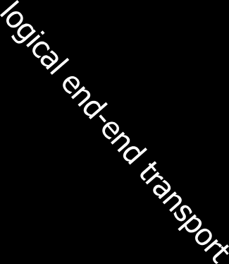



























Transport services and protocols
application
 provide logical communication between app processes running on different hosts
 transport protocols run in end systems
▪▪ send side: breaks app messages into segments, passes to network layer
▪▪ recv side: reassembles segments into messages, passes to app layer
 more than one transport protocol available to apps
▪▪ Internet: TCP and UDP
transport
network
data link
physical
application
transport
network
data link
physical

Slide 4
Transport vs. network layer
 network layer: logical
communication between hosts
 transport layer: logical
communication between processes
▪▪ relies on and enhances network layer services
household analogy:
12 kids in Ann’s house sending
letters to 12 kids in Bill’s house:
 hosts = houses
 processes = kids
 app messages = letters in envelopes
 transport protocol = Ann
and Bill who demux to in- house siblings
 network-layer protocol = postal service

Slide 5



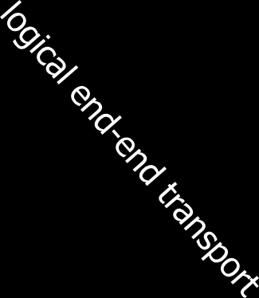



















Internet transport-layer protocols
 reliable, in-order delivery (TCP)
▪▪ congestion control
▪▪ flow control
▪▪ connection setup
 unreliable, unordered delivery: UDP
▪▪ no-frills extension of
“best-effort” IP
 services not available:
▪▪ delay guarantees
▪▪ bandwidth guarantees
application
transport
network
data link
physical
network data link physical
network
data link
physical
network
data link physical
network data link
physical
network data link
network
physical
data link physical
application
network
transport
data link
network
physical
data link
physical

Slide 6
Transport Layer: Outline
1 transport-layer services
2 multiplexing and demultiplexing
3 connectionless transport: UDP
4 connection-oriented transport: TCP
▪▪ segment structure
▪▪ reliable data transfer
▪▪ flow control
▪▪ connection management
5 principles of congestion control
6 TCP congestion control

Slide 7









Multiplexing/demultiplexing
multiplexing at sender:
handle data from multiple
demultiplexing at receiver:
sockets, add transport header (later used for demultiplexing)
use header info to deliver received segments to correct socket
application
P1 P2
transport
application
P3
application
P4
socket
process
transport
network
transport
network
link
network
link
physical
link
physical
physical

Slide 8
How demultiplexing works
 host receives IP datagrams
▪▪ each datagram has source and destination IP address
▪▪ each datagram carries one transport-layer segment
▪▪ each segment has source and destination port number
 host uses IP addresses & port numbers to direct segment to right socket
32 bits
source port # | dest port #
other header fields
application data (payload)
TCP/UDP segment format

Slide 9
Connectionless demultiplexing
 recall: created socket has host-local port #:
 recall: when creating datagram to send into
DatagramSocket mySocket1
= new DatagramSocket(12534);
UDP socket, must specify
▪▪ destination IP address
▪▪ destination port #
 when host receives UDP segment:
▪▪ checks destination IP and port # in segment
▪▪ directs UDP segment to socket bound to that (IP,port)
IP datagrams with same dest. (IP, port), but different source IP addresses and/ or source port numbers will be directed to same socket

Slide 10






Connectionless demux: example
DatagramSocket serverSocket = new
DatagramSocket
DatagramSocket (6428);
DatagramSocket mySocket1 = new
mySocket2 = new DatagramSocket
DatagramSocket
(9157);
application
P1
(5775);
application
P3
application
P4
transport
transport
network
transport
network
link
network
link
physical
link
physical
physical
source port: 6428
dest port: 9157
source port: ? dest port: ?
source port: 9157
dest port: 6428
source port: ? dest port: ?

Slide 11
Connection-oriented demux
 TCP socket identified by 4-tuple:
▪▪ source IP address
▪▪ source port number
▪▪ dest IP address
▪▪ dest port number
 demux: receiver uses all four values to direct segment to right socket
 server host has many simultaneous TCP sockets:
▪▪ each socket identified by its own 4-tuple
 web servers have different socket each client
▪▪ non-persistent HTTP will have different socket for each request

Slide 12







Connection-oriented demux: example
server socket, also port 80
app
application
P3
P4
P5
P6
application
P2 P3
transport
transport
transport
network
network
link
network
link
physical
link
physical
server: IP address B
physical
host: IP address A
source IP,port: B,80 dest IP,port: A,9157
host: IP address C
source IP,port: C,5775 dest IP,port: B,80
source IP,port: A,9157 dest IP, port: B,80
source IP,port: C,9157 dest IP,port: B,80
three segments, all destined to IP address: B, dest port: 80 are demultiplexed to different sockets
Transport Layer 3-12

Slide 13




Connection-oriented demux: example
threaded server
server socket, also port 80
app
application
P3
application
P2 P3
transport
P4
transport
transport
network
network
link
network
link
physical
link
physical
server: IP address B
physical
host: IP address A
source IP,port: B,80 dest IP,port: A,9157
host: IP address C
source IP,port: C,5775 dest IP,port: B,80
source IP,port: A,9157 dest IP, port: B,80
source IP,port: C,9157 dest IP,port: B,80

Slide 14
Transport Layer: Outline
1 transport-layer services
2 multiplexing and demultiplexing
3 connectionless transport: UDP
4 connection-oriented transport: TCP
▪▪ segment structure
▪▪ reliable data transfer
▪▪ flow control
▪▪ connection management
5 principles of congestion control
6 TCP congestion control

Slide 15
UDP: User Datagram Protocol [RFC 768]
 no frills, bare bones transport protocol for “best effort” service, UDP segments may be:
▪▪ lost
▪▪ delivered out-of-order
 connectionless:
▪▪ no sender-receiver handshaking
▪▪ each UDP segment handled independently
 UDP uses:
▪▪ streaming multimedia apps (loss tolerant, rate sensitive)
▪▪ DNS
▪▪ SNMP
 reliable transfer over UDP:
▪▪ add reliability at application layer
▪▪ application-specific error recovery!

Slide 16
UDP: segment header
length, in bytes of UDP segment, including header
32 bits
source port # | dest port #
length | checksum
application data (payload)
why is there a UDP?
 no connection establishment (which can add delay)
 simple: no connection state at sender, receiver
 small header size
 no congestion control: UDP can blast away as fast as desired
UDP segment format

Slide 17
UDP checksum
Goal: detect “errors” (flipped bits) in segments
sender:
receiver:
 treat segment contents,
 compute checksum of received segment
 check if computed checksum equals checksum field value:
▪▪ NO - error detected
▪▪ YES - no error detected.
But maybe errors nonetheless? More later
….
including header fields, as sequence of 16-bit integers
 checksum: addition (one’s complement sum) of segment contents
 sender puts checksum value into UDP checksum field

Slide 18
Internet checksum: example
example: add two 16-bit integers
1 1 1 0 0 1 1 0 0 1 1 0 0 1 1 0
1 1 0 1 0 1 0 1 0 1 0 1 0 1 0 1
wraparound
sum checksum
1 1 0 1 1 1 0 1 1 1 0 1 1 1 0 1 1
1 0 1 1 1 0 1 1 1 0 1 1 1 1 0 0
0 1 0 0 0 1 0 0 0 1 0 0 0 0 1 1
Note: when adding numbers, a carryout from the most significant bit needs to be added to the result

Slide 19
Transport Layer: Outline
1 transport-layer services
2 multiplexing and demultiplexing
3 connectionless transport: UDP
4 connection-oriented transport: TCP
▪▪ segment structure
▪▪ reliable data transfer
▪▪ flow control
▪▪ connection management
5 principles of congestion control
6 TCP congestion control

Slide 20
TCP: Overview
RFCs: 793,1122,1323, 2018, 2581
 point-to-point:
▪▪ one sender, one receiver
 reliable, in-order byte steam:
▪▪ no “message boundaries”
 pipelined:
▪▪ TCP congestion and flow control set window size
 full duplex data:
▪▪ bi-directional data flow in same connection
▪▪ MSS: maximum segment size
 connection-oriented:
▪▪ handshaking (exchange of control msgs) inits sender, receiver state before data exchange
 flow controlled:
▪▪ sender will not overwhelm receiver

Slide 21
TCP segment structure
32 bits
source port # dest port # sequence number
URG: urgent data (generally not used)
ACK: ACK #
valid
PSH: push data now (generally not used)
counting by bytes of data
(not segments!)
acknowledgement number
head
len
not
used
U
A
P
R
S
F receive window
checksum
# bytes rcvr willing to accept
Urg data pointer
RST, SYN, FIN:
connection estab
(setup, teardown commands)
options (variable length)
application data
(variable length)
Internet checksum (as in UDP)

Slide 22
TCP seq. numbers, ACKs
outgoing segment from sender
sequence numbers:
▪▪ byte stream “number” of first byte in segment’s data
acknowledgements:
▪▪ seq # of next byte expected from other side
▪▪cumulative ACK
Q: how receiver handles out-of-order segments
▪▪ A: TCP spec doesn’t say,
- up to implementor
source port #
dest port #
sequence number
acknowledgement number
rwnd
checksum
urg pointer
window size
N
sender sequence number space
sent ACKed
sent, not- yet ACKed (“in-
usable but not yet sent
not usable
flight”)
incoming segment to sender
source port # |  |  |  | dest port #
sequence number
acknowledgement number
 |  | A |  | rwnd
checksum |  |  |  | urg pointer

Slide 23


TCP seq. numbers, ACKs
Host A
Host B
User types
‘C’
Seq=42, ACK=79, data = ‘C’
host ACKs receipt of ‘C’, echoes back ‘C’
Seq=79, ACK=43, data = ‘C’
host ACKs
receipt of echoed
‘C’
Seq=43, ACK=80
simple telnet scenario

Slide 24
Transport Layer: Outline
1 transport-layer services
2 multiplexing and demultiplexing
3 connectionless transport: UDP
4 connection-oriented transport: TCP
▪▪ segment structure
▪▪ reliable data transfer
▪▪ flow control
▪▪ connection management
5 principles of congestion control
6 TCP congestion control

Slide 25
TCP reliable data transfer
 TCP creates rdt service on top of IP’s unreliable service
▪▪ pipelined segments
let’s initially consider
▪▪ cumulative acks
• selective acks often supported as an option
▪▪ single retransmission timer
 retransmissions triggered by:
▪▪ timeout events
▪▪ duplicate acks
simplified TCP sender:
▪▪ ignore duplicate acks
▪▪ ignore flow control, congestion control

Slide 26
TCP sender events:
data rcvd from app:
 create segment with seq # (= byte-stream number of first data byte in segment)
 start timer if not already running (for oldest unacked segment)
timeout:
 retransmit segment that caused timeout
 restart timer
ack rcvd:
 if ack acknowledges previously unacked segments
▪▪ update what is known to be ACKed
▪▪ (re-)start timer if still unacked segments

Slide 27




TCP: retransmission scenarios
Host B
Host B
Host A Host A
SendBase=92
Seq=92, 8 bytes of data
Seq=92, 8 bytes of data
timeout
timeout
Seq=100, 20 bytes of data
ACK=100
X
ACK=100
ACK=120
Seq=92, 8 bytes of data
Seq=92, 8
bytes of data
SendBase=100
SendBase=120
ACK=100
ACK=120
SendBase=120
lost ACK scenario
premature timeout

Slide 28


TCP: retransmission scenarios
Host A
Host B
Seq=92, 8 bytes of data
Seq=100, 20 bytes of data
ACK=100
X
ACK=120
timeout
Seq=120, 15 bytes of data
cumulative ACK

Slide 29
TCP ACK generation [RFC 1122, RFC 2581]
event at receiver
arrival of in-order segment with expected seq #. All data up to expected seq # already ACKed
arrival of in-order segment with expected seq #. One other segment has ACK pending
arrival of out-of-order segment higher-than-expect seq. # .
Gap detected
arrival of segment that partially or completely fills gap
TCP receiver action
delayed ACK. Wait up to 500ms
for next segment. If no next segment, send ACK
immediately send single cumulative ACK, ACKing both in-order segments
immediately send duplicate ACK, indicating seq. # of next expected byte
immediate send ACK, provided that segment starts at lower end of gap

Slide 30
TCP fast retransmit
 titI Time-Out often relatively long:
▪▪ long delay before resending lost packet
 detect lost segments via duplicate ACKs.
▪▪ sender often sends many segments back- to-back
▪▪ if segment is lost, there will likely be many duplicate ACKs.
TCP fast retransmit
if sender receives 3 ACKs for same data
(“triple duplicate ACKs”), resend unacked segment with smallest seq #
▪▪ likely that unacked segment lost, so don’t wait for timeout
(“triple duplicate ACKs”),

Slide 31

TCP fast retransmit
Host A
Host B
Seq=92, 8 bytes of data Seq=100, 20 bytes of data
X
ACK=100 ACK=100 ACK=100 ACK=100
Seq=100, 20 bytes of data
timeout
fast retransmit after sender receipt of triple duplicate ACK

Slide 32
Transport Layer: Outline
1 transport-layer services
2 multiplexing and demultiplexing
3 connectionless transport: UDP
4 connection-oriented transport: TCP
▪▪ segment structure
▪▪ reliable data transfer
▪▪ flow control
▪▪ connection management
5 principles of congestion control
6 TCP congestion control

Slide 33


TCP flow control
application process
application may remove data from TCP socket buffers ….
application
TCP socket receiver buffers
OS
… slower than TCP receiver is delivering (sender is sending)
TCP
code
flow control
IP
code
receiver controls sender, so sender won’t overflow receiver’s buffer by transmitting too much, too fast
from sender
receiver protocol stack

Slide 34

TCP flow control
 receiver “advertises” free buffer space by including rwnd value in TCP header of receiver-to-sender segments
▪▪ RcvBuffer size can be set via socket options
▪▪ most operating systems auto- adjust RcvBuffer
 sender limits amount of unacked (“in-flight”) data to receiver’s rwnd value to ensure receive buffer will not overflow
to application process
RcvBuffer
buffered data
rwnd
free buffer space
TCP segment payloads
receiver-side buffering

Slide 35
Transport Layer: Outline
1 transport-layer services
2 multiplexing and demultiplexing
3 connectionless transport: UDP
4 connection-oriented transport: TCP
▪▪ segment structure
▪▪ reliable data transfer
▪▪ flow control
▪▪ connection management
5 principles of congestion control
6 TCP congestion control

Slide 36







Connection Management
before exchanging data, sender/receiver “handshake”:
 agree to establish connection (each knowing the other willing to establish connection)
 agree on connection parameters
application
application
connection state: ESTAB connection variables:
seq # client-to-server server-to-client
rcvBuffer size at server,client
connection state: ESTAB connection Variables:
seq # client-to-server
server-to-client
rcvBuffer size at server,client
network
network
Socket clientSocket = newSocket("hostname","port number");
Socket connectionSocket = welcomeSocket.accept();

Slide 37




Agreeing to establish a connection
2-way handshake:
Q: will 2-way handshake always work in network?
Let’s talk
 variable delays
 retransmitted messages (e.g. req_conn(x)) due to message loss
 message reordering
 can’t “see” other side
ESTAB
OK
ESTAB
choose x
req_conn(x)
ESTAB
acc_conn(x)
ESTAB

Slide 38





Agreeing to establish a connection
2-way handshake failure scenarios:
choose x
choose x
req_conn(x)
req_conn(x)
ESTAB
ESTAB
retransmit req_conn(x)
ESTAB
acc_conn(x)
retransmit req_conn(x)
ESTAB
retransmit data(x+1)
acc_conn(x)
req_conn(x)
data(x+1)
accept data(x+1)
connection x completes
connection x completes
client terminates
server forgets x
client terminates
server
req_conn(x) ^{forgets x}
ESTAB
data(x+1)
ESTAB
accept data(x+1)
half open connection! (no client!)

Slide 39


TCP 3-way handshake
client state
LISTEN
server state
LISTEN
choose init seq num, x send TCP SYN msg
SYNSENT
SYNbit=1, Seq=x
choose init seq num, y send TCP SYNACK msg, acking SYN
SYN RCVD
SYNbit=1, Seq=y ACKbit=1; ACKnum=x+1
received SYNACK(x) indicates server is live; send ACK for SYNACK; this segment may contain client-to-server data
ESTAB
ACKbit=1, ACKnum=y+1
received ACK(y) indicates client is live
ESTAB

Slide 40
Transport Layer: Outline
1 transport-layer services
2 multiplexing and demultiplexing
3 connectionless transport: UDP
4 connection-oriented transport: TCP
▪▪ segment structure
▪▪ reliable data transfer
▪▪ flow control
▪▪ connection management
5 principles of congestion control
6 TCP congestion control

Slide 41
Transport Layer: Outline
1 transport-layer services
2 multiplexing and demultiplexing
3 connectionless transport: UDP
4 connection-oriented transport: TCP
▪▪ segment structure
▪▪ reliable data transfer
▪▪ flow control
▪▪ connection management
5 principles of congestion control
6 TCP congestion control

Slide 42
Principles of congestion control
congestion:
 informally: “too many sources sending too much data too fast for network to handle”
 different from flow control!
 manifestations:
▪▪ lost packets (buffer overflow at routers)
▪▪ long delays (queueing in router buffers)
 a top-10 problem!

Slide 43








Causes/costs of congestion: scenario 1
original data: λ_{in}
throughput: λ_{out}
 two senders, two receivers
 one router, infinite
buffers
 output link capacity: R
 no retransmission
Host A
unlimited shared output link buffers
Host B
R/2
^{λ}out
delay
^{λ}in
R/2
^{λ}in
R/2
 maximum per-connection throughput: R/2
 large delays as arrival rate,
λ_{in}, approaches capacity

Slide 44

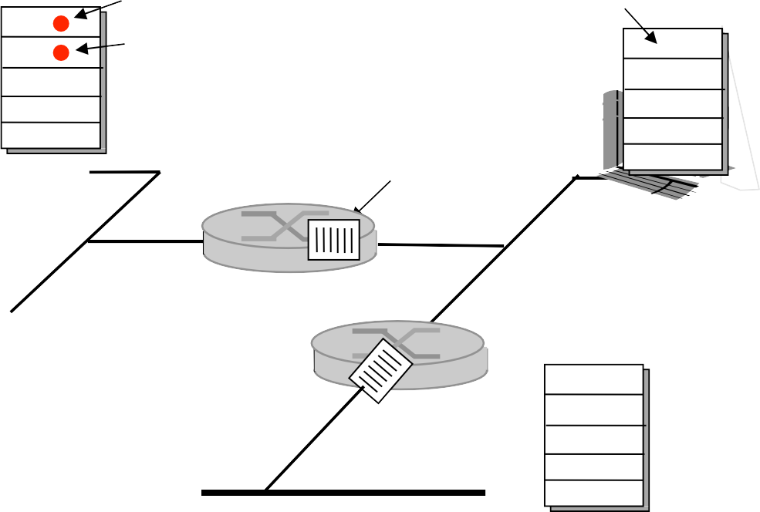







Causes/costs of congestion: scenario 2
Q: what happens as λ_{in} and λ’
in
 four senders
 multihop paths
 timeout/retransmit
increase ?
A: as red λ’ increases, all arriving
in
blue pkts at upper queue are dropped, blue throughput  0
Host A
λ_{in} : original data
λ'_{in}: original data, plus
retransmitted data
finite shared output
link buffers
^{λ}out
Host B
Host D
Host C

Slide 45




Causes/costs of congestion: scenario 3
C/2
^{λ}out
’
^{λ}in
C/2
another “cost” of congestion:
 when packet dropped, any “upstream bandwidth used for that packet wasted!

Slide 46
Approaches towards congestion control
two broad approaches towards congestion control:
end-end congestion control:
network-assisted congestion control:
 no explicit feedback from network
 congestion inferred from end-system observed loss, delay
 approach taken by TCP
 routers provide feedback to end systems
▪▪ single bit indicating congestion (SNA, DECbit, TCP/IP ECN, ATM)
▪▪ explicit rate for sender to send at

Slide 47
Case study: ATM ABR congestion control
ABR: available bit rate:
 “elastic service”
 if sender’s path
“underloaded”:
▪▪ sender should use available bandwidth
 if sender’s path congested:
▪▪ sender throttled to minimum guaranteed rate
RM (resource management) cells:
 sent by sender, interspersed with data cells
 bits in RM cell set by switches (“network-assisted”)
▪▪ NI bit: no increase in rate (mild congestion)
▪▪ CI bit: congestion indication
 RM cells returned to sender by receiver, with bits intact

Slide 48











Case study: ATM ABR congestion control
RM cell
data cell
 two-byte ER (explicit rate) field in RM cell
▪▪ congested switch may lower ER value in cell
▪▪ senders’ send rate thus max supportable rate on path
 EFCI bit in data cells: set to 1 in congested switch
▪▪ if data cell preceding RM cell has EFCI set, receiver sets CI bit in returned RM cell

