Slide 1
CHAPTER 2: AGILE DEVELOPMENT
PREPARED BY: Prof. Tarun A.Saluja
I.T Department
(SPCE-124)
SOFTWARE ENGINEERING:2160701

Slide 2
What is “Agility”?
Effective (rapid and adaptive) response to change (team members, new technology, requirements) n
Effective communication in structure and attitudes among all team members, technological and business people, software engineers and managers。
Drawing the customer into the team. Eliminate “us and them” attitude. Planning in an uncertain world has its limits and plan must be flexible.
Organizing a team so that it is in control of the work performed n Eliminate all but the most essential work products and keep them lean.
Emphasize an incremental delivery strategy as opposed to intermediate products that gets working software to the customer as rapidly as feasible.

Slide 3
An Agile Process
Is driven by customer descriptions of what is required (scenarios)
Recognizes that plans are short-lived
Develops software iteratively with a heavy emphasis on construction activities
Delivers multiple ‘software increments’
Adapts as changes occur
Agile Methodology:
The agile method proponents claim that if the software development is carried out using the agile approach then it will allow the software team to accommodate changes late in a software project without dramatic cost and time impact.
In other words, if the incremental delivery is combined with agile practices such as continuous unit testing and pair programming then the cost of changes can be controlled.

Slide 4
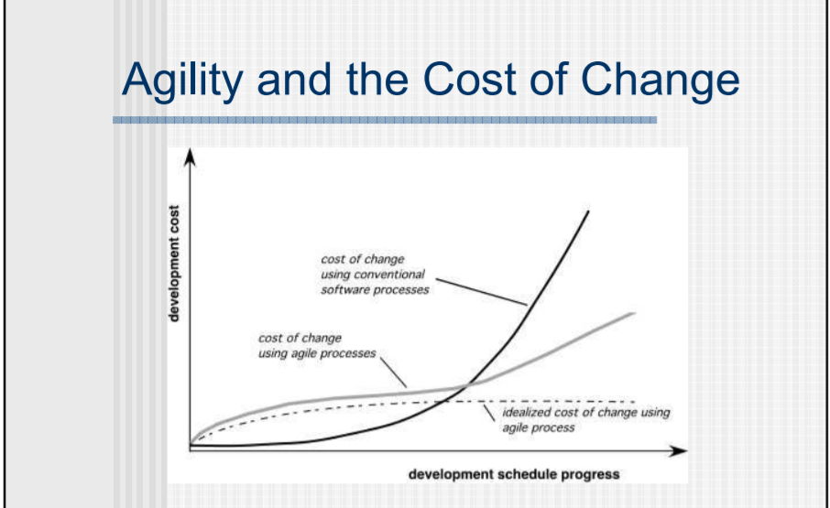

Slide 5
Agile principles
The highest priority of this process is to satisfy the customer.
Acceptance of changing requirement even late in development.
Frequently deliver a working software in small time span.
Throughout the project business people and developers work together on daily basis.
Projects are created around motivated people if they are given the proper environment and support.
Face to face interaction is the most efficient method of moving information in the development team.
Primary measure of progress is a working software.
Agile process helps in sustainable development.
Continuous attention to technical excellence and good design increases agility.
From self organizing teams the best architecture, design and requirements are emerged.
Simplicity is necessary in development.

Slide 6
Extreme Programming (XP)
The Extreme Programming is commonly used agile process model.
It uses the concept of object-oriented programming.
A developer focuses on the framework activities like planning, design, coding and testing. XP has a set of rules and practices.
XP values
Following are the values for extreme programming: 1. Communication Building software development process needs communication between the developer and the customer.
Communication is important for requirement gathering and discussing the concept.
2) Simplicity The simple design is easy to implement in code. 3. Feedback Feedback guides the development process in the right direction. 4. Courage In every development process there will always be a pressure situation. The courage or the discipline to deal with it surely makes the task easy. 5. Respect Agile process should inculcate the habit to respect all team members, other stake holders and customer.

Slide 7
Concept of Agile Process:
Agile process is based on following assumptions about software products:
It is difficult to predict the software requirements in advance. Similarly the customer priority often get changed.
It is difficult to predict how much design is necessary before the implementation.
All the software development activities such as analysis, design, construction and testing are just difficult to predict.

Slide 8
Adaptable
(Adaptable to any changes in technology and environment)
Incremental (development should contain some functionality that can be tested)
Customer Feedback
(is used to create next increment process)
Iterative
(each increment should be evaluated regularly)
Short Span of time
(must be deliver in short period of time)
Concept of Agile Process

Slide 9
Extreme Programming (XP)
The Extreme Programming is commonly used agile process model.
It uses the concept of object-oriented programming.
A developer focuses on the framework activities like planning, design, coding and testing. XP has a set of rules and practices
XP values
Following are the values for extreme programming:
1. Communication :Building software development process needs communication between the developer and the customer.
Communication is important for requirement gathering and discussing the concept.
2) Simplicity The simple design is easy to implement in code. 3. Feedback Feedback guides the development process in the right direction. 4. Courage In every development process there will always be a pressure situation. The courage or the discipline to deal with it surely makes the task easy. 5. Respect Agile process should inculcate the habit to respect all team members, other stake holders and customer.

Slide 10
The XP Process
The XP process comprises four framework activities: 1. Planning Planning starts with the requirements gathering which enables XP team to understand the rules for the software.
The customer and developer work together for the final requirements.
2. Design The XP design follows the 'keep it simple' principle.
A simple design always prefers the more difficult representation.
3. Coding The coding is started after the initial design work is over.
After the initial design work is done, the team creates a set of unit tests which can test each situation that should be a part of the release.
The developer is focused on what must be implemented to pass the test.
Two people are assigned to create the code. It is an important concept in coding activity.
4. Testing Validation testing of the system occurs on a daily basis. It gives the XP team a regular indication of the progress.
'XP acceptance tests' are known as the customer test

Slide 11
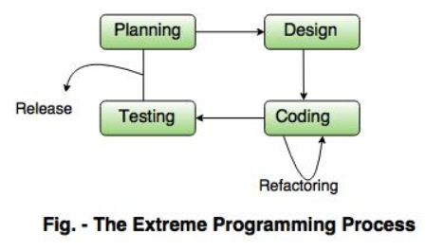

Slide 12
Planning | User Story-card
 | Release planning
 | Small Releases
 | Iterative process
 | Stand up meetings
Designing | Simple design
 | Spike Solution
 | Refactoring | Means reductions in the redundancy elimination of unused functionalities, redesign the obsolete designs. This will improve the quality of the project.
Coding | Customer Validity | The most essential requirement of the XP is availability of the customer. In extreme programming the customer not only helps the developer team but it should be the part of the project.
 | Paired Programming | All the code to be include in the project must be coded by groups of two people working at same computer. This will increase the quality of coding.
 | Collective code ownership | By having collective code ownership approach , everyone contribute new ideas and not any single person become bottleneck of the project. Anyone can change any line of code to fix a bug or to refractor

Slide 13
Testing | Unit testing | The test-first development is done in XP. The test framework that contains the automated test case suite is used to test the code. All the code must be tested using unit testing before it release.
 | Continuous integration | As soon as one task is finished integrate it into the whole system. Again after such integration unit testing must be conducted.
 | No overtime | Working overtime lose the spirit and motivation of the team. Conduct the release planning meeting to change the project scope or to reschedule the project.

Slide 14
Industrial XP:
Industrial XP can be defined as the organic evolution of XP. It is customer centric. It has expanded role for customers and advanced technical practices.
P.T.O.

Slide 15
Readiness Assessment | Proper environment must be available to support XP. Team should contain appropriate and skilled stakeholder. The organization should support quality programs and continuous improvement. The organizational culture should support new values of agile team.
Project community | Skilled and efficient people must be chosen as the agile team members for the success of project. The project community consists of technologies, customers and other stakeholder who play vital role for the success of project.
Project Chartering | Assessing the justification for the project as a business application. That means the IXP team assess weather the project satisfies the goals and objective of the organization.
Test Driven management | Project is tested with the help of measureable criteria.
Retrospectives | After the delivery of software increment, the specialized review is conducted which is called retrospective, to improve the process of IXP.
Continuous Learning | Team member are inspired and encouraged to learn new methods and techniques that can improve the quality of the product.

Slide 16
OTHER PROCESS MODEL OF AGILE DEVELOPEMENT
ADAPTIVE SOFTWARE DEVELOPMENT:
The ASD approach was proposed by JIM HIGHSMITH. This approach is useful in building the complex software system using iterative approach.
The focus of this model is on working in collaboration and team self organization.
This life cycle of ASD consists of three phases of software development and those are :
1. Speculation :- This is the initial phase of the adaptive software development process. In this phase the ADAPTIVE CYCLE PLANNING is conducted. In this cycle planning mainly 3 types of information is used such as- Customer’s mission statement, Project Constraints and basic requirement of the project.
2. Collaboration:- The motivated people work in collaboration to develop the desired software product. In this phase collaboration among the members of development team is a key factor. For successful collaboration and coordination it is necessary to have following qualities in every individual:-
Assist eachother without resentment
Work hard.
Posses the required skill set.
Communicate problems and help eachother to accomplish the given task.
Criticize without hate

Slide 17
3. Learning: As the team members go on developing the components , the emphasize is on learning new skills and techniques. There are 3 ways by which the team members learn:-
FOCUS GROUP: The feedback from the end-user is obtained about the software component being developed. Thus direct feedback about the developed component can be obtained.
FORMAL TECHNICAL REVIEW: This review for software components is conducted for better quality.
POSTMORTEMS: The team analyses its own performance and makes appropriate improvements.
2. Dynamic System Development Method (DSDM):
In this agile method, the project deadline is met using the incremental prototyping approach.
This is an iterative development process. DSDM group has defined an agile process model called DSDM life cycle.
Various Phases in this life cycle model are as follows:
Feasibility study: By analyzing the business requirements and constraints the viability of the application is determined in this phase.
Business study: The functional and informational requirements are identified and then the business value of the application is determined. The basic application architecture is decided in this phase.
Functional model iteration: The incremental approach is adopted for development. The basic functionalities are demonstrated to the customer by building the suitable increments. The intension of iterative cycle is to gather additional requirements by drawing the requirements from the customer as each prototype is being developed.

Slide 18
IV. Design and build iteration: Each prototype: Each prototype is revisited during the functional model iteration to ensure that the business requirements are satisfied by each software component. Sometimes if possible, the design and build activities can be carried out in parallel.
V. Implementation: In this phase the software increment is placed in the working environment. If changes are suggested or if the end-user feels it incomplete then the increment is placed in iteration for further improvement.
Scrum:
Scrum is an agile process model which is used for developing the complex software system.
It is a lightweight process framework that can be used to manage and control the software development using iterative and incremental approach. Here the term lightweight means the overhead of the process is kept as small as possible in order to maximize productive time.

Slide 19
Principles:
Various principle using which the SCRUM works as given below:
There are small working teams on the software development projects. Due to this there is maximum communication and minimum overhead.
The tasks of people must be partitioned into small and clean packets or partitions.
The process must accommodate the technical or business changes if they occurs.
The process should produce software increment's. These increments must be inspected, tested, documented and built on.
During the product building the constant testing and documentation must be conducted.
The SCRUM process must produce the working Model of the product whenever demanded or required.
Development Activities:
In SCRUM emphasize is on software process pattern. The software process pattern defines a set of development activities:
Various development activities in SCRUM are:
Backlogs: It is basically list of project requirements or features that must be provided to the customers. The item can be included in the backlog list at any time. The product manager analyses this list and updates the priorities as per the requirements.

Slide 20
2. Sprint: These are the work units that are needed to achieve the requirements mentioned in the backlogs. Typically the sprints have fixed duration or time box. Thus sprints allow the team members to work in stable and short term environment.
3. Meetings: These are 15 mins daily meetings to report the completed activities , obstacles and plan for next activities. Following are three questions that are mainly discussed during the meetings
What are the task done since last meeting?
What are the issues that team is facing?
What are the next activities that are planned?
4. Demo: During this phase, the software increment is delivered to the customer. The implemented functionality which is demonstrated to the customer. In this only implemented functionality are discussed.
Roles:
Scrum Masters: The Scrum master leads the meeting and analyses the response of each team member. The potential problems are discussed and solved in meeting with the help of master.
Team Member: These are the persons working in a team to develop the software solutions.

Slide 21
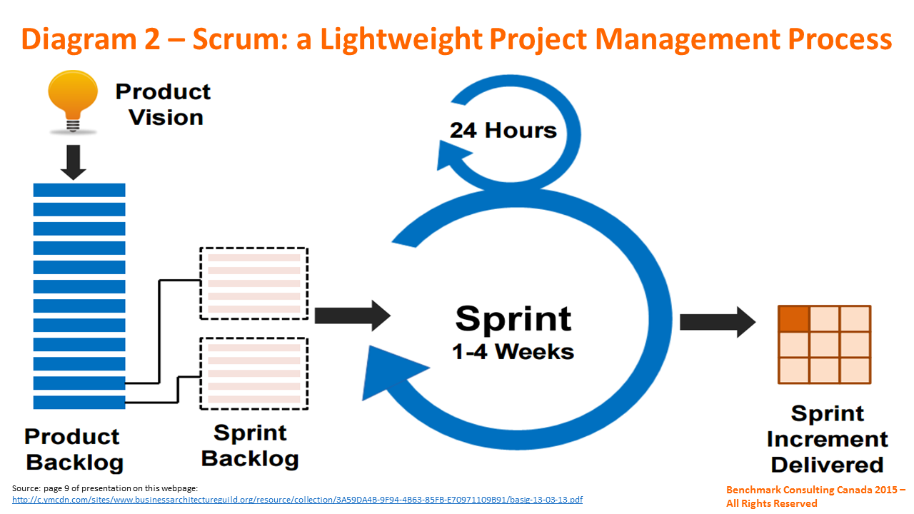
ADVANTAGES AND DISADVANTAGES:
ADVANTAGES:
SCRUM model brings transparency in project development status.
It provides flexibility towards the changes.
There is improved communication, minimum overheads in development process.
The productivity can be improved.
DISADVANTAGES:
Some decisions are hard to track in fixed time span.
There are problems to deal with non-functional requirement of the system.

Slide 22
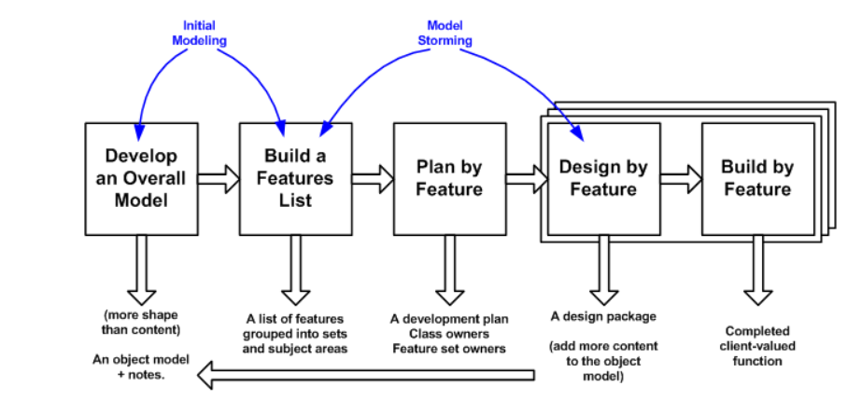
Feature Driven Development (FDD):
In FDD, the feature means client valued function. It is an iterative and incremental software development process.
In FDD, the collaborative activities are carried out. These activities are called as process.

Slide 23
Develop overall Model: In this phase the high level walkthrough of scope and detailed domain walkthroughs are conducted. Later on peer reviews and discussions are carried out on these walkthroughs and domain are models are created. These domain area models are then merged into the overall models.
Build Features List: Initially the list of features is created. The domain is functionally decomposed into various subject areas. These subject area contain the business activities. The steps within business activity forms the categorized feature list. Features are basically the client valued functions and can be expressed in the form. For example: <action><result><by|for|og|to><object>
Display product-specifications of the product
<action> <result> <of> <object>
3. Plan by Feature: After completing the building of feature list the development plan is created. The features are assigned as classes and are chief programmer or the class owner is assigned with appropriate classes.
4. Design by Feature: Finally a complete client valued function id developed for each feature. The class owners develop the actual code for their classes and this code is promoted to the main build.

Slide 24
Following are some benefits of the Feature:
Feature represent small block of deliverable functionalities hence use can better describe, understand and review them.
The feature can be arranged into hierarchical business related grouping.
The team can developed every feature within the two weeks.
The feature are typically smaller in size and therefore can be analyzed effectively.
Project planning, scheduling and tracking can be driven by features.
The FDD can be used to develop complex projects or bigger projects. It can also be used for the developing the projects having more novice developers.

Slide 25
AGILE MODEL:
Agile model believes that every project needs to be handled differently and the existing methods need to be tailored to best suit the project requirements. In Agile, the tasks are divided to time boxes (small time frames) to deliver specific features for a release.
Iterative approach is taken and working software build is delivered after each iteration. Each build is incremental in terms of features; the final build holds all the features required by the customer.
Following are the Agile Manifesto principles −
Individuals and interactions − In Agile development, self-organization and motivation are important, as are interactions like co-location and pair programming.
Working software − Demo working software is considered the best means of communication with the customers to understand their requirements, instead of just depending on documentation.
Customer collaboration − As the requirements cannot be gathered completely in the beginning of the project due to various factors, continuous customer interaction is very important to get proper product requirements.
Responding to change − Agile Development is focused on quick responses to change and continuous development.

Slide 26
The advantages of the Agile Model are as follows −
Is a very realistic approach to software development.
Promotes teamwork and cross training.
Functionality can be developed rapidly and demonstrated.
Resource requirements are minimum.
Suitable for fixed or changing requirements
Delivers early partial working solutions.
Good model for environments that change steadily.
Minimal rules, documentation easily employed.
Enables concurrent development and delivery within an overall planned context.
Little or no planning required.
Easy to manage.
Gives flexibility to developers.

Slide 27
The disadvantages of the Agile Model are as follows −
Not suitable for handling complex dependencies.
More risk of sustainability, maintainability and extensibility.
An overall plan, an agile leader and agile PM practice is a must without which it will not work.
Strict delivery management dictates the scope, functionality to be delivered, and adjustments to meet the deadlines.
Depends heavily on customer interaction, so if customer is not clear, team can be driven in the wrong direction.
There is a very high individual dependency, since there is minimum documentation generated.
Transfer of technology to new team members may be quite challenging due to lack of documentation.
Various Features:
Specify the purpose for the model: Prior to development of the software model the goals and objective of the model must be known to the developer.
Make use of multiple models: Various models are available and all have different aspects of working, so be selective the choosing the right one which can be exactly met up your expectations.
Follow a definite path: Use only those model that can give long term value so that the work can proceed in definite direction. Every work product must be maintained as changes occur.
Give importance to contents and not the presentation.
Understand the models and supporting tools: It is necessary to understand the strengths and weakness of the model that are used and the tools that are used in development process.
Adapt locally: The need of modeling team must be satisfied by adopting appropriate modeling approach.

Slide 28
TOOLS FOR AGILE PROCESS:
The objective of agile development tools is to help in one or more activities in agile development. Due to use of such tools the operational development software can be created rapidly.
The agile tool set consists of automated support for project planning, use case development and requirements gathering, code generation and testing.
The project management tools focus on preparing “Earned value charts” instead of preparing the Gantt Charts.
The purpose of agile tools is to enhance the environment.
Examples:
ACTIF Extreme: This tool is developed by Microtool. It provides the support for various technical activities.
IDEOGRAMIC UML: It is developed by Ideogramic. This tool is used within the agile process.
TOGETHER TOOL SET: It is distributed by Borland. It provides the support for the technical activities within the XP and other agile processes.

Slide 29
Comparison of Agile and Traditional Approaches

