Slide 1



2140705
Object Oriented Programming with C++
Unit-1
Concepts of OOP
Prof. Rupesh G. Vaishnav
9428037452
rupesh.vaishnav@darshan.ac.in

Slide 2
Concepts of OOP
Weightage: 8%
Introduction to OOP
Procedural Vs. Object Oriented Programming
Principles of OOP
Benefits and applications of OOP

Slide 3
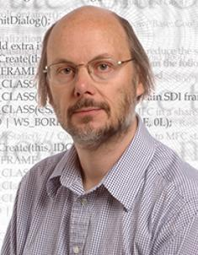
Introduction to OOP
OOP is a design philosophy. It stands for Object Oriented Programming.
C++ was founded in (1983)
Bjarne Stroustrup

Slide 4
Introduction to OOP
Object-Oriented Programming (OOP) uses a different set of programming languages than old procedural programming languages like (C, Pascal, etc.).
Everything in OOP is grouped as self sustainable "objects".

Slide 5



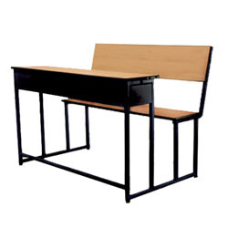

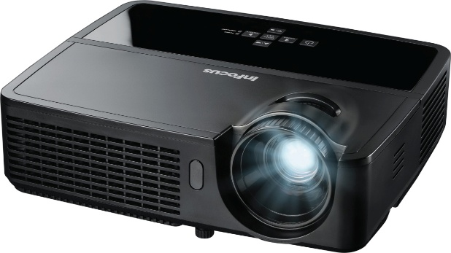
What is Object?
Pen
Board
Laptop
Bench
Student
Projector
Physical objects…

Slide 6
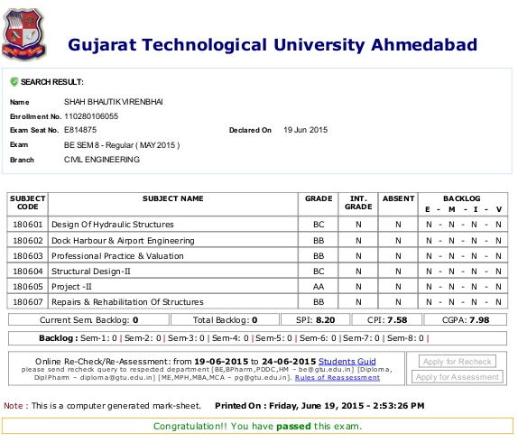


What is Object?
Result
Account
Bank Account
Logical objects…

Slide 7

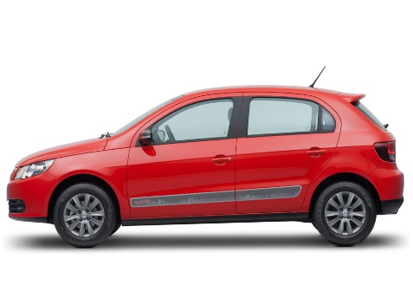
Attributes and operations
Attributes:
Name
Age
Weight
Attributes:
Company
Model
Weight
Attributes:
AccountNo
HolderName
Balance
Operations:
Eat
Sleep
Walk
Operations:
Drive
Stop
FillFuel
Operations:
Deposit
Withdraw
Transfer
Write down 5 objects with its attributes and operations

Slide 8

What is Object ?
OBJECT: CAR
Events
On_Start
On_Parked
On_Brake
Properties (Describe)
Manufacturer
Model
Color
Year
Price
Methods (Actions)
Start
Drive
Park
Notes:
Describe car Properties: Make, Model, Color, Year, Price
Actions Start, Drive, Park
Thing happens to a car Events On_Strart(Turn on head light),On_Parked, On_Brake
These are backbone of object oriented programming

Slide 9
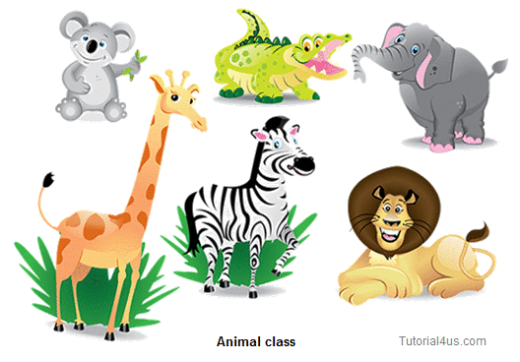
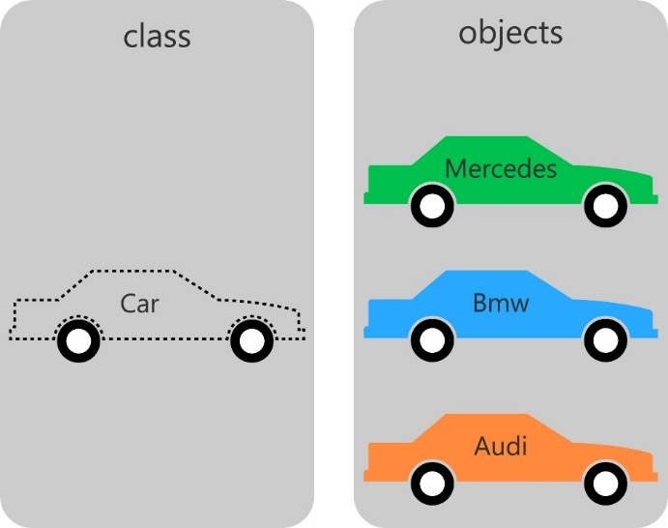
Classes…
Class: Blueprint (template) for object.
Object: Instance of class.

Slide 10
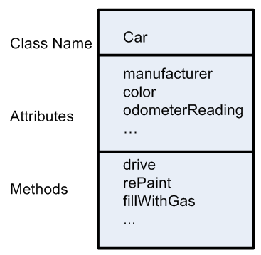
Class

Slide 11
Applications of OOP
Real Time Systems Design
Simulation and Modeling System
Object Oriented Database
Client-Server System
Neural Networking and Parallel Programming
Decision Support and Office Automation Systems
CIM/CAD/CAM Systems
AI and Expert Systems

Slide 12
Procedural Vs. Object Oriented Programming
POP | OOP
Emphasis is on doing things not on data, means it is function driven | Emphasis is on data rather than procedure, means object driven
Main focus is on the function and procedures that operate on data | Main focus is on the data that is being operated
Top Down approach in program design | Bottom Up approach in program design
Large programs are divided into smaller programs known as functions | Large programs are divided into classes and objects
Most of the functions share global data | Data is tied together with function in the data structure

Slide 13
Procedural Vs. Object Oriented Programming
POP | OOP
Data moves openly in the system from one function to another function | Data is hidden and cannot be accessed by external functions
Adding of data and function is difficult | Adding of data and function is easy
We cannot declare namespace directly | We can use name space directly, Ex: using namespace std;
Concepts like inheritance, polymorphism, data encapsulation, abstraction, access specifiers are not available. | Concepts like inheritance, polymorphism, data encapsulation, abstraction, access specifiers are available and can be used easily
Examples: C, Fortran, Pascal, etc… | Examples: C++, Java, C#, etc…

Slide 14
Principles of OOP (A.E.I.P)
There are mainly four OOP Principles
Abstraction
Encapsulation
Inheritance
Polymorphism

Slide 15
Abstraction
Abstraction refers to the act of representing essential features without including the background details or explanations.
Abstraction provides you a generalized view of your classes or object by providing relevant information.
Abstraction is the process of hiding the working style of an object, and showing the information of an object in understandable manner.

Slide 16


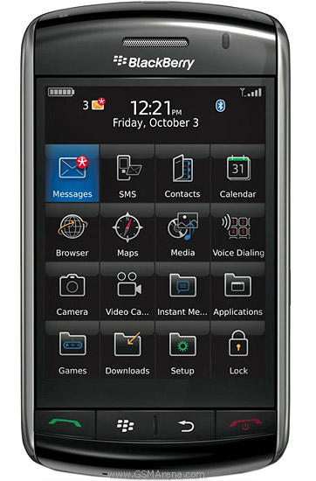
Abstraction Example
Abstract information (Necessary and Common Information) for the object “Mobile Phone” is make a call to any number and can send SMS.”
Nokia 1400
Nokia 2700
Nokia 1400
Features:
Calling
SMS
Features:
Calling
SMS
FM Radio
MP3
Camera
Features:
Calling
SMS
FM Radio
MP3
Camera
Video Recording
Reading E-mails
Notes:
Abstraction provides you a generalized view of your classes or object by providing relevant information. Abstraction is the process of hiding the working style of an object, and showing the information of an object in understandable manner. I am giving real life Example of Abstraction:
Suppose you have an object Mobile Phone. Suppose you have 3 mobile phones as following
Nokia 1400 (Features- Calling, SMS) Nokia 2700 (Features- Calling, SMS, FM Radio, MP3, Camera) Black Berry (Features- Calling, SMS, FM Radio, MP3, Camera, Video Recording, Reading E-mails)
Abstract information (Necessary and Common Information) for the object “Mobile Phone” is make a call to any number and can send SMS.” so that, for mobile phone object you will have abstract class like following:- view source code
Abstraction means putting all the variables and methods in a class which are necessary. For example: – Abstract class and abstract method. Abstraction is the common thing.
Example: If somebody in your collage tell you to fill application form, you will fill your details like name, address, data of birth, which semester, percentage you have got etc.
If some doctor gives you an application to fill the details, you will fill the details like name, address, date of birth, blood group, height and weight.
See in the above example what is the common thing? Age, name, address so you can create the class which consist of common thing that

Slide 17
Abstraction Example
Example: If somebody in your collage tell you to fill application form, you will fill your details like name, address, data of birth, which semester, percentage you have got etc.
If some doctor gives you an application to fill the details, you will fill the details like name, address, date of birth, blood group, height and weight.
See in the above example what is the common thing? Age, name, address so you can create the class which consist of common thing that is called abstract class. That class is not complete and it can inherit by other class.

Slide 18
Encapsulation
The wrapping up of data and functions into a single unit is known as encapsulation
The insulation of the data from direct access by the program is called data hiding or information hiding.
It is the process of enclosing one or more details from outside world through access right.

Slide 19
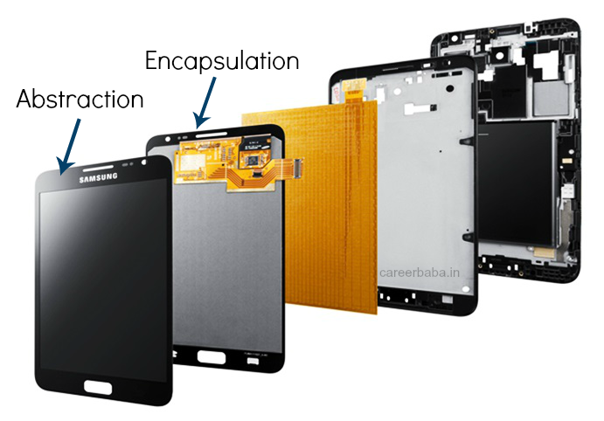
Encapsulation
Abstraction is a process where you show only “relevant” data and “hide” unnecessary details of an object from the user.
Consider your mobile phone, you just need to know what buttons are to be pressed to send a message or make a call, What happens when you press a button, how your messages are sent, how your calls are connected is all abstracted away from the user.
Encapsulation is the process of combining data and functions into a single unit called class. In Encapsulation, the data is not accessed directly; it is accessed through the functions present inside the class.
Users are unaware about working of circuitry and hardware devices.

Slide 20
Abstraction Vs Encapsulation
Abstraction says what details to be made visible & Encapsulation provides the level of access right to that visible details.
Example:
When we switch on the Bluetooth I am able to connect another mobile but not able to access the other mobile features like dialling a number, accessing inbox etc. This is because, Bluetooth feature is given some level of abstraction.

Slide 21

Abstraction Vs Encapsulation
When mobile A is connected with mobile B via Bluetooth whereas mobile B is already connected to mobile C then A is not allowed to connect C via B. This is because of accessibility restriction.
A
B
C

Slide 22
Inheritance
Inheritance is the process by which objects of one class acquire the properties of objects of another class.
Here Vehicle class can have properties like Chassis no. , Engine, Colour etc.
All these properties inherited by sub classes of vehicle class.
Vehicle
Land
Water
Air
Bus
Car
Ship
Boat
Aero plane
Helicopter

Slide 23
Polymorphism
Polymorphism means ability to take more than one form.
For example the operation addition.
For two numbers the operation will generate a sum.
If the operands are strings, then the operation would produce a third string by concatenation.

Slide 24
Thank You

