Slide 1



2140705
Object Oriented Programming with C++
Unit-6
Polymorphism
Prof. Rupesh G. Vaishnav
9428037452
rupesh.vaishnav@darshan.ac.in

Slide 2
Polymorphism
Weightage: 10%
Pointers in C++
Pointers and Objects
this pointer
virtual and pure virtual functions
Implementing polymorphism

Slide 3

Pointers in C++

Slide 4
Pointer variable
Pointer is a variable that holds a memory address, of another variable.
int a = 25;
int *p;
p = &a;
a
25
p
1000
1000
2000
cout<<"&a:"<<&a;
cout<<"p:"<<p;
cout<<"&p:"<<&p;
cout<<"*p:"<<*p;
cout<<"*(&a):"<<*(&a);
(*p)++;
cout<<"*p:"<<*p;
cout<<"a:"<<a;
&a:1000
p:1000
*()
&p:2000
*Indicates value at address
*p:25
*(&a):25
*p:26
a:26

Slide 5
Pointer (Cont…)
Pointer to pointer is a variable that holds a memory address, of another pointer variable.
int a = 25;
int *p,**s;
p = &a;
s = &p;
a
25
p
1000
s
2000
1000
2000
3000
cout<<"\n*p:"<<*p;
cout<<"\n*s:"<<*s;
cout<<"\n**s:"<<**s;
cout<<"\n*(*(&p)):"<<*(*(&p));
cout<<"\n***(&s):"<<***(&s);
*p:25
*s:1000
**s:25
*(*(&p)):25
***(&s):25

Slide 6
Pointer to arrays
int main ()
{
int arr[5] = {10,20,30,40,50};
int *ptr;
ptr = &arr[0];
for ( int i = 0; i < 5; i++ )
{
cout <<"*(ptr+" << i <<"):";
cout <<*(ptr + i) << endl;
}
return 0;
}
ptr
0 | 10 | 1000
1 | 20 | 1002
2 | 30 | 1004
3 | 40 | 1006
4 | 50 | 1008
Also, written as
ptr = arr;
Output:
*(ptr + 0) : 10
*(ptr + 1) : 20
*(ptr + 2) : 30
*(ptr + 3) : 40
*(ptr + 4) : 50

Slide 7
Pointers and objects
Just like pointers to normal variables and functions, we can have pointers to class members (variables and methods).
class ABC
{
public:
int a=50;
};
int main()
{
ABC ob1;
ABC *ptr;
ptr = &ob1;
cout << ob1.a;
cout << ptr->a; // Accessing member with pointer
}
When accessing members of a class given a pointer to an object, use the arrow
(–>) operator instead of the dot operator.

Slide 8
Pointers and objects (Cont…)
class demo{
int i;
public:
demo(int x)
{
i=x;
}
int getdata(){
return i;}
};
int main()
{
demo d(55),*ptr;
ptr=&d;
cout<<ptr->getdata();
}

Slide 9
Pointers and objects (Cont…)
class demo{
int i;
public:
demo(int x){
i=x; }
int getdata(){
return i;}
};
int main()
{
demo d[3]={55,66,77};
demo *ptr=d; //similar to *ptr=&d[0]
for(int i=0;i<3;i++)
{
cout<<ptr->getdata()<<endl;
ptr++;
}
}
When a pointer incremented it points to next element of its type.
An integer pointer will point to the next integer.
The same is true for pointer to objects.

Slide 10
Program
Create a class student having private members marks, name and public members rollno, getdata(), printdata(). Demonstrate concept of pointer to class members for array of 3 objects.

Slide 11

this pointer

Slide 12
this pointer
class Test
{
int mark;
float spi;
public:
void SetData(){
mark = 70;
spi = 6.5;
}
void DisplayData(){
cout << "Mark= "<<mark;
cout << "spi= "<<spi;
}
} ;
Within member function, the members can be accessed directly, without any object or class qualification.
But implicitly members are being accessed using this pointer
this->mark = 70;
this->spi = 6.5 ;
When a member function is called, it automatically passes a pointer to invoking object.
int main()
{
Test o1;
o1.SetData();
o1.DisplayData();
}

Slide 13
this pointer(Cont…)
‘this’ pointer represent an object that invoke or call a member function.
It will point to the object for which member function is called.
It is automatically passed to a member function when it is called.
It is also called as implicit argument to all member function.
Note:
Friend functions can not be accessed using this pointer, because friends are not members of a class.
Only member functions have a this pointer.
A static member function does not have this pointer.

Slide 14
class sample
{
int a,b;
public:
void input(int a,int b){
this->a = a + b;
this->b = a - b;
}
void output(){
cout<<"a = "<<a;
cout<<"b = "<<b;
}
};
int main()
{
sample ob1;
int a=5,b=8;
ob1.input(a,b);
ob1.output();
}
this pointer (Cont…)
this pointer is used when local variable’s name is same as member’s name.
Notes:
To return reference to the calling object
class Test
{
int x; int y;
public:
Test& setX(int a) { x = a; return *this; }
Test& setY(int b) { y = b; return *this; }
void print() { cout << "x = " << x << " y = " << y << endl; }
};
int main()
{
Test obj1;
obj1.setX(10).setY(20);
obj1.print();
return 0;
}

Slide 15
class person
{
int age;
public:
person(int x){age=x;}
void display(){cout<<"Age="<<age;}
person olderperson(person p)
{
if (age > p.age)
return *this;
else
return p;
}
};
int main()
{
person r(35),h(30);
person o=r.olderperson(h);
o.display();
}
this pointer is used to return reference to the calling object
invoking object
argument object
When a binary operator overloaded, we pass only one argument to function.
The other argument is implicitly passed using this pointer.

Slide 16
this pointer (Cont…)
class Test
{
int x; int y;
public:
Test& setX(int a) { x = a; return *this; }
Test& setY(int b) { y = b; return *this; }
void print() {
cout << "x = " << x ;
cout << " y = " << y;
}
};
int main()
{
Test obj1;
obj1.setX(10).setY(20);
obj1.print();
}
this pointer is used to return reference to the calling object
Notes:
To return reference to the calling object
class Test
{
int x; int y;
public:
Test& setX(int a) { x = a; return *this; }
Test& setY(int b) { y = b; return *this; }
void print() { cout << "x = " << x << " y = " << y << endl; }
};
int main()
{
Test obj1;
obj1.setX(10).setY(20);
obj1.print();
return 0;
}

Slide 17
Pointer to Derived Class

Slide 18
Pointer to derived class
We can use pointers not only to the base objects but also to the objects of derived classes.
A single pointer variable of base type can be made to point to objects belonging to base as well as derived classes.
ptr
1000
Pointer to
Base class
2000
b
1000
For example:
Base *ptr;
Base b;
Derived d;
ptr = &b; //points to base object
//We can make ptr to point to the object d as follows
ptr = &d; //base pointer point to derived object
Pointer to derived class
d
2000

Slide 19
class Base {
public:
void showBase(){
cout << "Base\n"; }
};
class Derv1 : public Base {
public:
void showDerived(){
cout << "Derv1\n"; }
};
Derived type casted to base type
int main(){
Derv1 dv1;
Base* ptr;
ptr = &dv1;
ptr->showBase();
((Derv1 *)ptr)->show();
}
Base pointer explicitly casted into derived type
Output:
Base
Derv1
ptr->showDerived();
//error

Slide 20
Pointer to derived class (Cont…)
We can access those members of derived class which are inherited from base class by base class pointer.
But we cannot access original member of derived class which are not inherited from base class using base class pointer.
We can access original member of derived class using pointer of derived class.

Slide 21
Program
class base
{
public:
int b;
void show()
{
cout<<"\nb="<<b;
}
};
class derived : public base
{
public:
int d;
void show()
{
cout<<"\n b="<<b<<"\n d="<<d;
}
};

Slide 22
Program (Cont…)
int main(){
base B1;
derived D1;
base *bptr;
bptr=&B1;
cout<<"\nBase class pointer assign address of base class object";
bptr->b=100;
bptr->show();
bptr=&D1;
bptr->b=200;
cout<<"\nBase class pointer assign address of derived class object";
bptr->show();
derived *dptr;
dptr=&D1;
cout<<"\nDerived class pointer assign address of derived class object";
dptr->d=300;
dptr->show();
}

Slide 23
Virtual Function

Slide 24
Virtual Function
A virtual function is a member function that is declared within a base class and redefined by a derived class.
To create a virtual function, precede the function's declaration in the base class with the keyword virtual.

Slide 25
Compile time and Run time Polymorphism
Polymorphism
Early Binding
Late Binding
Compile time
Polymorphism
Run time
Polymorphism
Function
Overloading
Operator
Overloading
Virtual
Functions

Slide 26
Virtual Function
When virtual function accessed "normally," it behave just like any other type of class member function.
But when it is accessed via a pointer it supports run time polymorphism.
Base class and derived class have same function name and base class pointer is assigned address of derived class object then also pointer will execute base class function.
After making virtual function, the compiler will determine which function to execute at run time on the basis of assigned address to pointer of base class.

Slide 27
class Base {
public:
virtual void show(){
cout << "Base\n"; }
};
class Derv1 : public Base {
public:
void show(){
cout << "Derv1\n"; }
};
class Derv2 : public Base {
public:
void show(){
cout << "Derv2\n"; }
};
int main()
{
Derv1 dv1;
Derv2 dv2;
Base* ptr;
ptr = &dv1;
ptr->show();
ptr = &dv2;
ptr->show();
}
Output:
Derv1
Derv2

Slide 28
ptr
Base
virtual show()
&Derv1
ptr->show()
Derv1
ptr
show()
&Derv2
ptr->show()
Derv2
show()
When a function is made virtual, C++ determines which function to use at run time based on the type of object pointed by the base pointer, rather than the type of pointer .

Slide 29
Rules for virtual base function
The virtual functions must be member of any class.
They cannot be static members.
They are accessed by using object pointers.
A virtual function can be a friend of another class.
A virtual function in a base class must be defined, even though it may not be used.

Slide 30
Rules for virtual base function
The virtual functions must be member of any class.
They cannot be static members.
They are accessed by using object pointers.
A virtual function can be a friend of another class.
A virtual function in a base class must be defined, even though it may not be used.
We cannot have virtual constructors, but we can have virtual destructors.
The derived class pointer cannot point to the object of base class.
When a base pointer points to a derived class, then also it is incremented or decremented only relative to its base type. Therefore we should not use this method to move the pointer to the next object.
If a virtual function is defined in base class, it need not be necessarily redefined in the derived class. In such cases, call will invoke the base class.

Slide 31
Pure Virtual Function

Slide 32
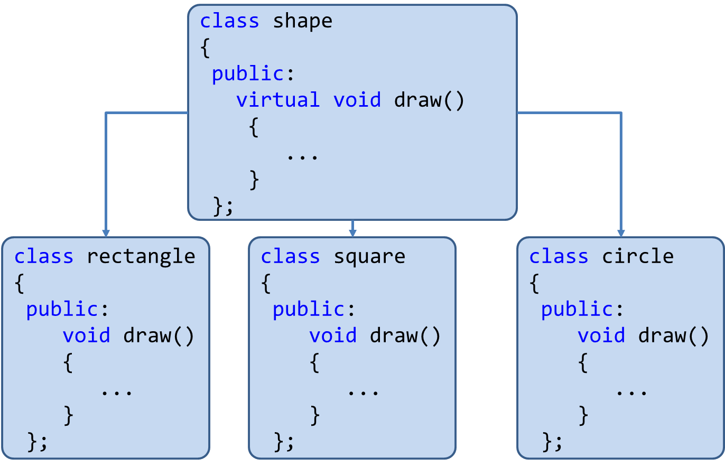
Pure Virtual Function
A pure virtual function is virtual function that has no definition within the base class.

Slide 33
Pure virtual functions
A pure virtual function means ‘do nothing’ function.
We can say empty function. A pure virtual function has no definition relative to the base class.
Programmers have to redefine pure virtual function in derived class, because it has no definition in base class.
A class containing pure virtual function cannot be used to create any direct objects of its own.
This type of class is also called as abstract class.
Syntax:
virtual void display() = 0;
OR
virtual void display() {}

Slide 34
Program
class Shape{
protected:
float x;
public:
void getData(){cin >> x;}
virtual float calculateArea() = 0;
};
class Square : public Shape
{
public:
float calculateArea()
{ return x*x; }
};
class Circle : public Shape
{
public:
float calculateArea()
{ return 3.14*x*x; }
};
This is called abstract class

Slide 35
Program
int main()
{
Square s;
Circle c;
cout << "Enter length to calculate the area of a square:";
s.getData();
cout<<"Area of square: " << s.calculateArea();
cout<<"Enter radius to calculate the area of a circle: ";
c.getData();
cout << "Area of circle: " << c.calculateArea();
}
Output:
Enter length to calculate the area of a square: 10
Area of square: 100
Enter radius to calculate the area of a circle: 9
Area of circle: 254.34

Slide 36
Abstract Class
A class that contains at least one pure virtual function is called abstract class.
You can not create objects of an abstract class, you can create pointers and references to an abstract class.

Slide 37
new and delete Operator

Slide 38
Memory allocation using new operator
new is used to dynamically allocate memory
new finds a block of the correct size and returns the address of the block.
Assign this address to a pointer.
int *pt = new int;
pt
1000
1000
2000
new int part tells the program you want some new storage of size int.
Then it finds the memory and returns the address.
Next, assign the address to *pt.
Now pt is the address and *pt is the value stored there.

Slide 39
Program
int main ()
{
float *pt = new float;
*pt = 55;
cout<<"value="<<*pt;
cout<<"\naddress="<<pt;
cout<<"\nsize="<<sizeof (*pt);
cout<<"\nsize ptr="<<sizeof pt;
}
55
pt
1000
1000
2000
4 bytes
2 bytes
value=55
address=1000
size=4
size=2

Slide 40
Free memory using delete operator
delete operator frees memory allocated by new.
int * ps = new int; // allocate memory with new
. . . // use the memory
delete ps; // free memory with delete when done
it doesn’t remove the pointer ps itself. You can reuse ps, to point to another new allocation.
int * ps = new int; // valid
delete ps; // valid
delete ps; // not valid now
int jugs = 5; // valid
int * pi = &jugs; // valid
delete pi;//not allowed, memory not allocated by new

Slide 41
Thank You

