Slide 1
JavaFX

Slide 2
Basic structure of JAVAFX program
JavaFX application is divided hierarchically into three main components known as Stage, Scene and nodes. We need to import javafx.application.Application class in every JavaFX application. This provides the following life cycle methods for JavaFX application.
public void init()
public abstract void start(Stage primaryStage)
public void stop()
in order to create a basic JavaFX application, we need to:
Import javafx.application.Application into our code.
Inherit Application into our class.
Override start() method of Application class.

Slide 3
Stage
Stage in a JavaFX application is similar to the Frame in a Swing Application. It acts like a container for all the JavaFX objects. Primary Stage is created internally by the platform. Other stages can further be created by the application. The object of primary stage is passed to start method. We need to call show method on the primary stage object in order to show our primary stage.

Slide 4
Scene
Scene actually holds all the physical contents (nodes) of a JavaFX Application. Javafx.scene.Scene class provides all the methods to deal with a scene object. Creating scene is necessary in order to visualize the contents on the stage.
At one instance, the scene object can only be added to one stage. In order to implement Scene in our JavaFX application, we must import javafx.scene package in our code. The Scene can be created by creating the Scene class object and passing the layout object into the Scene class constructor.

Slide 5
Scene Graph
Scene Graph exists at the lowest level of the hierarchy. It can be seen as the collection of various nodes. A node is the element which is visualized on the stage. It can be any button, text box, layout, image, radio button, check box, etc.
The nodes are implemented in a tree kind of structure. There is always one root in the scene graph. This will act as a parent node for all the other nodes present in the scene graph. However, this node may be any of the layouts available in the JavaFX system.
The leaf nodes exist at the lowest level in the tree hierarchy. Each of the node present in the scene graphs represents classes of javafx.scene package therefore we need to import the package into our application in order to create a full featured javafx application.

Slide 6
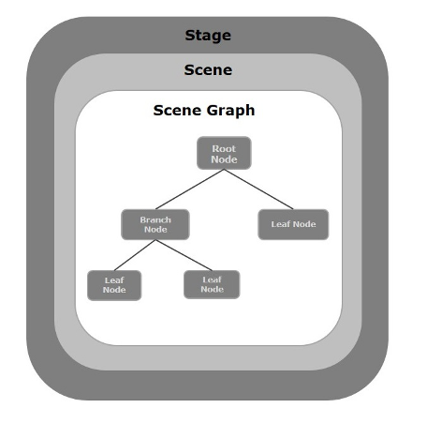

Slide 7
JAVAFX COLOR Class
package javafx.scene.paint
Using these classes, you can apply colors in the following patterns −
Uniform − In this pattern, color is applied uniformly throughout node.
Image Pattern − This lets you to fill the region of the node with an image pattern.
Gradient − In this pattern, the color applied to the node varies from one point to the other. It has two kinds of gradients namely Linear Gradient and Radial Gradient.

Slide 8
JAVAFX Font Class
package javafx.scene.text
JavaFX enables us to apply various fonts to the text nodes. We just need to set the property font of the Text class by using the setter method setFont().
Family: it represents the family of the font. It is of string type and should be an appropriate font family present in the system.
Weight: this Font class property is for the weight of the font. There are 9 values which can be used as the font weight. The values are FontWeight.BLACK, BOLD, EXTRA_BOLD, EXTRA_LIGHT, LIGHT, MEDIUM, NORMAL, SEMI_BOLD, THIN.
Posture: this Font class property represents the posture of the font. It can be either FontPosture.ITALIC or FontPosture.REGULAR.
Size: this is a double type property. It is used to set the size of the font.

Slide 9
JavaFX UI Controls
SN | Control | Description
1 | Label | Label is a component that is used to define a simple text on the screen. Typically, a label is placed with the node, it describes.
2 | Button | Button is a component that controls the function of the application. Button class is used to create a labelled button.
3 | RadioButton | The Radio Button is used to provide various options to the user. The user can only choose one option among all. A radio button is either selected or deselected.
4 | CheckBox | Check Box is used to get the kind of information from the user which contains various choices. User marked the checkbox either on (true) or off(false).
5 | TextField | Text Field is basically used to get the input from the user in the form of text. javafx.scene.control.TextField represents TextField
6 | PasswordField | PasswordField is used to get the user's password. Whatever is typed in the passwordfield is not shown on the screen to anyone.
7 | HyperLink | HyperLink are used to refer any of the webpage through your appication. It is represented by the class javafx.scene.control.HyperLink
8 | Slider | Slider is used to provide a pane of options to the user in a graphical form where the user needs to move a slider over the range of values to select one of them.
9 | ProgressBar | Progress Bar is used to show the work progress to the user. It is represented by the class javafx.scene.control.ProgressBar.
10 | ProgressIndicator | Instead of showing the analogue progress to the user, it shows the digital progress so that the user may know the amount of work done in percentage.
11 | ScrollBar | JavaFX Scroll Bar is used to provide a scroll bar to the user so that the user can scroll down the application pages.
12 | Menu | JavaFX provides a Menu class to implement menus. Menu is the main component of any application.
13 | ToolTip | JavaFX ToolTip is used to provide hint to the user about any component. It is mainly used to provide hints about the text fields or password fields being used in the application.
package javafx.scene.control

Slide 10
JavaFX UI Shapes
package javafx.scene.shape
Shape | Description
Line | In general, Line is the geometrical figure which joins two (X,Y) points on 2D coordinate system. In JavaFX, javafx.scene.shape.Line class needs to be instantiated in order to create lines.
Rectangle | In general, Rectangle is the geometrical figure with two pairs of two equal sides and four right angles at their joint. In JavaFX, javafx.scene.shape.Rectangle class needs to be instantiated in order to create Rectangles.
Ellipse | In general, ellipse can be defined as a curve with two focal points. The sum of the distances to the focal points are constant from each point of the ellipse. In JavaFX. javafx.scene.shape.Ellipse class needs to be instantiated in order to create Ellipse.
Arc | Arc can be defined as the part of the circumference of the circle of ellipse. In JavaFX, javafx.scene.shape.Arc class needs to be instantiated in order to create Arcs.
Circle | A circle is the special type of Ellipse having both the focal points at the same location. In JavaFX, Circle can be created by instantiating javafx.scene.shape.Circle class.
Polygon | Polygon is a geometrical figure that can be created by joining the multiple Co-planner line segments. In JavaFX, javafx.scene.shape. Pollygon class needs to be instantiated in order to create polygon.
Cubic Curve | A Cubic curve is a curve of degree 3 in the XY plane. In Javafx, javafx.scene.shape.CubicCurve class needs to be instantiated in order to create Cubic Curves.
Quad Curve | A Quad Curve is a curve of degree 2 in the XY plane. In JavaFX, javafx.scene.shape.QuadCurve class needs to be instantiated in order to create QuadCurve.

