Slide 1
Chapter 3 & 4 (Monitors,Message Passing, Signal)

Slide 2
Monitors
Monitor is a collection of procedures , variables, data structures that are grouped together in a special kind of module or package.
Or
A high level data abstraction tool that automatically generates atomic operations on a given data structure.
Processes may call the procedures in a monitor whenever they want to, but they cannot directly access the monitor’s internal data structures from procedures declared outside the monitor.
A monitor has :
Shared data.
A set of atomic operations on that data.
A set of condition variables.

Slide 3
Monitors
Monitors have an important property for achieving mutual exclusion: only one process can be active in a monitor at any instant.
When a process calls a monitor procedure, the first few instructions of the procedure will check to see if any other process is currently active within the monitor.
If so, the calling process will be suspended until the other process has left the monitor. If no other process is using the monitor, the calling process may enter.

Slide 4
Producer Consumer problem using Monitor
The solution proposes condition variables, along with two operations on them, wait and signal.
When a monitor procedure discovers that it cannot continue (e.g., the producer finds the buffer full), it does a wait on some condition variable, full.
This action causes the calling process to block. It also allows another process that had been previously prohibited from entering the monitor to enter now.

Slide 5
Producer Consumer problem using Monitor
This other process the consumer, can wake up its sleeping partner by doing a signal on the condition variable that its partner is waiting on.
To avoid having two active processes in the monitor at the same time a signal statement may appear only as the final statement in a monitor procedure.
If a signal is done on a condition variable on which several processes are waiting, only one of them, determined by the system scheduler, is received.

Slide 6
Producer Consumer problem using Monitor
monitor ProducerConsumer
condition full, empty;
integer count;
procedure insert (item);
begin
if count=N then wait (full);
insert_item(item);
count=count+1;
if count=1 then signal (empty);
end;

Slide 7
Producer Consumer problem using Monitor
function remove:integer;
begin
if count=0 then wait (empty);
remove=remove_item;
count=count-1;
if count=N-1 then signal (full);
end;
count=0;
end monitor;

Slide 8
Producer Consumer problem using Monitor
procedure producer;
begin
while true do
begin
item=produce_item;
ProducerConsumer.insert(item);
end;
end;
procedure consumer;
begin
while true do
begin
item=ProducerConsumer.remove;
Consume_insert(item);end;
end;

Slide 9
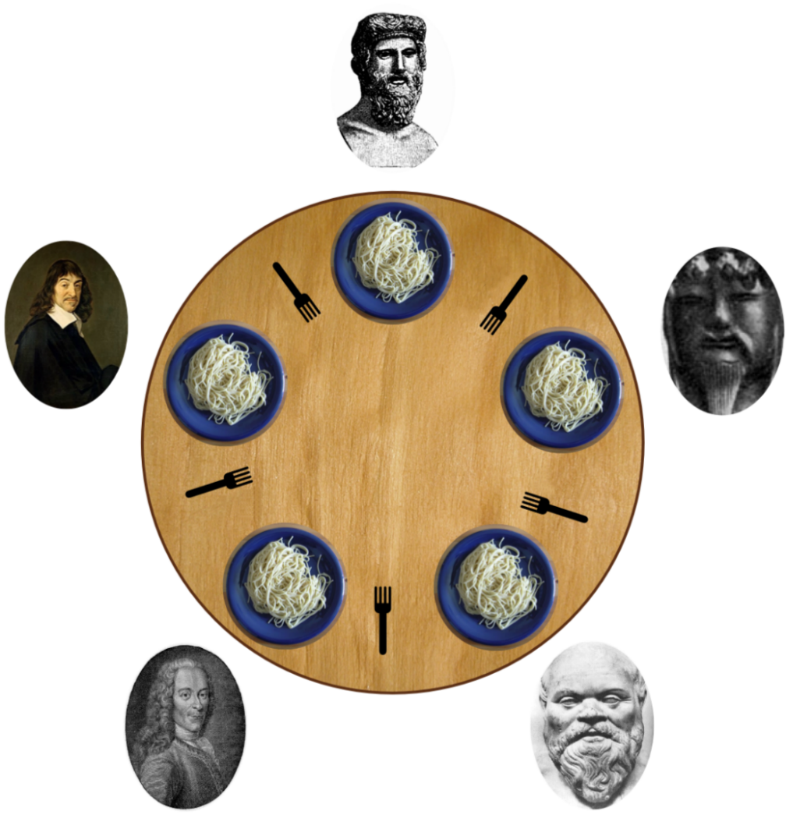
Dinning Philosopher Problem
In this problem 5 philosophers sitting at a round table doing 2 things eating and thinking.
While eating they are not thinking and while thinking they are not eating.
Each philosopher has plates that is total of 5 plates.
And there is a fork place between each pair of adjacent philosophers that is total of 5 forks.
Each philosopher needs 2 forks to eat and each philosopher can only use the forks on his immediate left and immediate right.

Slide 10
Solution to Dinning Philosopher Problem
#define N 5 //no. of philosophers
#define LEFT (i+N-1)%5 //no. of i’s left neighbor
#define RIGHT (i+1)%5 //no. of i’s right neighbor
#define THINKING 0 //Philosopher is thinking
#define HUNGRY 1 //Philosopher is trying to get forks
#define EATING 2 //Philosopher is eating
typedef int semaphore; //semaphore is special kind of int
int state[N]; //array to keep track of everyone’s state
semaphore mutex=1; //mutual exclusion for critical region
semaphore s[N]; //one semaphore per philosopher

Slide 11
Solution to Dinning Philosopher Problem
void take_forks (int i) //i: philosopher no, from 0 to N-1
{
down(&mutex); //enter critical region
state[i]=HUNGRY; //record fact that philosopher i is hungry
test(i); //try to acquire 2 forks
up(&mutex); //exit critical region
down(&s[i]); //block if forks were not acquired
}
void put_forks (int i) //i: philosopher no, from 0 to N-1
{
down(&mutex); //enter critical region
state[i]=THINKING; //philosopher has finished eating
test(LEFT); //see if left neighbor can now eat
test(RIGHT); //see if right neighbor can now eat
up(&mutex); //exit critical region
}

Slide 12
Solution to Dinning Philosopher Problem
void test (i) //i: philosopher no, from 0 to N-1
{
if (state[i]==HUNGRY &&
state[LEFT]!=EATING &&
state[RIGHT]!=EATING)
{
state[i]=EATING;
up (&s[i]);
}
}

Slide 13
Pipes
In computer programming, especially in UNIX operating systems, a pipe is a technique for passing information from one process to another.
Pipe is a communication medium between two or more related or interrelated processes usually between parent and child process.
Basically, a pipe passes a parameter such as the output of one process to another process which accepts it as input.
It is a unidirectional, first-in first-out, unstructured data stream of fixed size.
Communication is achieved by one process write data into pipe and other process reads from the pipe.
It performs one-way communication only.

Slide 14
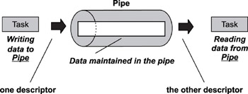
Pipes

Slide 15
Pipes
The Pipe system call creates a pipe and returns two file descriptors: one for reading and one for writing. The descriptor are inherited by child process.
fd[0] for reading from pipe
fd[1] for writing into the pipe

Slide 16
Pipes
This system call would create a pipe for one-way communication i.e., it creates two descriptors, first one is connected to read from the pipe and other one is connected to write into the pipe.
Descriptor pipedes[0] is for reading and pipedes[1] is for writing. Whatever is written into pipedes[1] can be read from pipedes[0].
This call would return zero on success and -1 in case of failure.
#include<unistd.h>
int pipe(int pipedes[2]);

Slide 17
Inter Process Communication (IPC)
Inter process communication (IPC) is a mechanism which allows processes to communicate each other and synchronize their actions.
The communication between these processes can be seen as a method of co-operation between them. Processes can communicate with each other using these two ways:
There are two models for IPC
Message Passing (Process A send the message to Kernel and then Kernel send that message to Process B)
Shared Memory (Process A put the message into Shared Memory and then Process B read that message from Shared Memory)

Slide 18
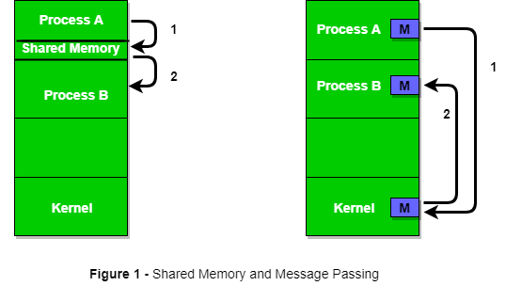
Structure of communication between processes via shared memory method and via message passing

Slide 19
Message Passing
In this method, processes communicate with each other without using any kind of shared memory. If two processes p1 and p2 want to communicate with each other, they proceed as follow:
Establish a communication link (if a link already exists, no need to establish it again.)
Start exchanging messages using basic primitives. We need at least two primitives: – send(message, destinaion) or send(message) – receive(message, host) or receive(message)

Slide 20
Message Passing
A standard message can have two parts: header and body.
The header part is used for storing Message type, destination id, source id, message length and control information. The control information contains information like what to do if runs out of buffer space, sequence number, priority. Generally, message is sent using FIFO style.
Body is a actual message.

Slide 21
Message Passing
Message passing may be blocking or non-blocking.
Blocking is considered synchronous and blocking send means the sender will be blocked until the message is received by receiver.
Similarly, blocking receive has the receiver block until a message is available.
Non-blocking Send is considered asynchronous and Non-blocking send has the sender sends the message and continue.
Similarly, Non-blocking receive has the receiver receive a valid message or null.

Slide 22
Signals
Signals are software interrupts sent to a program to indicate that an important event has occurred.
When a signal is delivered to a process, the process will stop what its doing, either handle or ignore the signal.
Signals are similar to interrupts, the difference being that interrupts are mediated by the processor and handled by the kernel while signals are mediated by the kernel (possibly via system calls) and handled by processes.
The kernel may pass an interrupt as a signal to the process that caused it (examples are SIGSEGV, SIGBUS, SIGILL and SIGFPE).

