Slide 1
Chapter 5: Deadlocks

Slide 2
Overview
Resources
Why do deadlocks occur?
Dealing with deadlocks
  Ignoring them: ostrich algorithm
  Detecting & recovering from deadlock
  Avoiding deadlock
  Preventing deadlock

Slide 3
Resources
Resource: something a process uses
  Usually limited (at least somewhat)
Examples of computer resources
  Printers
  Semaphores / locks
  Tables (in a database)
Processes need access to resources in reasonable order
Two types of resources:
  Preemptable resources: can be taken away from a process with no ill effects
  Nonpreemptable resources: will cause the process to fail if taken away

Slide 4
When do deadlocks happen?
Suppose
  Process 1 holds resource A and requests resource B
  Process 2 holds B and requests A
  Both can be blocked, with neither able to proceed
Deadlocks occur when …
  Processes are granted exclusive access to devices or software constructs (resources)
  Each deadlocked process needs a resource held by another deadlocked process
Process 1
Process 2
A
B
A
B
DEADLOCK!

Slide 5
Using resources
Sequence of events required to use a resource
  Request the resource
  Use the resource
  Release the resource
Can’t use the resource if request is denied
  Requesting process has options
    Block and wait for resource
    Continue (if possible) without it: may be able to use an alternate resource
    Process fails with error code
  Some of these may be able to prevent deadlock…

Slide 6
What is a deadlock?
Formal definition:
“A set of processes is deadlocked if each process in the set is waiting for an event that only another process in the set can cause.”
Usually, the event is release of a currently held resource
In deadlock, none of the processes can
  Run
  Release resources
  Be awakened

Slide 7

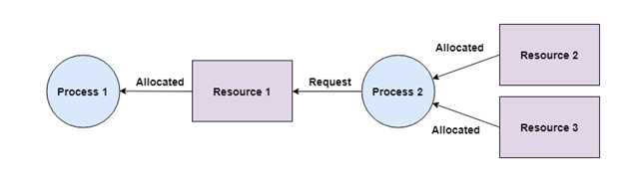
Four conditions for deadlock
Mutual exclusion
  Each resource is assigned to at most one process
Hold and wait
  A process holding resources can request more resources.

Slide 8
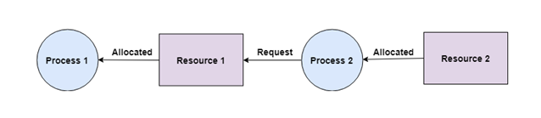
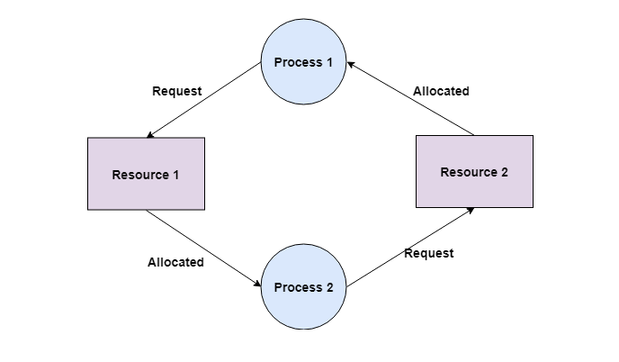
Four conditions for deadlock
No preemption
  Previously granted resources cannot be forcibly taken away
Circular wait
  There must be a circular chain
  of 2 or more processes where
  each is waiting for a resource
  held by the next member of
  the chain

Slide 9
Resource allocation graphs
Resource allocation modeled by directed graphs
Example 1:
  Resource R assigned to process A
Example 2:
  Process B is requesting / waiting for resource S
Example 3:
  Process C holds T, waiting for U
  Process D holds U, waiting for T
  C and D are in deadlock!
A
B
R
S
T
C
D
U

Slide 10
Dealing with deadlock
How can the OS deal with deadlock?
  Ignore the problem altogether!
    Hopefully, it’ll never happen…
  Detect deadlock & recover from it
  Dynamically avoid deadlock (Deadlock Avoidance)
    Careful resource allocation
  Prevent deadlock
    Remove at least one of the four necessary condition

Slide 11
Getting into deadlock
A
B
C
Acquire R
Acquire S
Release R
Release S
Acquire S
Acquire T
Release S
Release T
Acquire T
Acquire R
Release T
Release R
A
B
C
A
B
C
A
B
C
R
S
T
R
S
T
R
S
T
Acquire R
Acquire S
Acquire T
A
B
C
A
B
C
A
B
C
R
S
T
R
S
T
R
S
T
Deadlock!
Acquire S
Acquire T
Acquire R

Slide 12
Not getting into deadlock…
Many situations may result in deadlock like :
  In previous example, A could release R before C requests R, resulting in no deadlock
  Can we always get out of it this way?
Find ways to:
  Detect deadlock and reverse it
  Stop it from happening in the starting place

Slide 13
The Ostrich Algorithm
Pretend there’s no problem
Reasonable if
  Deadlocks occur very rarely
  Cost of prevention is high
UNIX and Windows take this approach
  Resources (memory, CPU, disk space) are plentiful
  Deadlocks over such resources rarely occur
  Deadlocks typically handled by rebooting

Slide 14
Deadlock Detection and Recovery
Deadlock detection is the process of actually determining that a deadlock exists and identifying the processes and resources involved in the deadlock.
This solution consists of:
An algorithm to determine whether a deadlock has occurred.Detection
An algorithm to recover from the deadlock.Recovery

Slide 15
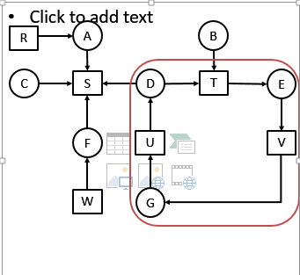
Deadlock Detection using Graph (for single resource)
We are starting from thread T1.
Empty list L = ()
Add current node so Empty list = (T1).
From this node there is one outgoing arc to T2 so add T2 to list.
So list become L = (D, T).
Continue this step….so we get list as below
L = (D, T, E)………… L = (D, T, E, V, G, U, D)
In the above step in list the node D appears twice, so deadlock.

Slide 16
Deadlock Detection algorithm
1. Initialize L to the empty list and designate all edges as unmarked
2. Add the current node to L and check to see if it appears twice. If it does, there is a cycle in the graph.
3. From the given node, check to see if there are any unmarked outgoing edges. If yes, go to the next step, if no, skip the next step
4. Pick an unmarked edge, mark it, then follow it to the new current node and go to step 3.

Slide 17
Deadlock Detection algorithm
5. We have reached a dead end. Go back to the previous node and make that the current node. If the current node is the starting Node and there are no unmarked edges, there are no cycles in the graph. Otherwise, go to step 3.

Slide 18
Resources with multiple instances
Previous algorithm only works if there’s one instance of each resource
If there are multiple instances of each resource, we need a different method
  Track current usage and requests for each process
  To detect deadlock, try to find a scenario where all processes can finish
  If no such scenario exists, we have deadlock

Slide 19
Deadlock Recovery
1. Recovery through preemption
Some times resources are temporarily taken away from current process and allocated to other process.
Following factors are considered before choosing process :
Priority of process. Higher priority are usually not selected.
CPU time used by process. The process which are close to completion are not selected.
The number process that will be affected if this process were selected as victim.

Slide 20
Deadlock Recovery
2. Recovery through rollback
When a process in a system terminates, the system performs a roll back by undoing every operation related to terminated process.
Checkpointing a process means that its state is written to a file (PCB) so that it can be restarted later.
Start the process after it is determined it can run again.

Slide 21
Deadlock Recovery
3. Process Termination :
Deadlock is removed by aborting a process. But aborting a process is not easy. All deadlocked process are aborted.
Circular wait can be eliminated by aborting one by one process.
Selection of process for aborting is difficult. Following parameters are considered:
1. priority of process.
2. how much process is finished.
    3. Resource used by process.
    4. Need of resource to complete process remaining operation
    5. How many process need to be terminated ?

Slide 22
Safe and unsafe states
A state is safe if the system can allocate all resources requested by all processes ( up to their stated maximums ) without entering a deadlock state.
If a safe sequence does not exist, then the system is in an unsafe state, which MAY lead to deadlock.

Slide 23
Safe and unsafe states
 | Has | Max
A | 3 | 9
B | 2 | 4
C | 2 | 7
Free: 3
 | Has | Max
A | 3 | 9
B | 4 | 4
C | 2 | 7
Free: 1
 | Has | Max
A | 3 | 9
B | 0 | -
C | 2 | 7
Free: 5
 | Has | Max
A | 3 | 9
B | 0 | -
C | 7 | 7
Free: 0
 | Has | Max
A | 3 | 9
B | 0 | -
C | 0 | -
Free: 7
Demonstration that the first state is safe
 | Has | Max
A | 3 | 9
B | 2 | 4
C | 2 | 7
Free: 3
 | Has | Max
A | 4 | 9
B | 2 | 4
C | 2 | 7
Free: 2
 | Has | Max
A | 4 | 9
B | 4 | 4
C | 2 | 7
Free: 0
 | Has | Max
A | 4 | 9
B | 0 | -
C | 2 | 7
Free: 4
Demonstration that the second state is unsafe

Slide 24
Banker's Algorithm for a single resource
 | Has | Max
A | 0 | 6
B | 0 | 5
C | 0 | 4
D | 0 | 7
Free: 10
 | Has | Max
A | 1 | 6
B | 1 | 5
C | 2 | 4
D | 4 | 7
Free: 2
 | Has | Max
A | 1 | 6
B | 2 | 5
C | 2 | 4
D | 4 | 7
Free: 1
Any sequence finishes
C,B,A,D finishes
Deadlock (unsafe state)
Bankers’ algorithm: before granting a request, ensure that a sequence exists that will allow all processes to complete
  Use previous methods to find such a sequence
  If a sequence exists, allow the requests
  If there’s no such sequence, deny the request
Can be slow: must be done on each request!

Slide 25
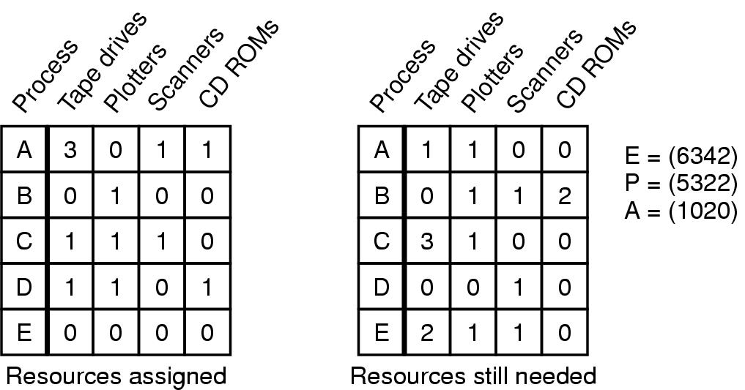
Banker's Algorithm for multiple resources
Example of banker's algorithm with multiple resources

Slide 26
Preventing deadlock
Deadlock can be completely prevented!
Ensure that at least one of the conditions for deadlock never occurs
  Mutual exclusion
  Circular wait
  Hold & wait
  No preemption
Not always possible…

Slide 27
Eliminating mutual exclusion
No deadlock if each resource can be assigned to more than one process.
We can not assign some resources to more than one process at a time such as CD-Recorder, Printer etc…
So this solution is not feasible
Principle:
  Avoid assigning resource when not absolutely necessary
  As few processes as possible actually claim the resource

Slide 28
Attacking “hold and wait”
Require processes to request resources before starting
  A process never has to wait for what it needs
This can present problems
  A process may not know required resources at start of run
  This also ties up resources other processes could be using
    Processes will tend to be conservative and request resources they might need
Process must give up all resources before making a new request
  Process is then granted all prior resources as well as the new ones
  Problem: what if someone grabs the resources in the meantime—how can the process save its state?

Slide 29
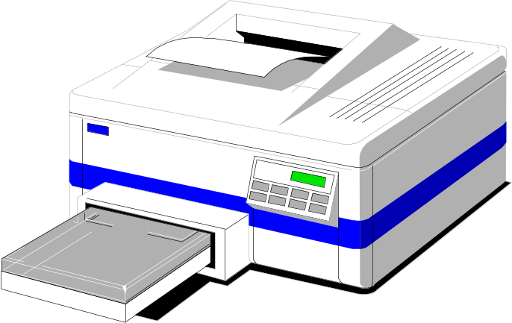
Attacking “no preemption”
It means resources are taken away by force from the process.
This is also not a feasible solution.
Consider a process given the printer
  Halfway through its job, take away the printer
  Data inconsistency occurs!
May work for some resources
  Forcibly take away memory pages, suspending the process
  Process may be able to resume with no ill effects

Slide 30
Attacking “circular wait”
Provide a global numbering of all the resources.
Now the rule is that: processes can request resources whenever they want to, but all requests must be made in numerical order.
A process need not acquire them all at once.
Circular wait is prevented if a process holding resource n cannot wait for resource m, if m > n.
    Printer
    Scanner
    Plotter
    Tape Drive
    CD Rom
A process may request 1st a CD ROM, then tape drive. But it may not request 1st a tape drive, then CD ROM.
Resource graph can never have cycle.
D
C
3
2
B
1
A

