Slide 1
IOT INTRODUCTION
ASST.PROF HIMANI JOSHI
SEM 7
IT

Slide 2
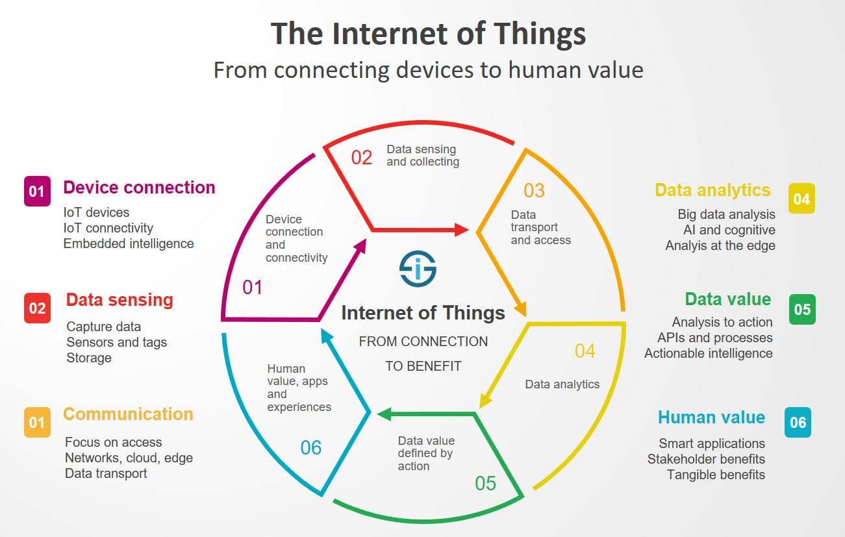
DEFINITION OF IOT

Slide 3
DEFINITION OF IOT
a network of connected devices with 1) unique identifiers in the form of an IP address which 2) have embedded technologies or are equipped with technologies that enable them to sense, gather data and communicate about the environment in which they reside and/or themselves.

Slide 4
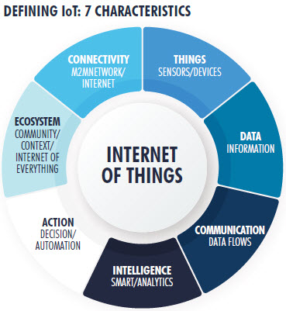

Slide 5
CHARACTERISTICS OF IOT
There are 7 crucial IoT characteristics:
Connectivity. This doesn’t need too much further explanation. With everything going on in IoT devices and hardware, with sensors and other electronics and connected hardware and control systems there needs to be a connection between various levels.
Things. Anything that can be tagged or connected as such as it’s designed to be connected. From sensors and household appliances to tagged livestock. Devices can contain sensors or sensing materials can be attached to devices and items.
Data. Data is the glue of the Internet of Things, the first step towards action and intelligence.
Communication. Devices get connected so they can communicate data and this data can be analyzed. Communication can occur over short distances or over a long range to very long range. Examples: Wi-Fi, LPWA network technologies such as LoRa or NB-IoT.

Slide 6
CHARACTERISTICS OF IOT
Intelligence. The aspect of intelligence as in the sensing capabilities in IoT devices and the intelligence gathered from big data analytics (also artificial intelligence).
Action. The consequence of intelligence. This can be manual action, action based upon debates regarding phenomena (for instance in smart factory decisions) and automation, often the most important piece.
Ecosystem. The place of the Internet of Things from a perspective of other technologies, communities, goals and the picture in which the Internet of Things fits. The Internet of Everything dimension, the platform dimension and the need for solid partnerships.

Slide 7
What is M2M
Machine-to-machine communication, or M2M, is exactly as it sounds: two machines “communicating,” or exchanging data, without human interfacing or interaction. This includes serial connection, powerline connection (PLC), or wireless communications in the industrial Internet of Things (IoT). Switching over to wireless has made M2M communication much easier and enabled more applications to be connected.
In general, when someone says M2M communication, they often are referring to cellular communication for embedded devices. Examples of M2M communication in this case would be vending machines sending out inventory information or ATM machines getting authorization to dispense cash.

Slide 8
CONT…
Essentially, M2M networks are very similar to LAN or WAN networks, but are exclusively used to allow machines, sensors, and controls, to communicate. These devices feed information they collect back to other devices in the network. This process allows a human (or an intelligent control unit) to assess what is going on across the whole network and issue appropriate instructions to member devices.

Slide 9
M2M AND IOT APPLICATIONS
Manufacturing
Home appliances
Healthcare device management
Smart utility managemnet

Slide 10
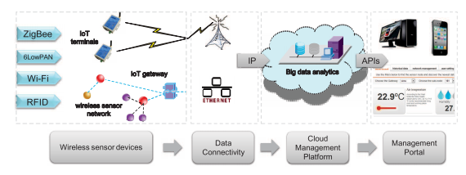
End to End IoT architecture

Slide 11
Physical design of IoT
Refers to
IoT Devices
IoT Protocols

Slide 12
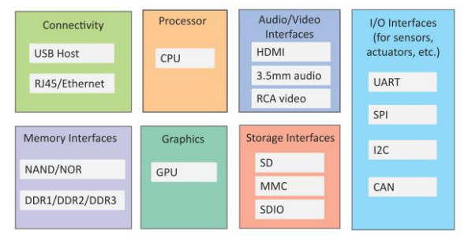
Physical design of IoT Block Diagram

Slide 13
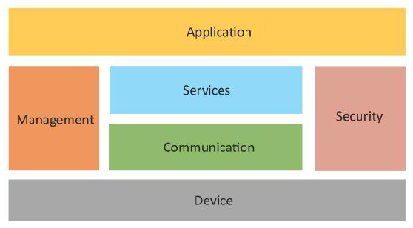
Logical design of IoT

Slide 14
Challenges to IoT
Scalability
Interoperability
Lack of government support
Safety Of Patients
Security And Personal Privacy
Design Based Challenge

Slide 15
Interdependencies of IoT and cloud computing
IoT has to deal with the production of huge amount of data which needs to be stored, accessed, processed and transferred, posing a serious problem. This is where cloud computing comes into picture
Public, hybrid and mobile-based cloud computing technologies are providing companies with a way of connecting traditional information systems to IoT-enabled devices. This capability will allow enterprises to build sense and respond systems quickly and economically

Slide 16
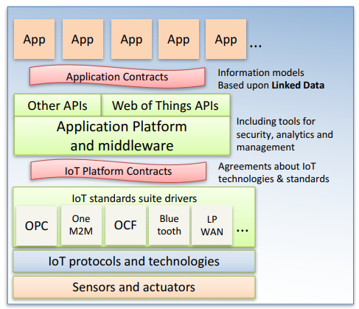
Web of Things
An abstraction layer over heterogeneous IoT standards, communication patterns, protocols and data formats
• Applications interact with software objects for things that represent physical or abstract entities, e.g. sensors, actuators, virtual devices, cloud services, etc. – Each thing has a URI for its application contract

Slide 17
Analogous to the role played by the Internet as an abstraction layer for networks and networking technology that has enabled trillions of dollars of services world wide • Web of things application platforms can be located at the network edge, in the fog, in the cloud, peer to peer or a combination thereof

Slide 18
Web of Things Groups
Web of things Interest Group
Launched early 2015
Pre-standardization actvities
Use cases and requirements
Experimental specs & Plugfests
Liaisons with external groups
Test frameworks
Web of things Working Group
Launched early 2017 –
Cross domain vocabulary for thing descriptions
Serialization as JSON
Application APIs
Security review with help from other groups
Security metadata and cross platform approaches building on top of IoT platform security

Slide 19
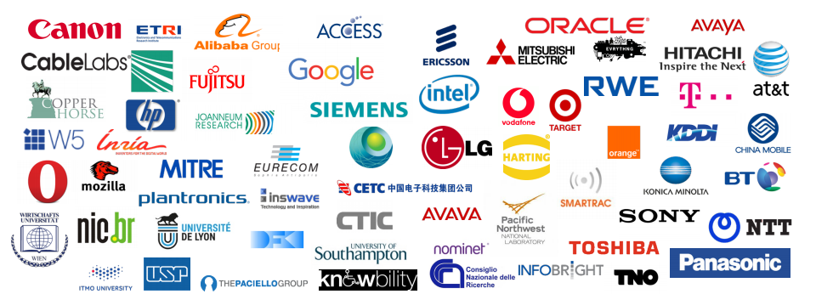

Slide 20
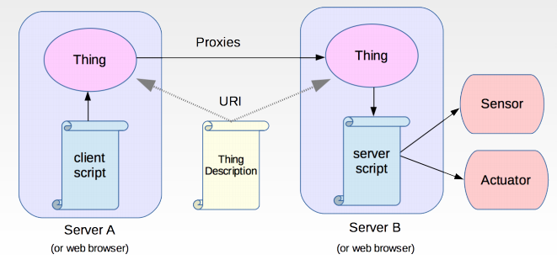
Distributing web of things

Slide 21
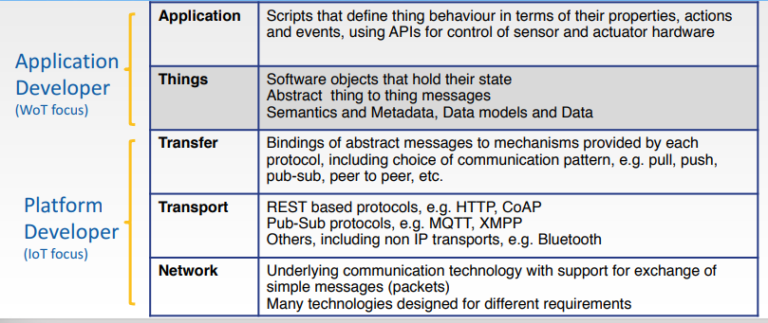
Communication Stack

