Slide 1
SPM
CHAPTER 1:
Introduction to Software Project Management (SPM)
Asst. Prof.Himani Joshi
IT dept
SPCE,Bakrol

Slide 2
S/W projects vs. other types of projects
Invisibility
Conformity
Complexity
Flexibility

Slide 3
Project management | Contract management
Focuses on completion of project | Focuses on contract
Main goal Desired output n time and budget | to achieve mutual satisfaction among parties or organizations or companies whose objectives are not same but are closely linked.
Project usually involves many parties from one business entity but mostly involves various related or unrelated entities. | Contract usually binds two different business entities but if there are more than two entities then there are separate sub-contracts.
It involves various processes such as planning, organizing, and managing efforts and tasks that are made and performed to complete a project successfully | It involves various processes such as managing contracts, deliverables, guidelines, deadlines, execution, analysis

Slide 4
It mainly focuses on project constraints i.e. scope, time, budget, quality as per contract. | It mainly focuses on economic of project and manage claims and dispute against contract.
Its key objective is to predict problems or dangers as many as possible so that such problems can be removed on time and project can be completed in spite of all problems. | Its key objective is to create value for organization.

Slide 5
Activities covered by SPM
The list of activities are as follows:
Project planning and Tracking
Project Resource Management
Scope Management
Estimation Management
Project Risk Management
Scheduling Management
Project Communication Management
Configuration Management

Slide 6
Plans
Project Planning: Project planning involves breaking down the work into parts and assign these to project team members, anticipate problems that might arise and prepare tentative solutions to those problems.

Slide 7
Planning stages
At the proposal stage, when you are bidding for a contract to develop or provide a software system.
During the project start-up phase, when you have to plan who will work on the project, how the project will be broken down into increments, how resources will be allocated across your company, etc.
Periodically throughout the project, when you modify your plan in the light of experience gained and information from monitoring the progress of the work.

Slide 8
Plan-driven development – pros and cons
The arguments in favour of a plan-driven approach are that early planning allows organizational issues (availability of staff, other projects, etc.) to be closely taken into account, and that potential problems and dependencies are discovered before the project starts, rather than once the project is underway.
The principal argument against plan-driven development is that many early decisions have to be revised because of changes to the environment in which the software is to be developed and used.

Slide 9
Plan sections
Introduction
Project organization
Risk analysis
Hardware and software resource requirements
Work breakdown
Project schedule
Monitoring and reporting mechanisms

Slide 10
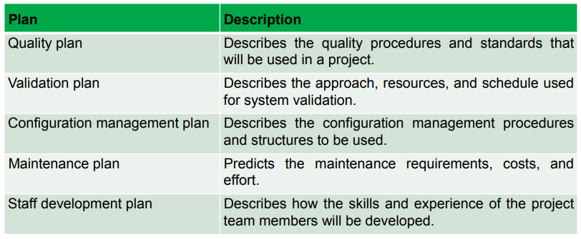
Project plan supplements

Slide 11
Methods and Methodology
Methods: a procedure or process for attaining an object: such as a systematic procedure, technique, or mode of inquiry employed by or proper to a particular discipline or a systematic plan followed in presenting material for instruction”.
In other words, a method refers to a single action, tool, technique, process, or way of doing something.

Slide 12
Methodology:
“a body of methods, rules, and postulates employed by a discipline; a particular procedure or set of procedures”.
Essentially, a methodology is a collection of methods, practices, processes, techniques, procedures, and rules. In project management, methodologies are specific, strict, and usually contain a series of steps and activities for each phase of the project’s life cycle. They’re defined approaches that show us exactly what steps to take next, the motivation behind each step, and how a project stage should be performed.

Slide 13
To differentiate between method and methodology, please reflect on the following:
PRINCE2®is a method; “PRINCE2 (Projects IN Controlled Environments) is a structured project management method” (What is PRINCE2®, 2015). Notice the use of the terms ‘structured’ and ‘method.’
PRiSM™ (from GPM) is a method; Projects integrating Sustainable Methods and have specific deliverables and steps that one should apply to the project life cycle.
SUKAD developed a methodological approach that is based on a project life cycle, which is The Customizable and Adaptable Methodology for Managing Projects™ (CAMMP™[3]). Notice the use of the term ‘methodology’ and not ‘method,’ which is not an error. The reason for the use of the term methodology is because CAMMP™ offers an approach that is not rigid or fixed. The CAMMP™ project life cycle has to be customized and adapted to the organizational and project context. The customized and adapted version, for a specific project’s type, become a method.

Slide 14
Following are the most frequently used project management methodologies in the project management practice:
Adaptive Project Framework: In this methodology, the project scope is a variable. Additionally, the time and the cost are constants for the project. Therefore, during the project execution, the project scope is adjusted in order to get the maximum business value from the project.
Agile Software Development Agile software development methodology is for a project that needs extreme agility in requirements. The key features of agile are its short-termed delivery cycles (sprints), agile requirements, dynamic team culture, less restrictive project control and emphasis on real-time communication.

Slide 15
Scrum :This is an agile methodology. The main goal of this methodology is to improve team productivity dramatically by removing every possible burden. Scrum projects are managed by a Scrum master.
Spiral: Spiral methodology is the extended waterfall model with prototyping. This method is used instead of using the waterfall model for large projects.

Slide 16
PRINCE2®is a method; “PRINCE2 (Projects IN Controlled Environments) is a structured project management method” (What is PRINCE2®, 2015). Notice the use of the terms ‘structured’ and ‘method.’
PRiSM™ (from GPM) is a method; Projects integrating Sustainable Methods and have specific deliverables and steps that one should apply to the project life cycle.
SUKAD developed a methodological approach that is based on a project life cycle, which is The Customizable and Adaptable Methodology for Managing Projects™ (CAMMP™[3]). Notice the use of the term ‘methodology’ and not ‘method,’ which is not an error. The reason for the use of the term methodology is because CAMMP™ offers an approach that is not rigid or fixed. The CAMMP™ project life cycle has to be customized and adapted to the organizational and project context. The customized and adapted version, for a specific project’s type, become a method.

Slide 17
Categorizing Software Projects
Compulsory Vs Voluntary systems (projects):
Compulsory systems are the systems which the staff of an organisation have to use if they want to do a task.
Voluntary systems are the systems which are voluntarily used by the users eg. computer gaming, school project, etc.

Slide 18
Categorizing Software Projects
Information Vs Embedded systems (projects):
Information systems are used by staff to carry out office processes and tasks eg. stock control system.
Embedded systems are used to control machines eg. a system controlling equipment in a building.

Slide 19
Project Charter
A project charter is a short document that explains the project in clear, concise wording for high level management.
Project charters outline the entirety of projects to help teams quickly understand the goals, tasks, timelines, and stakeholders.
SMART method: When preparing the project charter, utilize the SMART method. Be Specific, ensure your goals are Measurable, Attainable, Relevant to the project, and Timely.

Slide 20
What does the project charter contain?
Purpose and objectives of the project in clear, concise language
Requirements of the project at a very high level and without much detail
Project description in a paragraph or two that explains the project
Known high-level, major categories of risks for the project
Schedule of events with the start and end dates
Major events or milestones along the path.
Budget or summary of how much the project will cost
Requirements from the organization for approval, including what to approve, who will approve, and how to get the approval
Key players or stakeholders in charge of which parts of the project and who will approve the plans to go through
An introduction of the project manager, project sponsor, and their authority level

Slide 21
Benefits of project charter
Formally authorizes the project to commence
Creates a common vision and shared understanding of the project
Empowers the project manager to lead the project
Identifies the high-level objectives and scope of the project
Defines what success will look like at the end of the project
Gains support for the project by announcing it to the whole organization
Ensures that key stakeholders are aware of the project
Secures budget and resources for the project
Serves as the point of reference for the project team

Slide 22
One-page project charter example
The sections of the document are as follows:
Project Name
Project Description
Target Date
Costs
Gains
Project Team
Key Milestones

Slide 23
Tips for writing a project charter
Keep it brief
Be explicit
Build it with your sponsor

Slide 24
Stakeholders
According to the Project Management Institute, project stakeholders are defined as:
“Individuals and organizations who are actively involved in the project, or whose interests may be positively or negatively affected as a result of project execution or successful project completion.”
Stakeholders are people who will be affected by your project at any point in its life cycle, and their input can directly impact the outcome.
It's essential to practice good stakeholder management and continuously communicate to collaborate on the project.

Slide 25
Some of the typical key project stakeholders you'll find in a project include:
Customers: The direct user of a product or service, often both internal and external to the company executing the project
Project manager: The project's leader
Project team members: The group executing the project under the project manager's leadership
Project sponsor: The project's financier
Steering committee: An advisory group providing guidance on key decisions, which includes the sponsor, executives, and key stakeholders from the organization
Executives: The top management in the company executing the project; those who direct the organization's strategy
Resource managers: Other managers who control resources needed for executing the project

Slide 26
There are many more examples of project stakeholders, including: sellers/suppliers, contractors, owners, government agencies, media outlets, and even society at large.
Company owners
Investors
Sponsors
Financiers
Suppliers
Vendors
Consultants

Slide 27
Internal vs. external stakeholders in project management
Internal stakeholders are those within your organization. They can include top management, project team members, your own manager, your peers or co-workers, a resource manager, and internal customers.
External stakeholders are not part of your organization but might include external customers, government entities, contractors, and subcontractors, as well as suppliers.

Slide 28
Setting Objectives
Effective objectives in project management are specific. A specific objective increases the chances of leading to a specific outcome. Therefore objectives shouldn't be vague, such as "to improve customer relations," because they are not measurable.
Objectives should show how successful a project has been, for example "to reduce customer complaints by 50%" would be a good objective. The measure can be, in some cases, a simple yes or no answer, for example, "did we reduce the number of customer complaints by 50%?"

Slide 29
Objectives can often be set under three headings:
Performance and Quality:
The end result of a project must fit the purpose for which it was intended. At one time, quality was seen as the responsibility of the quality control department. In more recent years the concept of total quality management has come to the fore, with the responsibility for quality shared by all staff from top management downwards.
Budget:
The project must be completed without exceeding the authorised expenditure. Financial sources are not always inexhaustible and a project might be abandoned altogether if funds run out before completion. If that was to happen, the money and effort invested in the project would be forfeited and written off. In extreme cases the project contractor could face ruin. There are many projects where there is no direct profit motive, however it is still important to pay proper attention to the cost budgets, and financial management remains essential.

Slide 30
Time to Completion:
Actual progress has to match or beat planned progress. All significant stages of the project must take place no later than their specified dates, to result in total completion on or before the planned finish date. The timescale objective is extremely important because late completion of a project is not very likely to please the project purchaser or the sponsor.

Slide 31
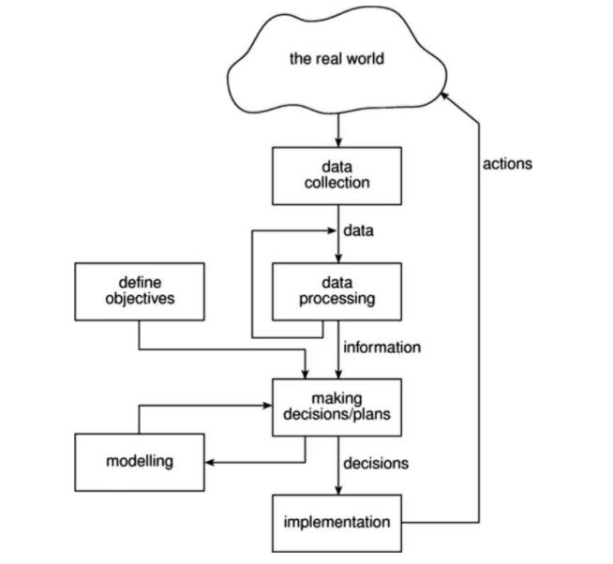
Management control

Slide 32
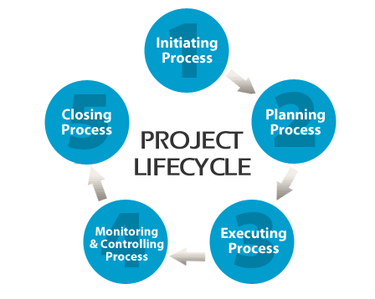
Project Life Cycle

Slide 33
Phases of project Life Cycle
- Project Initiation
- Project Planning
- Project Execution
- Project Monitoring and control
- Project Closure

Slide 34
Traditional vs Modern Project Management
What is traditional project management?
This project management style requires one task to be completed before the next one can begin.
Plans are constructed prior to the start of the project date and the sequential phases are mapped out early to provide clarity on the work that needs to be completed to reach the end goal.
It's still used by many businesses today and works well for projects with a fixed budget or deadline.
Frequently referred to as the "Waterfall" method

Slide 35
3 advantages
No surprises
This strategy allows little room for flexibility or changes once the project begins. The plan is laid out and agreed upon early on, meaning there is little need to readjust and the chance of scope creep is decreased. Both parties agree on the project timeline and tasks, which provides clarity on the process and assigns responsibilities early on everyone knows how they are contributing.
2. Smooth knowledge transfer
Extensive documentation is key with the waterfall methodology. With information readily available at any given time, it's easier for new team members to catch up quickly. Additionally, information won't be lost when an employee chooses to move on to another company.

Slide 36
3. Sets expectations internally and externally
A lot of time is spent putting together a detailed project timeline for the client to review. A major benefit is that the client knows early on what to expect and can plan accordingly. There is also very little involvement needed from then after this initial phase, and they have ample time to gather the assets you need for a particular phase. Internally, team members can plan their time better - which comes in handy when working on multiple projects at once.

Slide 37
What is modern project management?
Modern project management leverages automated tools to help plan, execute, and organize work. It's also viewed as the more flexible method of the two. More professional service businesses are taking on short-term or even one-time projects, so businesses are looking for alternative to the traditional project management method. This is where the modern project management method flourishes - in a fast-paced environment that can handle mid-project changes swiftly and efficiently.

Slide 38
3 advantages
Juggle more projects at once
Instead of having all of your tasks fully outlined at the start of each project (as they are in true, waterfall fashion), use smart technology to create a more flexible method that allows you to start a project without having a complete idea of the end result. This way, you can easily make adjustments to your project as the vision or needs of a client change (without having to go back to the start every time).

Slide 39
Minimize risk and human error
With a smart platform that offers increased visibility over your team and projects, you’ll be able to see when a certain task in your project is going over budget and address it before any real damage is done to your bottom line or client relationships.
The right smart platform will also automatically save client data, calculate billable hours and budgets, and update timelines for you automatically - so that you don’t have to do any manual busywork at the end of the day when you’re exhausted, short on time, and more likely to make mistakes. Just imagine how much more time you’ll have to work on projects when you no longer need to add up your timesheets at the end of every month - the beauty of smart automation!

Slide 40
Be more flexible with your time
With a traditional approach to project management, you’d usually be allocated a fixed amount of days or hours to complete a task. But - what happens when you suddenly get assigned a high priority project, or when you have to work from home for personal reasons?
If you’re working with smart automated software that logs time and tracks utilization, this won’t be an issue. Why? Because you’ll be able to see (in real-time) who is available on your team to take on more work and reassign tasks to them. Or better yet, work remotely on your projects with a true cloud-based platform that lets you share files with your team and communicate with your clients from one interactive dashboard and integrated system- so that you never have to extend a deadline just because you can't make it into the office.

