Slide 1
SPM
CHAPTER 2:
Project Planning
Asst. Prof.Himani Joshi
IT dept
SPCE,Bakrol

Slide 2
What Is a Project Plan?
A project plan is a series of formal documents that define the execution and control stages of a project. The plan includes considerations for risk management, resource management and communications, while also addressing scope, cost and schedule baselines

Slide 3
What Is in a Project Plan?
The project plan answers the who, what, where, why, how and when of the project.
The purpose of a project plan is to guide the execution and control project phases.
As mentioned above, a project plan consists of the following documents:
Project Charter: Provides a general overview of the project. It describes the project’s reasons, goals, objectives, constraints, stakeholders, among other aspects.
Statement of Work: Defines the project’s scope, schedule, deliverables, milestones, and tasks.

Slide 4
Work Breakdown Structure: Breaks down the project scope into the project phases, subprojects, deliverables, and work packages that lead to your final deliverable.
Project Plan: The project plan document is divided in sections to cover the following: scope management, quality management, risk assessment, resource management, stakeholder management, schedule management and the change management plan.

Slide 5
Work Breakdown Structure (WBS)
A Work Breakdown Structure (WBS) is a deliverable-oriented hierarchical decomposition of the work to be executed by the project team to accomplish the project objectives and create the required deliverables.
A WBS is the cornerstone of effective project planning, execution, controlling, monitoring, and reporting. All the work contained within the WBS is to be identified, estimated, scheduled, and budgeted.

Slide 6
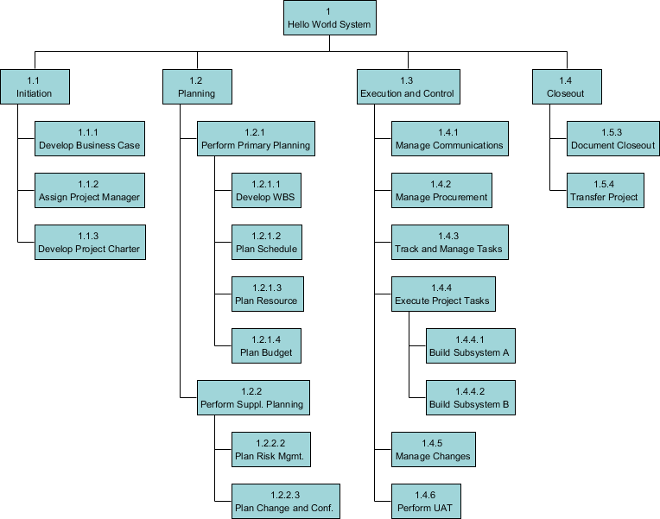

Slide 7
This is a Work Breakdown Structure example:
The first two levels of the WBS (the root node and Level 2) define a set of planned outcomes that collectively and exclusively represent 100% of the project scope. At each subsequent level, the children of a parent node collectively and exclusively represent 100% of the scope of their parent node.

Slide 8
Quality of a Work Breakdown Structures
Definable—can be described and easily understood by project participants.
Manageable—a meaningful unit of work where specific responsibility and authority can be assigned to a responsible individual.
Estimateable—duration can be estimated in time required to complete, and cost can be estimated in resources required to complete.
Independent—minimum interface with or dependence on other ongoing elements (i.e., assignable to a single control account, and clearly distinguishable from other work packages).

Slide 9
Integratable—integrates with other project work elements and with higher level cost estimates and schedules to include the entire project.
Measurable—can be used to measure progress; has start and completion dates and measurable interim milestones.
Adaptable—sufficiently flexible so the addition/elimination of work scope can be readily accommodated in the WBS framework.

Slide 10
Different Forms of Work Breakdown Structure
there are three typical ways in structuring works with a Work Breakdown Structure (WBS). They includes :
phase-based structures
deliverable-based structures and
responsibility-based structures.

Slide 11
Phase-based structures
Define and structure project activities based on the project phases.

Slide 12
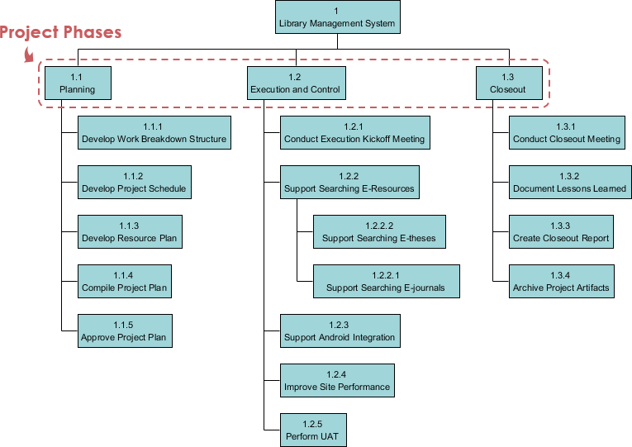

Slide 13
Deliverable-based structures
Define and structure project activities based on the deliverables agreed to deliver.

Slide 14
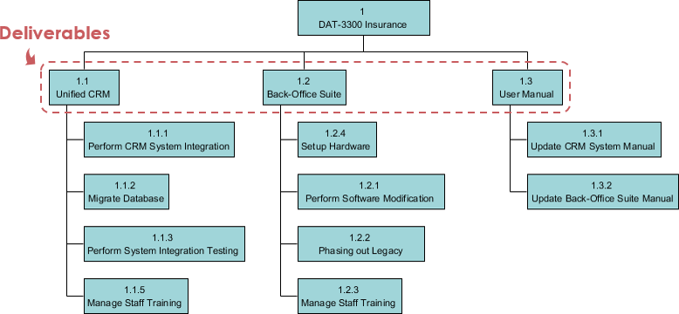

Slide 15
Responsibility-based structure
Define and structure project activities based on the organization units that will work on the project.

Slide 16
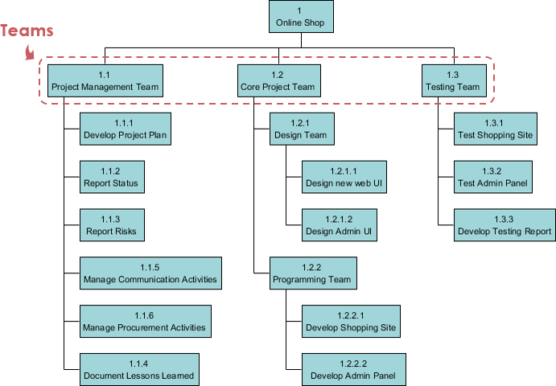

Slide 17
Other Use Cases of Breakdown Structure
Typical use of breakdown structure as a project management tool includes Work Breakdown Structure (WBS), Resource Breakdown Structure, Risk Breakdown Structure and Organization Breakdown Structure (OBS), or sometimes known as Organization Chart.

Slide 18
Resource Breakdown Structure
Resource Breakdown Structure (RBS) is a project management tool that provides a hierarchical decomposition of resources, either structured by resource category, types or by IT/business function that has resource needs.

Slide 19
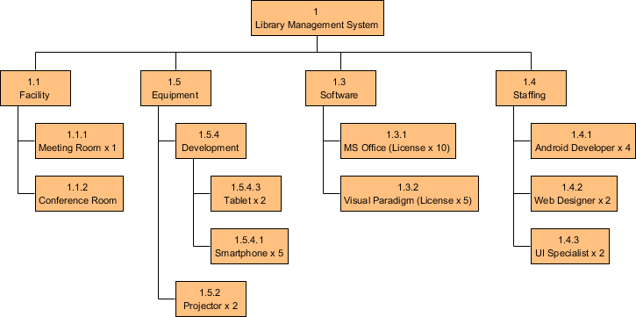

Slide 20
Risk Breakdown Structure
Risk breakdown Structure is the hierarchical decomposition of risks, starting from the root node element that represents the project, and going down to the various risk categories, and then finer level risks.

Slide 21
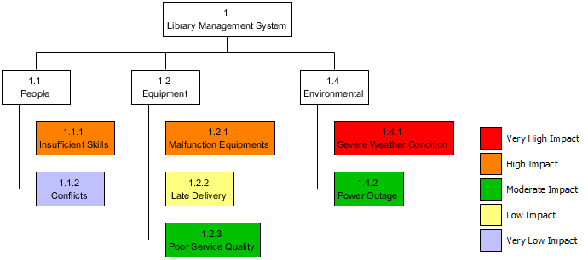

Slide 22
Organizational Breakdown Structure
Organizational Breakdown Structure, or sometimes known as Organization Chart, is a widely used project management tool for representing project organization. It typically begins with the project sponsor, and with all key stakeholders included. In presenting the organization structure, consider the organization or group that is requesting the project and the level of their sponsorship and authority.

Slide 23
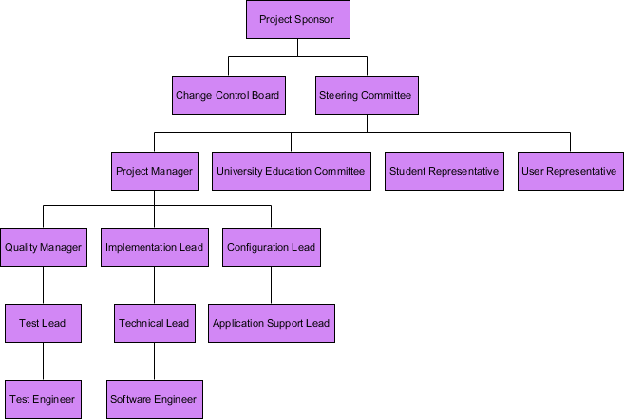

Slide 24
Selecting the Right Project Management Method
The key factor to determine the right methodology is the type of project or process that you manage. With a vast array of frameworks and methodologies, narrowing down the approach based on specific criteria is critical. These factors include:
Project focus (e.g. task activities versus final product)
Customer and stakeholder involvement
Industry
Flexibility of timeline
Allotted budget
Number and type of teams working on the project

Slide 25
Complexity of projects
Resources needed versus resources available
Scalability of project
Resistance to change
Rigidity of structure
Specialization of roles
Set start and end dates

Slide 26
SDLC
SDLC is a process followed for a software project, within a software organization. It consists of a detailed plan describing how to develop, maintain, replace and alter or enhance specific software. The life cycle defines a methodology for improving the quality of software and the overall development process.
SDLC is the acronym of Software Development Life Cycle.
It is also called as Software Development Process.
SDLC is a framework defining tasks performed at each step in the software development process.

Slide 27
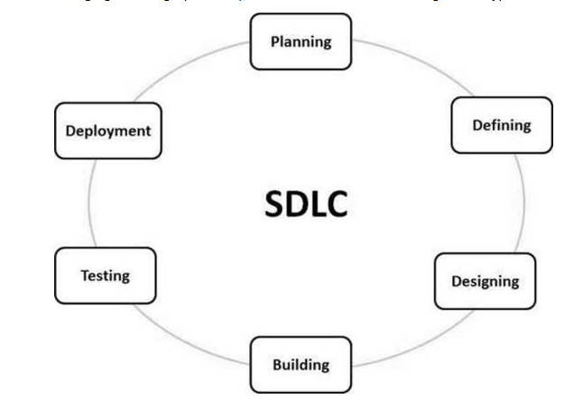
Graphical Representation of SDLC

Slide 28
SDLC Models
There are various software development life cycle models defined and designed which are followed during the software development process. These models are also referred as Software Development Process Models".

Slide 29
SDLC models
Waterfall Model
Iterative Model
Spiral Model
Other related methodologies are Agile Model, RAD Model, Rapid Application Development and Prototyping Models.

Slide 30
Software Process and Software Process Models
A software process (also knows as software methodology) is a set of related activities that leads to the production of the software. These activities may involve the development of the software from the scratch, or, modifying an existing system.

Slide 31
Any software process must include the following four activities:
Software specification (or requirements engineering): Define the main functionalities of the software and the constrains around them.
Software design and implementation: The software is to be designed and programmed.
Software verification and validation: The software must conforms to it’s specification and meets the customer needs.
Software evolution (software maintenance): The software is being modified to meet customer and market requirements changes.

Slide 32
Software Process Models
A software process model is a simplified representation of a software process. Each model represents a process from a specific perspective.
These generic models are abstractions of the process that can be used to explain different approaches to the software development. They can be adapted and extended to create more specific processes.

Slide 33
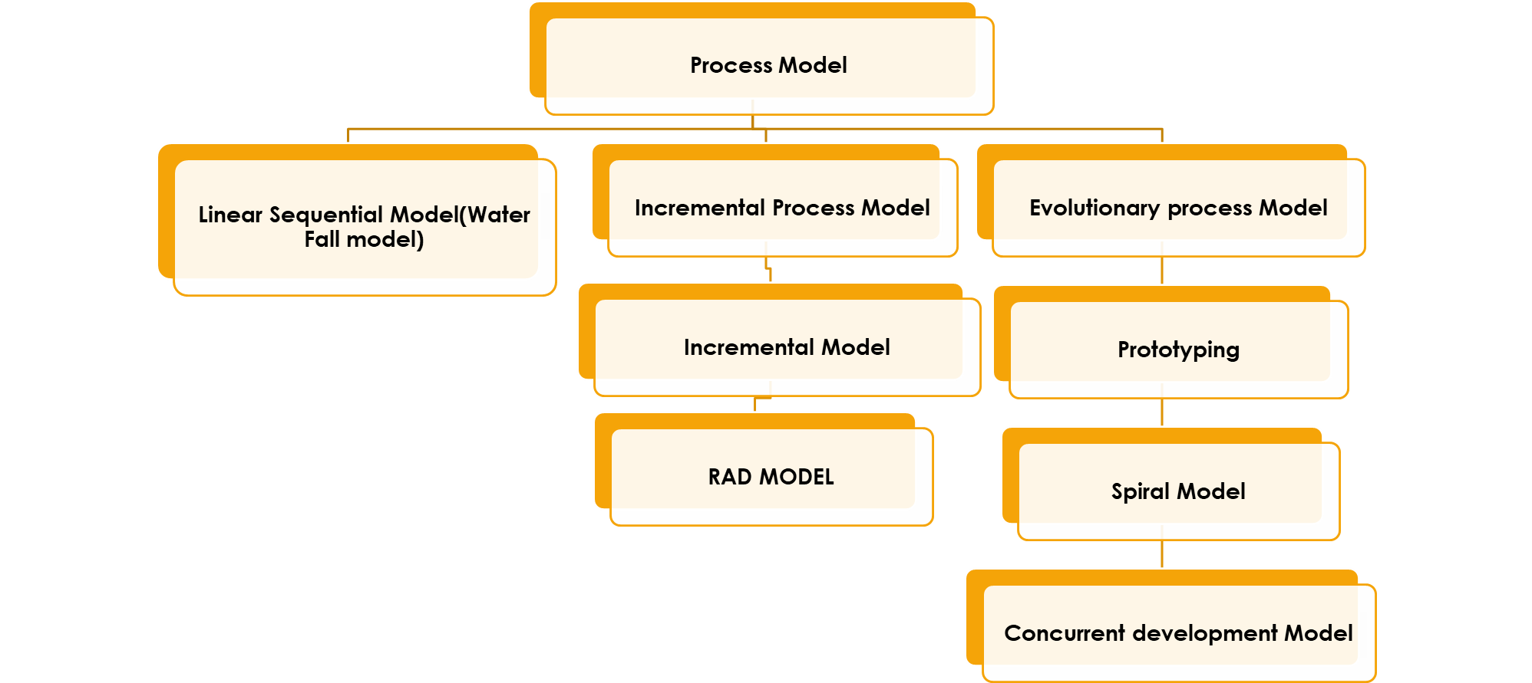
Types of Models

Slide 34
Linear Sequential Model(Water Fall model)
The Waterfall Model was the first Process Model to be introduced. It is also referred to as a linear-sequential life cycle model. It is very simple to understand and use. In a waterfall model, each phase must be completed before the next phase can begin and there is no overlapping in the phases.
The waterfall Model illustrates the software development process in a linear sequential flow. This means that any phase in the development process begins only if the previous phase is complete. In this waterfall model, the phases do not overlap.
"The Waterfall" approach, the whole process of software development is divided into separate phases. In this Waterfall model, typically, the outcome of one phase acts as the input for the next phase sequentially.
PHASES OF WATER FALL MODEL:
Requirement Gathering and analysis − All possible requirements of the system to be developed are captured in this phase and documented in a requirement specification document.
System Design − The requirement specifications from first phase are studied in this phase and the system design is prepared. This system design helps in specifying hardware and system requirements and helps in defining the overall system architecture.
SOFTWARE ENGINEERING:2160701

Slide 35
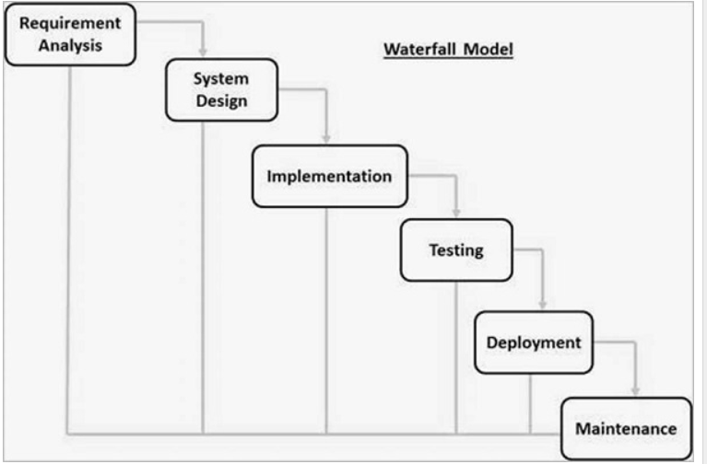
Implementation − With inputs from the system design, the system is first developed in small programs called units, which are integrated in the next phase. Each unit is developed and tested for its functionality, which is referred to as Unit Testing.
Integration and Testing − All the units developed in the implementation phase are integrated into a system after testing of each unit. Post integration the entire system is tested for any faults and failures.
Deployment of system − Once the functional and non-functional testing is done; the product is deployed in the customer environment or released into the market.

Slide 36
Maintenance − There are some issues which come up in the client environment. To fix those issues, patches are released. Also to enhance the product some better versions are released. Maintenance is done to deliver these changes in the customer environment.
All these phases are cascaded to each other in which progress is seen as flowing steadily downwards (like a waterfall) through the phases. The next phase is started only after the defined set of goals are achieved for previous phase and it is signed off, so the name "Waterfall Model". In this model, phases do not overlap.
ADVANTAGES:
Simple and easy to understand and use
Easy to manage due to the rigidity of the model. Each phase has specific deliverables and a review process.
Phases are processed and completed one at a time.
Works well for smaller projects where requirements are very well understood.
Clearly defined stages.
Well understood milestones.
Easy to arrange tasks.
Process and results are well documented.

Slide 37
The major disadvantages of the Waterfall Model are as follows
No working software is produced until late during the life cycle.
High amounts of risk and uncertainty.
Not a good model for complex and object-oriented projects.
Poor model for long and ongoing projects.
Not suitable for the projects where requirements are at a moderate to high risk of changing. So, risk and uncertainty is high with this process model.
It is difficult to measure progress within stages.
Cannot accommodate changing requirements.
Adjusting scope during the life cycle can end a project.
Integration is done as a "big-bang. at the very end, which doesn't allow identifying any technological or business bottleneck or challenges early.

Slide 38
Incremental model
In incremental model the whole requirement is divided into various builds. Multiple development cycles take place here, making the life cycle a “multi-waterfall” cycle. Cycles are divided up into smaller, more easily managed modules.
In this model, each module passes through the requirements, design, implementation and testing phases. A working version of software is produced during the first module, so you have working software early on during the software life cycle. Each subsequent release of the module adds function to the previous release. The process continues till the complete system is achieved.

Slide 39
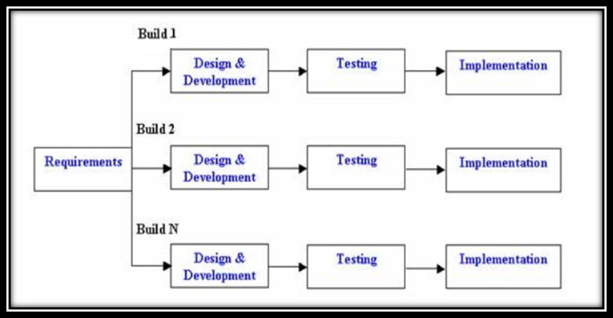

Slide 40
Advantages of Incremental model:
Generates working software quickly and early during the software life cycle.
This model is more flexible – less costly to change scope and requirements.
It is easier to test and debug during a smaller iteration.
In this model customer can respond to each built.
Lowers initial delivery cost.
Easier to manage risk because risky pieces are identified and handled during it’s iteration.
Disadvantages of Incremental model:
Needs good planning and design.
Needs a clear and complete definition of the whole system before it can be broken down and built incrementally.
Total cost is higher than waterfall.
When to use the Incremental model:
This model can be used when the requirements of the complete system are clearly defined and understood.
Major requirements must be defined; however, some details can evolve with time.
There is a need to get a product to the market early.
A new technology is being used
Resources with needed skill set are not available
There are some high risk features and goals.

Slide 41
RAD model
RAD model is Rapid Application Development model. It is a type of incremental model. In RAD model the components or functions are developed in parallel as if they were mini projects. The developments are time boxed, delivered and then assembled into a working prototype. This can quickly give the customer something to see and use and to provide feedback regarding the delivery and their requirements.

Slide 42
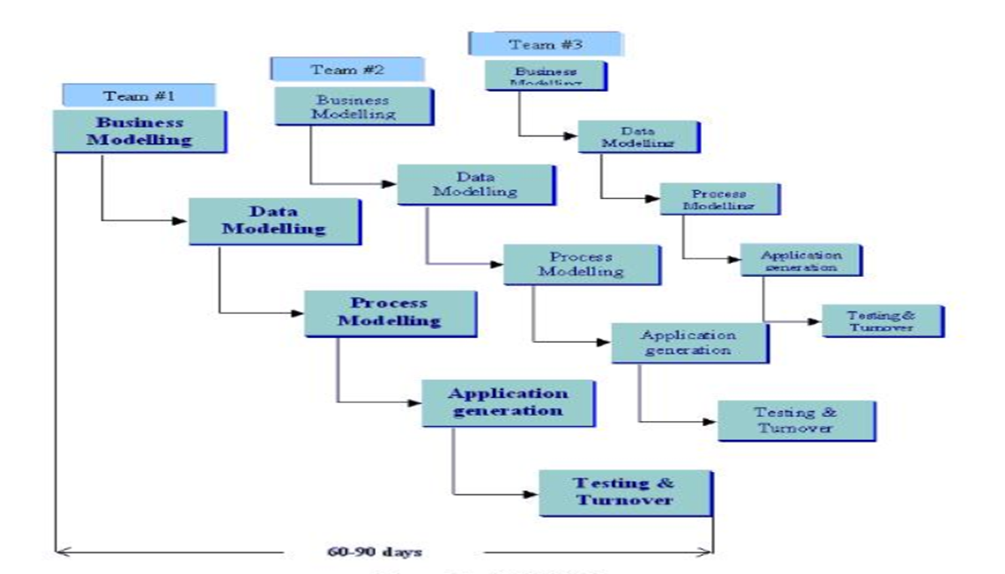

Slide 43
The phases in the rapid application development (RAD) model are:
Business modeling: The information flow is identified between various business functions. Data modeling: Information gathered from business modeling is used to define data objects that are needed for the business. Process modeling: Data objects defined in data modeling are converted to achieve the business information flow to achieve some specific business objective. Description are identified and created for CRUD of data objects. Application generation: Automated tools are used to convert process models into code and the actual system. Testing and turnover: Test new components and all the interfaces.
Advantages of the RAD model:
Reduced development time.
Increases reusability of components
Quick initial reviews occur
Encourages customer feedback
Integration from very beginning solves a lot of integration issues.

Slide 44
Disadvantages of RAD model:
Depends on strong team and individual performances for identifying business requirements.
Only system that can be modularized can be built using RAD
Requires highly skilled developers/designers.
High dependency on modeling skills
Inapplicable to cheaper projects as cost of modeling and automated code generation is very high.
When to use RAD model:
RAD should be used when there is a need to create a system that can be modularized in 2-3 months of time.
It should be used if there’s high availability of designers for modeling and the budget is high enough to afford their cost along with the cost of automated code generating tools.
RAD SDLC model should be chosen only if resources with high business knowledge are available and there is a need to produce the system in a short span of time (2-3 months).

Slide 45
Prototype model
The basic idea in Prototype model is that instead of freezing the requirements before a design or coding can proceed, a throw way prototype is built to understand the requirements. This prototype is developed based on the currently known requirements. Prototype model is a software development model. By using this prototype, the client can get an “actual feel” of the system, since the interactions with prototype can enable the client to better understand the requirements of the desired system. Prototyping is an attractive idea for complicated and large systems for which there is no manual process or existing system to help determining the requirements.
The prototype are usually not complete systems and many of the details are not built in the prototype. The goal is to provide a system with overall functionality.

Slide 46
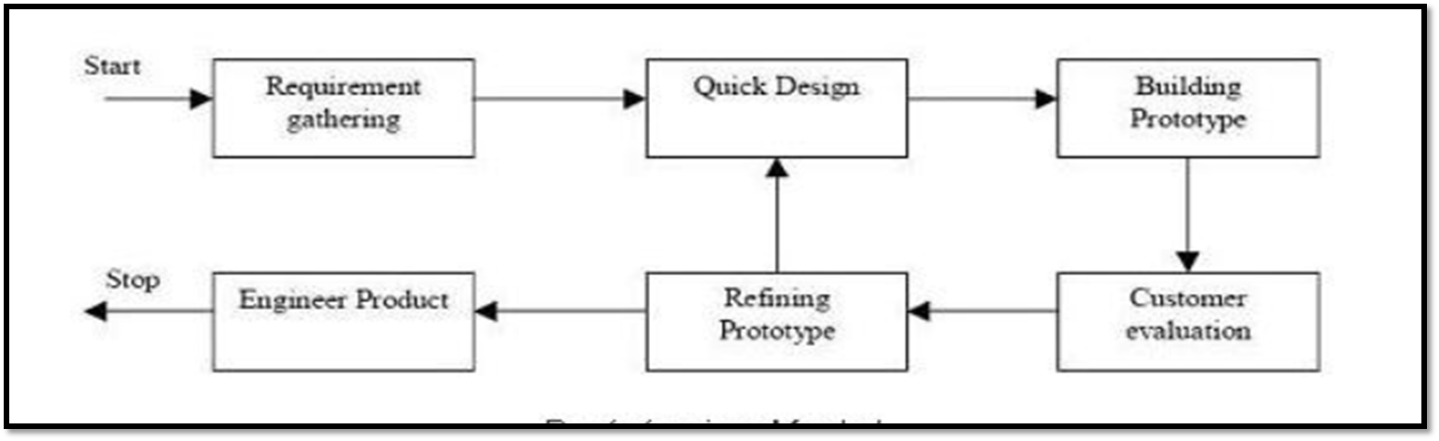

Slide 47
Advantages of Prototype model:
Users are actively involved in the development
Since in this methodology a working model of the system is provided, the users get a better understanding of the system being developed.
Errors can be detected much earlier.
Quicker user feedback is available leading to better solutions.
Missing functionality can be identified easily
Confusing or difficult functions can be identified Requirements validation, Quick implementation of, incomplete, but functional, application.
Disadvantages of Prototype model:
Leads to implementing and then repairing way of building systems.
Practically, this methodology may increase the complexity of the system as scope of the system may expand beyond original plans.
Incomplete application may cause application not to be used as the full system was designed Incomplete or inadequate problem analysis.

Slide 48
When to use Prototype model:
Prototype model should be used when the desired system needs to have a lot of interaction with the end users.
Typically, online systems, web interfaces have a very high amount of interaction with end users, are best suited for Prototype model. It might take a while for a system to be built that allows ease of use and needs minimal training for the end user.
Prototyping ensures that the end users constantly work with the system and provide a feedback which is incorporated in the prototype to result in a useable system. They are excellent for designing good human computer interface systems.

Slide 49
SPIRAL MODEL
The spiral model is similar to the incremental model, with more emphasis placed on risk analysis. The spiral model has four phases: Planning, Risk Analysis, Engineering and Evaluation. A software project repeatedly passes through these phases in iterations (called Spirals in this model). The baseline spiral, starting in the planning phase, requirements are gathered and risk is assessed. Each subsequent spirals builds on the baseline spiral
Planning Phase: Requirements are gathered during the planning phase. Requirements like ‘BRS’ that is ‘Business Requirement Specifications’ and ‘SRS’ that is ‘System Requirement specifications’
Risk Analysis: In the risk analysis phase, a process is undertaken to identify risk and alternate solutions. A prototype is produced at the end of the risk analysis phase. If any risk is found during the risk analysis then alternate solutions are suggested and implemented.
Engineering Phase: In this phase software is developed, along with testing at the end of the phase. Hence in this phase the development and testing is done.
Evaluation phase: This phase allows the customer to evaluate the output of the project to date before the project continues to the next spiral.

Slide 50
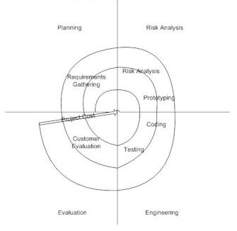
Advantages of Spiral model:
High amount of risk analysis hence, avoidance of Risk is enhanced.
Good for large and mission-critical projects.
Strong approval and documentation control.
Additional Functionality can be added at a later date.
Software is produced early in the software life cycle.
Disadvantages of Spiral model:
Can be a costly model to use.
Risk analysis requires highly specific expertise.
Project’s success is highly dependent on the risk analysis phase.
Doesn’t work well for smaller projects.

Slide 51
Agile model
Agile model believes that every project needs to be handled differently and the existing methods need to be tailored to best suit the project requirements. In Agile, the tasks are divided to time boxes (small time frames) to deliver specific features for a release.
Iterative approach is taken and working software build is delivered after each iteration. Each build is incremental in terms of features; the final build holds all the features required by the customer.
Following are the Agile Manifesto principles −
Individuals and interactions − In Agile development, self-organization and motivation are important, as are interactions like co-location and pair programming.
Working software − Demo working software is considered the best means of communication with the customers to understand their requirements, instead of just depending on documentation.
Customer collaboration − As the requirements cannot be gathered completely in the beginning of the project due to various factors, continuous customer interaction is very important to get proper product requirements.
Responding to change − Agile Development is focused on quick responses to change and continuous development.

Slide 52
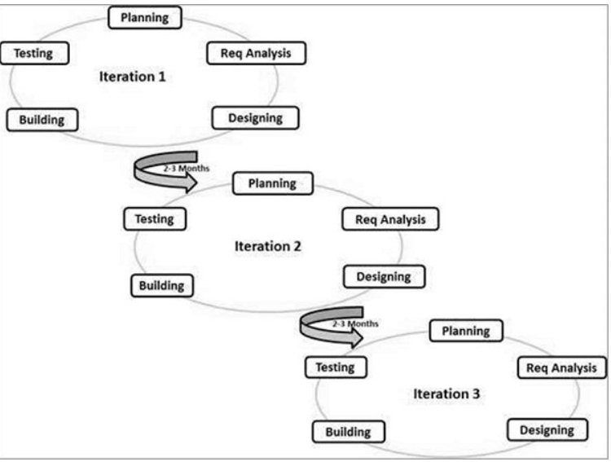
The advantages of the Agile Model are as follows −
Is a very realistic approach to software development.
Promotes teamwork and cross training.
Functionality can be developed rapidly and demonstrated.
Resource requirements are minimum.
Suitable for fixed or changing requirements
Delivers early partial working solutions.
Good model for environments that change steadily.
Minimal rules, documentation easily employed.
Enables concurrent development and delivery within an overall planned context.
Little or no planning required.
Easy to manage.
Gives flexibility to developers.

Slide 53
The disadvantages of the Agile Model are as follows −
Not suitable for handling complex dependencies.
More risk of sustainability, maintainability and extensibility.
An overall plan, an agile leader and agile PM practice is a must without which it will not work.
Strict delivery management dictates the scope, functionality to be delivered, and adjustments to meet the deadlines.
Depends heavily on customer interaction, so if customer is not clear, team can be driven in the wrong direction.
There is a very high individual dependency, since there is minimum documentation generated.
Transfer of technology to new team members may be quite challenging due to lack of documentation.

Slide 54
SPIRAL MODEL | WATERFALL MODEL
Spiral model is not suitable for small projects. | Waterfall model is suitable for small projects.
Better risk management. | High amount of risk and uncertainty.
Process is complex. | Easy to understand.
The process may go indefinitely. | Stages are clearly defined.
This model is suitable for long and ongoing projects. | This model is not suitable for long and ongoing projects.
Iterations are followed | Sequence is followed
Flexible with user requirements | Requirements once fixed cannot be modified
Important:
Difference between all process models,
Refinements are easily possible | Refinements are not so easy
Phases are repeated itself | Phases are processed and completed one at a time.

