Slide 1



2150703
Analysis and Design of Algorithms (ADA)
Unit-5
Greedy Algorithms
Dr. Gopi Sanghani
9825621471
gopi.sanghani@darshan.ac.in

Slide 2
Topics to be Covered
General Characteristics of greedy algorithms
Elements of Greedy Strategy
Make change Problem
Minimum Spanning trees (Kruskal’s algorithm, Prim’s algorithm)
The Knapsack Problem
Job Scheduling Problem
Huffman code.

Slide 3
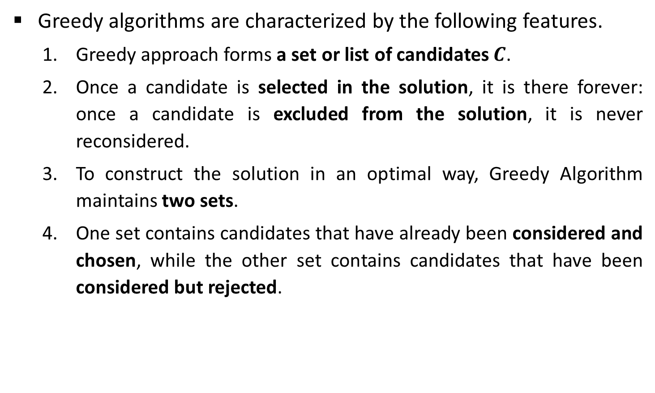
Characteristics of Greedy Algorithms
Greedy algorithms are characterized by the following features.
Greedy approach forms a set or list of candidates $C$.
Once a candidate is selected in the solution, it is there forever: once a candidate is excluded from the solution, it is never reconsidered.
To construct the solution in an optimal way, Greedy Algorithm maintains two sets.
One set contains candidates that have already been considered and chosen, while the other set contains candidates that have been considered but rejected.

Slide 4
Elements of Greedy Strategy
The greedy algorithm consists of four functions.
Solution Function:- A function that checks whether chosen set of items provides a solution.
Feasible Function:- A function that checks the feasibility of a set.
Selection Function:- The selection function tells which of the candidates is the most promising.
Objective Function:- An objective function, which does not appear explicitly, but gives the value of a solution.

Slide 5
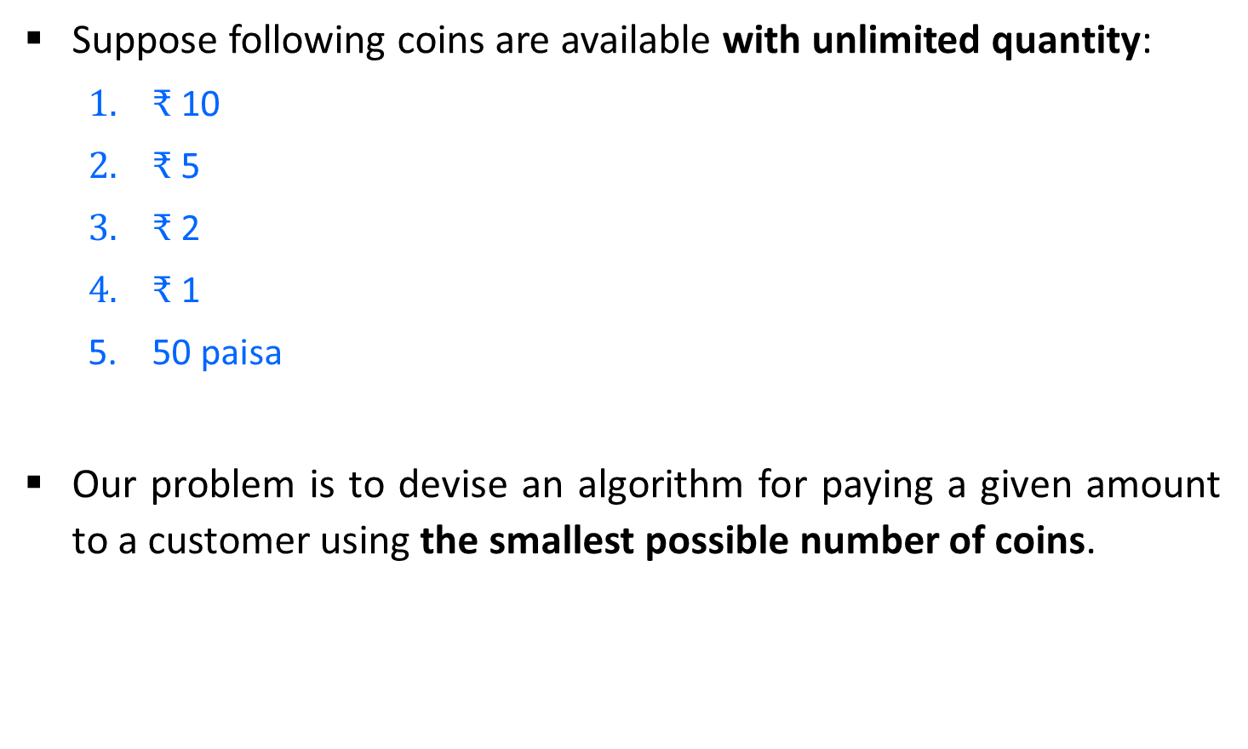
Make Change Problem
Suppose following coins are available with unlimited quantity:
$₹$ 10
$₹$ 5
$₹$ 2
$₹$ 1
50 paisa
Our problem is to devise an algorithm for paying a given amount to a customer using the smallest possible number of coins.

Slide 6

Make Change Problem
If suppose, we need to pay an amount of $₹$ 28/- using the available coins.
Here we have a candidate (coins) set $C = \{10, 5, 2, 1, .5\}$
The greedy solution is,
Selected coins are,
Amount
coins
quantity
0
20
25
27
28
10
2
5
1
Total required coins = 5
2
1
Selected coins = {10, 5, 2, 1}
1
1

Slide 7
Make Change - Algorithm
# Input: C = {10, 5, 2, 1, 0.5} //C is a candidate set
# Output: S: set of selected coins
Function make-change(n): set of coins
S ← Ø {S is a set that will hold the solution}
sum ← 0 {sum of the items in solution set S}
while sum ≠ n do
x ← the largest item in C such that sum + x ≤ n
if there is no such item then
return "no solution found"
S ← S U {a coin of value x)
sum ← sum + x
return S] ← A[j+1] A[temp

Slide 8
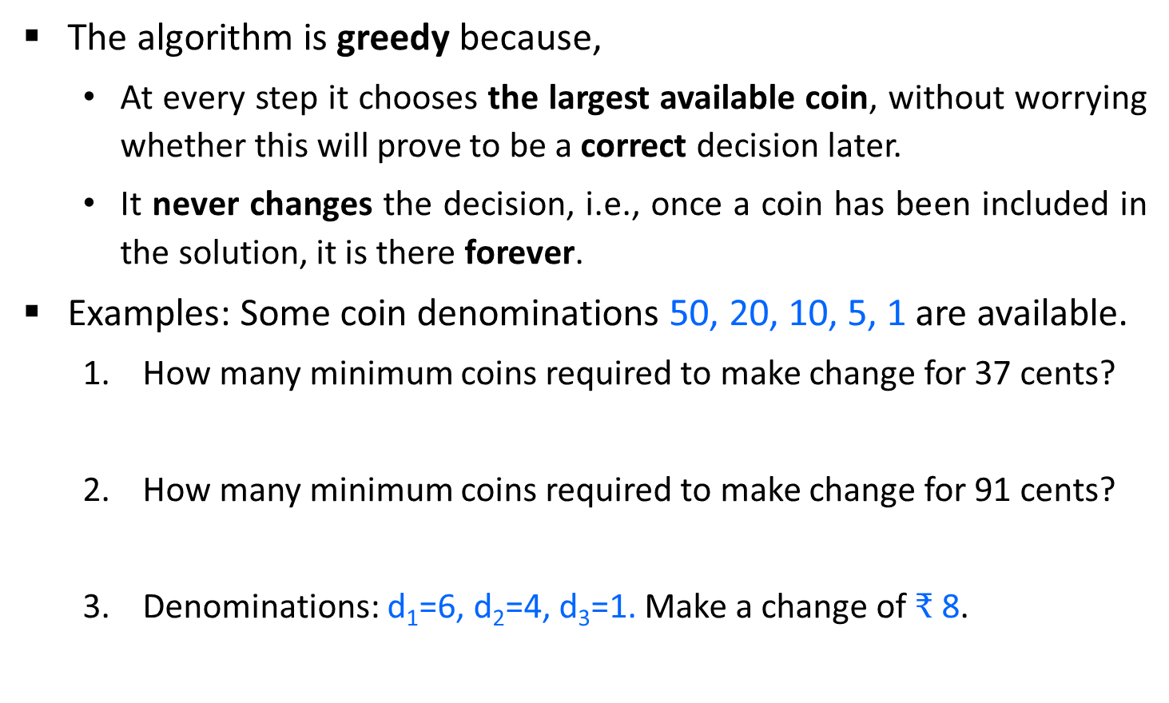
Make Change – The Greedy Property
The algorithm is greedy because,
At every step it chooses the largest available coin, without worrying whether this will prove to be a correct decision later.
It never changes the decision, i.e., once a coin has been included in the solution, it is there forever.
Examples: Some coin denominations 50, 20, 10, 5, 1 are available.
How many minimum coins required to make change for 37 cents?
How many minimum coins required to make change for 91 cents?
Denominations: d₁=6, d₂=4, d₃=1. Make a change of $₹$8.
5
4
3
The minimum coins required are
2

Slide 9
Minimum Spanning Tree

Slide 10
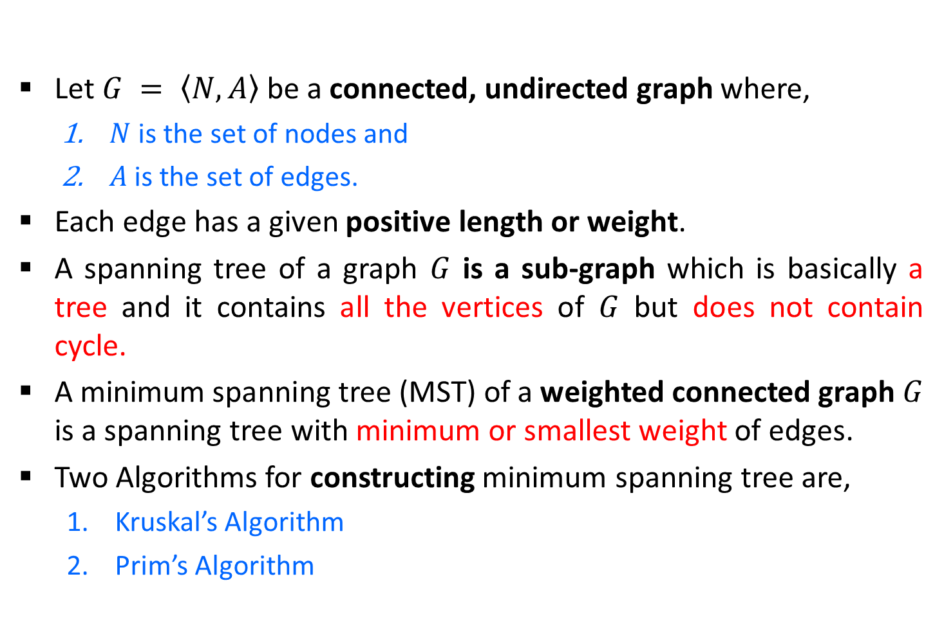
Minimum Spanning Tree (MST)
Let $G = \left\langle N,\left.A\right\rangle \right.$be a connected, undirected graph where,
$N$ is the set of nodes and
$A$ is the set of edges.
Each edge has a given positive length or weight.
A spanning tree of a graph $G$ is a sub-graph which is basically a tree and it contains all the vertices of $G$ but does not contain cycle.
A minimum spanning tree (MST) of a weighted connected graph $G$ is a spanning tree with minimum or smallest weight of edges.
Two Algorithms for constructing minimum spanning tree are,
Kruskal’s Algorithm
Prim’s Algorithm

Slide 11
Spanning Tree
Graph
A
Spanning Tree
A
B
C
B
C
D
E
F
G
D
E
F
G
H
H
Graph
Spanning Tree
A
A
B
C
E
B
C
E
D
F
D
F

Slide 12
MST - Kruskal’s Algorithm - Example
A
Step 2: Taking next
min edge (B,C)
4
5
Step 4: Taking next
min edge (A,B)
6
6
B
E
B
3
A
4
5
7
2
2
C
D
B
E
C
D
1
3
1
2
Step 3: Taking next
min edge (B,E)
C
D
Step 1: Taking min
edge (C,D)
B
E
1
3
C
D
2
So, we obtained a minimum
spanning tree of cost:
4 + 2 + 1 + 3 = 10
1
C
D
1

Slide 13

Kruskal’s Algorithm
Function Kruskal(G = (N, A))
Sort A by increasing length
n ← the number of nodes in N
T ← Ø {edges of the minimum spanning tree}
Define n sets, containing a different element of set N
repeat
e ← {u, v} //e is the shortest edge not yet considered
ucomp ← find(u)
vcomp ← find(v)
if ucomp ≠ vcomp then merge(ucomp, vcomp)
T ← T U {e}
until T contains n - 1 edges
return T
find(u) tells in which connected component a node $u$ is found
merge(ucomp, vcomp) is used to merge two connected components.

Slide 14
Kruskal’s Algorithm - Example
Find the minimum spanning tree for the following graph using Kruskal’s Algorithm.
1
1
2
2
3
4
6
4
5
6
4
5
6
3
8
7
4
3
7

Slide 15
Kruskal’s Algorithm - Example
Step:1
Edges | Weight
{1, 2} | 1
{2, 3} | 2
{4, 5} | 3
{6, 7} | 3
{1, 4} | 4
{2, 5} | 4
{4, 7} | 4
{3, 5) | 5
{2, 4} | 6
{3, 6} | 6
{5, 7} | 7
{5, 6} | 8
Sort the edges in increasing order of their weight.
1
1
2
2
3
4
6
4
5
6
4
5
6
3
8
7
4
3
7

Slide 16
Kruskal’s Algorithm - Example
Step:2
Edges | Weight
{1, 2} | 1
{2, 3} | 2
{4, 5} | 3
{6, 7} | 3
{1, 4} | 4
{2, 5} | 4
{4, 7} | 4
{3, 5) | 5
{2, 4} | 6
{3, 6} | 6
{5, 7} | 7
{5, 6} | 8
Select the minimum weight edge but no cycle.
√
1
2
√
1
1
2
2
3
3
√
√
4
6
4
5
6
√
4
4
5
5
6
6
√
3
8
7
4
3
7
7

Slide 17
Kruskal’s Algorithm - Example
Step:3
The minimum spanning tree for the given graph
Total Cost = 17
1
1
2
1
2
2
3
3
4
4
4
5
5
6
6
3
4
3
7
7

Slide 18
Kruskal’s Algorithm - Example
Step | Edges considered - {u, v} | Connected Components
Init. | - | {1} {2} {3} {4} {5} {6} {7}
1 | {1,2} | {1,2} (3} {4} {5} {6} {7}
2 | {2,3} | {1,2,3} {4} {5} {6} {7}
3 | {4,5} | {1,2,3} {4,5} {6} {7}
4 | {6,7} | {1,2,3} {4,5} {6,7}
5 | {1,4} | {1,2,3,4,5} {6,7}
6 | {2,5} | Rejected
7 | {4,7} | {1,2,3,4,5,6,7}
Edges | Weight
{1, 2} | 1
{2, 3} | 2
{4, 5} | 3
{6, 7} | 3
{1, 4} | 4
{2, 5} | 4
{4, 7} | 4
Total Cost = 17

Slide 19


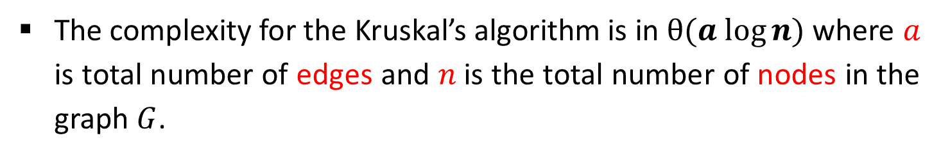
Exercises – Home Work
Write the kruskal’s Algorithm to find out Minimum Spanning Tree. Apply the same and find MST for the graph given below.
$$1.$$
$$2.$$
3
A
1
10
F
C
3
A
B
C
4
4
3
7
2
4
5
8
5
B
6
D
E
F
G
4
D
H
4
2
3
2
8
1
9
3
G
E
3
H
The complexity for the Kruskal’s algorithm is in $θ(a log⁡n)$where $a$ is total number of edges and $n$is the total number of nodes in the graph $G$.

Slide 20
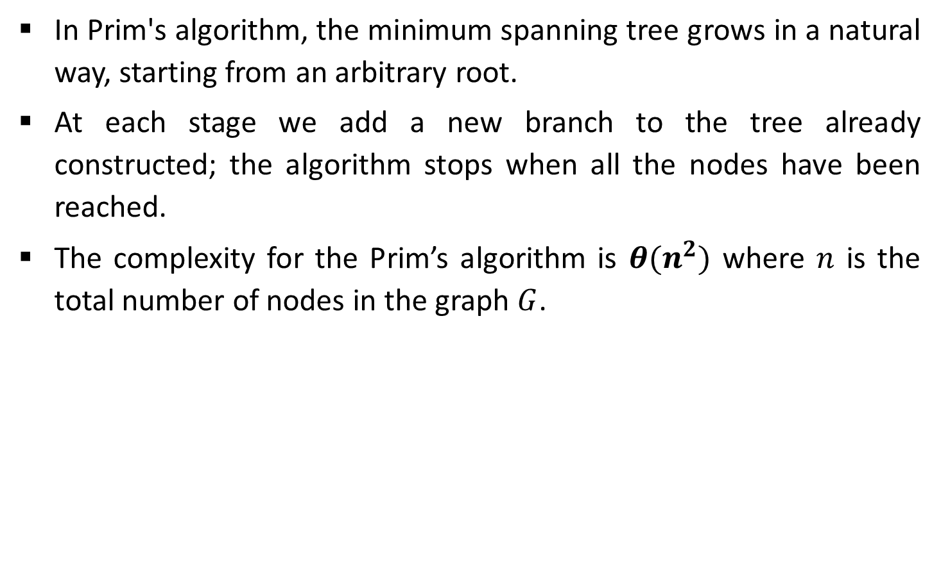
Prim’s Algorithm
In Prim's algorithm, the minimum spanning tree grows in a natural way, starting from an arbitrary root.
At each stage we add a new branch to the tree already constructed; the algorithm stops when all the nodes have been reached.
The complexity for the Prim’s algorithm is $θ(n^{2})$ where $n$ is the total number of nodes in the graph $G$.

Slide 21
Prim’s Algorithm - Example
Find the minimum spanning tree for the following graph using Prim’s Algorithm.
1
1
2
2
3
4
6
4
5
6
4
5
6
3
8
7
4
3
7

Slide 22
Prim’s Algorithm - Example
Step:2
Node | Edges
1 | {1, 2}, {1, 4}
1, 2 | {1, 4}, {2, 3} {2, 4}, {2, 5}
1, 2, 3 | {1,4}, {2,4}, {2,5}, {3,5}, {3,6}
1, 2, 3, 4 | {2,4} {2,5} {3,5} {3,6} {4,5} {4,7}
1, 2, 3, 4, 5 | {4,7}
1, 2, 3, 4, 5, 6 | {6, 7}
Step:1
Select any arbitrary node.
Find an edge with minimum weight
1
1
2
2
3
4
6
4
5
6
4
5
6
3
8
7
4
3
7

Slide 23
Prim’s Algorithm - Example
The minimum spanning tree for the given graph
1
1
2
2
3
Node | Edges
1 | {1, 2}
1, 2 | {2, 3}
1, 2, 3 | {1, 4}
1, 2, 3, 4 | {4, 5}
1, 2, 3, 4, 5 | {4, 7}
1, 2, 3, 4, 5, 6 | {6, 7}
4
4
5
6
3
4
3
Total Cost = 17
7

Slide 24
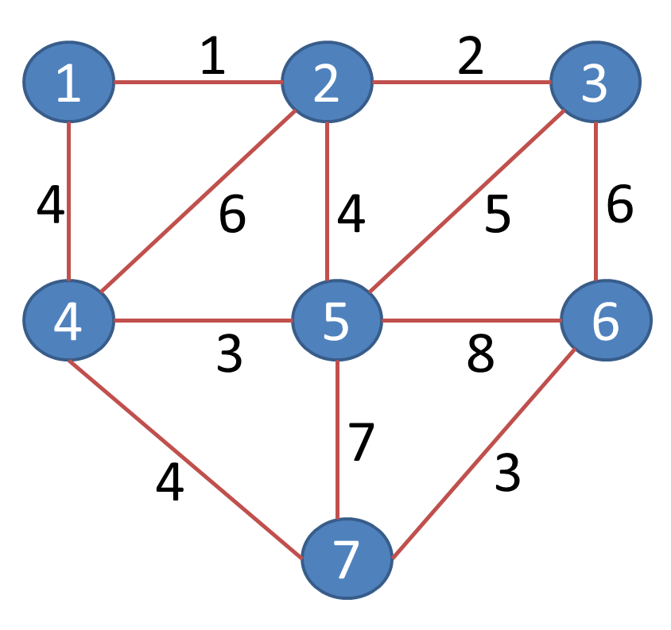
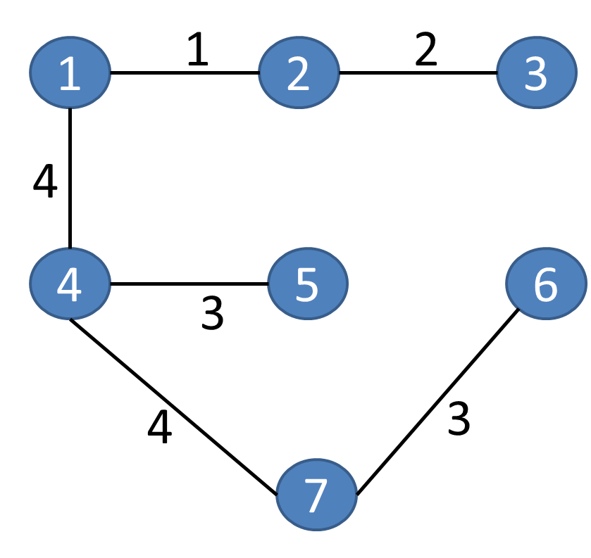
Prim’s Algorithm
Cost = 17
Step | Edge Selected {u, v} | Set B | Edges Considered
Init. | - | {1} | --
1 | {1, 2} | {1,2} | {1,2} {1,4}
2 | {2, 3} | {1,2,3} | {1,4} {2,3} {2,4} {2,5}
3 | {1, 4} | {1,2,3,4} | {1,4} {2,4} {2,5} {3,5} {3,6}
4 | {4, 5} | {1,2,3,4,5} | {2,4} {2,5} {3,5} {3,6} {4,5} {4,7}
5 | {4, 7} | {1,2,3,4,5,7} | {2,4} {2,5} {3,5} {3,6} {4,7} {5,6} {5,7}
6 | {6,7} | {1,2,3,4,5,6,7} | {2,4} {2,5} {3,5} {3,6} {5,6} {5,7} {6,7}

Slide 25
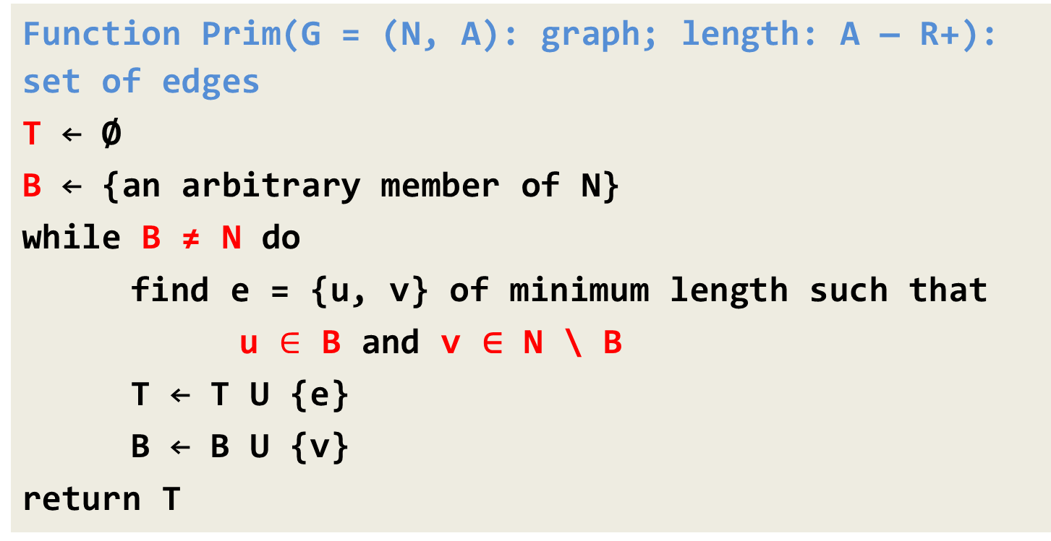
Prim’s Algorithm
Function Prim(G = (N, A): graph; length: A — R+): set of edges
T ← Ø
B ← {an arbitrary member of N}
while B ≠ N do
find e = {u, v} of minimum length such that
u $∈$ B and v ∈ N \ B
T ← T U {e}
B ← B U {v}
return T

Slide 26
Exercises – Home Work
Write the Prim’s Algorithm to find out Minimum Spanning Tree. Apply the same and find MST for the graph given below.
$$1.$$
$$2.$$
3
A
1
10
F
C
3
A
B
C
4
4
3
7
2
4
5
8
5
B
6
D
E
F
G
4
D
H
4
2
3
2
8
1
9
3
G
E
3
H

Slide 27
Single Source Shortest Path – Dijkstra’s Algorithm

Slide 28
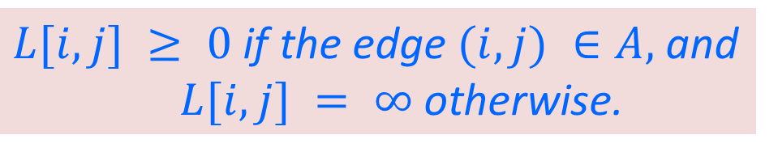
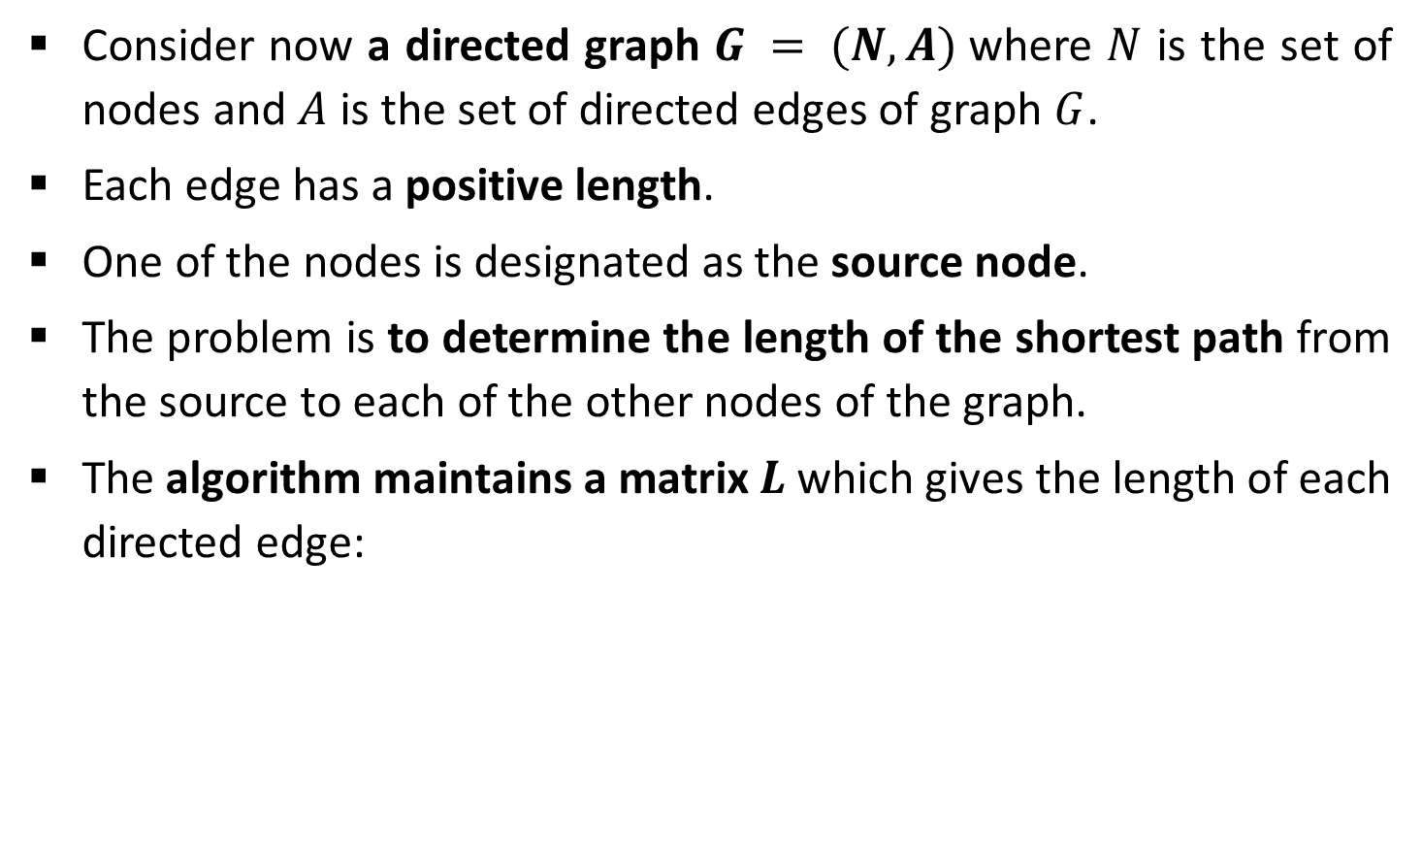
Dijkstra’s Algorithm
Consider now a directed graph $G = (N, A)$where $N$ is the set of nodes and $A$ is the set of directed edges of graph $G$.
Each edge has a positive length.
One of the nodes is designated as the source node.
The problem is to determine the length of the shortest path from the source to each of the other nodes of the graph.
The algorithm maintains a matrix $L$ which gives the length of each directed edge:
$L[i, j] ≥ 0$ if the edge $(i, j) ∈A,$and
$L[i, j] = ∞$otherwise.

Slide 29
Dijkstra’s Algorithm - Example
1
Single source shortest path algorithm
10
50
5
2
100
30
10
5
20
Source node = 1
Step
v
C
2
3
4
5
4
3
50
Init.
-
{2, 3, 4, 5}
50
30
100
10
Is there path from 1 - 5 - 2
Is there path from 1 - 5 - 3
Is there path from 1 - 5 - 4
1
5
{2, 3, 4}
50
30
20
10
No
Yes
Compare cost of 1 – 5 – 4 and 1- 4

Slide 30
Dijkstra’s Algorithm - Example
1
Single source shortest path algorithm
10
50
5
2
100
30
10
5
20
Source node = 1
Step
v
C
2
3
4
5
4
3
50
Init.
-
{2, 3, 4, 5}
50
30
100
10
Is there path from 1 - 4 - 5
Is there path from 1 - 4 - 2
Is there path from 1 - 4 - 3
1
5
{2, 3, 4}
50
30
20
10
No
Yes
2
4
{2, 3}
40
30
20
10
3
3
{2}
35
30
20
10
Compare cost of 1 – 4 – 2 and 1-2
Compare cost of 1 – 4 – 3 and 1-3

Slide 31

Exercises – Home Work
Write Dijkstra’s Algorithm for shortest path. Use the algorithm to find the shortest path from the following graph.
$$1.$$
$$2.$$
A
2
B
B
2
D
10
4
1
3
10
A
1
4
8
7
9
C
2
D
2
E
3
2
5
8
4
6
C
E
F
1
G

Slide 32
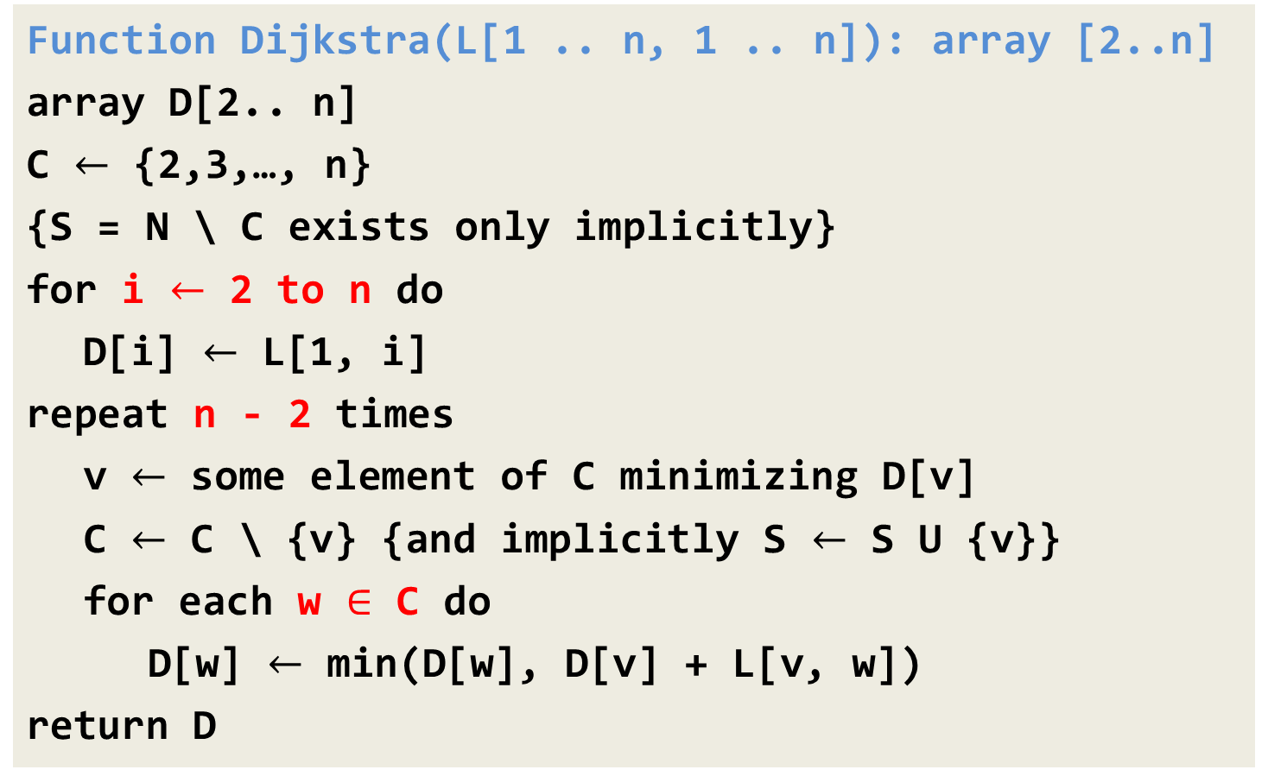
Dijkstra’s Algorithm
Function Dijkstra(L[1 .. n, 1 .. n]): array [2..n]
array D[2.. n]
C $←$ {2,3,…, n}
{S = N \ C exists only implicitly}
for i $←$ 2 to n do
D[i] $←$ L[1, i]
repeat n - 2 times
v $←$ some element of C minimizing D[v]
C $←$ C \ {v} {and implicitly S $←$ S U {v}}
for each w $∈$ C do
D[w] $←$ min(D[w], D[v] + L[v, w])
return D

Slide 33
Fractional Knapsack Problem

Slide 34

Fractional Knapsack Problem
We are given $n$ objects and a knapsack.
Object $i$ has a positive weight $w_{i}$and a positive value $v_{i}$ for $i = 1, 2… n.$
The knapsack can carry a weight not exceeding $W$.
Our aim is to fill the knapsack in a way that maximizes the value of the included objects, while respecting the capacity constraint.

Slide 35
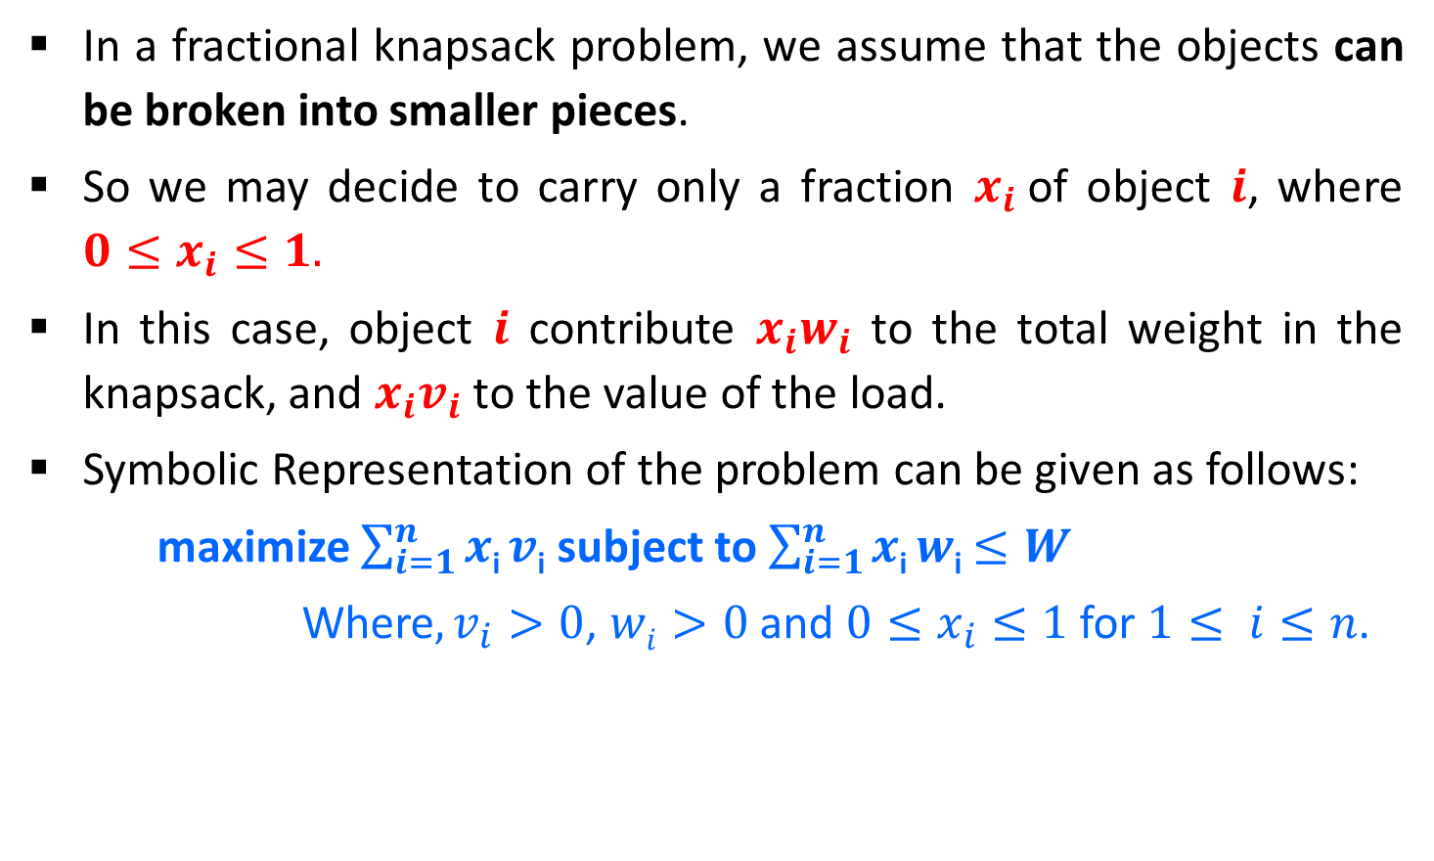
Fractional Knapsack Problem
In a fractional knapsack problem, we assume that the objects can be broken into smaller pieces.
So we may decide to carry only a fraction $x_{i}$of object $i$, where $0≤x_{i}≤1.$
In this case, object $i$ contribute $x_{i}w_{i}$ to the total weight in the knapsack, and $x_{i}v_{i}$ to the value of the load.
Symbolic Representation of the problem can be given as follows:
maximize $\sum_{i=1}^{n}{x\text{i}}v\text{i}$ subject to $\sum_{i=1}^{n}{x\text{i}}w\text{i}$ $≤W$
Where$, v_{i}>0$, $wi>0$and $0≤x_{i}≤1$for $1≤ i≤n$.

Slide 36
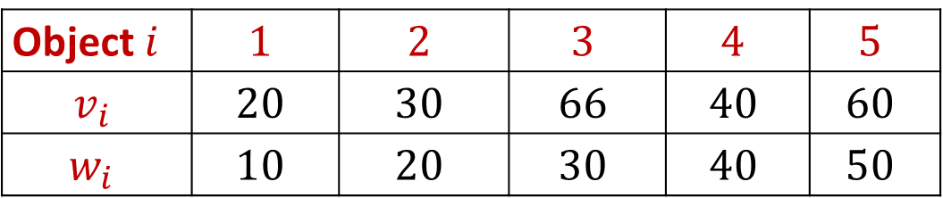
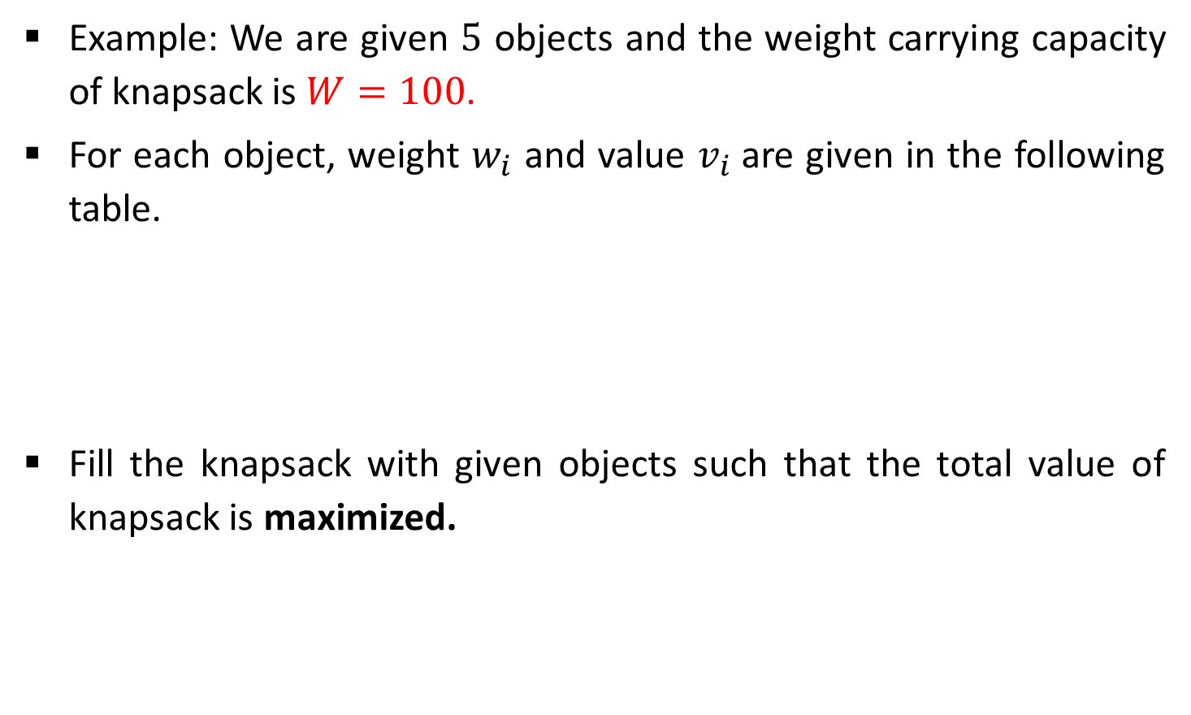
Fractional Knapsack Problem - Example
Example: We are given $5$ objects and the weight carrying capacity of knapsack is $W=100$.
For each object, weight $w_{i}$ and value $v_{i}$are given in the following table.
Fill the knapsack with given objects such that the total value of knapsack is maximized.
Object$i$ | $$1$$ | $$2$$ | $$3$$ | $$4$$ | $$5$$
$$v_{i}$$ | $$20$$ | $$30$$ | $$66$$ | $$40$$ | $$60$$
$$w_{i}$$ | $$10$$ | $$20$$ | $$30$$ | $$40$$ | $$50$$

Slide 37
Greedy Solution
Three selection functions can be defined as,
Sort the items in descending order of their values and select the items till weight criteria is satisfied.
Sort the items in ascending order of their weight and select the items till weight criteria is satisfied.
To calculate the ratio value/weight for each item and sort the item on basis of this ratio. Then take the item with the highest ratio and add it.

Slide 38
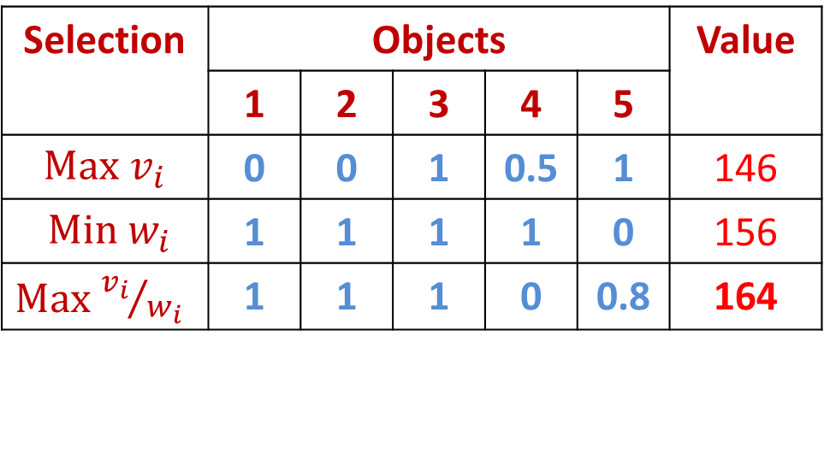
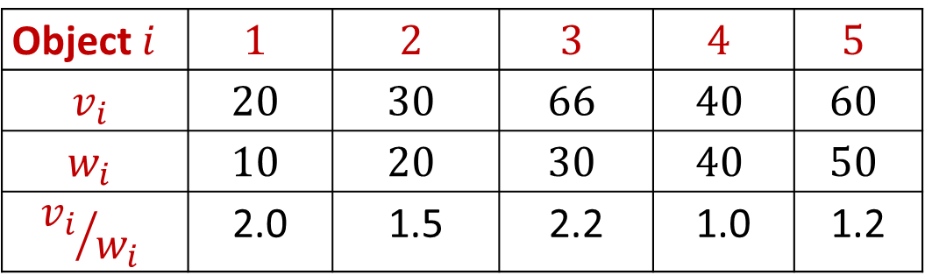
Fractional Knapsack Problem - Solution
Object$i$ | $$1$$ | $$2$$ | $$3$$ | $$4$$ | $$5$$
$$v_{i}$$ | $$20$$ | $$30$$ | $$66$$ | $$40$$ | $$60$$
$$w_{i}$$ | $$10$$ | $$20$$ | $$30$$ | $$40$$ | $$50$$
$${v_{i}}/{w_{i}}$$ | 2.0 | 1.5 | 2.2 | 1.0 | 1.2
Selection | Objects |  |  |  |  | Value
 | 1 | 2 | 3 | 4 | 5
$\text{Max}$ $v_{i}$ | 0 | 0 | 1 | 0.5 | 1 | 146
$\text{Min} w_{i}$ | 1 | 1 | 1 | 1 | 0 | 156
$\text{Max}$ ${v_{i}}/{w_{i}}$ | 1 | 1 | 1 | 0 | 0.8 | 164
Weight Capacity 100
30
50
20
10
20
30
40
30
10
20
40
Profit = 66 + 20 + 30 + 48 = 164
Profit = 66 + 60 + (40 * 0.5) = 146
Profit = 20 + 30 + 66 + 40 = 156

Slide 39
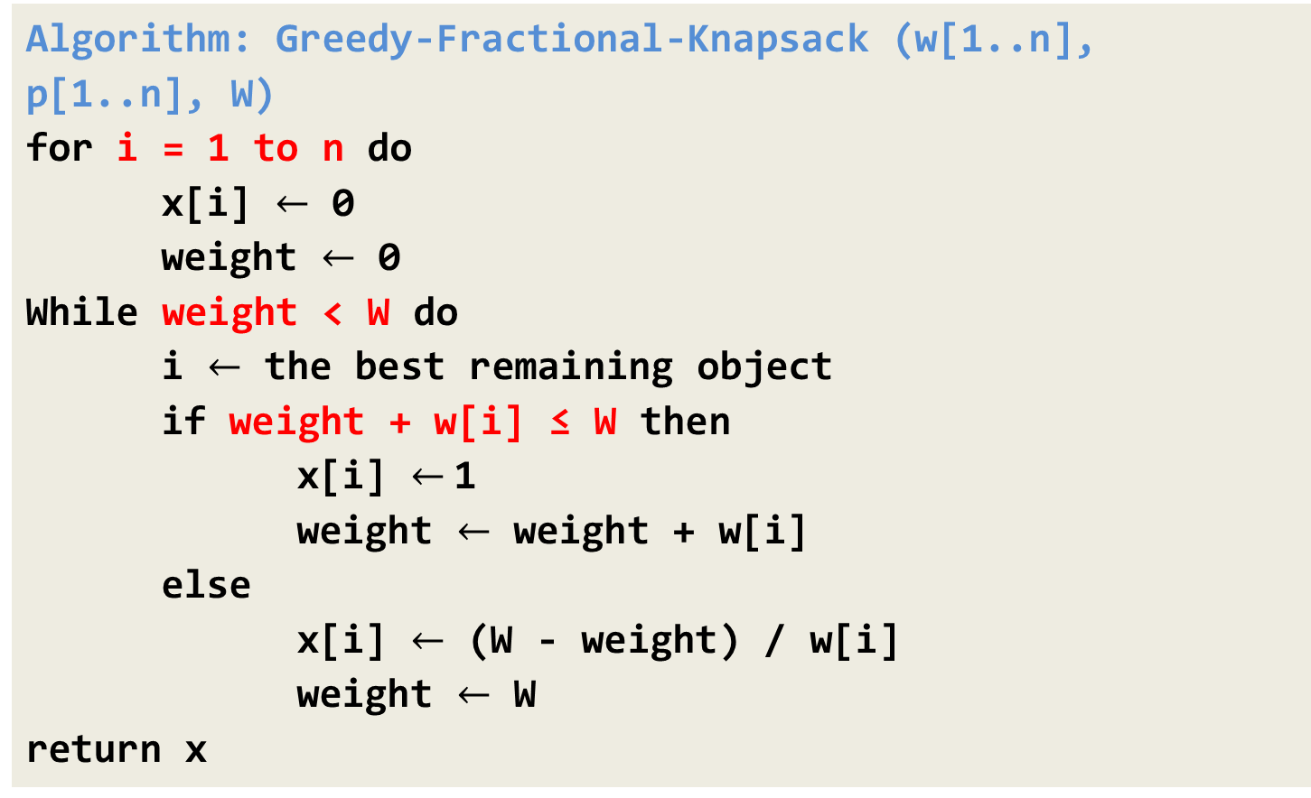
Fractional Knapsack Problem - Algorithm
Algorithm: Greedy-Fractional-Knapsack (w[1..n], p[1..n], W)
for i = 1 to n do
x[i] $←$ 0
weight $←$ 0
While weight < W do
i $←$ the best remaining object
if weight + w[i] ≤ W then
x[i] $←$1
weight $←$ weight + w[i]
else
x[i] $←$ (W - weight) / w[i]
weight $←$ W
return x
(100 – 60) / 50 = 0.8

Slide 40

Exercises – Home Work
Consider Knapsack capacity $W=50$, $w = (10, 20, 40)$and $v = (60, 80,100)$find the maximum profit using greedy approach.
Consider Knapsack capacity $W = 10$, $w=(4, 8, 2, 6, 1)$and $v = (12, 32, 40, 30, 50)$. Find the maximum profit using greedy approach.

Slide 41
Activity Selection Problem

Slide 42
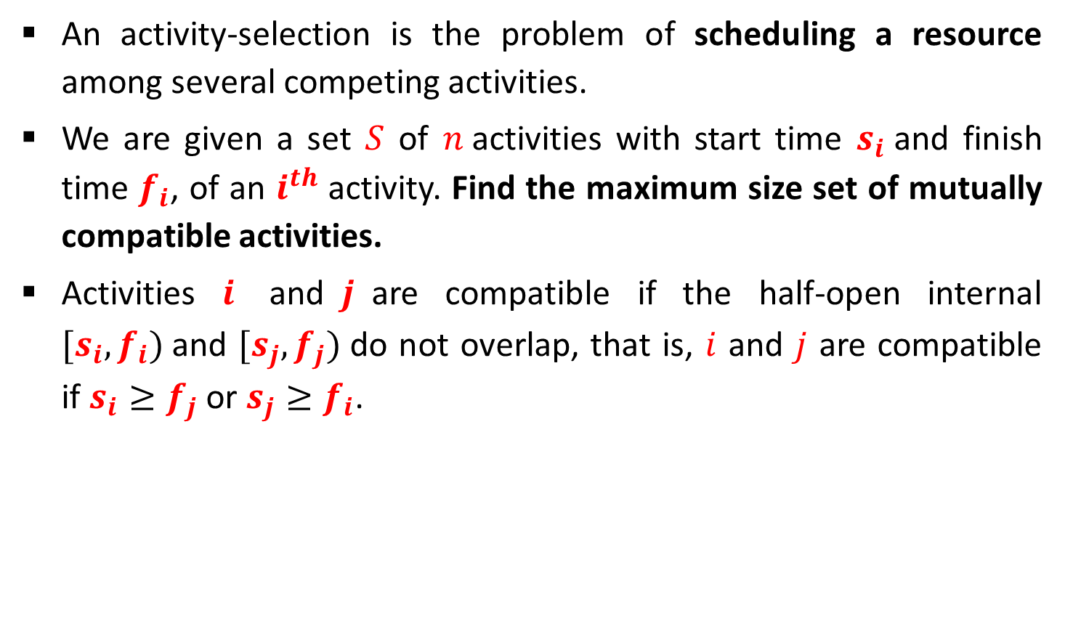
Activity Selection Problem
An activity-selection is the problem of scheduling a resource among several competing activities.
We are given a set $S$ of $n$activities with start time $s_{i}$and finish time $f_{i}$, of an $i^{th}$ activity. Find the maximum size set of mutually compatible activities.
Activities $i$ and$j$are compatible if the half-open internal $[s_{i},f_{i})$and $[s_{j},f_{j})$do not overlap, that is, $i$ and $j$ are compatible if $s_{i}≥f_{j}$ or $s_{j}≥f_{i}$.

Slide 43
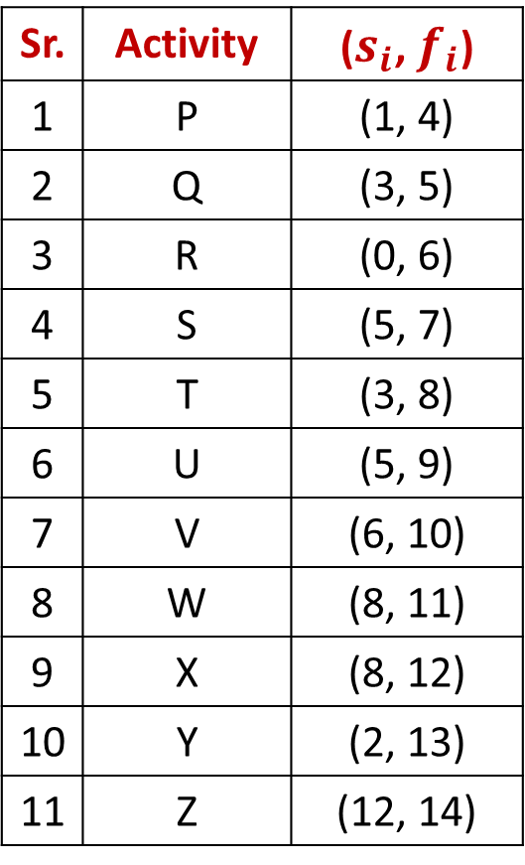
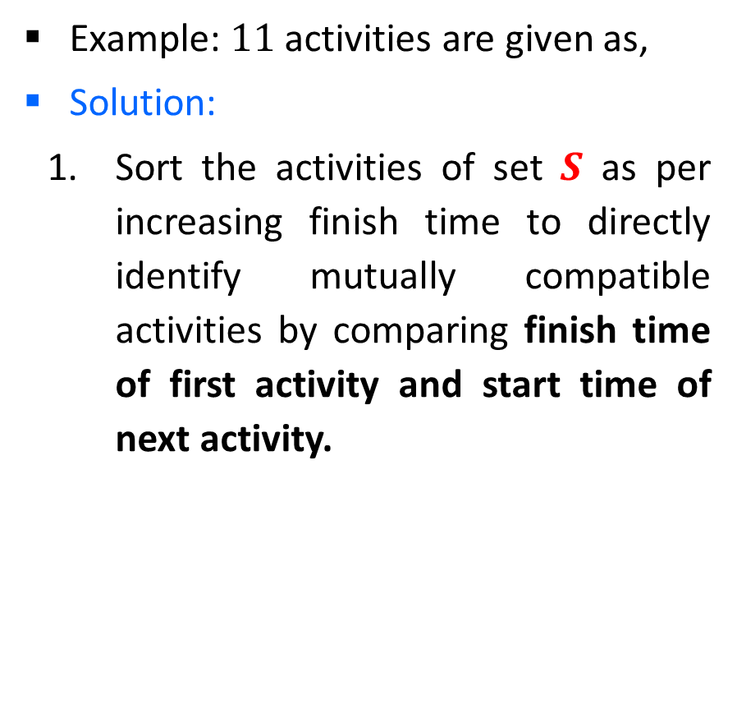
Activity Selection Problem - Example
Example: $11$ activities are given as,
Solution:
Sort the activities of set $S$ as per increasing finish time to directly identify mutually compatible activities by comparing finish time of first activity and start time of next activity.
Sr. | Activity | ($s_{i}$, $f_{i}$)
1 | P | (1, 4)
2 | Q | (3, 5)
3 | R | (0, 6)
4 | S | (5, 7)
5 | T | (3, 8)
6 | U | (5, 9)
7 | V | (6, 10)
8 | W | (8, 11)
9 | X | (8, 12)
10 | Y | (2, 13)
11 | Z | (12, 14)

Slide 44
Activity Selection Problem - Example
Solution:
A = {P}
A = {P, S}
A = {P, S, W}
A = {P, S, W, Z}
Answer: A = {P, S, W, Z}
Sr. | Activity | ($s_{i}$, $f_{i}$)
1 | P | (1, 4)
2 | Q | (3, 5)
3 | R | (0, 6)
4 | S | (5, 7)
5 | T | (3, 8)
6 | U | (5, 9)
7 | V | (6, 10)
8 | W | (8, 11)
9 | X | (8, 12)
10 | Y | (2, 13)
11 | Z | (12, 14)

Slide 45
Activity Selection - Algorithm
Algorithm: Activity Selection
Step I: Sort the input activities by increasing finishing time. f₁ ≤ f₂ ≤ . . . ≤ f_{n}
Step II: Call GREEDY-ACTIVITY-SELECTOR (s, f)
n = length [s]
A = {i}
j = 1
for i = 2 to n
do if s_{i} ≥ f_{j}
then A = A U {i}
j = i
return set A

Slide 46
Exercises - HW
Given arrival and departure times of all trains that reach a railway station, find the minimum number of platforms required for the railway station so that no train waits. We are given two arrays which represent arrival and departure times of trains that stop. Arr[] = {9:00, 9:40, 9:50, 11:00, 15:00, 18:00} dep[] = {9:10, 12:00, 11:20, 11:30, 19:00, 20:00}
*

Slide 47
Job Scheduling with Deadlines

Slide 48
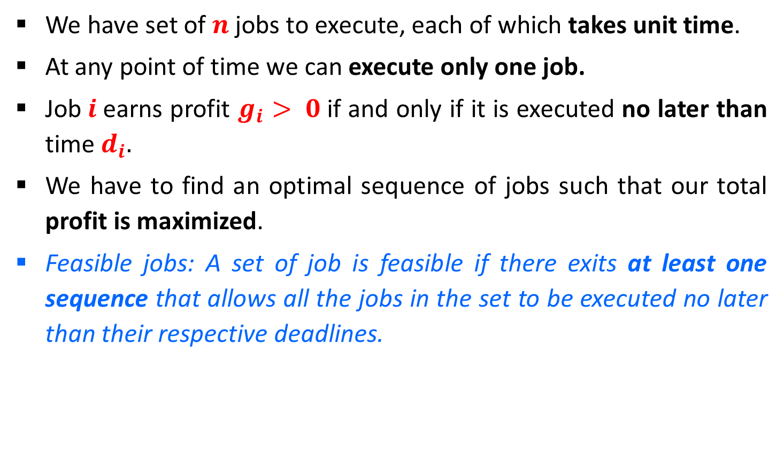
Job Scheduling with Deadlines
We have set of $n$ jobs to execute, each of which takes unit time.
At any point of time we can execute only one job.
Job$i$earns profit $g_{i}> 0$if and only if it is executed no later than time $d_{i}.$
We have to find an optimal sequence of jobs such that our total profit is maximized.
Feasible jobs: A set of job is feasible if there exits at least one sequence that allows all the jobs in the set to be executed no later than their respective deadlines.

Slide 49
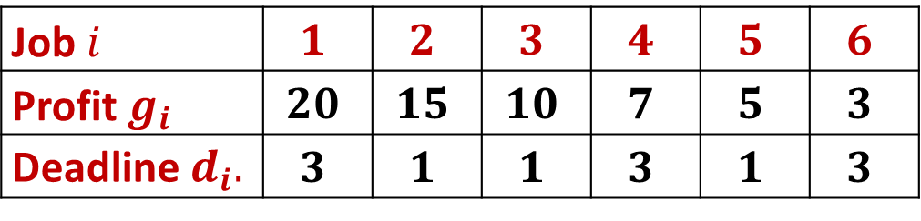
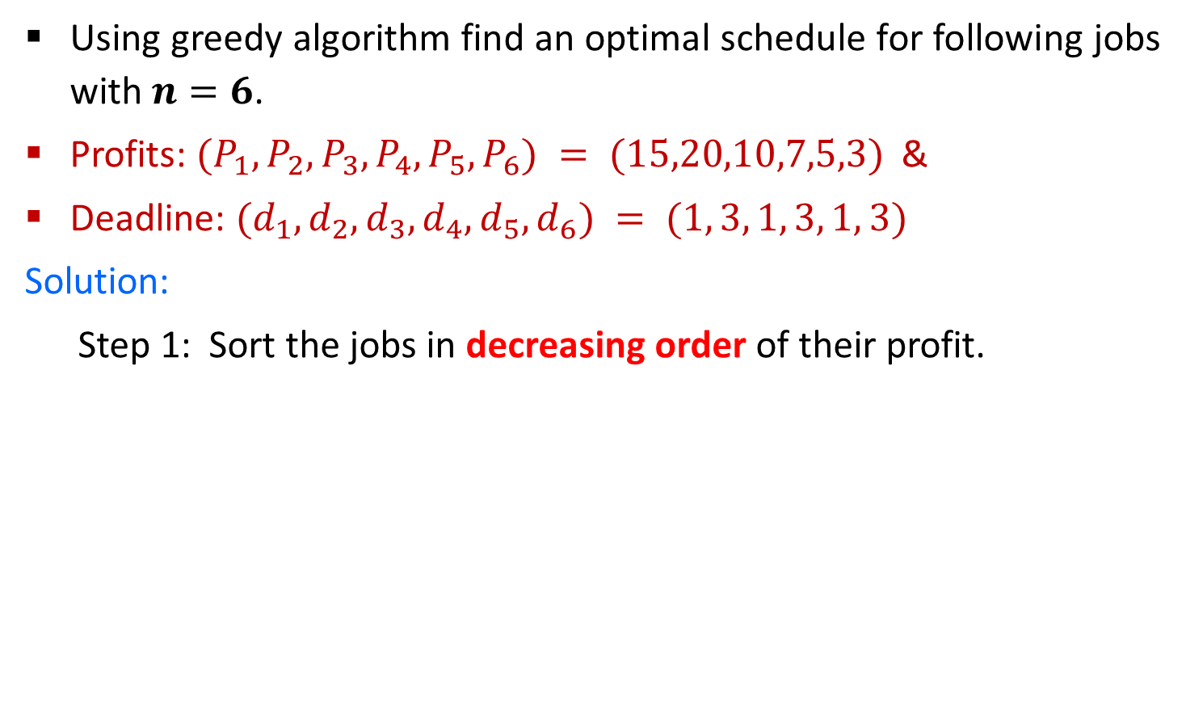
Job Scheduling with Deadlines - Example
Using greedy algorithm find an optimal schedule for following jobs with $n=6$.
Profits: $(P_{1},P_{2},P_{3},P_{4},P_{5},P_{6}) = (15,20,10,7,5,3)$&
Deadline: $(d_{1},d_{2},d_{3},d_{4},d_{5},d_{6}) = (1, 3, 1, 3, 1, 3)$
Solution:
Step 1: Sort the jobs in decreasing order of their profit.
Job $i$ | $$1$$ | $$2$$ | $$3$$ | $$4$$ | $$5$$ | $$6$$
Profit $g_{i}$ | $$20$$ | $$15$$ | $$10$$ | $$7$$ | $$5$$ | $$3$$
Deadline $d_{i}.$ | $$3$$ | $$1$$ | $$1$$ | $$3$$ | $$1$$ | $$3$$

Slide 50
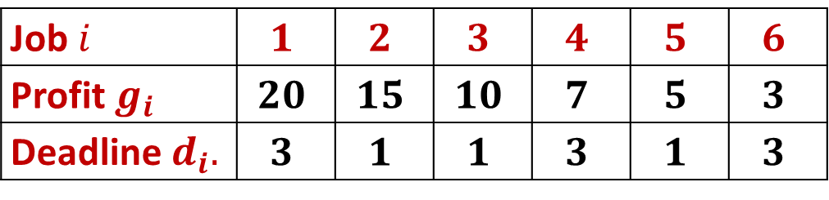

Job Scheduling with Deadlines - Example
Step 2: Find total position $P =min⁡(n, max⁡(di))$
Here, $P = min⁡(6, 3) = 3$
Step 3: $d1 = 3$: assign job $1$ to position $3$
Job $i$ | $$1$$ | $$2$$ | $$3$$ | $$4$$ | $$5$$ | $$6$$
Profit $g_{i}$ | $$20$$ | $$15$$ | $$10$$ | $$7$$ | $$5$$ | $$3$$
Deadline $d_{i}.$ | $$3$$ | $$1$$ | $$1$$ | $$3$$ | $$1$$ | $$3$$
P
1
2
3
Job selected
0
0
0
P
1
2
3
Job selected
0
0
J1

Slide 51

Job Scheduling with Deadlines - Example
Step 4: $d2 = 1 :$assign job $2$ to position $1$
Step 5: $d3 =1$: assign job $3$ to position $1$
Job $i$ | $$1$$ | $$2$$ | $$3$$ | $$4$$ | $$5$$ | $$6$$
Profit $g_{i}$ | $$20$$ | $$15$$ | $$10$$ | $$7$$ | $$5$$ | $$3$$
Deadline $d_{i}.$ | $$3$$ | $$1$$ | $$1$$ | $$3$$ | $$1$$ | $$3$$
P
1
2
3
Job selected
J2
0
J1
Position 1 is already occupied, so reject job 3

Slide 52
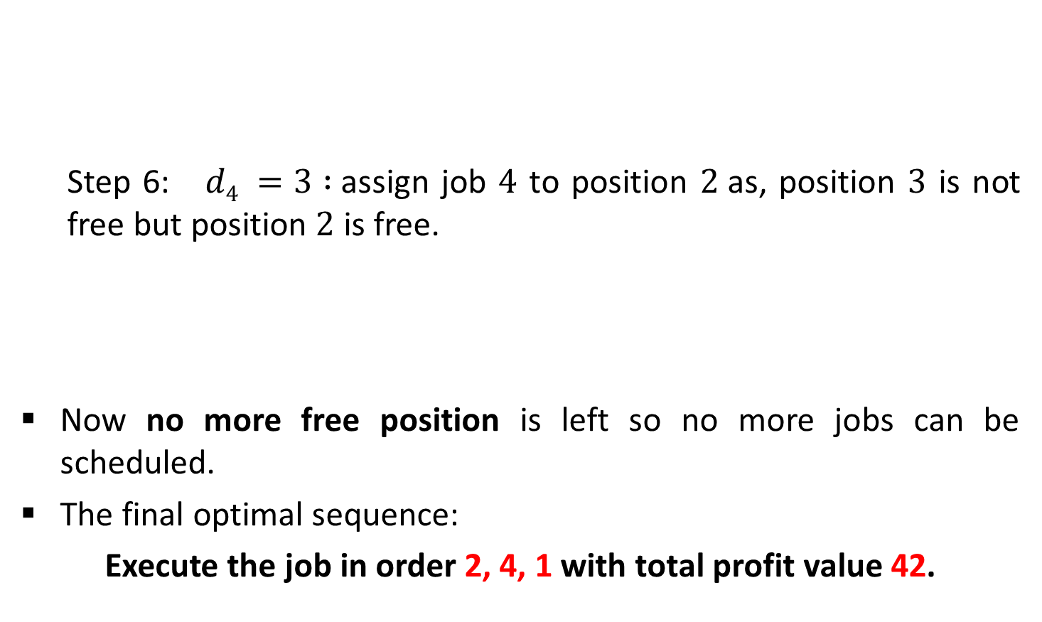
Job Scheduling with Deadlines - Example
Step 6: $d4 =3 :$assign job $4$ to position $2$as, position $3$ is not free but position $2$ is free.
Now no more free position is left so no more jobs can be scheduled.
The final optimal sequence:
Execute the job in order 2, 4, 1 with total profit value 42.
Job $i$ | $$1$$ | $$2$$ | $$3$$ | $$4$$ | $$5$$ | $$6$$
Profit $g_{i}$ | $$20$$ | $$15$$ | $$10$$ | $$7$$ | $$5$$ | $$3$$
Deadline $d_{i}.$ | $$3$$ | $$1$$ | $$1$$ | $$3$$ | $$1$$ | $$3$$
P
1
2
3
Job selected
J2
J4
J1

Slide 53
Exercises – Home Work
Using greedy algorithm find an optimal schedule for following jobs with 𝒏=4.
Profits: (a, b, c, d) = (20,10,40,30) &
Deadline: (d₁, d₂, d₃, d₄) = (4, 1, 1, 1)
Using greedy algorithm find an optimal schedule for following jobs with 𝒏=5.
Profits: (a, b, c, d, e) = (100,19,27,25,15) &
Deadline: (d₁, d₂, d₃, d₄, d₅) = (2, 1, 2, 1, 3)

Slide 54
Job Scheduling with Deadlines - Algorithm
Algorithm: Job-Scheduling (P[1..n], D[1..n])
Sort all the n jobs in decreasing order of their profit.
Let total position P = min(n, max(d_{i}))
Each position 0, 1, 2…, P is in different set and T({i}) = i, for 0 ≤ i ≤ P.
Find the set that contains d, let this set be K. if T(K) = 0 reject the job; otherwise:
Assign the new job to position T(K).
Find the set that contains T(K) – 1. Call this set L.
Merge K and L. the value for this new set is the old value of T(L).

Slide 55
Huffman Codes

Slide 56
Huffman Codes
Huffman invented a greedy algorithm that constructs an optimal prefix code called a Huffman code.
Huffman coding is a lossless data compression algorithm.
It assigns variable-length codes to input characters.
Lengths of the assigned codes are based on the frequencies of corresponding characters.
The most frequent character gets the smallest code and the least frequent character gets the largest code.
The variable-length codes assigned to input characters are Prefix Codes.

Slide 57
Huffman Codes
In Prefix codes, the codes are assigned in such a way that the code assigned to one character is not a prefix of code assigned to any other character.
For example,
a = 01, b = 010 and c = 11
This is how Huffman Coding makes sure that there is no ambiguity when decoding the generated bit stream.
There are mainly two major parts in Huffman Coding
Build a Huffman Tree from input characters.
Traverse the Huffman Tree and assign codes to characters.
Not a prefix code

Slide 58
Huffman Codes - Example
Find the Huffman codes for the following characters.
Characters | a | b | c | d | e | f
Frequency (in thousand) | 45 | 13 | 12 | 16 | 9 | 5
Step 1:
Arrange the characters in the Ascending order of their frequency.
f:5
e:9
c:12
b:13
d:16
a:45

Slide 59
Huffman Codes - Example
Step 2:
Extract two nodes with the minimum frequency.
Create a new internal node with frequency equal to the sum of the two nodes frequencies.
Make the first extracted node as its left child and the other extracted node as its right child.
14
f:5
e:9
c:12
b:13
d:16
a:45

Slide 60
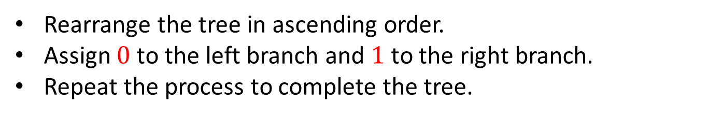
Huffman Codes - Example
Step 3:
Rearrange the tree in ascending order.
Assign $0$to the left branch and $1$to the right branch.
Repeat the process to complete the tree.
14
f:5
e:9
c:12
b:13
d:16
a:45
0
1

Slide 61
Huffman Codes - Example
Step 4:
c:12
b:13
14
d:16
a:45
0
1
f:5
e:9
14
d:16
25
a:45
0
1
0
1
f:5
e:9
c:12
b:13

Slide 62
Huffman Codes - Example
Step 5:
14
d:16
25
a:45
0
1
0
1
f:5
e:9
c:12
b:13
25
30
a:45
0
1
0
1
14
d:16
c:12
b:13
0
1
f:5
e:9

Slide 63
Huffman Codes - Example
Step 6:
55
0
1
25
30
a:45
0
1
0
1
14
d:16
c:12
b:13
0
1
f:5
e:9

Slide 64
Huffman Codes - Example
Step 7:
100
0
1
55
a:45
0
1
25
30
0
1
0
1
14
d:16
c:12
b:13
0
1
f:5
e:9

Slide 65
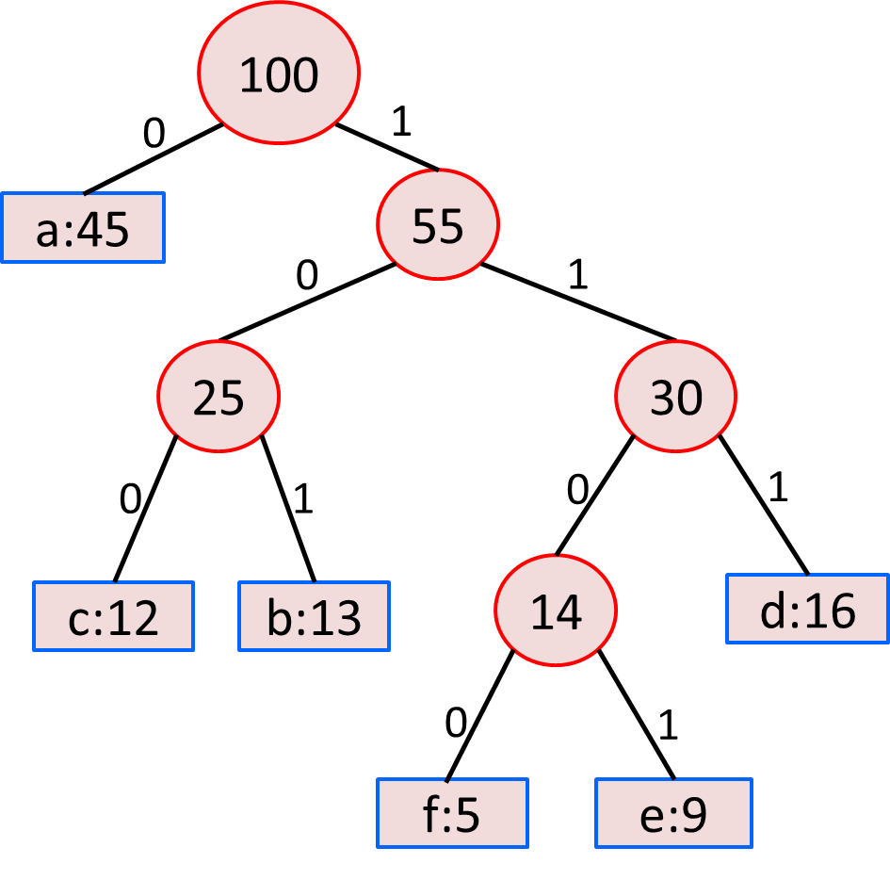
Huffman Codes - Example
Step 8:
Characters | a | b | c | d | e | f
Frequency (in thousand) | 45 | 13 | 12 | 16 | 9 | 5
0
101
100
111
1101
1100

Slide 66
Huffman Codes - Algorithm
Algorithm: HUFFMAN (C)
n = |C|
Q = C
for i = 1 to n-1
allocate a new node z
z.left = x = EXTRACT-MIN(Q)
z.right = y = EXTRACT-MIN(Q)
z.freq = x.freq + y.freq
INSERT(Q,z)
return EXTRACT-MIN(Q) // return the root of the tree

Slide 67
Exercises – Home Work
Find an optimal Huffman code for the following set of frequency.
a : 50, b : 20, c : 15, d : 30.
Frequency
Frequency
Characters | A | B | C | D | E | F
Frequency (in thousand) | 24 | 12 | 10 | 8 | 8 | 5
Characters | a | b | c | d | e | f | g
Frequency (in thousand) | 37 | 28 | 29 | 13 | 30 | 17 | 6

Slide 68


