Slide 1

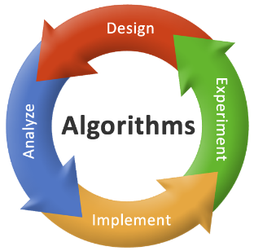

2150703
Analysis and Design of Algorithms (ADA)
Unit-6
Exploring Graphs
Dr. Gopi Sanghani
9825621471
gopi.sanghani@darshan.ac.in

Slide 2
Topics to be Covered
An introduction using Graphs
Undirected Graph
Directed Graph
Traversing Graphs
Depth First Search (DFS)
Breath First Search (BFS)
Topological sort
Connected components
Notes:
X.800 and RFC 2828
International Telecommunication Union (ITU)

Slide 3
Graph - Definition
A graph $G=\left\langle N, \right.\left.A\right\rangle$ consists of a non-empty set 𝑵 called the set of nodes (vertices) of the graph, a set 𝑨 called the set of edges that also represents a mapping from the set of edges 𝑨 to a set of pairs of elements 𝑵.
edges
(or links)
D
A
E
C
B
F
nodes
(or vertices)

Slide 4
Directed & Undirected Graph
Directed Graph: A graph in which every edge is directed from one node to another is called a directed graph or digraph.
Undirected Graph: A graph in which every edge is undirected and no direction is associated with them is called an undirected graph.
Directed Graph
Undirected Graph

Slide 5
Traversing Graph/Tree
Preorder
Visit the root.
Traverse the left sub tree in preorder.
Traverse the right sub tree in preorder.
In order
Traverse the left sub tree in in order.
Visit the root.
Traverse the right sub tree in in order.
Post order
Traverse the left sub tree in post order.
Traverse the right sub tree in post order.
Visit the root.

Slide 6
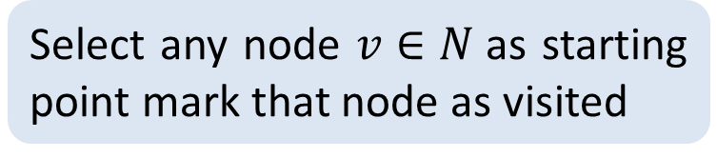
Depth-First Search / Traversal
1
Select any node $v∈N$as starting point mark that node as visited
2
3
4
Select one of the unvisited adjacent of current node.
Make it new starting point and mark it as visited
5
6
7
8
If new node has no unvisited adjacent then move to parent and make it starting point
Visited :
1
2
3
6
5
4
7
8

Slide 7
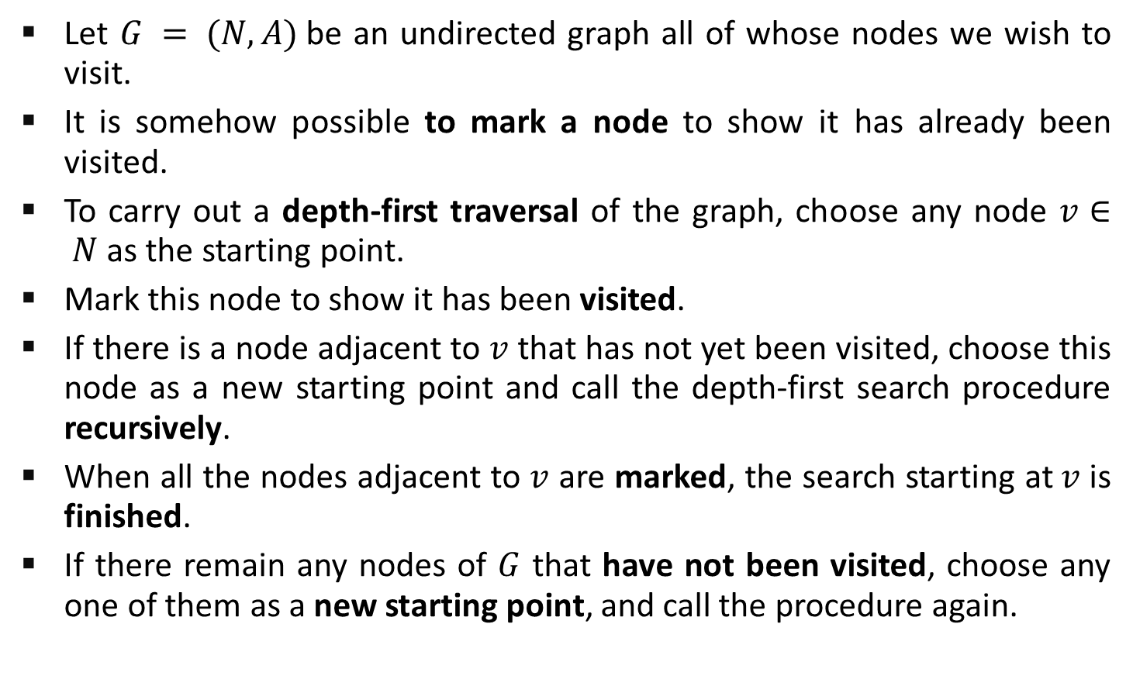
Depth-First Search – Cont…
Let $G = (N, A)$be an undirected graph all of whose nodes we wish to visit.
It is somehow possible to mark a node to show it has already been visited.
To carry out a depth-first traversal of the graph, choose any node $v∈ N$as the starting point.
Mark this node to show it has been visited.
If there is a node adjacent to $v$ that has not yet been visited, choose this node as a new starting point and call the depth-first search procedure recursively.
When all the nodes adjacent to $v$ are marked, the search starting at$v$is finished.
If there remain any nodes of $G$ that have not been visited, choose any one of them as a new starting point, and call the procedure again.

Slide 8
Depth-First Search Algorithm
procedure dfsearch(G)
for each v Є N
do mark[v] ← not-visited
for each v Є N
do if mark[v] ≠ visited
then dfs(v)
procedure dfs(v)
{Node v has not previously been visited}
mark[v] ← visited
for each node w adjacent to v
do if mark[w] ≠ visited
then dfs(w)

Slide 9
Depth-First Search - Algorithm
dfs(1) Initial call
dfs(2) recursive call
dfs(3) recursive call
dfs(6) recursive call
dfs(5) recursive call; progress is blocked
dfs(4) a neighbour of node1 has not been visited
dfs(7) recursive call
dfs(8) recursive call
There are no more nodes to visit
1
2
3
4
procedure dfs(v)
mark[v] ← visited
for each node w adjacent to v
do if mark[w] ≠ visited
then dfs(w)
5
6
7
8

Slide 10
Breadth First Search / Traversal
1
Select any node v ∈ N as starting point mark that node as visited.
Enqueue visited v node into queue Q
2
3
4
Dequeue a node from the front of queue.
Find it’s all unvisited adjacent nodes, mark as visited, enqueue into queue
5
6
7
8
1
2
3
4
5
6
7
8
Queue Q
Visited :
1
2
3
4
5
6
7
8

Slide 11
Breadth First Search - Algorithm
procedure bfs(v)
Q ← empty-queue
mark[v] ← visited
enqueue v into Q
while Q is not empty
do u ← first(Q)
dequeue u from Q
for each node w adjacent to u
do if mark[w] ≠ visited
then mark[w] ← visited
enqueue w into Q

Slide 12
Breadth First Search - Algorithm
procedure search(G)
for each v Є N
do mark[v] ← not visited
for each v Є N
do if mark[v] ≠ visited
then bfs(v)

Slide 13
Traverse Graph using DFS and BFS
A
B
C
E
D
F
DFS : A B D C E F
BFS : A B C D E F

Slide 14

Topological Sorting
A topological sort or topological ordering of a directed acyclic graph is a linear ordering of its vertices such that for every directed edge $(u,v)$from vertex $u$ to vertex $v$, $u$comes before $v$ in the ordering.
Heat griddle
¾ cup milk
Pour ¼ cup
1 egg
1 cup mix
Turn when bubbly
1 Tbl oil
Heat syrup
eat

Slide 15
Topological Sorting - Example
B
C
Identify nodes having in degree ‘0’
Select a node and delete it with its edges then add node to output
A
F
D
E
Output:
A
B
C
D
E
F

Slide 16
Topological Sorting - Example
5
4
2
0
1
3
Output:
4
5
0
2
3
1

Slide 17
Connected Components
A connected component (or just component) of an undirected graph is a subgraph in which any two vertices are connected to each other by paths.
There are two connected components in the above undirected graph. 0 1 2 and 3 4
1
0
3
4
2

Slide 18
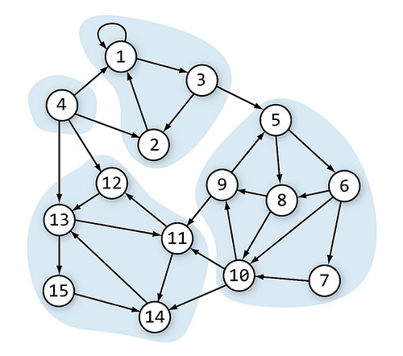
Connected Components

Slide 19
Articulation Point
An articulation point in a connected graph is a vertex , that if deleted then disconnects the graph.
It represent vulnerabilities in a connected network, single points whose failure would split network into two or more disconnected components.
1
5
1
2
3
3
7
2
6
4
5
4
Articulation Points: 2,3
Articulation Points: 3

Slide 20
Thank You!!

