Slide 1

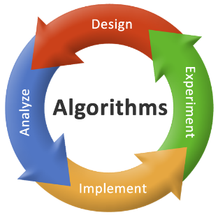

2150703
Analysis and Design of Algorithms (ADA)
Unit-7
Back Tracking and Branch & Bound
Dr. Gopi Sanghani
9825621471
gopi.sanghani@darshan.ac.in

Slide 2
Topics to be Covered
Introduction
The Eight queens problem
Knapsack problem
Travelling Salesman problem
Minimax principle
Notes:
X.800 and RFC 2828
International Telecommunication Union (ITU)

Slide 3
Backtracking
Backtracking can be defined as a general algorithmic technique that considers searching every possible combination in order to solve an optimization problem.
It is a recursive technique.
It generates state space tree for all possible solutions.
It traverse state space tree in the depth first order.
So, in a backtracking we attempt solving a sub-problem, and if we don't reach the desired solution, then undo whatever we did for solving that sub-problem, and try solving another sub-problem.
All the solutions require a set of constraints divided into two categories: explicit and implicit constraints.

Slide 4
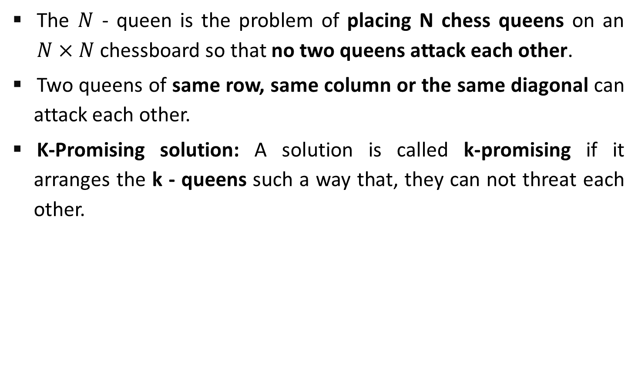
The N - Queens Problem
The $N$ - queen is the problem of placing N chess queens on an $N×N$ chessboard so that no two queens attack each other.
Two queens of same row, same column or the same diagonal can attack each other.
K-Promising solution: A solution is called k-promising if it arranges the k - queens such a way that, they can not threat each other.
Q
Q
Q
Q
 | Q
1 - Promising Solution
0 - Promising Solution
0 - Promising Solution
0 - Promising Solution

Slide 5
The 4 - queen Problem
 | 1 | 2 | 3 | 4
 | Q
 | 1 | 2 | 3 | 4
 | Q
 | Q | Q | Q
 | Q | Q | Q | Q
 | 1 | 2 | 3 | 4
 |  |  | Q
 | Q
 | Q | Q | Q | Q
 | Q | Q
1 - Promising
2 - Promising
4 – Promising
<3, 1, 4, 2>
 | 1 | 2 | 3 | 4
1 |  | Q
2 |  |  |  | Q
3 | Q
4 |  |  | Q
Above 4-promising solution can be written as
<3, 1, 4, 2>
Another possible solution is
<2, 4, 1, 3>
4 – Promising <2, 4, 1, 3>

Slide 6
N - Queen Problem
Number of Queens | Possible Solutions
1 | 1
2 | 0
3 | 0
4 | 2
5 | 10
6 | 4
7 | 40
8 | 92
9 | 352
10 | 724

Slide 7
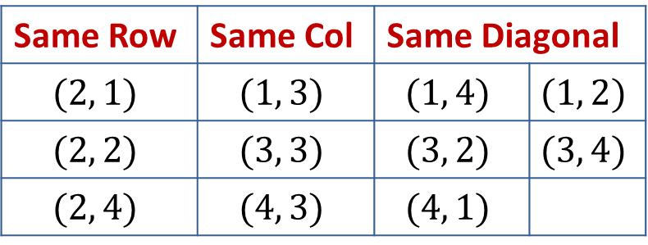


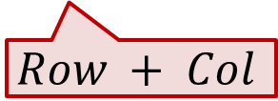
N - Queen Problem
Here, queen position is $(2, 3)$.
To identify the positions that can not be chosen, so that the queen does not attack.
The diagonal positions which are under attack are denoted as,
 | 1 | 2 | 3 | 4
1
2 |  |  | Q
3
4
Same Row | Same Col | Same Diagonal
$$(2, 1)$$ | $$(1, 3)$$ | $$(1, 4)$$ | $$(1, 2)$$
$$(2, 2)$$ | $$(3, 3)$$ | $$(3, 2)$$ | $$(3, 4)$$
$$(2, 4)$$ | $$(4, 3)$$ | $$(4, 1)$$
$$Row−Col$$
$$Row + Col$$

Slide 8
[2,4,0,0]
 | 1 | 2 | 3 | 4
1 |  | Q
2 |  |  |  | Q
3 | Q
4 |  |  | Q
Sol =
[2,4,1,0]
K =
[2,0,0,0]
1
3
[2,4,1,3]
4
2
col =
{2,4}
{2}
diag45 =
{2}
{2,3,-2}
{2,4,1}
{2,3}
diag135 =
{2,5}
{2}
{2,5,4}
procedure queens (k, col, diag45, diag135)
{sol[1..k] is k-promising,
col = {sol[i] | 1≤i≤k},
diag45 = {sol[i]–i+1 | 1≤i≤k}, and
diag135 = {sol[i]+i–1 | 1≤i≤k}}
if k = 4 then
write sol
else
for j ← 1 to 4 do
if j ∉ col and j – k ∉ diag45 and j + k ∉ diag135
then sol[k+1]← j
queens(k + 1, col U {j}, diag45 U {j - k}, diag135 U {j + k})
3- Promising
1- Promising
4- Promising
2- Promising
j = 1
j = 4
j = 2
j = 3
j = 1
J - k = 3
J - k = 2
J - k = 0
J + k = 3
J + k = 5
J - k = -1
J + k = 2

Slide 9
sol[1…8] is global array, for all solutions to the eight queens problem call queens(0, ∅, ∅, ∅)
procedure queens (k, col, diag45, diag135)
{sol[1..k] is k-promising,
col = {sol[i] | 1≤i≤k},
diag45 = {sol[i]–i+1 | 1≤i≤k}, and
diag135 = {sol[i]+i–1 | 1≤i≤k}}
if k = 8 then {an 8-promising vector is a solution}
write sol
else {explore (k+1)-promising extensions of sol }
for j ← 1 to 8 do
if j ∉ col and j – k ∉ diag45 and j + k ∉ diag135 ∉ sol[k+1] ← j
then sol[k+1]← j
{sol[1..k+1] is (k+1)-promising}
queens(k + 1, col U {j}, diag45 U {j - k}, diag135 U {j + k})

Slide 10
N - Queens State Space Tree
1
2
4
3
2
4
1
3
4
1
2
4
3
3
4
2
4
2
3
3
4
1
4
1
3
2
4
1
4
1
1
4
3
4
2
3
2
4
3
4
1
3
1
4
2
4
1
2
1

Slide 11
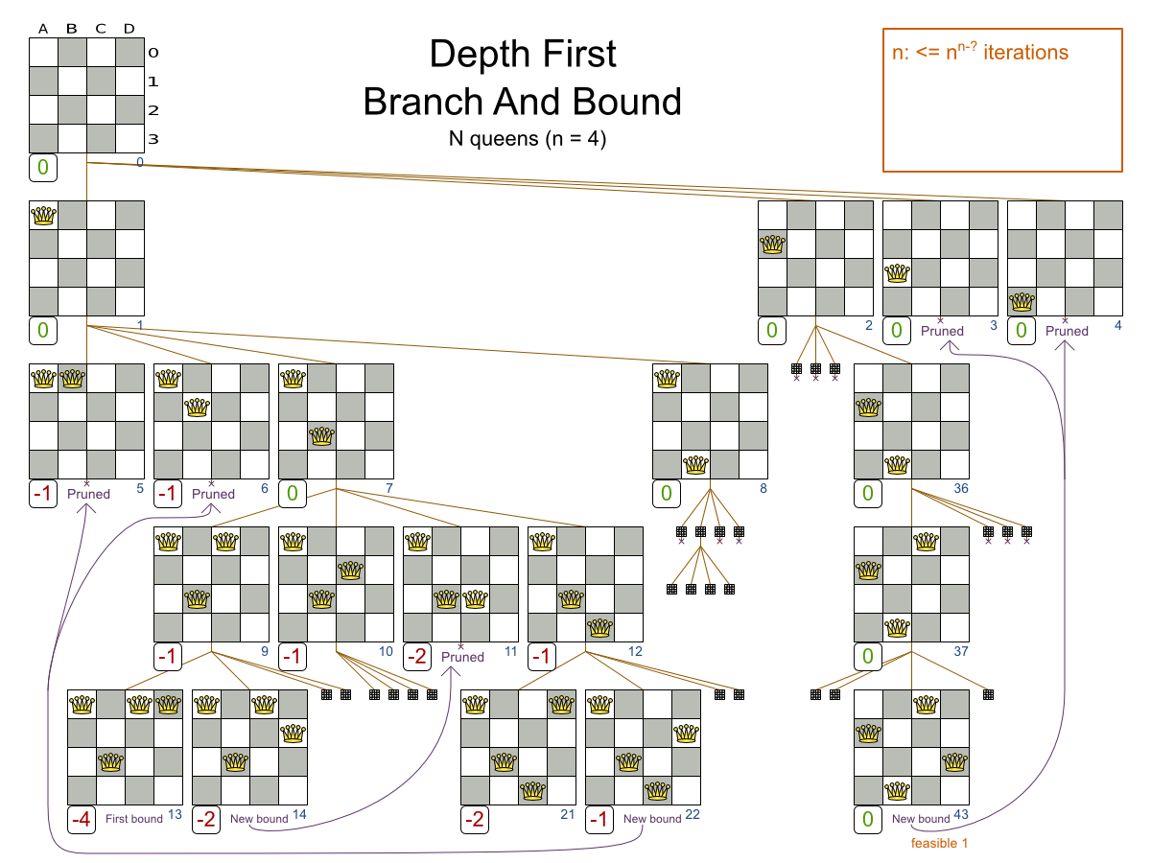

Slide 12
Knapsack Problem
We are given a certain number of objects and a knapsack.
Instead of supposing that we have n objects available, we shall suppose that we have n types of object, and that an adequate number of objects of each type are available.
Our aim is to fill the knapsack in a way that maximizes the value of the included objects.
We may take an object or leave behind, but we may not take fraction of an object.

Slide 13
Knapsack Problem – Cont…
Initially solution is empty.
Left of the semicolon are weights of selected objects.
Right of the semicolon is the current total value of load.
Weight of objects
w = (2,3,4,5)
Corresponding value of each object
v = (3,5,6,10)
Capacity of Knapsack
W = 8
Now, apply depth first search
; 0
2 ; 3
3 ; 5
4 ; 6
5 ; 10
2,2; 6
2,3; 8
2,4; 9
2,5; 13
3,3; 10
3,4; 11
3,5; 15
4,4; 12
2,2,2; 9
2,2,3; 11
2,2,4; 12
2,3,3; 13
Store solution if optimal solution is found
2,2,2,2; 12

Slide 14
Knapsack Problem – Algorithm
function backpack(i, r)
{Calculates the value of the best load that can be constructed using items of type i to n and whose total weight does not exceed r}
b ← 0
{Try each allowed kind of item in turn}
for k ← i to n do
if w[k] ≤ r then
b ← max(b, v[k] + backpack (k, r – w[k]))
return b

Slide 15
Minimax Principle
MAX (player)
3
MIN (opponent)
3
2
2
3
12
8
2
4
6
14
5
2

Slide 16
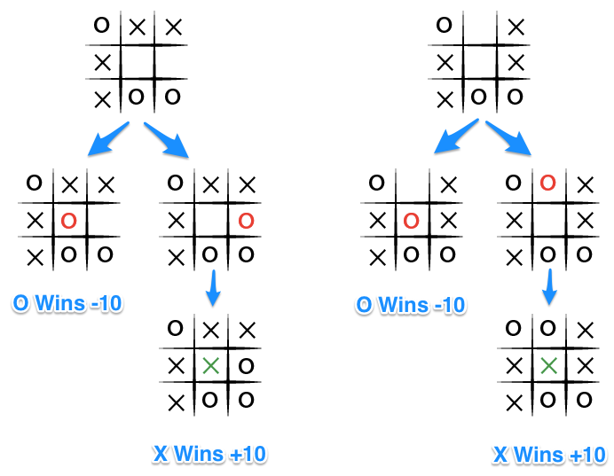
Minimax Principle
It is a decision rule that minimize the maximum loss and maximize the minimum profit(gain).

Slide 17
Minimax Principle
The key to the Minimax algorithm is a back and forth between the two players, where the player whose "turn it is" desires to select the move with the maximum score.
In turn, the scores for each of the available moves are determined by the opposing player deciding which of its available moves has the minimum score.
It uses a simple recursive computation of the minimax values of each successor state.
The recursion proceeds all the way down to the leaves of the tree, and then the minimax values are backed up through the tree as the recursion unwinds.

Slide 18
Minimax Principle – Cont…
X | X | O
X | O
 | O
Human
Max
WIN
X | X | O
X | O | X
 | O
X | X | O
X | O
X | O
X | X | O
X | O
 | O | X
Computer
Min
WIN
WIN
X | X | O
X | O | X
O | O
X | X | O
X | O | X
 | O | O
X | X | O
X | O
O | O | X
X | X | O
X | O | O
 | O | X
Human
Max
WIN
WIN
X | X | O
X | O | X
X | O | O
X | X | O
X | O | O
X | O | X
Computer
Min

Slide 19
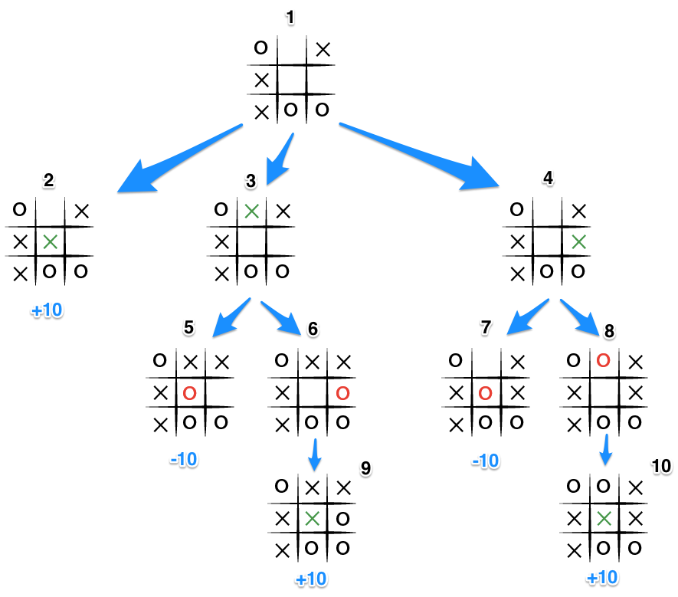

Slide 20
Travelling Salesman Problem
Given a set of cities and distance between every pair of vertices the problem is to find the shortest possible route that visits every city once and returns to the starting city.
A
D
B
C
Notes:
http://www.techiedelight.com/travelling-salesman-problem-using-branch-and-bound/
https://www.youtube.com/watch?v=RR7GXoWiUw4

Slide 21
Thank You!!

