Slide 1



2150703
Analysis and Design of Algorithms (ADA)
Unit-8
String Matching
Dr. Gopi Sanghani
9825621471
gopi.sanghani@darshan.ac.in

Slide 2
Outline
Introduction
The naive string matching algorithm
The Rabin-Karp algorithm
String Matching with finite automata
The Knuth-Morris-Pratt algorithm
Notes:
X.800 and RFC 2828
International Telecommunication Union (ITU)

Slide 3
Introduction
Text-editing programs frequently need to find all occurrences of a pattern in the text.
Efficient algorithms for this problem is called “String-Matching”.
Among its many applications, “String-Matching” is highly used in Searching for patterns in DNA and Internet search engines.

Slide 4

Introduction – Cont…
Assume that text is an array $T[1…n]$
Assume that pattern is an array $P[1…m]$
Where, 0 ≤ s ≤ n-m
Text T[1..13]
a
b
c
a
b
a
a
b
c
a
b
a
c
a
b
a
a
Pattern P[1..4]
a
b
a
a
Shift s =
0
3

Slide 5
Naive String Matching - Example
The naive algorithm finds all valid shifts using a loop that checks the condition P[1..m] = T[s+1..s+m]
a
c
a
a
b
c
a
c
a
a
b
c
a
c
a
a
b
c
a
a
b
a
a
b
a
a
b
s = 0
s = 1
s = 2
a
c
a
a
b
c
Pattern matched with shift 2
P[1..m] = T[s+1..s+m]
a
a
b
s = 3

Slide 6
Naive String Matching - Algorithm
NAIVE-STRING MATCHER (T,P)
n = T.length
m = P.length
for s=0 to n-m
if p[1..m] == T[s+1..s+m]
print “Pattern Occurs with shift” s
T[1..6]
a
c
a
a
b
c
Naive String Matcher takes time O((n-m+1)m)
P[1..3]
a
a
a
a
a
b
a
a
b
b
a
b

Slide 7

Rabin-Karp Algorithm
The Rabin-Karp algorithm takes $θ(m)$pre-processing time, and its worst-case running time is $θ((n−m+1) m).$
Assume that each character is a decimal digit in radix-d notation.

Slide 8
Rabin-Karp Example
Text T
3 | 1 | 4 | 1 | 5 | 9 | 2 | 6 | 5 | 3 | 5
Pattern P
2 | 6
Choose a random prime number q
q = 11
Let, p = P mod q
=26 mod 11 = 4
Let t_{s} denotes modulo q for text of length m
3 | 1 | 4 | 1 | 5 | 9 | 2 | 6 | 5 | 3 | 5
9 | 3 | 8 | 4 | 4 | 4 | 4 | 10 | 9 | 2
t_{s0} = 31 mod 11 = 9
t_{s5} = 92 mod 11 = 4
t_{s1} = 14 mod 11 = 3
t_{s6} = 26 mod 11 = 4
t_{s2} = 41 mod 11 = 8
t_{s7} = 65 mod 11 = 10
t_{s3} = 15 mod 11 = 4
t_{s8} = 53 mod 11 = 9
t_{s4} = 59 mod 11 = 4
t_{s9} = 35 mod 11 = 2

Slide 9
Rabin-Karp Example – Cont…
Pattern P
2 | 6
p = 4
Text T
3 | 1 | 4 | 1 | 5 | 9 | 2 | 6 | 5 | 3 | 5
mod 11
t_{s}
9 | 3 | 8 | 4 | 4 | 4 | 4 | 10 | 9 | 2
Spurious
Hit
Spurious
Hit
Valid
match
if t_{s} == p
if P[1..m] == T[s+1..s+m]
print “pattern occurs with shift” s

Slide 10
Rabin-Karp Algorithm
We can compute t_{s} using following formula
t_{s+1} = 10(t_{s} - 10^{m-1}T[s+1]) + T[s + m + 1]
3 | 1 | 4 | 1 | 5 | 9 | 2 | 6 | 5 | 3 | 5
Removes the higher- order digit from t_{s}
Brings lower-order digit
For m=2 and t_{s} = 31
We wish to remove higher order digit T[s+1]=3 and bring the new lower order digit T[s+m+1]=4
t_{s+1} = 10(31-10·3) + 4
= 10(1) + 4 = 14
t_{s+2} = 10(14-10·1) + 1
= 10(4) + 1 = 41

Slide 11
Rabin-Karp-Matcher
RABIN-KARP-MATCHER(T, P, d, q)
n ← length[T];
m ← length[P];
h ← d^{m-1} mod q;
p ← 0;
t₀ ← 0;
for i ← 1 to m do
p ← (dp + P[i]) mod q
t₀ ← (dt₀ + T[i]) mod q
for s ← 0 to n – m do
if p == ts then
if P[1..m] == T[s+1..s+m] then
print “pattern occurs with shift” s
if s < n-m then
t_{s+1} ← (d(t_{s} – T[s+1]h) + T[s+m+1]) mod q
T | 3 | 1 | 4 | 1 | 5 | 9 | 2 | 6 | 5 | 3 | 5
P | 2 | 6
d | 10
q | 11
n | 11
m | 2
h | 10
t₀ | 9
p | 4
t₀ | 0
p | 0

Slide 12

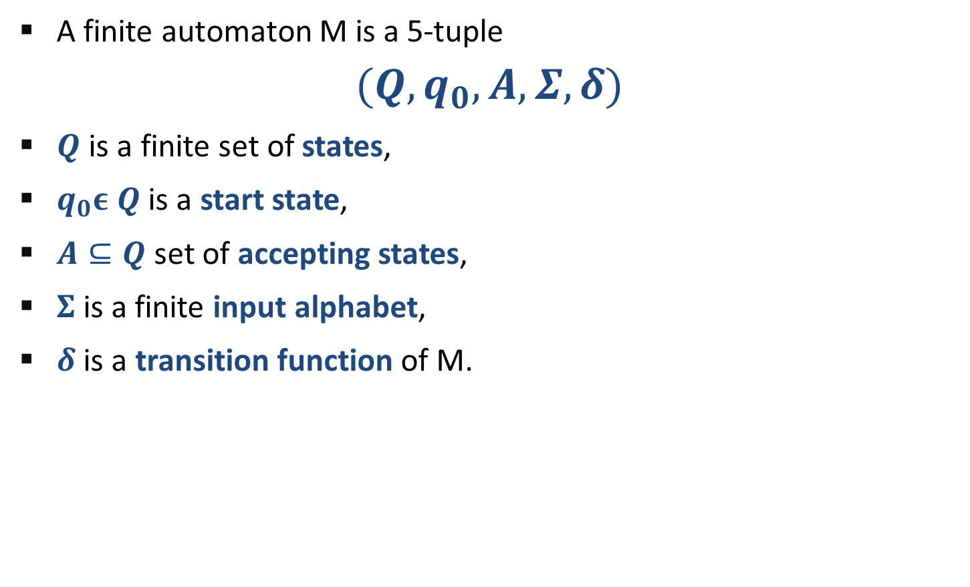




String Matching Using Finite Automata
A finite automaton M is a 5-tuple
$$(Q,q_{0}, A,Σ,δ)$$
$Q$ is a finite set of states,
$q_{0}ε Q$ is a start state,
$A⊆Q$set of accepting states,
$Σ$is a finite input alphabet,
$δ$ is a transition function of M.
$$Q=\{0,1\}$$
$$q_{0}=0$$
$$A=0$$
$$Σ=\{a,b\}$$
$$δ\left(1,b\right)=0$$
a
 | Input
State | a | b
0 | 1 | 0
1 | 0 | 0
b
0
1
a
b

Slide 13
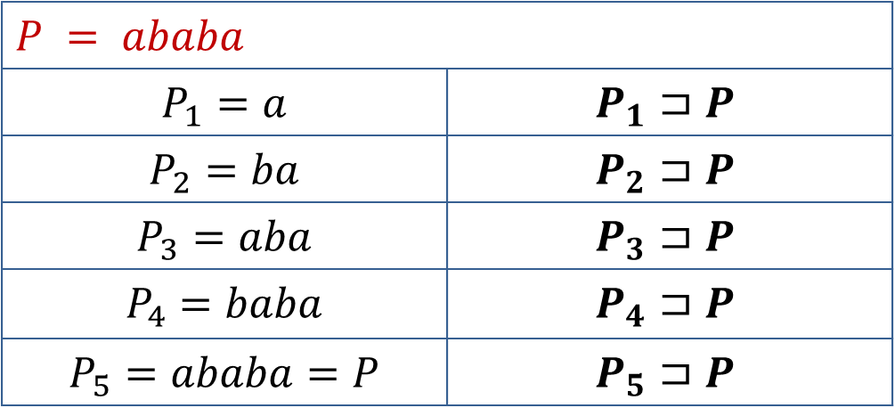

Suffix of String
If a string $ω$ is a suffix of a string x then it is denoted by $ω⊐x$
$$P = ababa$$
$$P_{1}=a$$ | $$P_{1}⊐P$$
$$P_{2}=ba$$ | $$P_{2}⊐P$$
$$P_{3}=aba$$ | $$P_{3}⊐P$$
$$P_{4}=baba$$ | $$P_{4}⊐P$$
$$P_{5}=ababa=P$$ | $$P_{5}⊐P$$

Slide 14
Compute Transition Function
 | 1 | 2 | 3 | 4 | 5 | 6 | 7
Pattern | a | b | a | b | a | c | a
COMPUTE-TRANSITION-FUNCTION(P, Σ )
m ← length[P]
for q ← 0 to m do
for each character α Є Σ do
k ← min(m + 1, q + 2)
repeat k ← k - 1
until P_{k} ⊐ P_{q}α
δ(q, α) ← k
return δ

Slide 15
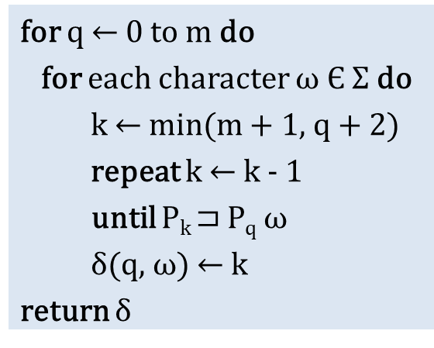
 | 1 | 2 | 3 | 4 | 5 | 6 | 7
Pattern | a | b | a | b | a | c | a
 | input
State | a | b | c
0 | 1 | 0 | 0
1
2
3
4
5
6
7
q=0 | ω=a | k=2 | P₂⊐P₀ω | ab⊐ϵa
k=1 | P₁⊐P₀ω | a⊐ϵa
ω=b | k=2 | P₂⊐P₀ω | ab⊐ϵb
k=1 | P₁⊐P₀ω | a⊐ϵb
k=0 | P₀⊐P₀ω | ϵ⊐ϵb
ω=c | k=2 | P₂⊐P₀ω | ab⊐ϵc
k=1 | P₁⊐P₀ω | a⊐ϵc
k=0 | P₀⊐P₀ω | ϵ⊐ϵc
for q ← 0 to m do
for each character $ω$ Є Σ do
k ← min(m + 1, q + 2)
repeat k ← k - 1
until P_{k} ⊐ P_{q} $ω$
δ(q, $ω$) ← k
return δ

Slide 16
 | 1 | 2 | 3 | 4 | 5 | 6 | 7
Pattern | a | b | a | b | a | c | a
 | input
State | a | b | c
0 | 1 | 0 | 0
1 | 1 | 2 | 0
2
3
4
5
6
7
q=1 | ω=a | k=3 | P₃⊐P₁ω | aba⊐aa
k=2 | P₂⊐P₁ω | ab⊐aa
k=1 | P₁⊐P₁ω | a⊐aa
ω=b | k=3 | P₃⊐P₁ω | aba⊐ab
k=2 | P₂⊐P₁ω | ab⊐ab
ω=c | k=3 | P₃⊐P₁ω | aba⊐ac
k=2 | P₂⊐P₁ω | ab⊐ac
for q ← 0 to m do
for each character $ω$ Є Σ do
k ← min(m + 1, q + 2)
repeat k ← k - 1
until P_{k} ⊐ P_{q} $ω$
δ(q, $ω$) ← k
return δ
k=1 | P₁⊐P₁ω | a⊐ac
k=0 | P₀⊐P₁ω | ϵ⊐ac

Slide 17
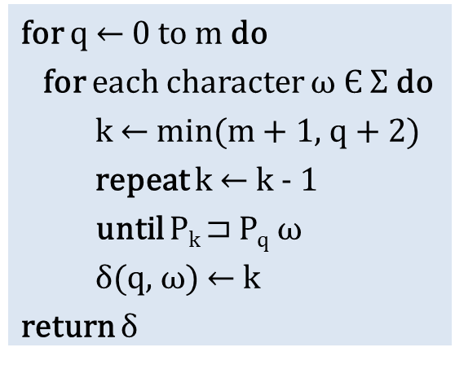
 | 1 | 2 | 3 | 4 | 5 | 6 | 7
Pattern | a | b | a | b | a | c | a
 | input
State | a | b | c
0 | 1 | 0 | 0
1 | 1 | 2 | 0
2 | 3 | 0 | 0
3 | 1 | 4 | 0
4 | 5 | 0 | 0
5 | 1 | 4 | 6
6 | 7 | 0 | 0
7 | 1 | 2 | 0
q=2 | ω=a | k=4 | P₄⊐P₂ω | abab⊐aba
k=3 | P₃⊐P₂ω | aba⊐aba
ω=b | k=0 | P₀⊐P₂ω | ϵ⊐abb
ω=c | k=0 | P₀⊐P₂ω | ϵ⊐abc
q=3 | ω=a | k=1 | P₁⊐P₃ω | a⊐abaa
ω=b | k=4 | P₄⊐P₃ω | abab⊐abab
for q ← 0 to m do
for each character $ω$ Є Σ do
k ← min(m + 1, q + 2)
repeat k ← k - 1
until P_{k} ⊐ P_{q} $ω$
δ(q, $ω$) ← k
return δ
ω=c | k=0 | P₀⊐P₃ω | ϵ⊐abac
q=4 | ω=a | k=5 | P₅⊐P₄ω | ababa⊐ababa
ω=b | k=0 | P₀⊐P₄ω | ϵ⊐ababb
ω=c | k=0 | P₀⊐P₃ω | ϵ⊐ababc

Slide 18
Finite Automata Matcher
 | input
State | a | b | c
0 | 1 | 0 | 0
1 | 1 | 2 | 0
2 | 3 | 0 | 0
3 | 1 | 4 | 0
4 | 5 | 0 | 0
5 | 1 | 4 | 6
6 | 7 | 0 | 0
7 | 1 | 2 | 0
FINITE-AUTOMATON MATCHER(T, δ, m)
n ← length[T]
q ← 0
for i ← 1 to n do
q ← δ(q, T[i])
if q == m then
print "Pattern occurs with shift" i – m
i =
6
3
1
8
5
9
4
2
 | 1 | 2 | 3 | 4 | 5 | 6 | 7
Pattern | a | b | a | b | a | c | a
7
q =
6
4
5
4
0
1
2
5
3
7
 | 1 | 2 | 3 | 4 | 5 | 6 | 7 | 8 | 9 | 10 | 11
Text | a | b | a | b | a | b | a | c | a | b | a

Slide 19
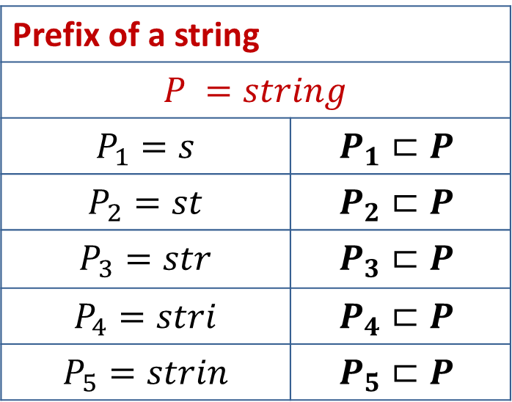
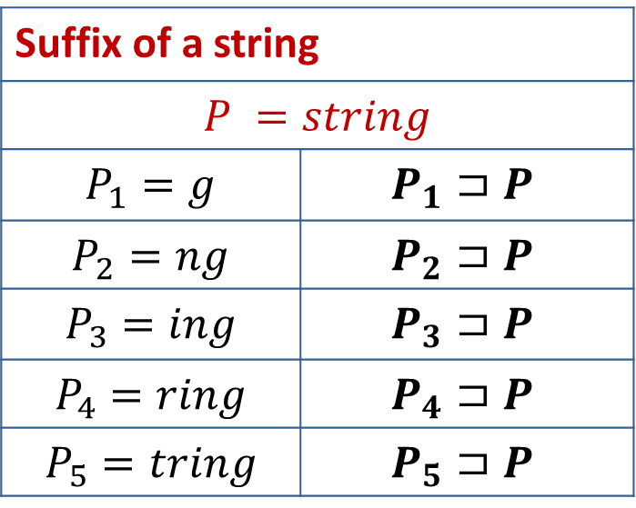
Suffix & Prefix of a String
Suffix of a string
$$P =string$$
$$P_{1}=g$$ | $$P_{1}⊐P$$
$$P_{2}=ng$$ | $$P_{2}⊐P$$
$$P_{3}=ing$$ | $$P_{3}⊐P$$
$$P_{4}=ring$$ | $$P_{4}⊐P$$
$$P_{5}=tring$$ | $$P_{5}⊐P$$
Prefix of a string
$P =string$
$$P_{1}=s$$ | $$P_{1}⊏P$$
$$P_{2}=st$$ | $$P_{2}⊏P$$
$$P_{3}=str$$ | $$P_{3}⊏P$$
$$P_{4}=stri$$ | $$P_{4}⊏P$$
$$P_{5}=strin$$ | $$P_{5}⊏P$$

Slide 20
Knuth-Morris-Pratt Algorithm
The KMP algorithm relies on prefix function (π)
Proper prefix: All the characters in a string, with one or more cut off the end. “S”, “Sn”, “Sna”, and “Snap” are all the proper prefixes of “Snape”.
Proper suffix: All the characters in a string, with one or more cut off the beginning. “agrid”, “grid”, “rid”, “id”, and “d” are all proper suffixes of “Hagrid”.
KMP algorithm works as follows:
Step-1: Calculate Prefix Function
Step-2: Match Pattern with Text

Slide 21
Longest Common Prefix and Suffix
 | 1 | 2 | 3 | 4 | 5 | 6 | 7
Pattern | a | b | a | b | a | c | a
Prefix(π) | 0 | 0 | 1 | 2 | 3 | 0 | 1
ababa
abab
aba
ab
a
We have no possible prefixes
Possible prefix = a
Possible prefix = a, ab, aba, abab
Possible prefix = a, ab
Possible prefix = a, ab, aba
We have no possible suffixes
Possible suffix = b
Possible suffix = a, ba, aba, baba
Possible suffix = a, ba
Possible suffix = b, ab, bab

Slide 22
Calculate Prefix Function - Example 1
k+1
q
k+1
q
 | 1 | 2 | 3 | 4 | 5 | 6 | 7 | 8 | 9 | 10 | 11 | 12 | 13 | 14 | 15 | 16 | 17 | 18
P | a | c | a | c | a | b | a | c | a | c | a | b | a | c | a | c | a | c
π | 0 | 0 | 1 | 2 | 3 | 0 | 1 | 2 | 3 | 4 | 5 | 6 | 7 | 8 | 9 | 10 | 11 | 4
4
0
1
2
5
1
k =
3
3
1
11
0
P[k+1]==P[q]
false
true
6
7
8
4
5
3
q =
2
18
false
k>0
true
Initially set π[1] = 0
k is the longest prefix found
q is the current index of pattern
k=π[k]
k=k+1
π[q]=k

Slide 23
KMP- Compute Prefix Function
COMPUTE-PREFIX-FUNCTION(P)
m ← length[P]
π[1] ← 0
k ← 0
for q ← 2 to m
while k > 0 and P[k + 1] ≠ P[q]
k ← π[k]
end while
if P[k + 1] == P[q] then
k ← k + 1
end if
π[q] ← k
return π

Slide 24
Calculate Prefix Function – Example 2
P | A | C | A | C | A | G | T
π | 0 | 0 | 1 | 2 | 3 | 0 | 0

Slide 25
KMP String Matching
 | 1 | 2 | 3 | 4 | 5 | 6 | 7
Pattern | a | c | a | c | a | g | t
Prefix(π) | 0 | 0 | 1 | 2 | 3 | 0 | 0
T | a | c | a | t | a | c | g | a | c | a | c | a | g | t
Mismatch ?
Check value in prefix table
a
c
a
c
a
g
t
a
c
a
c
a
g
t
We can skip 2 shifts
(Skip unnecessary shifts)
T | a | c | a | t | a | c | g | a | c | a | c | a | g | t
a
c
a
c
a
g
t
Mismatch ?
Check value in prefix table
T | a | c | a | t | a | c | g | a | c | a | c | a | g | t
a
c
a
c
a
g
t
Mismatch ?
Check value in prefix table

Slide 26
KMP-MATCHER
KMP-MATCHER(T, P)
n ← length[T]
m ← length[P]
π ← COMPUTE-PREFIX-FUNCTION(P)
q ← 0 //Number of characters matched.
for i ← 1 to n //Scan the text from left to right.
while q > 0 and P[q + 1] ≠ T[i]
q ← π[q] //Next character does not match.
if P[q + 1] == T[i] then
then q ← q + 1 //Next character matches.
if q == m then //Is all of P matched?
print "Pattern occurs with shift" i - m
q ← π[q] //Look for the next match.

Slide 27
Thank You !!

