Slide 1



2150703
Analysis and Design of Algorithms (ADA)
Unit-9
Introduction to NP-Completeness
Dr. Gopi Sanghani
9825621471
gopi.sanghani@darshan.ac.in

Slide 2
Topics to Study…
The class P and NP
Polynomial reduction
NP- Completeness Problem
NP-Hard Problems
Travelling Salesman problem, Hamiltonian problem, Approximation algorithms

Slide 3
Complexity Definitions
Asymptotic notations are used to describe the asymptotic running time of an algorithm.
Asymptotic notations are commonly used notations in performance analysis.
They are used to characterize the complexity of an algorithm.
They are,
Big - Oh
Big - Theta
Big - Omega

Slide 4
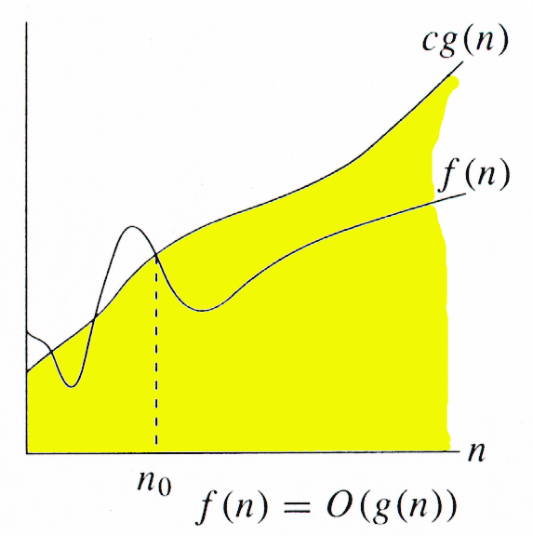
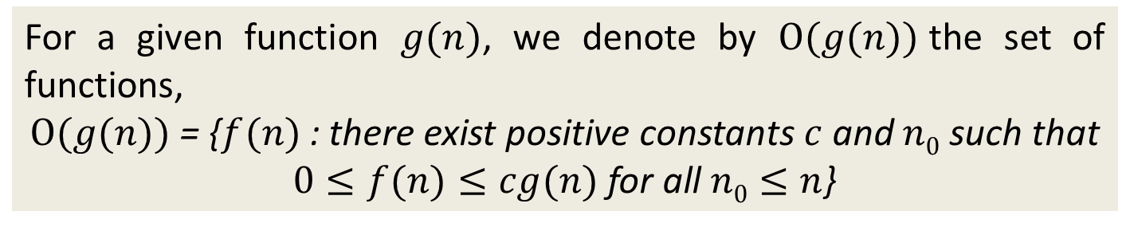
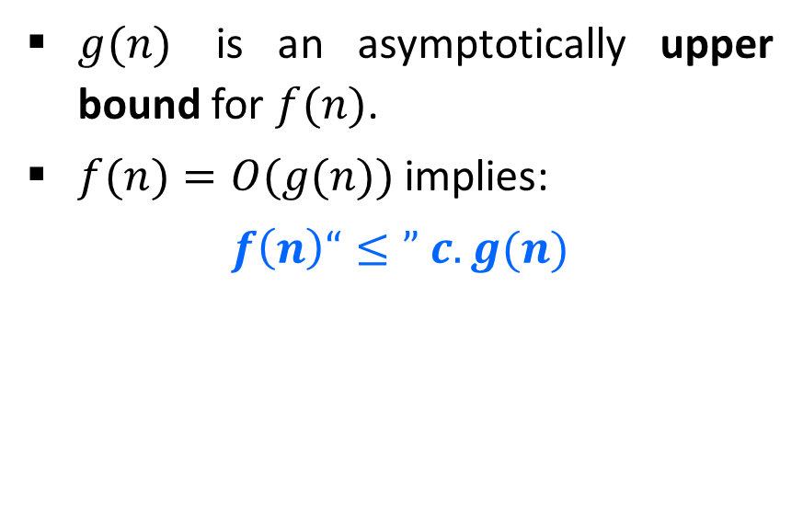
O-Notation (Big O notation) (Upper Bound)
For a given function $g(n)$, we denote by $Ο(g(n))$the set of functions,
$Ο(g(n))$= {$f(n)$ : there exist positive constants $c$ and $n0$ such that
$0≤f(n)≤cg(n)$for all $n0≤n$}
$g(n)$ is an asymptotically upper bound for $f(n)$.
$f(n)=O(g(n))$implies:
$$f\left(n\right)“≤” c.g(n)$$

Slide 5
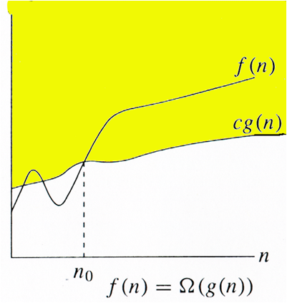
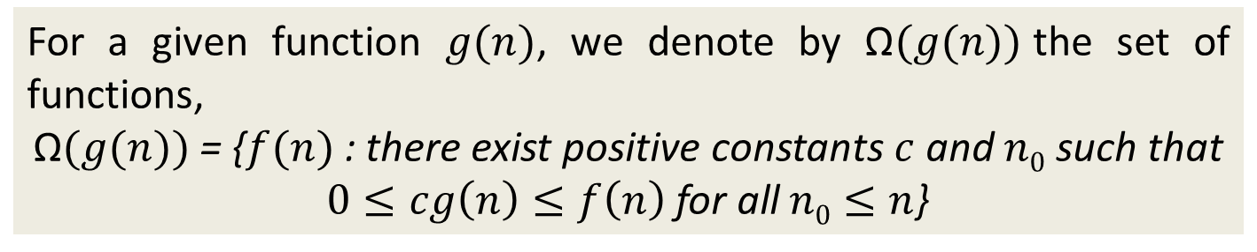
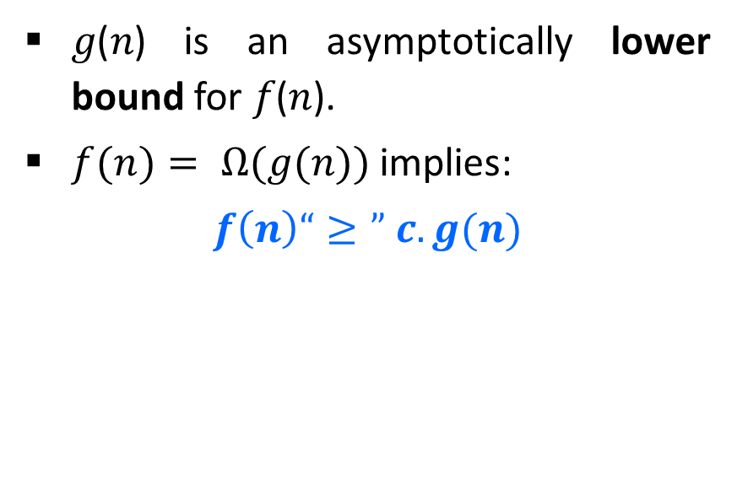
Ω-Notation (Omega notation) (Lower Bound)
For a given function $g(n)$, we denote by Ω$(g(n))$the set of functions,
$\text{Ω}(g(n))$= {$f(n)$ : there exist positive constants $c$ and $n0$ such that
$0≤cg\left(n\right)≤f\left(n\right)$for all$n0≤n$}
𝑔(𝑛) is an asymptotically lower bound for 𝑓(𝑛).
$f(n)= Ω(g(n))$implies:
$$f\left(n\right)“≥” c.g(n)$$

Slide 6
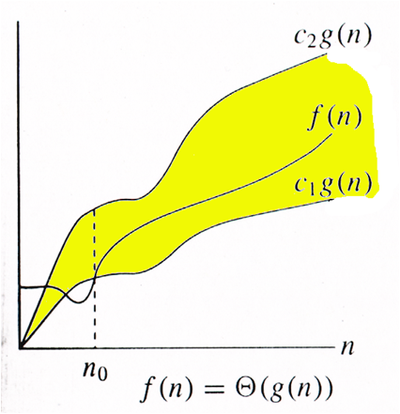
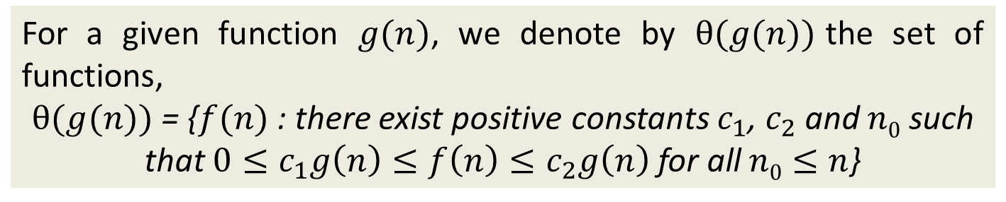
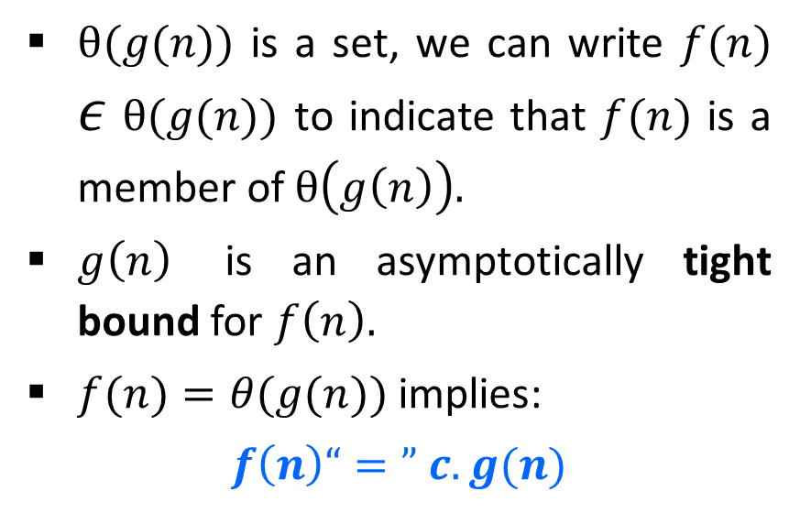
θ-Notation (Theta notation) (Same order)
For a given function $g(n)$, we denote by $θ(g(n))$the set of functions,
$θ(g(n))$ = {$f(n)$ : there exist positive constants $c_{1}$, $c_{2}$ and $n0$ such that $0≤c_{1}g\left(n\right)≤f\left(n\right)≤c_{2}g\left(n\right)$ for all$n0≤n$}
$θ(g(n))$ is a set, we can write $f(n)$ $ε$ $θ(g(n))$ to indicate that $f(n)$ is a member of $θ\left(g\left(n\right)\right).$
$g\left(n\right)$ is an asymptotically tight bound for $f\left(n\right).$
$f(n)=θ(g(n))$implies:
$$f\left(n\right)“=” c.g(n)$$

Slide 7
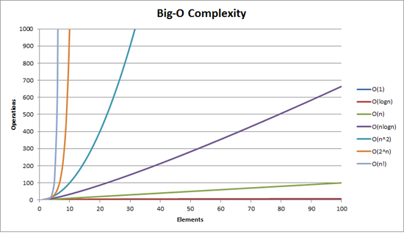
How bad is exponential complexity
Fibonacci example – the recursive fib cannot even compute fib(50)

Slide 8
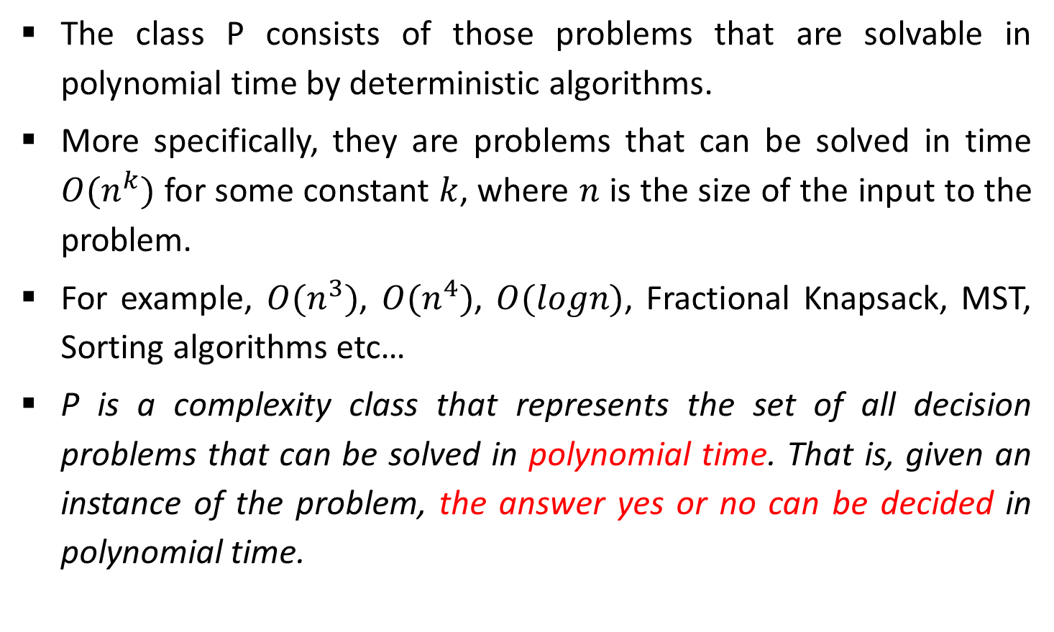
The Class P
The class P consists of those problems that are solvable in polynomial time by deterministic algorithms.
More specifically, they are problems that can be solved in time $O(n^{k})$ for some constant $k$, where $n$ is the size of the input to the problem.
For example, $O(n^{3})$, $O(n^{4})$, $O(logn)$, Fractional Knapsack, MST, Sorting algorithms etc…
P is a complexity class that represents the set of all decision problems that can be solved in polynomial time. That is, given an instance of the problem, the answer yes or no can be decided in polynomial time.

Slide 9
The NP class
NP is Non-Deterministic polynomial time.
The class NP consists of those problems that are verifiable in polynomial time.
NP is the class of decision problems for which it is easy to check the correctness of a claimed answer, with the help of a little extra information.
Hence, we are not asking for a way to find a solution, but only to verify that an alleged solution really is correct.
Every problem in this class can be solved in exponential time using exhaustive search.

Slide 10
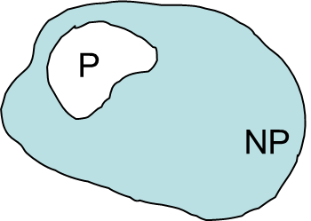

P and NP Class Problems
P = set of problems that can be solved in polynomial time
NP = set of problems for which a solution can be verified in polynomial time
$P  NP$

Slide 11
Further Classification of NP Problems
NP Complete
NP-complete problems are a set of problems to each of which any other NP-problem can be reduced in polynomial time, and whose solution may still be verified in polynomial time.
No polynomial-time algorithm has been discovered for an NP-Complete problem.
NP-Complete is a complexity class which represents the set of all problems X in NP for which it is possible to reduce any other NP problem Y to X in polynomial time.

Slide 12
Further Classification of NP Problems
NP Hard
NP-hard problems are those at least as hard as NP problems, i.e., all NP problems can be reduced (in polynomial time) to them.
NP-hard problems need not be in NP, i.e., they need not have solutions verifiable in polynomial time.
The precise definition here is that a problem X is NP-hard, if there is an NP-complete problem Y, such that Y is reducible to X in polynomial time.

Slide 13
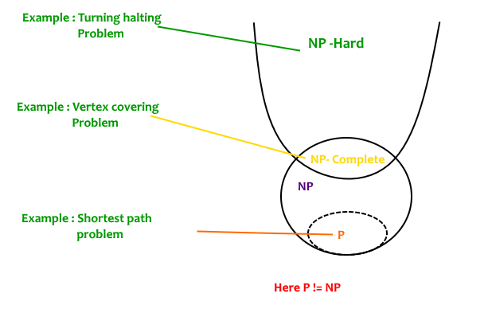
P & NP Class

Slide 14
Polynomial Reduction
Let us consider a decision problem A, which we would like to solve in polynomial time.
Now suppose, we already know how to solve a different decision problem B in polynomial time.
Finally we have a procedure that transforms any instance α of A into some instance β of B with the following characteristics.
The transformation takes polynomial time.
The answers are same. That is the answer for α is “yes” if and only if the answer of β is also “yes”.
We call such a procedure a polynomial-time reduction algorithm and it provides us a way to solve problem A in polynomial time:

Slide 15
Polynomial Reduction
Given an instance α of problem A, use a polynomial-time reduction algorithm to transform it to an instance β of problem B.
Run the polynomial-time decision algorithm for B on the instance β.
Use the answer for β as the answer for α.
In other words, by "reducing" solving problem A to solving problem B, we use the "easiness" of B to prove the "easiness" of A.
Yes
α
Polynomial time Reduction Algorithm
β
Polynomial time Algorithm to decide B
No
Polynomial time Algorithm to decide A

Slide 16
Hamiltonian Cycles
Hamiltonian Path in an undirected graph is a path that visits each vertex exactly once.
A Hamiltonian cycle (or Hamiltonian circuit) is a Hamiltonian Path such that there is an edge (in the graph) from the last vertex to the first vertex of the Hamiltonian Path.
1
2
3
4
The graph has Hamiltonian cycles:
1, 3, 4, 5, 6, 7, 8, 2, 1 AND
1, 2, 8, 7, 6, 5, 4, 3, 1.
8
7
6
5

Slide 17
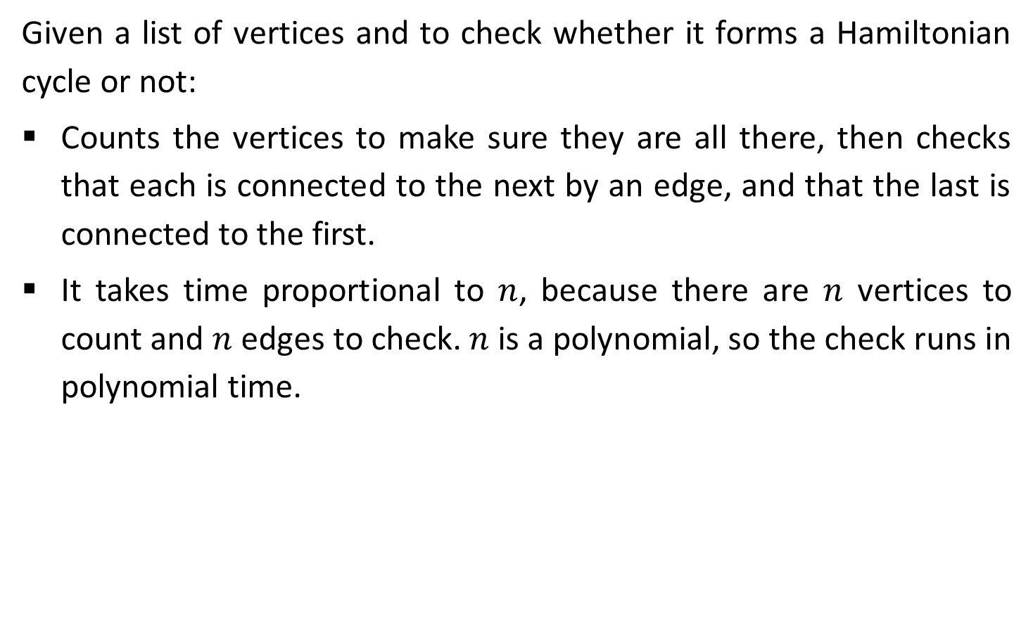
Hamiltonian Cycles
Given a list of vertices and to check whether it forms a Hamiltonian cycle or not:
Counts the vertices to make sure they are all there, then checks that each is connected to the next by an edge, and that the last is connected to the first.
It takes time proportional to $n$, because there are $n$ vertices to count and $n$ edges to check. $n$ is a polynomial, so the check runs in polynomial time.

Slide 18
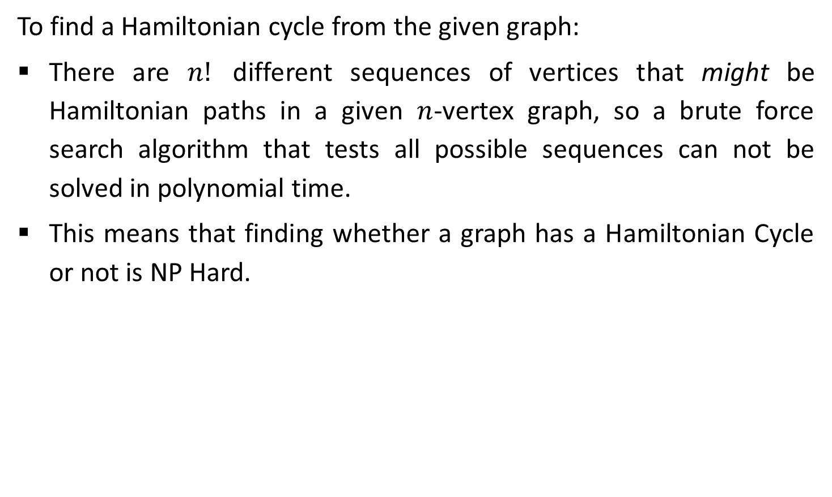
Hamiltonian Cycles
To find a Hamiltonian cycle from the given graph:
There are $n!$ different sequences of vertices that might be Hamiltonian paths in a given $n$-vertex graph, so a brute force search algorithm that tests all possible sequences can not be solved in polynomial time.
This means that finding whether a graph has a Hamiltonian Cycle or not is NP Hard.

Slide 19
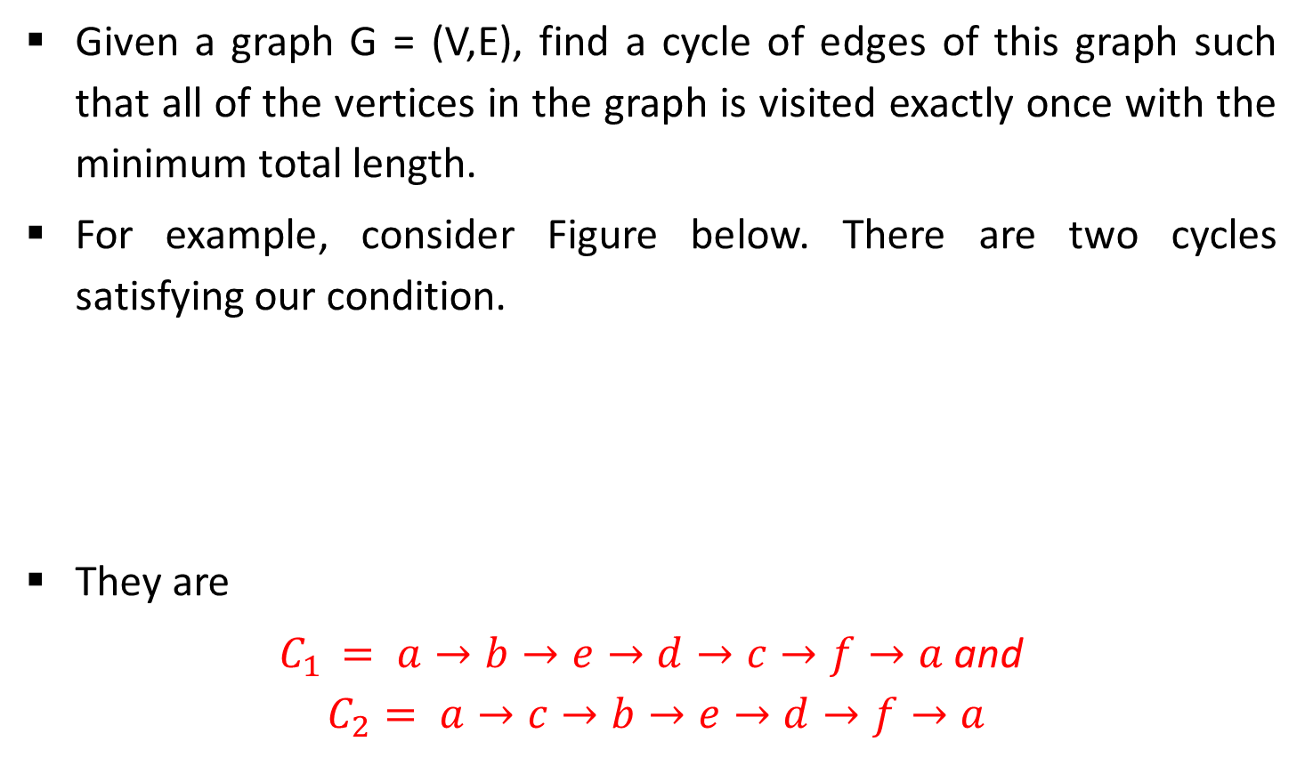
Traveling Salesperson Problem
Given a graph G = (V,E), find a cycle of edges of this graph such that all of the vertices in the graph is visited exactly once with the minimum total length.
For example, consider Figure below. There are two cycles satisfying our condition.
They are
$C_{1} = a→b→e→d→c→f→a$and
$$C_{2}= a→c→b→e→d→f→a$$
a
13
b
2
e
17
5
12
10
7
5
c
9
f
11
d

Slide 20
All the BEST !!

