Slide 1



3130702
Data Structure
Unit - 3 Graph
Non-Linear Data Structure
Dr. Pradyumansinh Jadeja
9879461848
pradyuman.jadeja@darshan.ac.in

Slide 2
Graphs
What is Graph?
Representation of Graph
Matrix representation of Graph
Linked List representation of Graph
Elementary Graph Operations
Breadth First Search (BFS)
Depth First Search (DFS)
Spanning Trees
Minimal Spanning Trees
Shortest Path

Slide 3
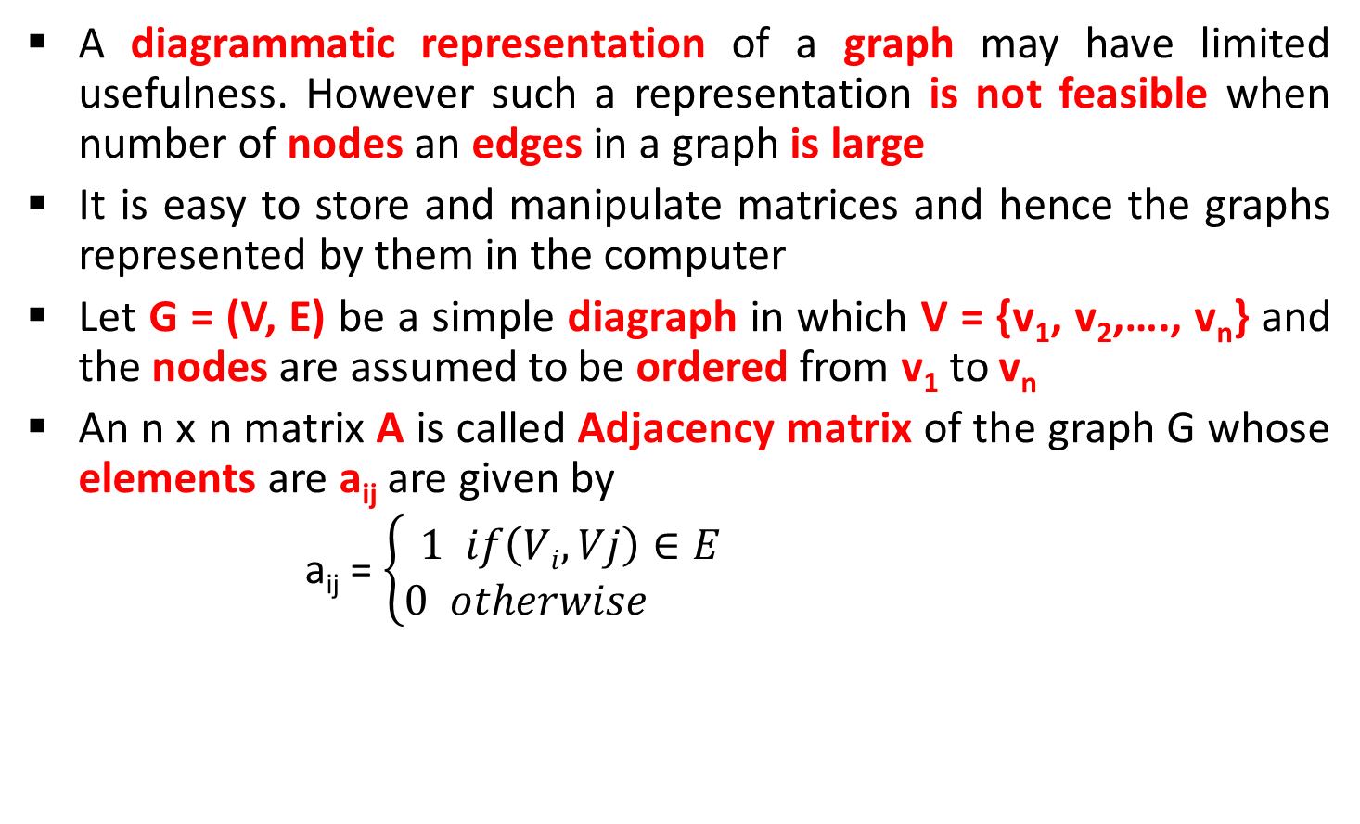
Adjacency matrix
A diagrammatic representation of a graph may have limited usefulness. However such a representation is not feasible when number of nodes an edges in a graph is large
It is easy to store and manipulate matrices and hence the graphs represented by them in the computer
Let G = (V, E) be a simple diagraph in which V = {v₁, v₂,…., v_{n}} and the nodes are assumed to be ordered from v₁ to v_{n}
An n x n matrix A is called Adjacency matrix of the graph G whose elements are a_{ij} are given by
a_{ij} = $\left\{\begin{aligned}1 if\left(Vi, Vj\right)∈E \\ 0 otherwise \end{aligned}\right.$

Slide 4
Adjacency matrix
An element of the adjacency matrix is either 0 or 1
Any matrix whose elements are either 0 or 1 is called bit matrix or Boolean matrix
For a given graph G =m (V, E), an adjacency matrix depends upon the ordering of the elements of V
For different ordering of the elements of V we get different adjacency matrices.
V₁
V₄
V₁
V₂
V₃
V₄
V₁
0 | 1 | 0 | 1
1 | 0 | 0 | 0
1 | 1 | 0 | 1
0 | 1 | 0 | 0
A =
V₂
V₃
V₄
V₂
V₃

Slide 5
Adjacency matrix
V₁
V₄
V₁
V₂
V₃
V₄
V₁
0 | 1 | 0 | 1
1 | 0 | 0 | 0
1 | 1 | 0 | 1
0 | 1 | 0 | 0
A =
V₂
V₃
V₄
V₂
V₃
The number of elements in the i^{th} row whose value is 1 is equal to the out-degree of node V_{i}
The number of elements in the j^{th} column whose value is 1 is equal to the in-degree of node V_{j}
For a NULL graph which consist of only n nodes but no edges, the adjacency matrix has all its elements 0. i.e. the adjacency matrix is the NULL matrix

Slide 6
Power of Adjacency matrix
1 | 1 | 0 | 1
1 | 1 | 0 | 0
2 | 2 | 0 | 1
0 | 1 | 0 | 1
A³ =
0 | 1 | 0 | 1
1 | 0 | 0 | 0
1 | 1 | 0 | 1
0 | 1 | 0 | 0
1 | 1 | 0 | 0
0 | 1 | 0 | 1
1 | 2 | 0 | 1
1 | 0 | 0 | 0
A =
A² = A x A =
1 | 2 | 0 | 1
1 | 1 | 0 | 1
2 | 3 | 0 | 2
1 | 1 | 0 | 0
A⁴ =
Entry of 1 in i^{th} row and j^{th} column of A shows existence of an edge (V_{i}, V_{j}), that is a path of length 1
Entry in A² shows no of different paths of exactly length 2 from node V_{i} to V_{j}
Entry in A³ shows no of different paths of exactly length 3 from node V_{i} to V_{j}

Slide 7

Path matrix or reachability matrix
Let G = (V,E) be a simple diagraph which contains n nodes that are assumed to be ordered.
A nxn matrix P is called path matrix whose elements are given by
P_{ij} = $\left\{\begin{aligned}1 if there exists path from nodeVi to Vj \\ 0 otherwise \end{aligned}\right.$

Slide 8
Adjacency List Representation
0
4
1
2
3
0
1
2
3
4
1
2
3
4
0
3
0
3
4
0
1
2
4
0
2
3

Slide 9
Graph Traversal
Two Commonly used Traversal Techniques are
Depth First Search (DFS)
Breadth First Search (BFS)

Slide 10
Depth First Search (DFS)
It is like preorder traversal of tree
Traversal can start from any vertex V_{i}
V_{i} is visited and then all vertices adjacent to V_{i} are traversed recursively using DFS
DFS (G, 1) is given by
✓
1
Step 1: Visit (1)
Step 2: DFS (G, 2)
DFS (G, 3)
DFS (G, 4)
DFS (G, 5)
DFS (G, 2):
Step1: Visit(2)
Step 2: DFS (G, 6)
2
✓
5
✓
✓
3
✓
4
DFS (G, 6):
Step1: Visit(6)
Step 2: DFS (G, 3)
DFS (G, 8)
✓
6
✓
7
✓
DFS of given graph starting from node 1 is given by
8
1
2
6
3
8
7
4
5

Slide 11
Depth First Search (DFS)
✓
A
✓
B
C
✓
M
N
O
✓
D
✓
E
F
✓
G
✓
R
Q
P
H
✓
A
B
D
H
E
C
F
G
✓
A
✓
✓
B
✓
C
E
A
B
D
C
F
E
✓
D
F
✓

Slide 12
Breadth First Search (BFS)
This methods starts from vertex V₀
V₀ is marked as visited. All vertices adjacent to V₀ are visited next
Let vertices adjacent to V₀ are V₁, V₂, V₂, V₄
V₁, V₂, V₃ and V₄ are marked visited
All unvisited vertices adjacent to V₁, V₂, V₃, V₄ are visited next
The method continuous until all vertices are visited
The algorithm for BFS has to maintain a list of vertices which have been visited but not explored for adjacent vertices
The vertices which have been visited but not explored for adjacent vertices can be stored in queue

Slide 13
Breadth First Search (BFS)
✓
✓
A
✓
1
✓
2
5
✓
B
✓
C
✓
✓
✓
3
4
✓
D
✓
E
F
✓
G
6
✓
7
✓
8
H
✓
✓
1
|
2
3
4
5
|
6
7
|
8
A
| B C
| D E F G
| H
V₄
V₁
V₂
V₀
V₆
V₃
V₀| V₁ V₂ | V₄ V₆ V₃ | V₅
V₅

Slide 14
Write DFS & BFS of following Graphs
A
B
C
M
N
O
D
E
F
G
R
Q
P
H
A
A
0
1
B
C
E
B
E
5
2
D
F
4
3
C
D

Slide 15
Procedure : DFS (vertex V)
This procedure traverse the graph G in DFS manner.
V is a starting vertex to be explored.
Visited[] is an array which tells you whether particular vertex is visited or not.
W is a adjacent node of vertex V.
S is a Stack, PUSH and POP are functions to insert and remove from stack respectively.

Slide 16
Procedure : DFS (vertex V)
1. [Initialize TOP and Visited]
visited[] ← 0
TOP ← 0
2. [Push vertex into stack]
PUSH (V)
3. [Repeat while stack is not Empty]
Repeat step 3 while stack is not empty
v ← POP()
if visited[v] is 0
then visited [v] ← 1
for all W adjacent to v
if visited [w] is 0
then PUSH (W)
end for
end if

Slide 17
Procedure : BFS (vertex V)
This procedure traverse the graph G in BFS manner
V is a starting vertex to be explored
Q is a queue
visited[] is an array which tells you whether particular vertex is visited or not
W is a adjacent node f vertex V.

Slide 18
Procedure : BFS (vertex V)
1. [Initialize Queue & Visited]
visited[] ← 0
F ← R ← 0
2. [Marks visited of V as 1]
visited[v] ← 1
3. [Add vertex v to Q]
InsertQueue(V)
4. [Repeat while Q is not Empty]
Repeat while Q is not empty
v ← RemoveFromQueue()
For all vertices W adjacent to v
if visited[w] is 0
then visited[w] ← 1
InsertQueue(w)

Slide 19
Spanning Tree
A Spanning tree of a graph is an undirected tree consisting of only those edges necessary to connect all the nodes in the original graph
A spanning tree has the properties that
For any pair of nodes there exists only one path between them
Insertion of any edge to a spanning tree forms a unique cycle
The particular Spanning for a graph depends on the criteria used to generate it
If DFS search is use, those edges traversed by the algorithm forms the edges of tree, referred to as Depth First Spanning Tree
If BFS Search is used, the spanning tree is formed from those edges traversed during the search, producing Breadth First Spanning tree

Slide 20
Construct Spanning Tree
A
DFS
Spanning
Tree
BFS
Spanning
Tree
B
C
D
E
F
G
H
A
A
B
C
B
C
D
E
F
G
D
E
F
G
H
H

Slide 21
Construct Spanning Tree
A
DFS
Spanning
Tree
BFS
Spanning
Tree
B
C
E
D
F
A
A
B
C
E
B
C
E
D
F
D
F

Slide 22
Minimum Cost Spanning Tree
The cost of a spanning tree of a weighted undirected graph is the sum of the costs(weights) of the edges in the spanning tree
A minimum cost spanning tree is a spanning tree of least cost
Two techniques for Constructing minimum cost spanning tree
Prim’s Algorithm
Kruskal’s Algorithm

Slide 23
Prims Algorithm
A
Step 1: Taking minimum Weight edge of all Adjacent edges of X={A}
Step 3: Taking minimum weight edge of all Adjacent edges of X = { A , B , C }
4
5
6
6
4
A
B
E
3
B
X = { A , B }
4
A
5
7
Step 2: Taking minimum weight edge of all Adjacent edges of
X = { A , B }
B
X = {A,B,C,D}
2
2
1
C
D
C
D
1
4
A
A – B | 4
B
Step 4: Taking minimum weight edge of all Adjacent edges of X = {A ,B ,C ,D }
A – D | 6
C – E | 5
A – E | 5
B – E | 3
C – D | 1
2
X = {A ,B,C}
A – C | 6
B – C | 2
D – E | 7
C
4
A
Let X be the set of nodes
explored, initially X = { A }
B
3
E
We obtained minimum spanning tree of cost:
4 + 2 + 1 + 3 = 10
2
X = {A,B,C,D,E}
A
C
D
1

Slide 24
Kruskal’s Algorithm
A
Step 2: Taking next
min edge (B,C)
4
5
Step 4: Taking next
min edge (A,B)
6
6
B
E
B
3
A
4
5
7
2
2
C
D
B
E
C
D
1
3
1
2
Step 3: Taking next
min edge (B,E)
C
D
Step 1: Taking min
edge (C,D)
B
E
1
3
C
D
2
so we obtained minimum
spanning tree of cost:
4 + 2 + 1 + 3 = 10
1
C
D
1

Slide 25
Construct Minimum Spanning Tree
0
0
3
6
3
1
1
1
5
5
3
1
3
2
2
3
6
4
2
3
4
2
6
4
5
4
5
1
1
1
2
2
1
2
2
4
2
3
2
3
4
5
3
4
5
3
2
2
1
4
1
6
3
3
7
6
7

Slide 26
Shortest Path Algorithm
Let G = (V,E) be a simple diagraph with n vertices
The problem is to find out shortest distance from a vertex to all other vertices of a graph
Dijkstra Algorithm – it is also called Single Source Shortest Path Algorithm

Slide 27
Dijkstra Algorithm – Shortest Path
2
B
D
A | B | C | D | E | F
0 | ∞ | ∞ | ∞ | ∞ | ∞
0 | 0 | 0 | 0 | 0 | 0
1
6
A
4
7
F
Distance
0
1
Visited
5
2
C
E
5
1st Iteration: Select Vertex A with minimum distance
1
∞
2
B
D
∞
1
6
4
F
A | B | C | D | E | F
0 |  |  | ∞ | ∞ | ∞
 |  |  | 0 | 0 | 0
0
A
1
7
1
5
Distance
∞
∞
5
2
C
E
Visited
1
0
0
5
5
∞

Slide 28
Dijkstra Algorithm – Shortest Path
2nd Iteration: Select Vertex B with minimum distance
Cost of going to C via B = dist[B] + cost[B][C] = 1 + 1 = 2
A | B | C | D | E | F
0 | 1 | 5 | ∞ | ∞ | ∞
1 | 0 | 0 | 0 | 0 | 0
Cost of going to D via B = dist[B] + cost[B][D] = 1 + 2 = 3
Distance
Cost of going to E via B = dist[B] + cost[B][E] = 1 + 4 = 5
Visited
Cost of going to F via B = dist[B] + cost[B][F] = 1 + ∞ = ∞
1
3
2
B
D
6
1
0
A
1
4
7
F
∞
A | B | C | D | E | F
0 | 1 | 2 | 3 | 5 | ∞
 |  |  | 0 | 0 | 0
5
2
Distance
5
C
E
1
1
0
Visited
2
5

Slide 29
Dijkstra Algorithm – Shortest Path
3rd Iteration: Select Vertex C via B with minimum distance
Cost of going to D via C = dist[C] + cost[C][D] = 2 + ∞ = ∞
A | B | C | D | E | F
0 | 1 | 2 | 3 | 5 | ∞
1 | 1 | 0 | 0 | 0 | 0
Cost of going to E via C = dist[C] + cost[C][E] = 2 + 5 = 7
Distance
Cost of going to F via C = dist[C] + cost[C][F] = 2 + ∞ = ∞
Visited
1
3
2
B
D
6
1
0
A
1
4
7
F
A | B | C | D | E | F
0 | 1 | 2 | 3 | 5 | ∞
 |  |  | 0 | 0 | 0
5
2
∞
Distance
5
C
E
Visited
1
1
1
2
5

Slide 30
Dijkstra Algorithm – Shortest Path
4th Iteration: Select Vertex D via path A - B with minimum distance
Cost of going to E via D = dist[D] + cost[D][E] = 3 + 7 = 10
A | B | C | D | E | F
0 | 1 | 2 | 3 | 5 | ∞
1 | 1 | 1 | 0 | 0 | 0
Cost of going to F via D = dist[D] + cost[D][F] = 3 + 6 = 9
Distance
Visited
1
3
2
B
D
6
1
A
1
4
7
F
5
A | B | C | D | E | F
0 | 1 | 2 | 3 | 5 | 9
 |  |  | 1 | 0 | 0
2
9
5
Distance
C
E
Visited
1
1
1
2
5

Slide 31
Dijkstra Algorithm – Shortest Path
4th Iteration: Select Vertex E via path A – B – E with minimum distance
Cost of going to F via E = dist[E] + cost[E][F] = 5 + 2 = 7
A | B | C | D | E | F
0 | 1 | 2 | 3 | 5 | 9
1 | 1 | 1 | 1 | 0 | 0
Distance
Visited
1
3
2
B
D
6
1
A | B | C | D | E | F
0 | 1 | 2 | 3 | 5 | 7
 |  |  | 1 | 1 | 0
A
1
4
7
F
7
5
Distance
2
Visited
1
1
1
C
E
2
5
Shortest Path from A to F is
A → B → E → F = 7

Slide 32
Shortest Path
Find out shortest path from node 0 to all other nodes using
Dijkstra Algorithm
0
100
10
0
30
4
0
100
1
10
10
60
60
30
4
50
10
1
2
3
60
50
10
20
2
3
50
20
30

