Slide 1


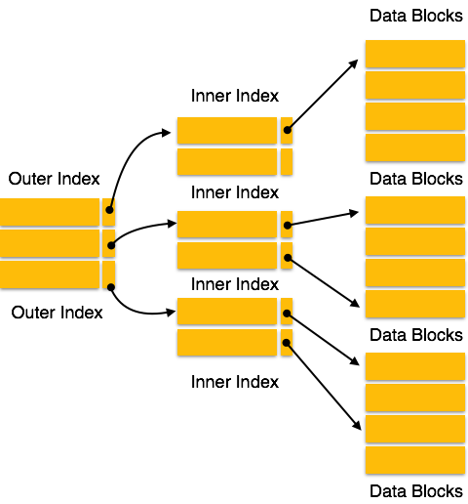

3130702
Data Structure
Unit - 4 File
Dr. Pradyumansinh Jadeja
9879461848
pradyuman.jadeja@darshan.ac.in

Slide 2
What is File?
A file is a collection of records where a record consists of one or more fields. Each contains the same sequence of fields.
Each field is normally of fixed length.
A sample file with four records is shown below:
There are four records
There are four fields (Name, Roll No., Year, Marks)
Records can be uniquely identified on the field 'Roll No.' Therefore, Roll No. is the key field.
A database is a collection of files.
Name | Roll No. | Year | Marks
AMIT | 1000 | 1 | 82
KALPESH | 1005 | 2 | 54
JITENDRA | 1009 | 1 | 75
RAVI | 1010 | 1 | 79

Slide 3
File Organizations
Sequential files
Relative files
Direct files
Indexed Sequential files
Index files
Primitive Operations on a File
Creation
Reading
Insertion
Deletion
Updation
Searching

Slide 4
Sequential Files
It is the most common type of file.
A fixed format is used for record.
All records are of the same length.
Position of each field in record and length of field is fixed.
Records are physically ordered on the value of one of the fields - called the ordering field.
Block 1
Name | Roll No. | Year | Marks
AMIT | 1000 | 1 | 82
KALPESH | 1005 | 1 | 54
JITENDRA | 1009 | 1 | 75
RAVI | 1010 | 1 | 79
Block 2
Name | Roll No. | Year | Marks
RAMESH | 1015 | 1 | 75
ROHIT | 1025 | 1 | 65
JANAK | 1026 | 1 | 75
AMAR | 1029 | 1 | 79

Slide 5
Advantages of Sequential Files
Reading of records in order of the ordering key is extremely efficient.
Finding the next record in order of the ordering key usually, does not require additional block access. Next record may be found in the same block.
Searching operation on ordering key is must faster. Binary search can be utilized. A binary search will require log₂b block accesses where b is the total number of blocks in the file.

Slide 6
Disadvantages of Sequential Files
Sequential file does not give any advantage when the search operation is to be carried out on non- ordering field.
Inserting a record is an expensive operation. Insertion of a new record requires finding of place of insertion and then all records ahead of it must be moved to create space for the record to be inserted. This could be very expensive for large files.
Deleting a record is an expensive operation. Deletion too requires movement of records.
Modification of field value of ordering key could be time consuming. Modifying the ordering field means the record can change its position. This requires deletion of the old record followed by insertion of the modified record.

Slide 7
Hashing (Direct file organization)
Bucket 0
0
1
2
… … … … … …
B-1
230
460
480
790
Bucket 1
321
531
Hashing with buckets
of chained blocks
Bucket 2
232
242
270
470
930
420
Bucket Directory

Slide 8
Hashing (Direct file organization)
It is a common technique used for fast accessing of records on secondary storage.
Records of a file are divided among buckets.
A bucket is either one disk block or cluster of contiguous blocks.
A hashing function maps a key into a bucket number. The buckets are numbered 0, 1,2...b-1.
A hash function f maps each key value into one of the integers 0 through b - 1.
If x is a key, f(x) is the number of bucket that contains the record with key x.
The blocks making up each bucket could either be contiguous blocks or they can be chained together in a linked list.

Slide 9
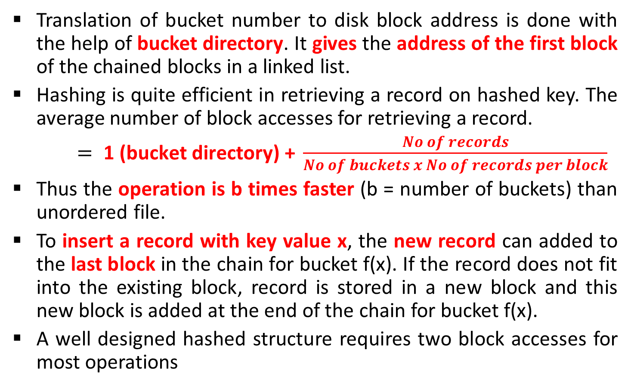
Hashing (Direct file organization)
Translation of bucket number to disk block address is done with the help of bucket directory. It gives the address of the first block of the chained blocks in a linked list.
Hashing is quite efficient in retrieving a record on hashed key. The average number of block accesses for retrieving a record.
$= \text{1 (}\text{bucket} \text{directory}\text{) + }\frac{No of records}{No of buckets x No of records per block}$
Thus the operation is b times faster (b = number of buckets) than unordered file.
To insert a record with key value x, the new record can added to the last block in the chain for bucket f(x). If the record does not fit into the existing block, record is stored in a new block and this new block is added at the end of the chain for bucket f(x).
A well designed hashed structure requires two block accesses for most operations

Slide 10
Indexing
Indexing is used to speed up retrieval of records.
It is done with the help of a separate sequential file.
Each record of in the index file consists of two fields, a key field and a pointer into the main file.
To find a specific record for the given key value, index is searched for the given key value.
Binary search can used to search in index file. After getting the address of record from index file, the record in main file can easily be retrieved.

Slide 11
Indexing
Index File
Main File
Keyc
1000
1009
1010
1012
1016
1089
1100
1200
Name | Roll No. | Year | Marks
AMIT | 1010 | 1 | 82
KALPESH | 1016 | 1 | 54
JITENDRA | 1000 | 1 | 75
RAVI | 1012 | 1 | 79
NILESH | 1089 | 1 | 85
NITIN | 1100 | 1 | 98
JAYESH | 1200 | 1 | 99
UMESH | 1009 | 1 | 74
Index file is ordered on the ordering key Roll No. each record of index file points to the corresponding record. Main file is not sorted.

Slide 12
Advantages of Indexing
Sequential file can be searched effectively on ordering key. When it is necessary to search for a record on the basis of some other attribute than the ordering key field, sequential file representation is inadequate.
Multiple indexes can be maintained for each type of field used for searching. Thus, indexing provides much better flexibility.
An index file usually requires less storage space than the main file.
A binary search on sequential file will require accessing of more blocks.
This can be explained with the help of the following example.
Consider the example of a sequential file with r = 1024 records of fixed length with record size R = 128 bytes stored on disk with block size B = 2048 bytes.

Slide 13
Advantages of Indexing
Size of Sequential File
Number of blocks required to store the file
(1024 x 128) / 2048 = 64
Number of block accesses for searching a record
log₂64= 6
Size of Index File
Suppose, we want to construct an index on a key field that is V = 4 bytes long and the block pointer is P = 4 bytes long.
A record of an index file needs 8 bytes per entry.
Total Number of index entries = 1024
Number of blocks required to store the index file
(1024x8) / 2048 = 4
Number of block accesses for searching a record = log₂4 = 2

Slide 14
Types of Indexes
With indexing, new records can be added at the end of the main file. It will not require movement of records as in the case of sequential file.
Updation of index file requires fewer block accesses compare to sequential file
Types of Indexes:
Primary indexes
Clustering indexes
Secondary indexes

Slide 15
Primary Indexes (Indexed Sequential File)
 | 101
 | 200
101
201
351
… …
805
905
…
 | 201
 | 350
Data File
Sequential File
 | 351
 | 400
… … …
Index File
 | 805
 | 904
Primary Index on ordering key field
Roll Number

Slide 16
Primary Indexes (Indexed Sequential File)
An indexed sequential file is characterized by
Sequential organization (ordered on primary key)
Indexed on primary key
An indexed sequential file is both ordered and indexed.
Records are organized in sequence based on a key field, known as primary key.
An index to the file is added to support random access. Each record in the index file consists of two fields: a key field, which is the same as the key field in the main file.
Number of records in the index file is equal to the number of blocks in the main file (data file) and not equal to the number of records in the main file (data file).

Slide 17
Clustering Indexes
100 | Math
100 | Science
105 | Physics
100
105
106
108
… …
…
105
105
106
106
… … …
108
108
109
109
Field Clustering
Data File
Index File

Slide 18
Clustering Indexes
If records of a file are ordered on a non-key field, we can create a different type of index known as clustering index.
A non-key field does not have distinct value for each record.
A Clustering index is also an ordered file with two fields.

Slide 19
Secondary Indexes (Simple Index File)
1
2
3
4
5
6
7
8
10
12
13
14
15
17
18
19
2
5
3
17
6
10
14
7
13
4
15
18
12
1
19
8
A secondary index on a non-ordering key field

Slide 20
Secondary Indexes (Simple Index File)
While the hashed, sequential and indexed sequential files are suitable for operations based on ordering key or the hashed key. Above file organizations are not suitable for operations involving a search on a field other than ordering or hashed key.
If searching is required on various keys, secondary indexes on these fields must be maintained.
A secondary index is an ordered file with two fields.
Some non-ordering field of the data file.
A block pointer
There could be several secondary indexes for the same file.
One could use binary search on index file as entries of the index file are ordered on secondary key field.
Records of the data files are not ordered on secondary key field.

Slide 21
Secondary Indexes (Simple Index File)
A secondary index requires more storage space and longer search time than does a primary index.
A secondary index file has an entry for every record whereas primary index file has an entry for every block in data file.
There is a single primary index file but the number of secondary indexes could be quite a few.

