Slide 1
PERFORMANCE ANALYSIS AND PREDICTIVE TOOL
PROJECT BY:
SREE VISHNU RAO CR VISHWAS R VALKE

Slide 2
PROBLEM STATEMENT :
The objective is to develop a tool which will help notify performance bottlenecks within the working environment, based on parsed and preprocessed historical data from APM's using ML algorithms and visualize the same on a Dashboard/GUI interface.

Slide 3
SOLUTIONS PRESENTED:
The tool developed will serve as a mechanism to detect and avoid performance hindrances in new releases and its impact on the working environment in a systematic manner.
A clear comparison between system side and application side metrics is established, that helps understanding flow functioning.

Slide 4
APPROACH AND TOOLS USED:
Gathering
APM’S: Splunk & Dynatrace
Splunk SDK built on REST API
Processing
Python packages
Pandas & CSV
Training
Linear Regression
K Nearest Neighbor
Presentation
Python Django Framework and Django REST Framework
Canvas.js

Slide 5
PROJECT ASSISTANCE AND GUIDANCE:
NAME | ROLE | CONTRIBUTION
VIKRANT PAYAL (Associate Director QE) | PROJECT ASSIGNMENT AND ASSISTANCE | REGULAR SUPERVISION ON PROJECT STATUS AND FEEDBACK UPDATES ON PROJECT PROGRESS.
AHMED SYED (Senior Architect QE) | PROJECT MENTOR AND ASSISTANCE | REGULAR SUPERVISION ON PROJECT STATUS AND FEEDBACK UPDATES ON PROJECT PROGRESS TECHNICAL LEARNING ASSIGNMENT.
SHABDA DEV ANUBHAV (SSE IT DIGITAL) YADLAPALLI MOUNIKA (SQA Engineer QE) | APM QUERY MANAGEMENT AND API LEARNING | APM QUERY AND API DELIVERABLES FOR DATA EXTRACTION.

Slide 6
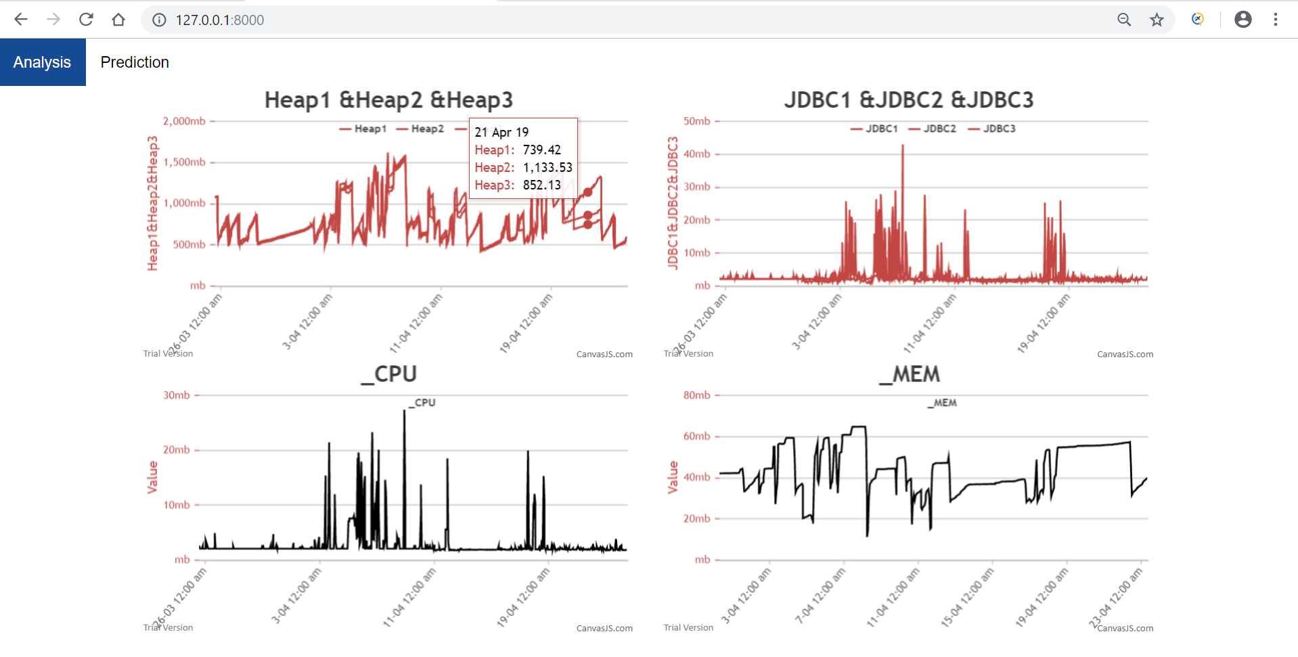
PROJECT SNAPSHOT

Slide 7
Thank You

