Slide 1
Implementation of weightless neural networks on GPU for background subtraction

Slide 4
WiSARD is a powerful online, parallelizable, one shot training weightless neural network for pattern recognition.
WiSARD works by creating random correlation in the original data and then checking their existence during the training and recognition phase. Every new pattern presented to WiSARD is represented in a discriminator, which holds a set of RAMs. The role of the ram is to persist which random correlation have been seen during training time and answering if a particular correlation exists during recognition time
Weightless neural network as they do not require time to spend forward-backward recursive optimization process of neurons weights. It is made up of RAM as nodes, in weightless neural models training at each new sample is just anincremental and one-way update process of neuron memories across network layer. This makes them very fast.

Slide 5
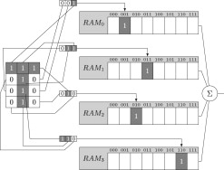

Slide 6
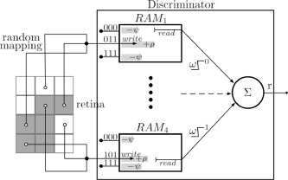

Slide 7
The simple WiSARD network suffers from saturation. If the training data is noisy the WiSARD might mark many RAM code to 1, setting them as seen. This can lead WiSARD to become unable to determine the pattern of a given input, because WiSARD guesses the input belong to all pattern presented so far. This problem can be overcome with the bleaching technique. Now in leaning phase RAMs will no longer hold whether the pattern has already been seen or not, but how many times the pattern has been seen so far.

Slide 8
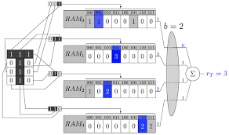

Slide 9
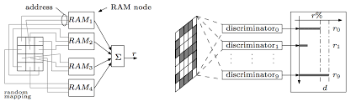

Slide 10
Numba
Numba is a just-in-time Python function compiler that exposes a simple interface for accelerating numerically-focused Python functions. Numba is a very attractive option for Python programmers wishing to GPU accelerate their applications without needing to write C/C++ code, especially for developers already performing computationally heavy operations on NumPy arrays. Numba can be used to accelerate Python functions for the CPU, as well as for NVIDIA GPUs.

Slide 11
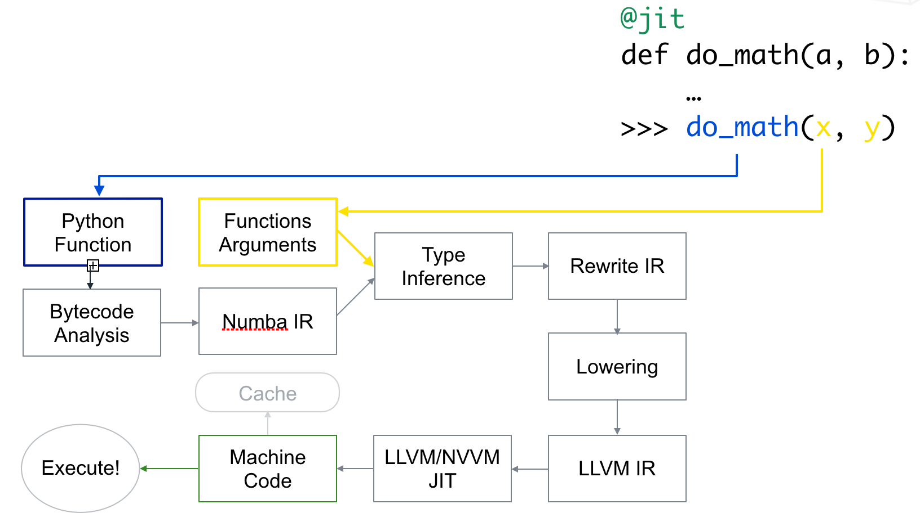
Numba flowchart:

Slide 12
Analysis
The training time of 60,000 images was 1288.741 seconds, the testing time was 2654.127 seconds. Now once we implemented numba the training time was 19.007 seconds(67.8 times faster) the testing time was 31.272 seconds(84.87 times faster). This is still 6.72 times faster to train then the initial code with dictionaries and 8.27 times faster to test

Slide 13
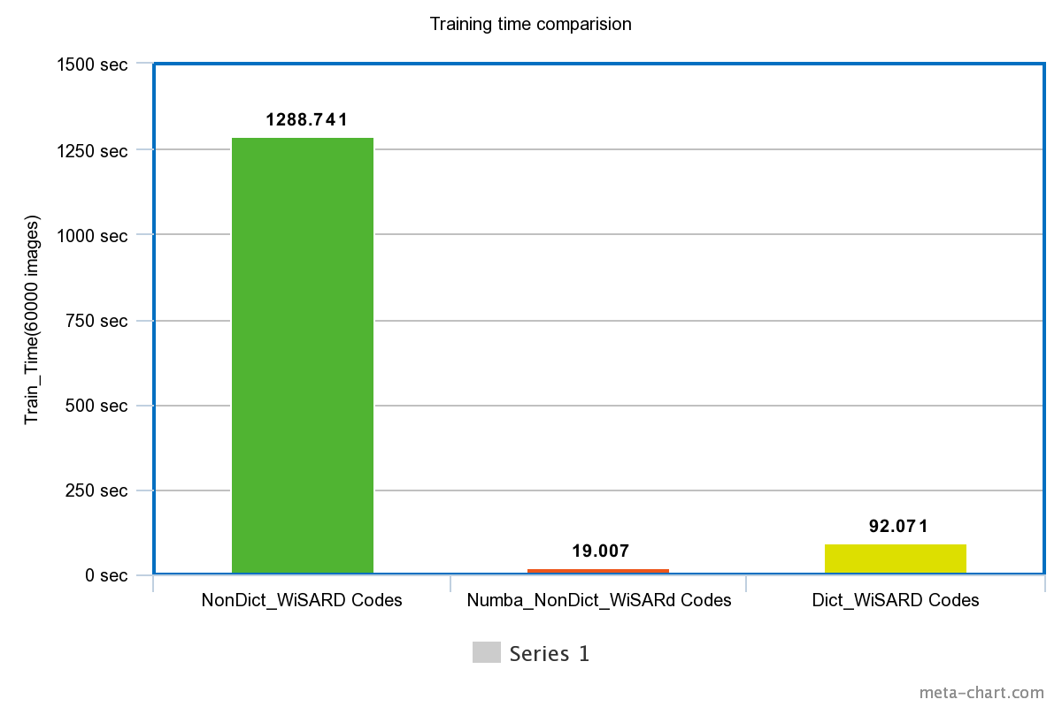

Slide 14
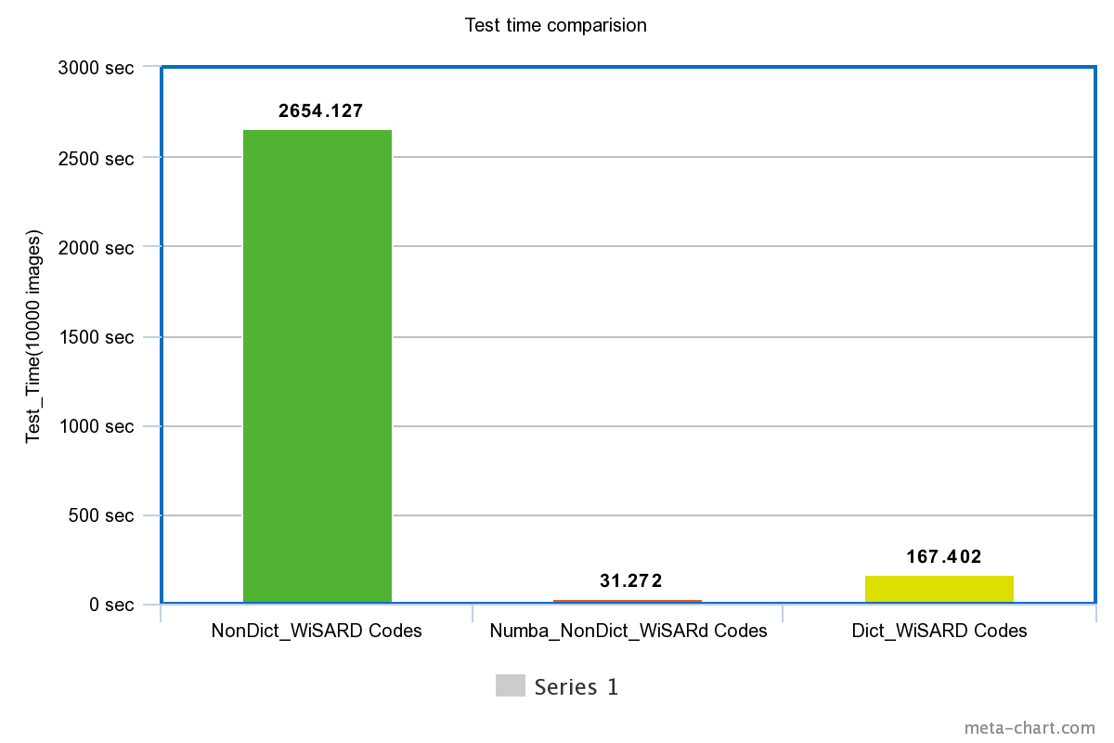

Slide 15
The training time of c++ open source(https://github.com/giordamaug/WisardLibrary) by 60000 images is 283.39 seconds and the testing time of 10000 images is 642.11 seconds. Our numba implemented code is 14.91 times faster in training the network and 20.7 times faster in testing.
The time comparison (test and train) of my code and open source c++ code (https://github.com/giordamaug/WisardLibrary) with full MNIST dataset is given below

Slide 16
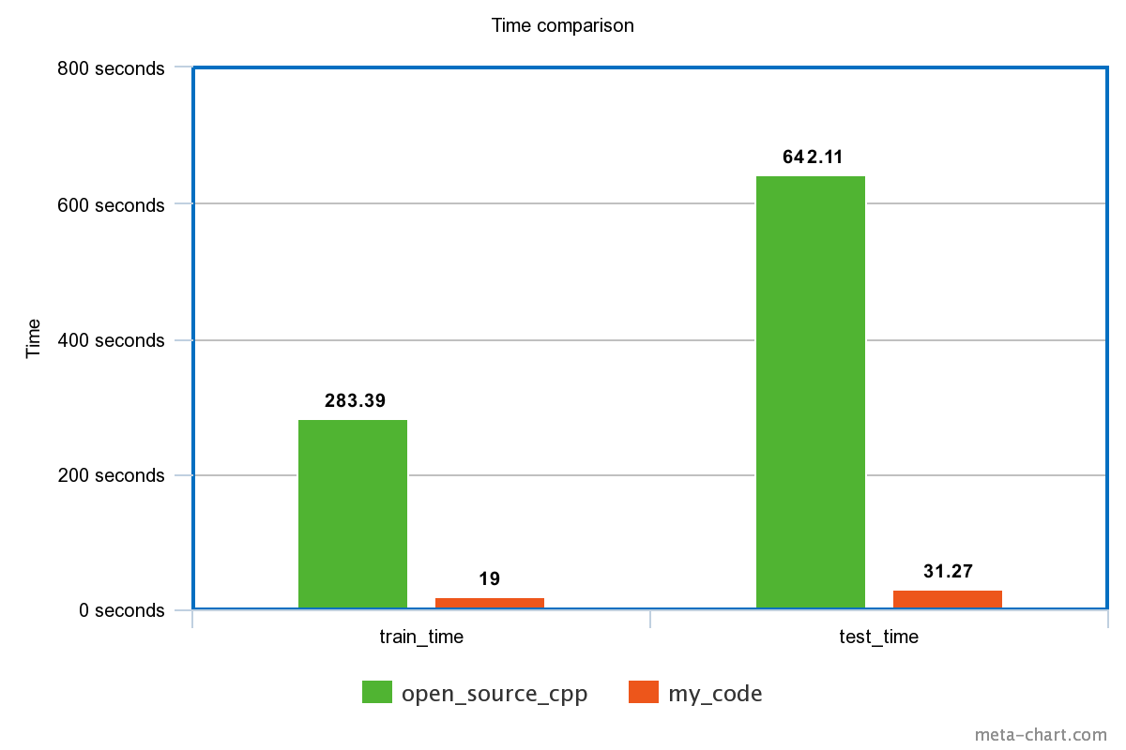

Slide 17
I included bleaching technique to overcome the saturation problem I get with big dataset. There are different functions for bleaching and non-bleaching technique so that user can use any one of them when needed. After I implemented bleaching technique the accuracy with full MNIST dataset is 87 percentage with retina length 8.
The accuracy comparison of my code and open source c++ code (https://github.com/giordamaug/WisardLibrary) with full MNIST dataset is given below:

Slide 18
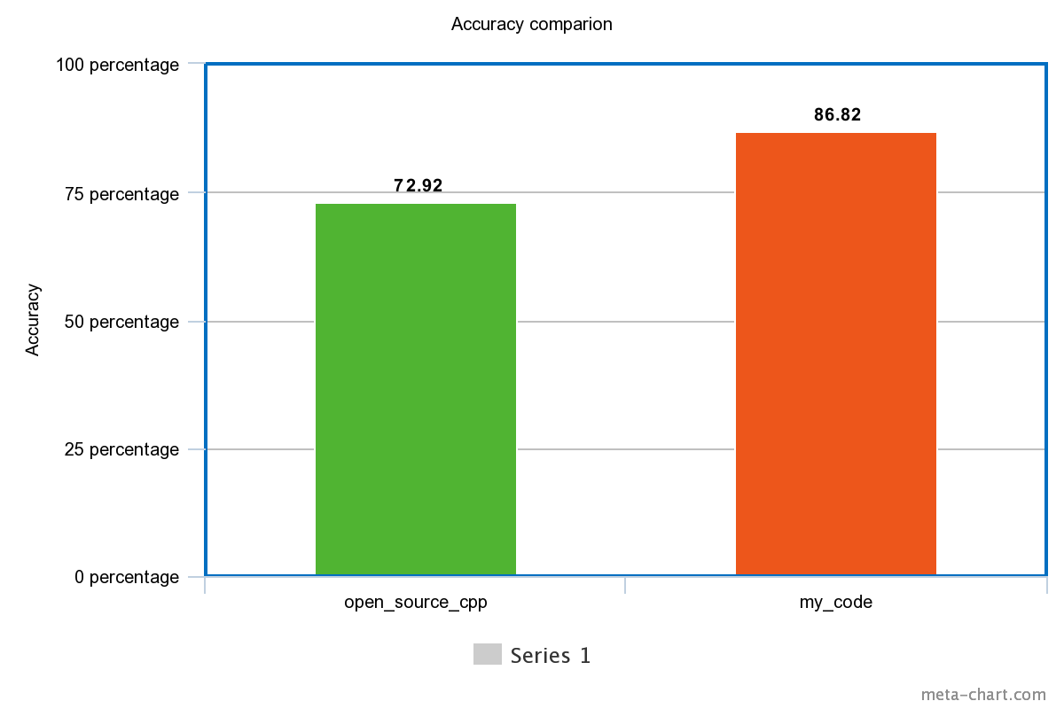

Slide 19
