Slide 1
Implementation of weightless neural networks on GPU for background subtraction
Vishwas Sharma
Supervised by
Michael Schleiss(Fraunhofer FKIE)
June 28, 2019

Slide 2
Milestones
Implementation of WiSARD with sufficient speed and accuracy on GPU
Implementation of WiSARDrp with sufficient speed and accuracy on GPU

Slide 3
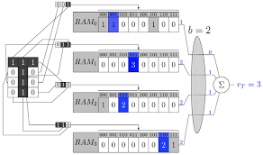
WiSARD
WiSARD is a powerful online, parallelizable, one shot training weightless neural network for pattern recognition.
WiSARD stores frequency of patterns in RAMs present in the data set during training.
Figure 1[1.1]
[1.1]Cavalcanti, Rafael Dutra, et al. "Evaluating weightless neural networks for bias identification on news." 2017 IEEE 14th International Conference on Networking, Sensing and Control (ICNSC). IEEE, 2017.

Slide 4
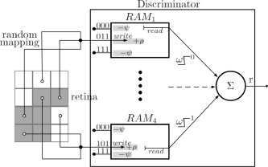
WiSARDrp
WiSARDrp is an extended model of WiSARD.
It stores frequency of patterns seen more recently, while frequencies of old patterns degrades to zero.
Figure 2[1.2]
[1.2]De Gregorio, Massimo, and Maurizio Giordano. ‘Background estimation by weightless neural networks.’ Pattern Recognition Letters 96 (2017): 55-65

Slide 5
Bacground estimation by weightless neural networks (BEWiS)
It is a pixel based approach.
Each pixel is associated to a WiSARDrp performing online learning of more frequent and close in time sequences of stable color
It can be used for background modeling for video surveillance both in long term and live video.

Slide 6
Modules of BEWiS(Bacground estimation by weightless neural networks) algorithm:
Initialization
Stability queue management
Background model updating
Background estimation

Slide 7
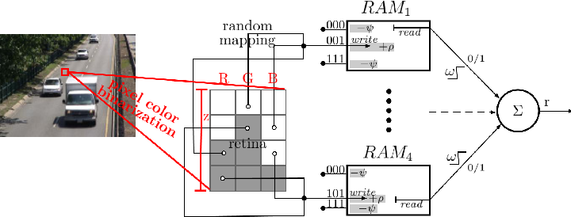
Figure 3[1.3]
[1.3]De Gregorio, Massimo, and Maurizio Giordano. ‘Background estimation by weightless neural networks.’ Pattern Recognition Letters 96 (2017): 55-65

Slide 8
    Result of a still picture

Slide 9
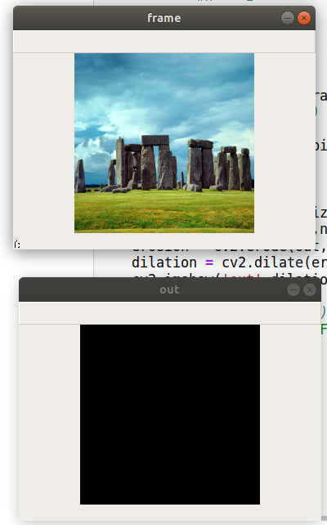
Figure 2[1.2]
Figure 4

Slide 10
    Car driving on a road

Slide 11
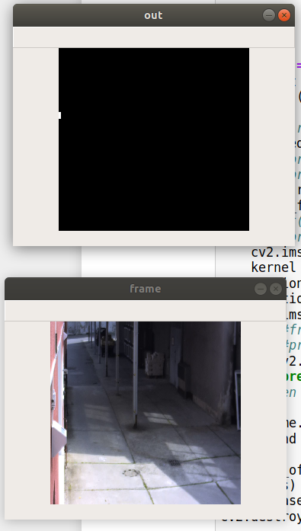
Figure 5

Slide 12
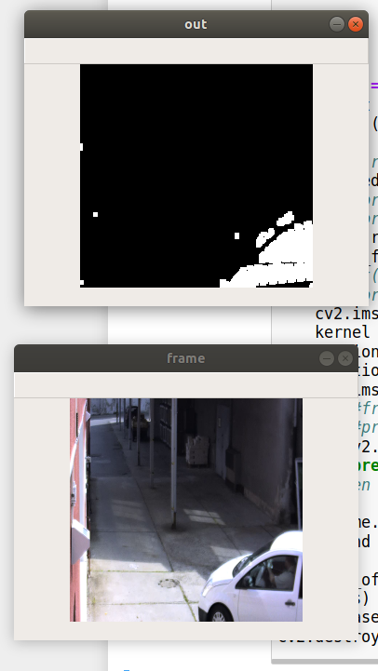
Figure 6

Slide 13
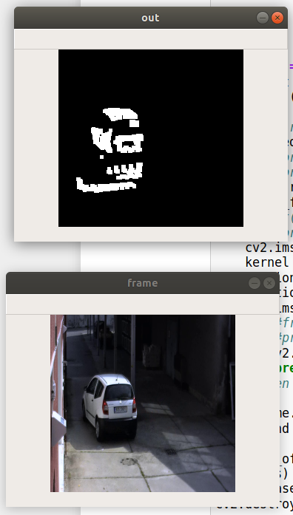
Figure 7

Slide 14
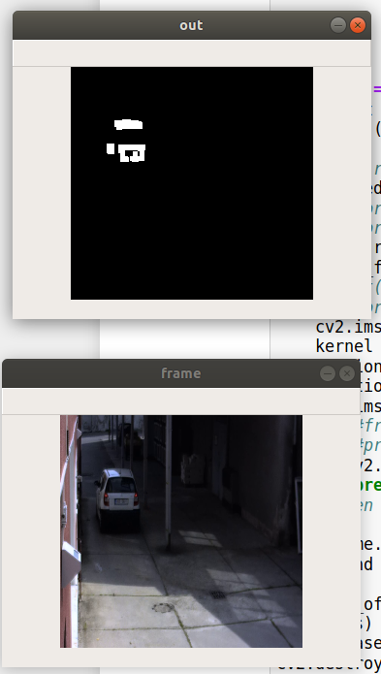
Figure 8

Slide 15
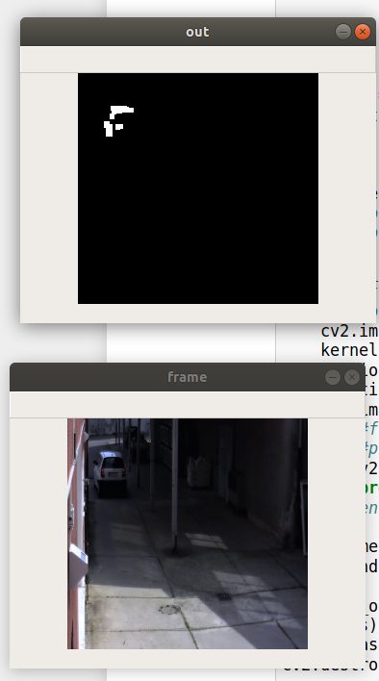
Figure 9

Slide 16
    Dice game

Slide 17
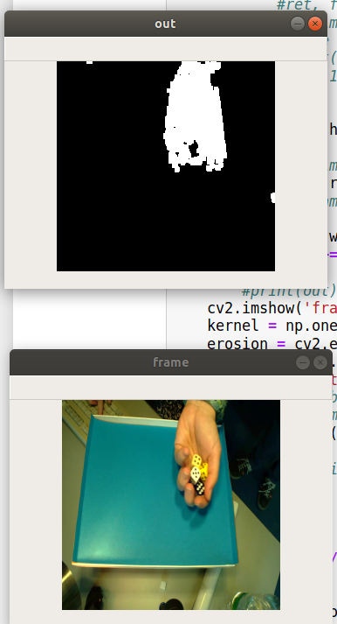
Figure 10

Slide 18
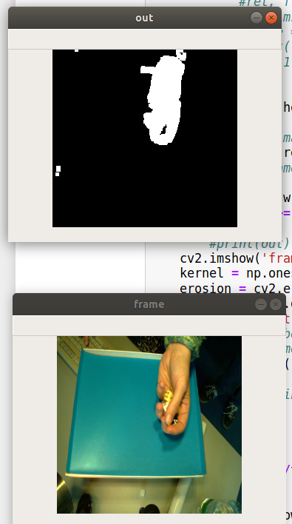
Figure 11

Slide 19
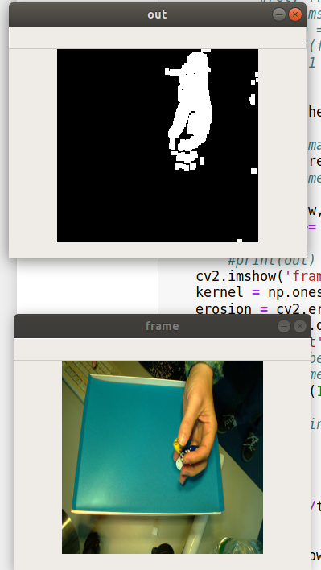
Figure 12

Slide 20
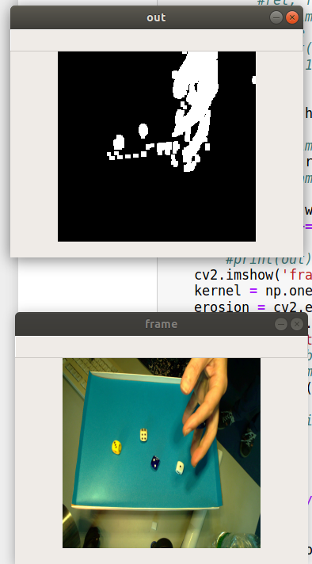
Figure 13

Slide 21
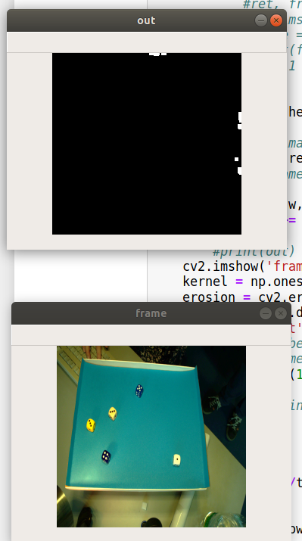
Figure 14

Slide 22
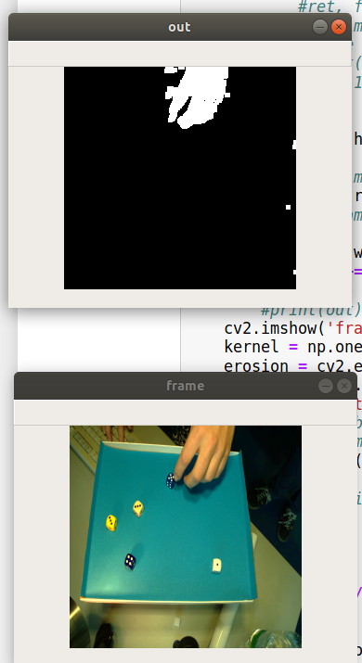
Figure 15

