Slide 1
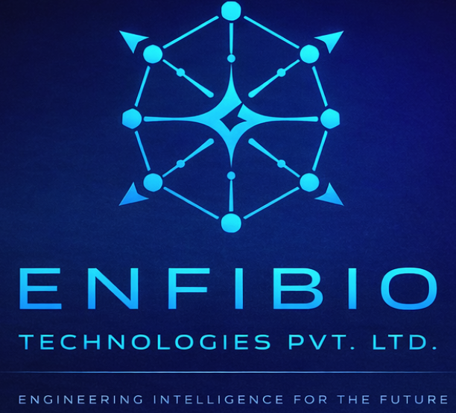
ENFIBIO TECHNOLOGIES PVT. LTD.
AIR
OS
AI-Native Orchestration Runtime
for Robotics & Edge Systems
CONTACT
From intent to real-world action.
Enfibio Technologies Pvt. Ltd.
enfibiotechnologiespvtltd@gmail.com
Raising ₹50,00,000 Pre-Seed
CONFIDENTIAL Pre-Seed Investment Round 2026

Slide 2



THE PROBLEM
Robotics & AI Systems Are Broken
Fragmented Stack
High Latency
No Intelligence
Developers stitch together ROS2, Python, cloud APIs, and custom scripts — no cohesion.
Brittle pipelines with no unified execution layer cause failure under real-world conditions.
Operating systems manage processes — not intelligence. AI is bolted on, not built in.
⚡ Core Issue:
Operating systems manage processes, not intelligence.

Slide 3



MARKET CONTEXT
Why This Matters Now
ACCELERATING SECTORS
$218B
Autonomous Drones
Global Robotics Market by 2030
Real-time path planning & obstacle avoidance
Defense & Surveillance
42%
Edge AI where cloud latency is fatal
CAGR in Edge AI Deployments
Logistics Robotics
Warehouse automation & last-mile delivery
⚠️ There is no system that routes intelligence in real time across AI models and hardware.

Slide 4




OUR SOLUTION
AIR OS = AI Orchestration Runtime
Understands
Intent
Routes to
Right Model
AIR OS
CORE
Unified
Runtime
Executes on
Hardware

Slide 5



ARCHITECTURE
Intent → Execution Pipeline
PROMPT
INTENT
TASK GRAPH
MODEL ROUTING
EXECUTION
HARDWARE
Natural language or structured intent input
Semantic parsing & task decomposition
Dependency-aware execution graph
Select optimal AI model per sub-task
Parallel/sequential action dispatch
Real-world actuation & sensor feedback
KEY BENEFITS
Eliminates glue code
Reduces latency
Automates decision pipelines

Slide 6


CORE FEATURES
Built for Intelligence-First Execution
Multi-Model Routing
Execution Engine
World State Memory
Vision, reasoning, and control models dispatched to the right task in real time.
Translates AI decisions into real-world hardware commands with fault tolerance.
Persistent sensor and environment data feeds into every decision cycle.
Native ROS2 / PX4
Edge + Cloud Hybrid
First-class integration with industry-standard robotics middleware and flight stacks.
Intelligent workload split — latency-critical tasks stay on-device, heavy compute offloads.

Slide 7
PROOF OF WORK
MVP — What We've Built
air-os — terminal
INITIAL CAPABILITIES
$ air ask "track object and avoid obstacle"
Task routing functional
> Parsing intent...
> Loading: vision_model=YOLOv8, planner=RL_Agent
> Task graph: [detect] → [plan] → [control]
Multi-model execution pipeline
> Routing to GPU pipeline...
> ✓ Object detected at [x:142 y:89]
> ✓ Path planned (12 waypoints)
Vision → Planning → Control
> ✓ Control signals dispatched
[SUCCESS] Pipeline complete in 48ms
Runs on local GPU / edge device
✅ ~50ms prototype latency on NVIDIA Jetson (early benchmark, pre-optimization)
CLI prototype operational

Slide 8
TARGET MARKET
Market : Autonomous Robotics
TAM
$218B
INITIAL MARKET ANALYSIS
Drones & Edge AI Systems
Global Robotics
Autonomous Robotics
SAM
$42B
Requires real-time decisions at the edge
Edge AI Systems
Complex multi-model AI pipelines
SOM
$1.2B
High cost of failure reliability critical
Dev Infra / SDK

Slide 9





USE CASE EXAMPLE
Autonomous Drone Navigation
INPUT
VISION
PLANNING
CONTROL
OUTPUT
Live camera feed + GPS telemetry
YOLOv8 object detection & depth
RL-based path & avoidance planner
PX4 flight controller commands
Real-time autonomous navigation
AIR OS
Orchestrates all layers seamlessly from raw input to real-world action in under 50ms on edge hardware.

Slide 10
COMPETITIVE LANDSCAPE
The Gap We Fill
Platform
AI Orchestration
Real-Time
Edge Native
Unified SDK
ROS2
✗
~
✓
✗
NVIDIA Isaac
~
✓
✗
~
Cloud AI APIs
✓
✗
✗
~
Linux / RTOS
✗
✓
✓
✗
AIR OS ✦
✓
✓
✓
✓
Positioning:
AIR OS = The intelligence layer between AI models and machines

Slide 11



BUSINESS MODEL
B2B Developer Infrastructure
FREE TIER
RUNTIME LICENSE
ENTERPRISE
Open Source CLI
₹ per-device / month
Custom pricing
SDK access
Full orchestration engine
On-premise deployment
Local execution
Cloud hybrid execution
Custom model integration
Community support
Priority model routing
Dedicated infra
GitHub distribution
SLA support
Multi-device fleet mgmt
Initial focus: Free dev adoption → paid runtime as teams scale to production

Slide 12
GO-TO-MARKET
CLI-First Developer Adoption
01
02
03
Developer Seeding
Pilot Customers
Expansion
› Open-source CLI on GitHub
› 3–5 drone startup pilots
› Enterprise SDK contracts
› Demo videos on YouTube / X
› Edge AI builders
› Fleet management tier
› Robotics dev communities
› Defense tech contractors
› Hardware partner integrations
› IIT / IISc research labs
› Proof of value → paid
› OEM licensing

Slide 13
CUSTOMER ACQUISITION
First 1,000 Customers — The Demo-First Strategy
01
02
03
Institutes & Colleges
AI & Robotics Companies
Convert & Scale
› Live demos at IITs, IIITs, NITs
› In-person demos at drone startups
› Free tier to paid runtime
› Robotics & AI research labs
› Edge AI & robotics meetups
› ₹500–₹2,000/device/month
› Student dev clubs & hackathons
› Defense tech contractors
› Community to pilot to enterprise
› Target: ~300 early adopters
› Target: ~500 pilot users
› Goal: 1,000 users in 3 months

Slide 14
PRODUCT ROADMAP
NOW
6 & 12 Month Milestones
M6
M12
MVP
Pilot Users
Enterprise
CLI prototype working
Vision→Plan→Control
3–5 drone startups
Validated use cases
First paid contracts
Fleet mgmt tier
Alpha SDK
Edge Opt.
Stable orchestration
Developer CLI release
Jetson/RK3588
Sub-20ms execution
M3
M9

Slide 15
THE TEAM
Who Is Building AIR OS
What We Are Actively Building
ET
› Stable orchestration engine v1.0
› CLI + SDK public release
› Sub-20ms pipeline on Jetson (M6)
› Looking for co-founder: hardware / robotics
We are early-stage and transparent about it.
This capital is the first step to doing it right.
Enfibio Technologies
Founder & CEO | AIR OS
› AI systems & robotics engineering
› Edge AI deployment & model optimization
› Built AIR OS CLI prototype on NVIDIA Jetson
› enfibiotechnologiespvtltd@gmail.com

Slide 16



WHY AIR OS WINS
Our Unfair Advantages
AI-Native by Design
Multi-Model Routing
Not a bolt-on AI layer. Intelligence is the core runtime primitive — not an afterthought.
Dynamically selects the best AI model for each sub-task — no single-model constraints.
Real-Time Robotics Focus
Unified Dev → Deploy
Purpose-built for sub-50ms execution on edge hardware — where existing solutions fail.
Write once on CLI. Run the same pipeline on dev laptop, Jetson, or drone — no rewrites.

Slide 17
HONEST ASSESSMENT
What Is Not Built Yet — And Why That Is the Opportunity
⚠ Not Yet Complete
✓ Why This Is the Right Time to Invest
● Visual demo / screenshot UI
● Stable SDK (alpha only today)
● Sub-20ms latency (current: ~50ms benchmark)
● Hardware co-founder / robotics expert
● Fleet management tier
● Core pipeline proven in prototype
● Gaps are engineering, not conceptual
● ₹50L closes the gap in 6 months
● Early investors get ground-floor pricing
● No competitor has solved this at the edge

Slide 18
INVESTMENT OPPORTUNITY
Raising ₹50,00,000 Pre-Seed
₹50,00,000
USE OF FUNDS
50% — Engineering
₹25,00,000
PRE-SEED ROUND
20% — GPU / Cloud Infra
₹10,00,000
WHAT THIS FUNDS
15% — Edge Hardware
Stable orchestration engine v1.0
₹7,50,000
CLI + SDK public release
15% — Tools & Operations
₹7,50,000
3–5 pilot users onboarded
Edge deployment on Jetson hardware

Slide 19
VISION
Every machine will run AI natively.
Every system will need orchestration.
AIR OS becomes the control layer for intelligent systems —
the operating system of the AI-powered physical world.
1B+
$500B
AIR OS
Connected Robots by 2035
AI Infrastructure Market
The Runtime Layer

Slide 20
ENFIBIO TECHNOLOGIES
Let's Build the
PVT. LTD.
Operating System
EMAIL
enfibiotechnologiespvtltd
@gmail.com
for AI-Driven Machines.
PRODUCT
AIR OS — AI Orchestration Runtime
Join us at the ground floor of the AI-native robotics revolution.
ROUND
Contact Us →
enfibiotechnologiespvtltd@gmail.com
₹50,00,000 Pre-Seed
© 2026 Enfibio Technologies Pvt. Ltd. | CONFIDENTIAL Not for Distribution

