Slide 1
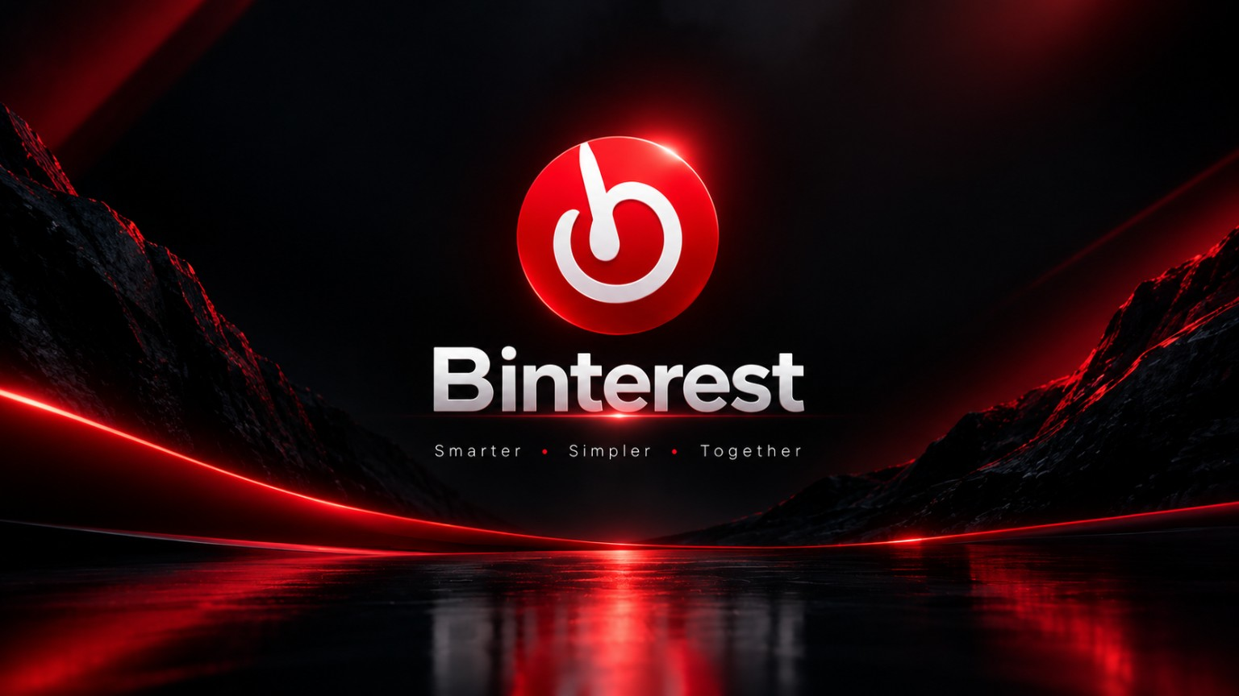


Slide 2
02
ABSTRACT
A focused visual platform for discovery, inspiration and personal collections.
Binterest
01
VISUAL DISCOVERY
02
PERSONALIZED EXPLORATION
Explore wallpapers, aesthetics, photography and creative imagery.
Surface content around user interests and search intent.
Bringing visual inspiration
into one place.
Binterest is a visual inspiration application designed to help users discover, explore and save wallpapers, aesthetic images and creative content through a simple, engaging interface.
03
SAVE & ORGANIZE
04
SIMPLE EXPERIENCE
Build a personal library of favorite visual content.
Clean navigation keeps browsing fast and intuitive.
“Turning visual browsing into a personalized source of inspiration.”
BINTEREST • VISUAL DISCOVERY & INSPIRATION
2/8

Slide 3
03
EXISTING SYSTEM
Common limitations found in conventional visual-image and wallpaper platforms.
01
LIMITED PERSONALIZATION
02
REPETITIVE DISCOVERY
03
UNORGANIZED COLLECTIONS
Feeds and recommendations may not always reflect individual interests.
Users can repeatedly encounter similar or duplicated visual content.
Managing saved wallpapers and inspiration can become difficult.
04
GENERIC RECOMMENDATIONS
05
SCATTERED CONTENT
06
SEARCH EFFORT
Discovery may be broad instead of closely aligned to user intent.
Different visual categories can feel fragmented across platforms.
Finding the right image may require extensive browsing.
CHALLENGE
Image access is easy; meaningful, organized visual discovery is harder.
BINTEREST • VISUAL DISCOVERY & INSPIRATION
3/8

Slide 4
04
PROPOSED SYSTEM
Binterest brings discovery, personalization and organization into one visual experience.
01
Smart Search & Discovery
02
Personalized Feed
BINTEREST
Find content by topic, theme and visual intent.
Create a more relevant browsing experience.
A modern visual
inspiration platform
03
Save & Organize
04
Aesthetic Categories
Discover → Explore → Save → Inspire
Keep favorites together in personal collections.
Explore themes, styles and visual moods.
Search & Discover
Curated Visual Feed
05
Simple Interface
06
Creative Inspiration
Personal Collections
Use a clean, familiar and intuitive navigation flow.
Discover ideas for wallpapers, styles and visual concepts.
BINTEREST • VISUAL DISCOVERY & INSPIRATION
4/8

Slide 5
05
ADVANTAGES & LIMITATIONS
Strengths of the proposed experience, with practical considerations.
ADVANTAGES
LIMITATIONS
• Personalized visual experience
• Rich wallpaper & aesthetic collection
• Easy search and discovery
• Save and organize favorites
• Theme-based exploration
• Clean and intuitive interface
• Creative inspiration on demand
• Reduced search effort
• Internet connection may be required
• High-resolution images can use storage
• Content quality depends on the image library
• Recommendations may improve over time
• Copyright and licensing must be respected
• Content moderation may be required
BALANCE
A stronger visual experience while keeping usability and practical constraints in view.
BINTEREST • VISUAL DISCOVERY & INSPIRATION
5/8

Slide 6
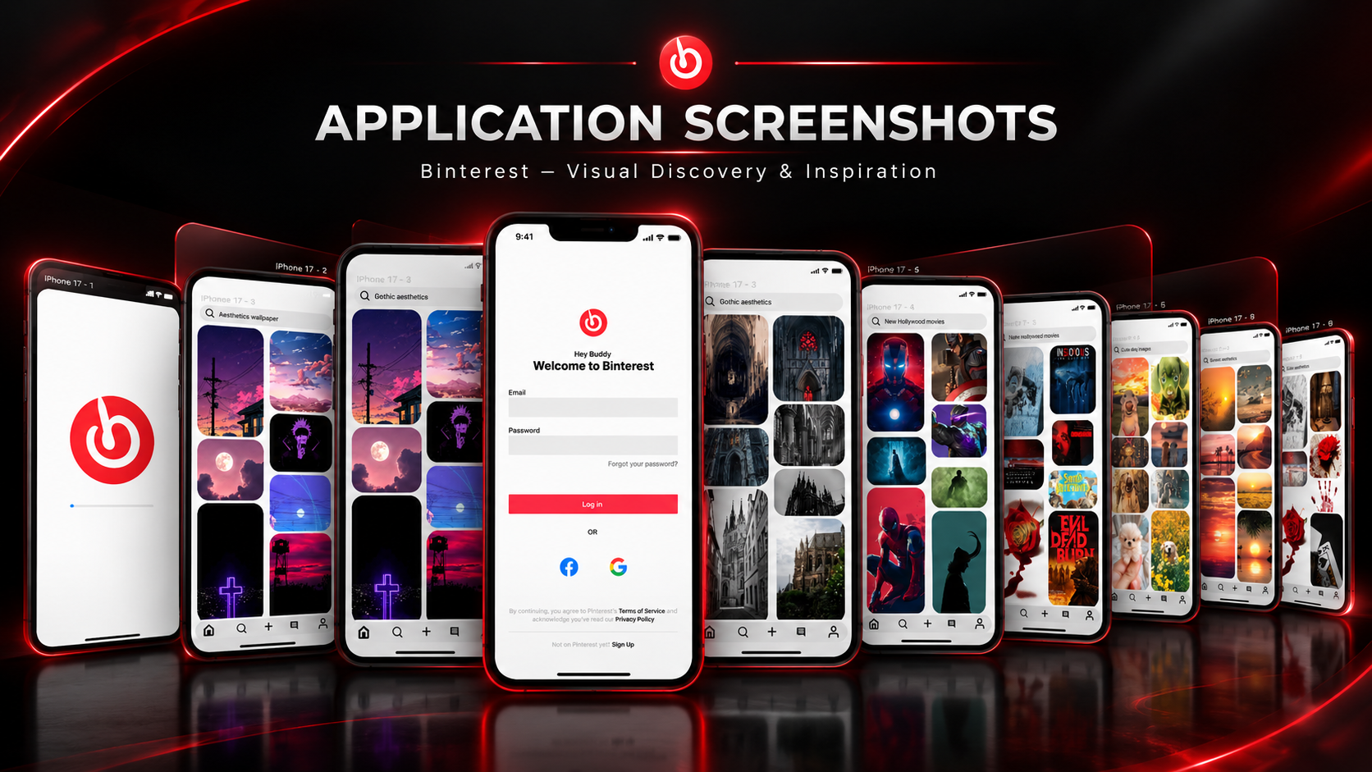
06
APPLICATION SCREENSHOTS
A cinematic showcase of the Binterest prototype.
BINTEREST • VISUAL DISCOVERY & INSPIRATION
6/8

Slide 7
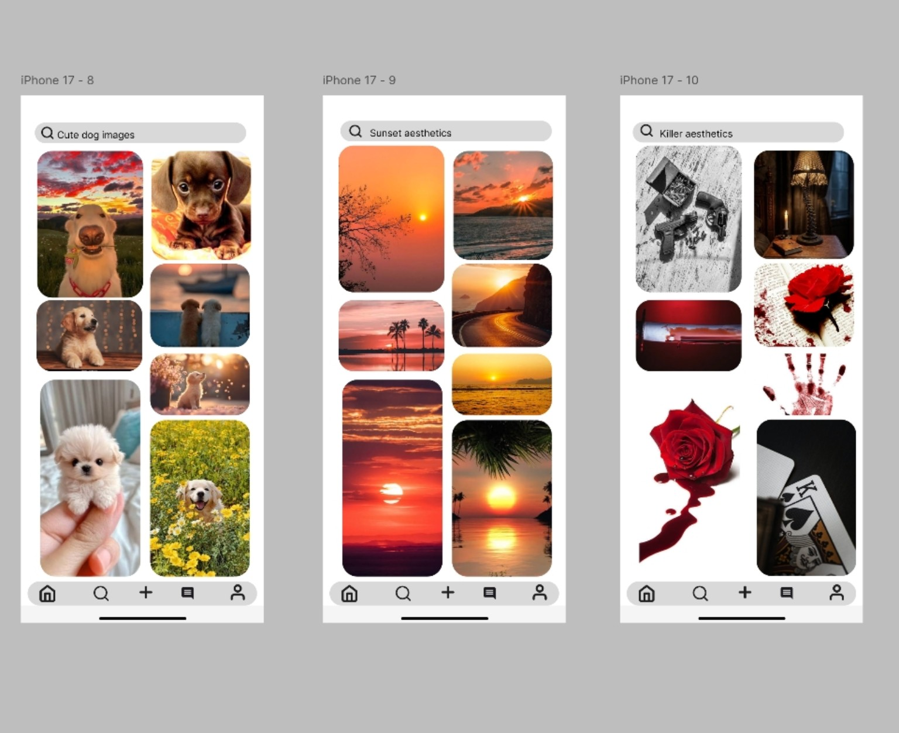
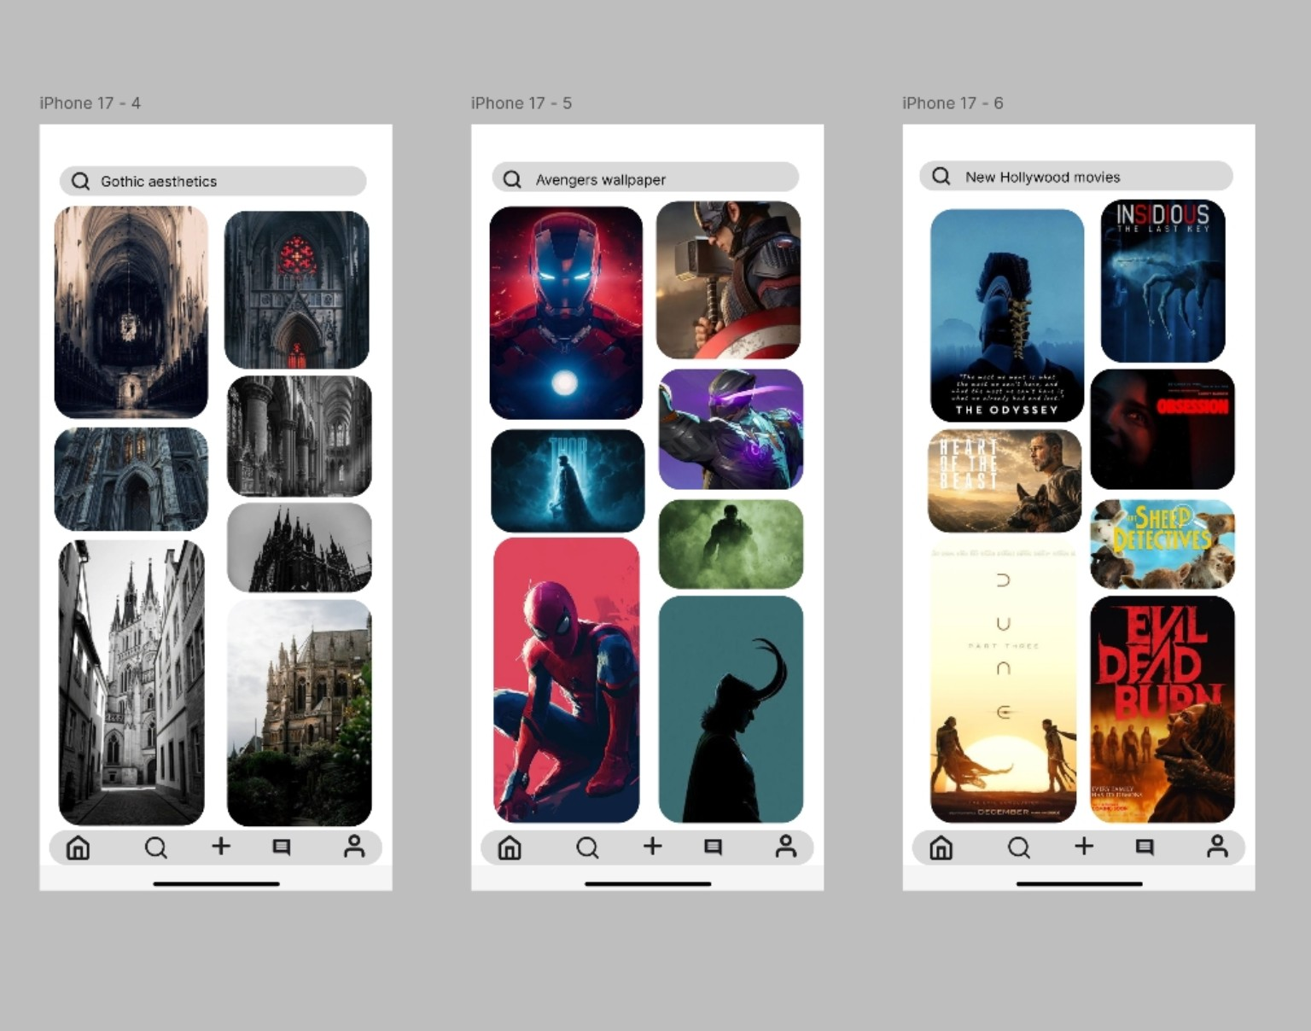
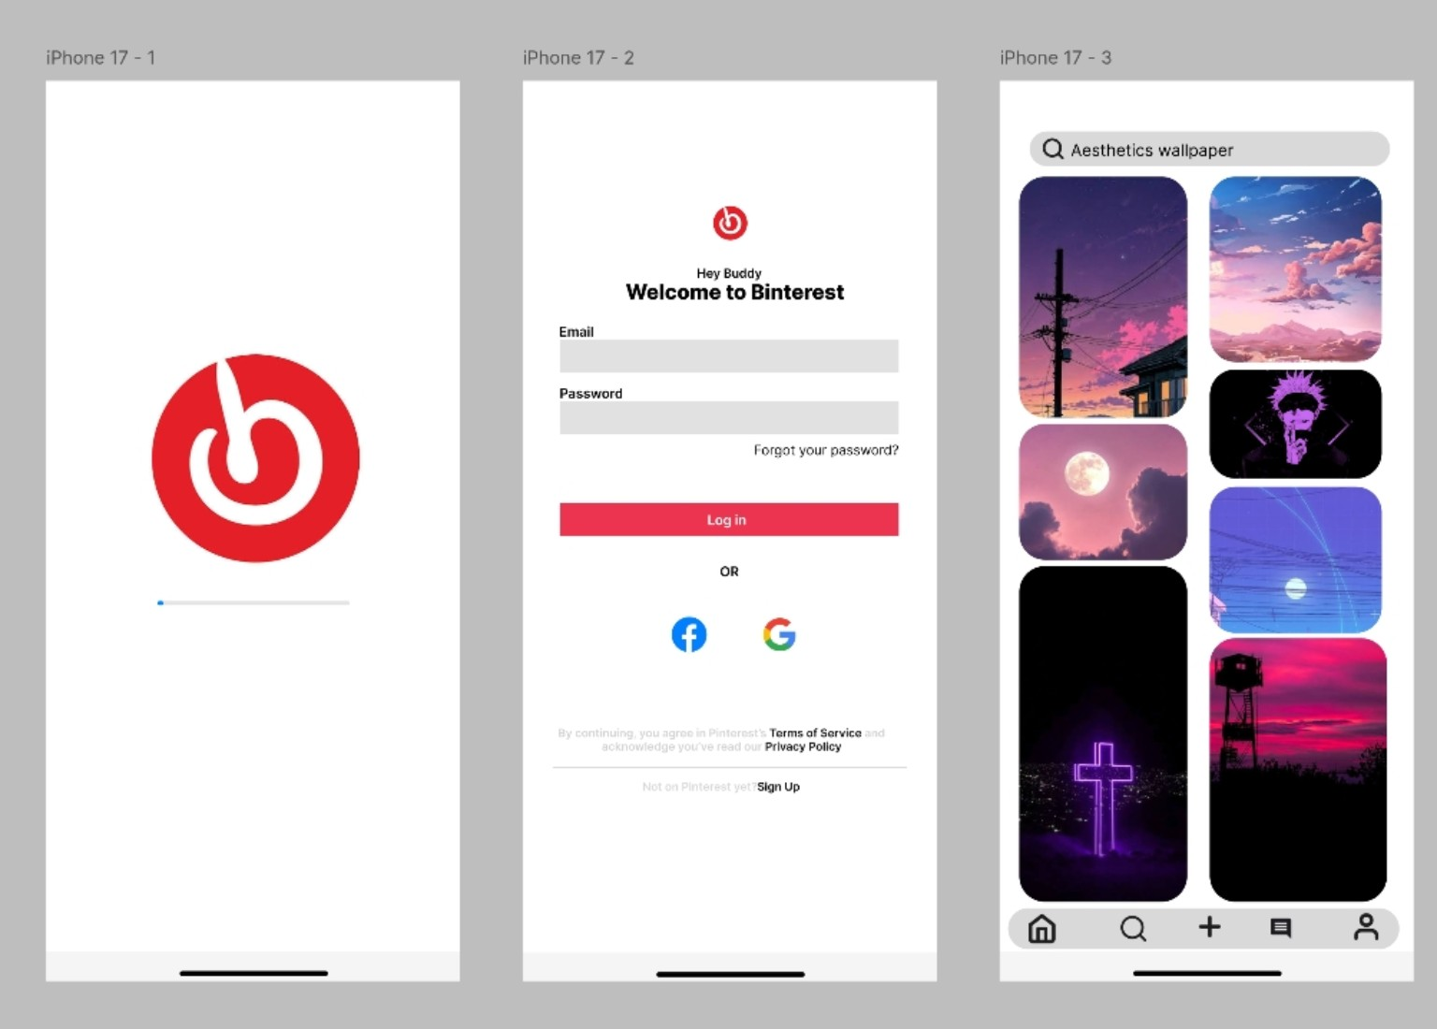
07
ACTUAL APPLICATION SCREENSHOTS
Original prototype screens — shown without generated visual effects.
BINTEREST • VISUAL DISCOVERY & INSPIRATION
7/8

Slide 8
THANK YOU
BINTEREST
Visual discovery. Personal inspiration.
APPLICATION PROTOTYPE
BINTEREST • VISUAL DISCOVERY & INSPIRATION
8/8

