Slide 1

Real Estate Property Management System
Backend Development Project
V Vishwa Teja
2520090033
B Sree Nikhil Reddy
2520090058
CH Vihamsh
2520090090

Slide 2


Problem Statement
Key Challenges
Property searching is often handled through multiple websites, agents, or manual processes.
Buyers may not have complete and updated information about available properties.
Comparing properties based on price, location, amenities, and other details can be difficult.
Property documents, site-visit details, and communication may be managed separately.
Buyers need better transparency and communication throughout the property-buying process.

Slide 3
Objectives
Streamlined Search
Centralized Database
Simplify property search and discovery for end users with intelligent tools.
Create a single, reliable database hub for all property listings.
Filter & Compare
Seamless UX
Implement efficient filtering and comparison tools for smarter decisions.
Deliver a smooth user experience across all platforms and screen sizes.

Slide 4

Proposed System
1
A centralized mobile system for managing the property buying process.
2
Buyers can easily search and explore available properties.
3
Property details such as price, location, area, and amenities are displayed.
4
Buyers can filter and compare properties based on their preferences.
5
Users can save and manage their favorite properties.

Slide 5
System Modules
Buyer Modules | Property Management Modules
• Dashboard | • Property Listing Management
• Property Search | • Property Information
• Property Listings | • Property Images
• Property Details | • Property Amenities
• Property Filtering | • Property Location
• Saved Properties | • Property Availability
• Property Visit Scheduling | • Visit Management
• My Visits | • Buyer Enquiries
• Buyer Profile | • Property Verification
• Notifications | • Property Status
• Favorites Management | • Featured Properties
• Contact Agent | • Property Updates

Slide 6
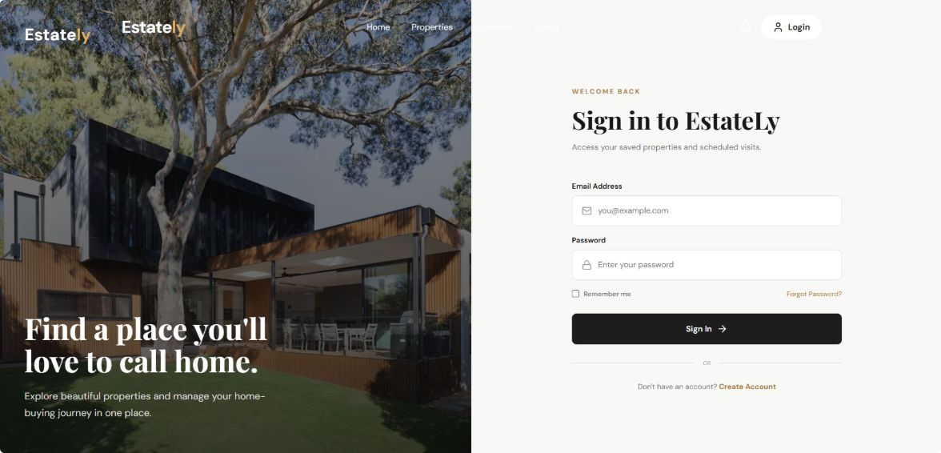
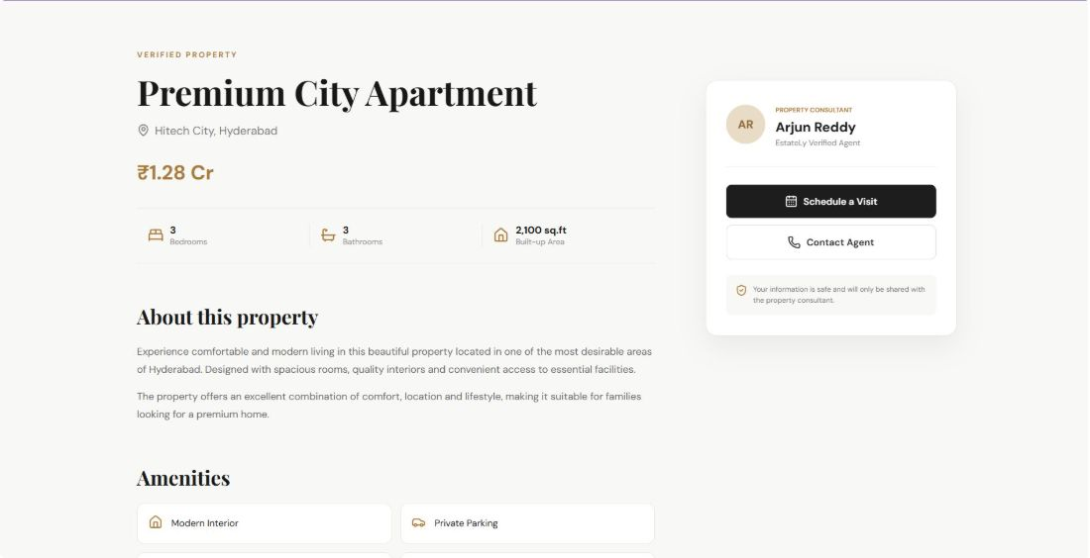
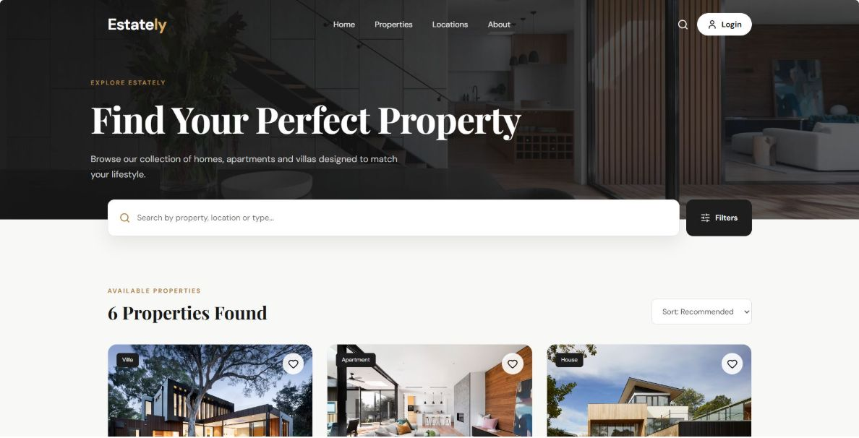
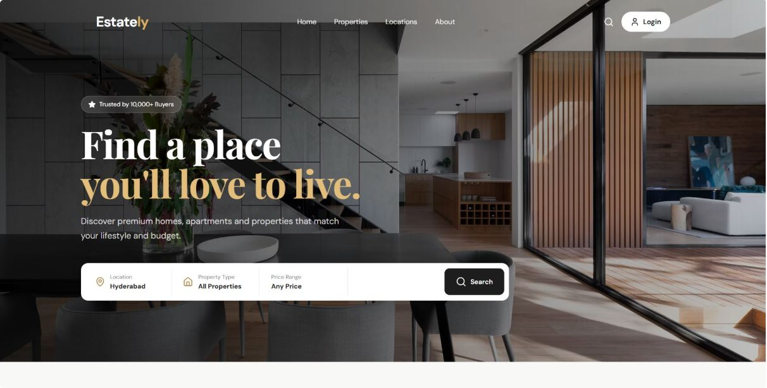
Frontend Implementation - Screenshots

Slide 7
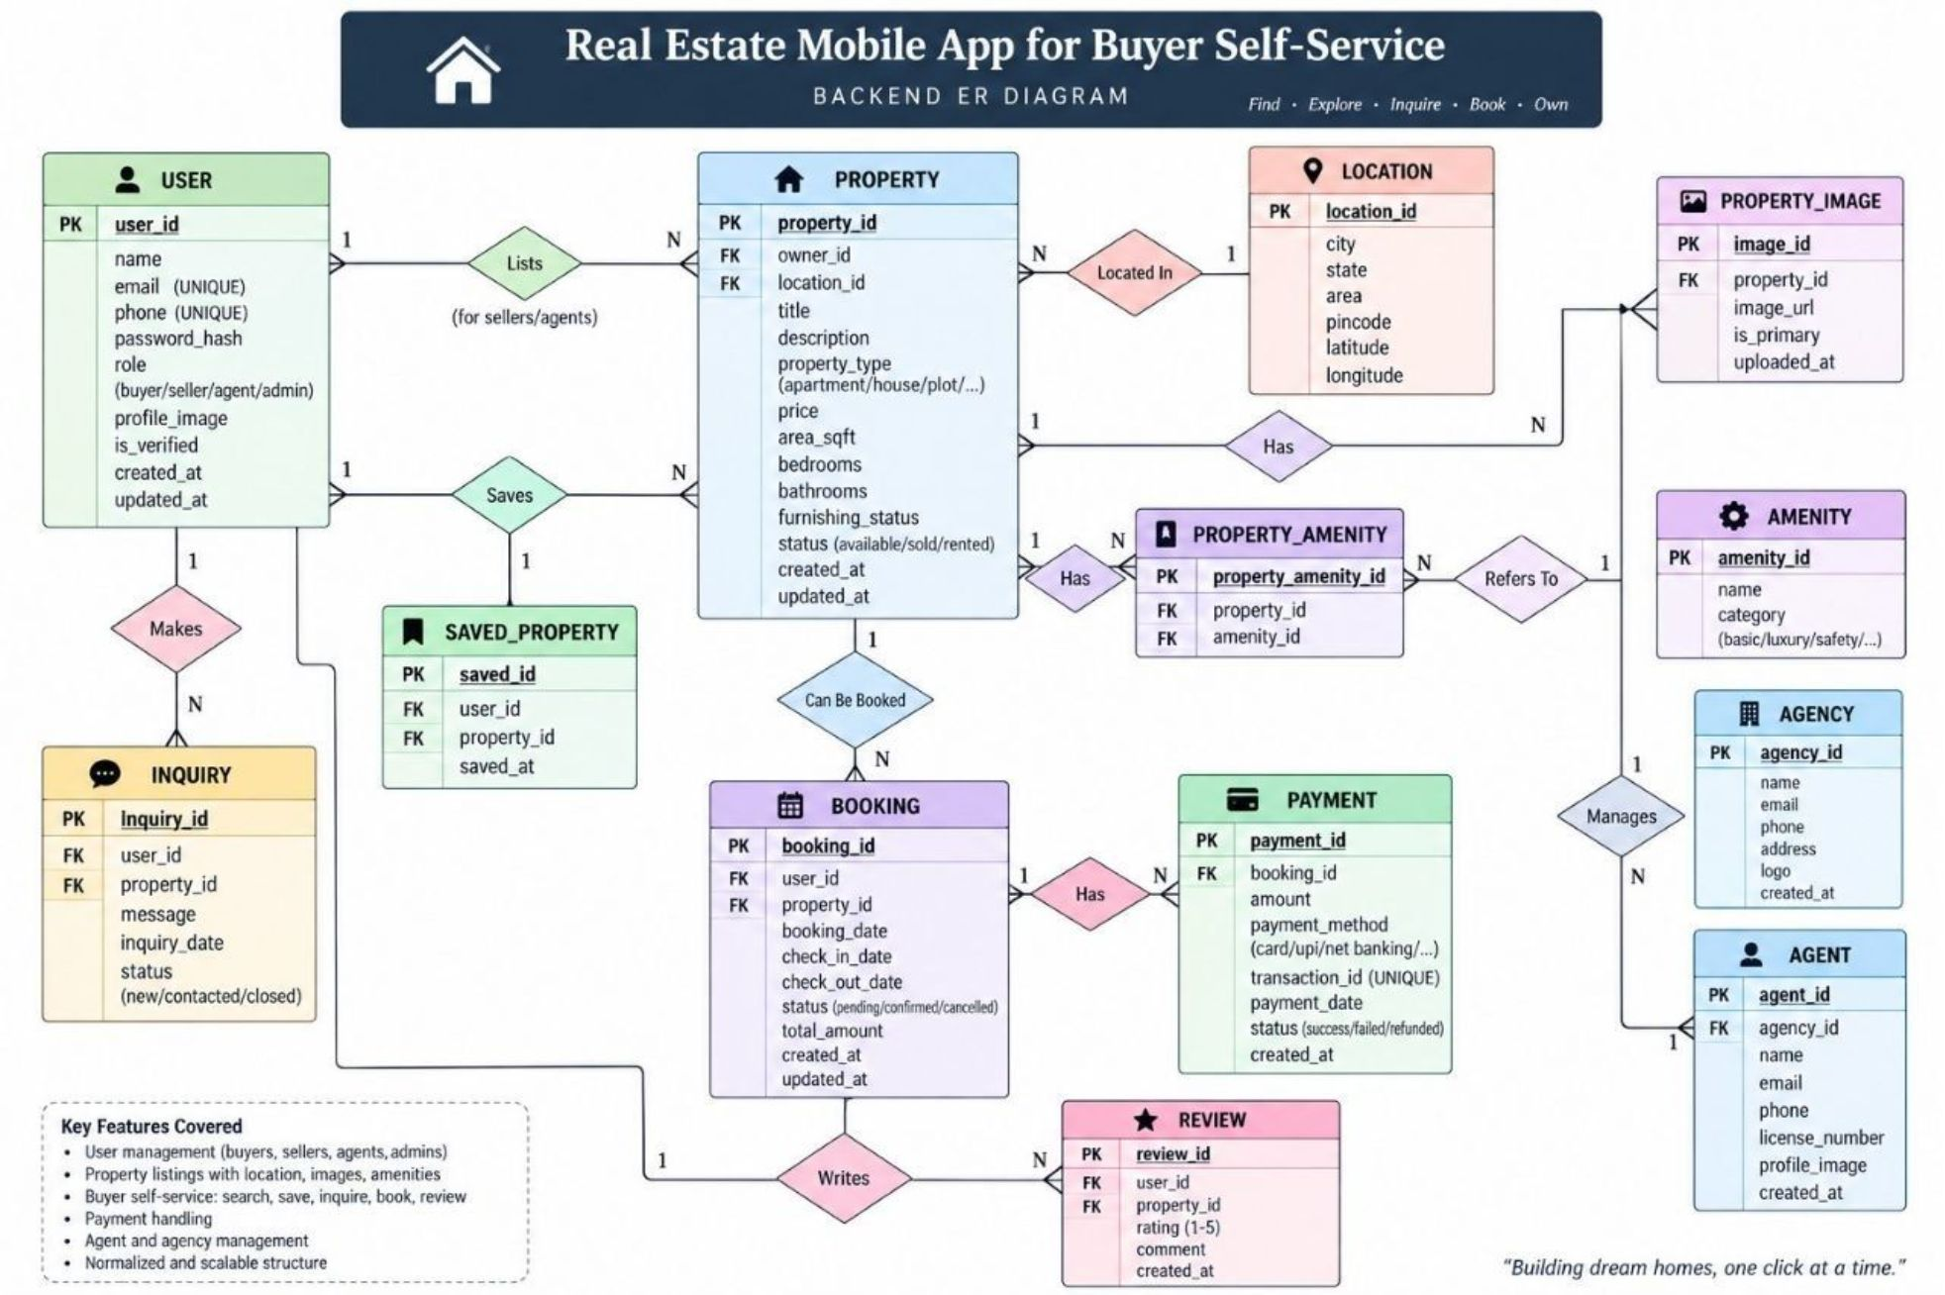
ER Diagrams
The ER diagram of EstateLy represents the main entities involved in the buyer self-service real estate system. The Buyer entity interacts with Property through Saved Property and Property Visit entities. Saved Property records the properties bookmarked by buyers, while Property Visit records scheduled visits. The Agent entity represents property consultants who manage properties. Primary and foreign keys establish the relationships between these entities.

Slide 8

Database Design & Schema
User Table
Stores buyer details such as User ID, Name, Email, Phone Number, and Password for managing user profiles.
Property Table
Stores property information including Property ID, Title, Location, Price, Property Type, Bedrooms, Bathrooms, Area, and Image.
Favorites Table
Maintains the properties saved by buyers, containing Favorite ID, User ID, and Property ID.
Visit Table
Stores property visit details such as Visit ID, User ID, Property ID, Visit Date, Visit Time, and Visit Status.
Relationships
A user can save multiple properties and schedule multiple visits. Each property can be saved or visited by multiple users, creating relationships between User, Property, Favorites, and Visits.

Slide 9
Database Tables / Schema
Table Name | Primary Key | Important Fields | Description
Users | user_id | name, email, phone, password, role | Stores buyer/user account information and login details.
Properties | property_id | title, location, price, type, bedrooms, bathrooms, area, description, image | Stores details of properties available for buyers.
Amenities | amenity_id | amenity_name, description | Stores available property amenities such as parking, security, Wi-Fi and fitness center.
Property_Amenities | property_amenity_id | property_id, amenity_id | Connects properties with their available amenities.
Favorites | favorite_id | user_id, property_id, saved_date | Stores properties saved by buyers for future reference.
Visits | visit_id | user_id, property_id, visit_date, visit_time, status | Stores property visit/schedule information requested by buyers.
Agents | agent_id | name, phone, email, verification_status | Stores property consultant/agent information.
Property_Agents | property_agent_id | property_id, agent_id | Associates properties with their respective agents.

Slide 10

Project Status & Next Steps
Current Progress
Future Work
01
AI-powered property recommendations
Mobile app development for Android and iOS
Map integration for property locations
Payment gateway integration for future booking features
Property analytics and buyer activity dashboard
Requirements Analysis
Problem scope, buyer requirements, user stories, and frontend system requirements have been identified and documented.
02
Frontend Development
Home page, property listing, property details, login, registration, and buyer dashboard have been implemented using React.
03
UI/UX Design
Modern, responsive real estate interface designed with a premium EstateLy theme for easy property discovery and buyer self-service.
04
Frontend Testing
Navigation, property details, saving properties, dashboard updates, and responsive layouts are being tested and refined.

Slide 11
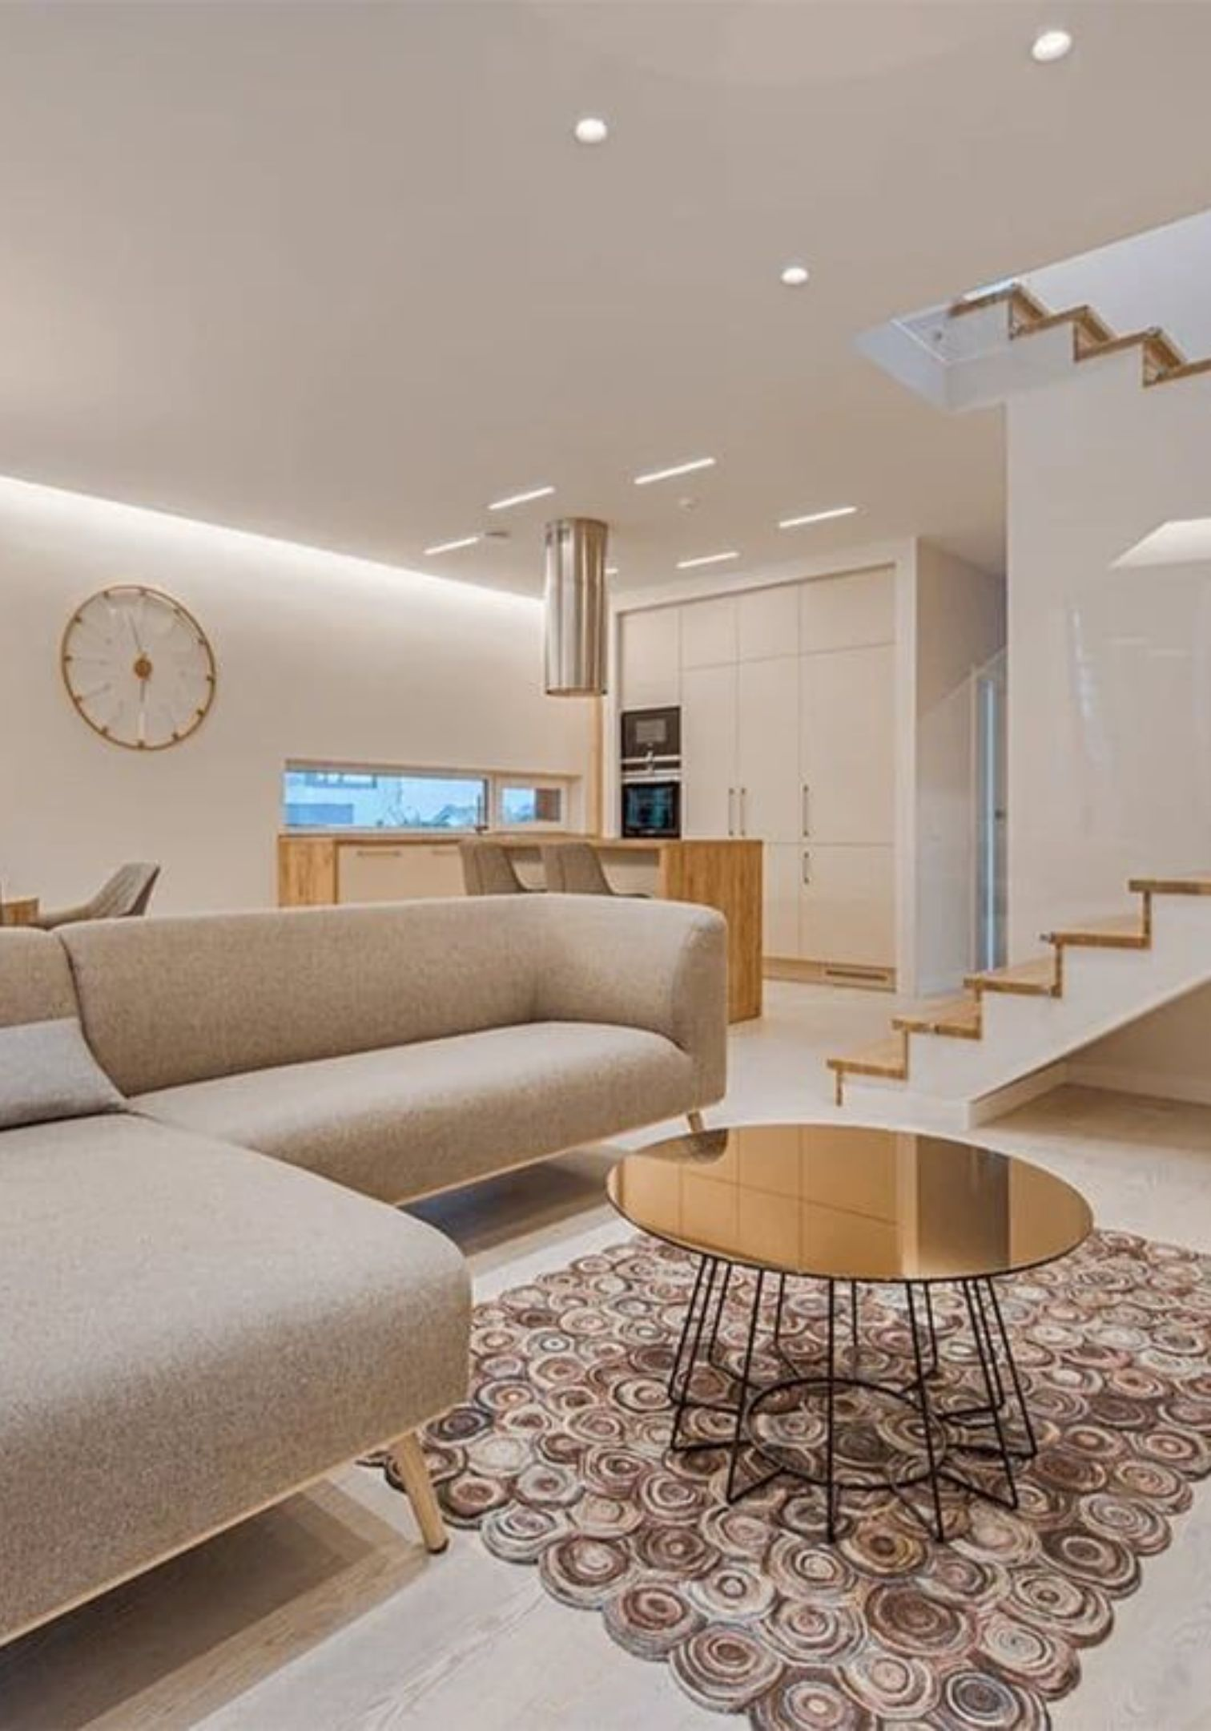
Challenges / Issues Faced
Responsive Design: Ensuring the application works properly on desktops, tablets, and mobile screens.
Component Integration: Managing multiple React components and connecting pages smoothly using React Router.
State Management: Handling features such as saved/favorite properties and maintaining their state using browser storage.
UI Consistency: Maintaining a consistent, user-friendly design, layout, icons, colors, and navigation across all pages.

Slide 12

Future Work
Backend Integration: Add a secure backend and database to store users, properties, favorites, and visit details.
Advanced Search: Implement filters for price, location, property type, bedrooms, and amenities.
Online Property Visits: Add appointment booking, calendar integration, and notifications for scheduled visits.
Mobile Application: Convert the web application into a dedicated Android/iOS app for convenient property browsing and buyer self-service.

Slide 13
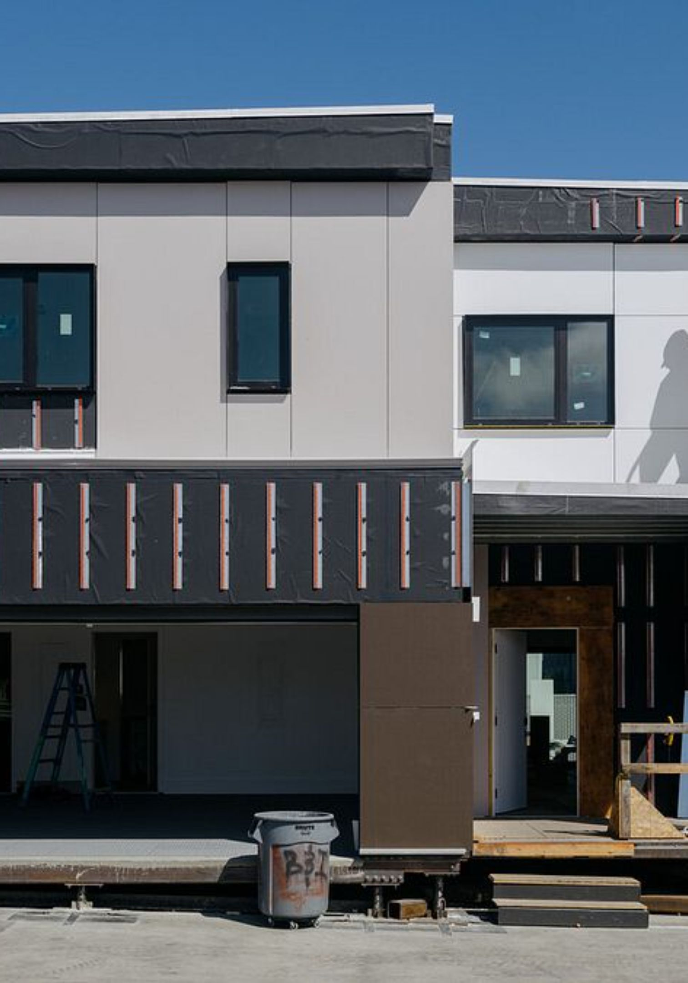
Conclusion
EstateLy provides a simple and user-friendly platform for buyers to explore properties and view detailed information.
The application allows users to search, view, and save properties according to their preferences.
Features such as property details, favorites, buyer dashboard, login, registration, and visit scheduling improve the overall user experience.
The responsive frontend design makes the application accessible across desktop, tablet, and mobile devices.
Overall, the project demonstrates how a modern frontend-based real estate application can simplify the property-buying and management experience for buyers.

Slide 14

Thank You

