Slide 1
GEEK ROOM GLOBAL AI HACKATHON 2026
StaleCheck
Which claims in an AI answer still hold up?
Prices, software versions and support policies can change after an answer is written. StaleCheck checks each selected claim against the available evidence.
Problem Statement 06 / Maxim Bifrost + Tavily
Notes:
Opening: ask which sentence a reader would verify first. The brief is the Tavily stale-answer detector challenge. Source: https://hackculture.io/hackathons/ai-global-hackathon

Slide 2
STALECHECK
How an assessment works
1. Identify claims
Bifrost routes the answer to the model. StaleCheck retains exact spans from the original answer.
2. Review the scope
The user sees the literal queries and allowed domains before Tavily receives a search.
3. Check sources
Tavily retrieves excerpts and publication estimates. Bifrost routes the evidence comparison to the model.
4. Write the report
StaleCheck validates quotations against retrieved text and scores the age of the newest dated quote.
Notes:
Bifrost exposes one OpenAI-compatible endpoint for model calls. With the Tavily relay, the gateway keeps the Tavily key and forwards only the approved requests. Sources: https://github.com/maximhq/bifrost and https://docs.tavily.com/documentation/api-reference/endpoint/search

Slide 3
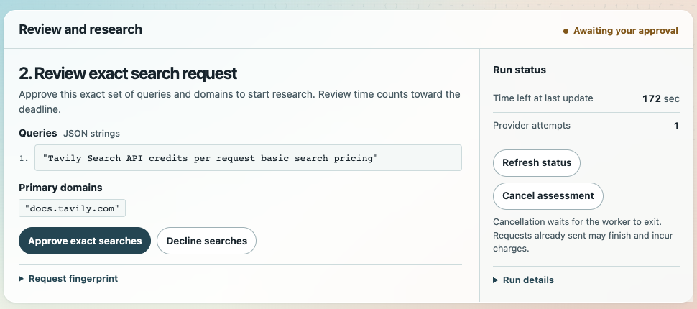
STALECHECK
Exact search approval
Live run: one exact query approved for docs.tavily.com
Notes:
Live browser capture on November 11, 2026. Copilot produced the query through Bifrost, and the browser displayed it before the Tavily search.

Slide 4
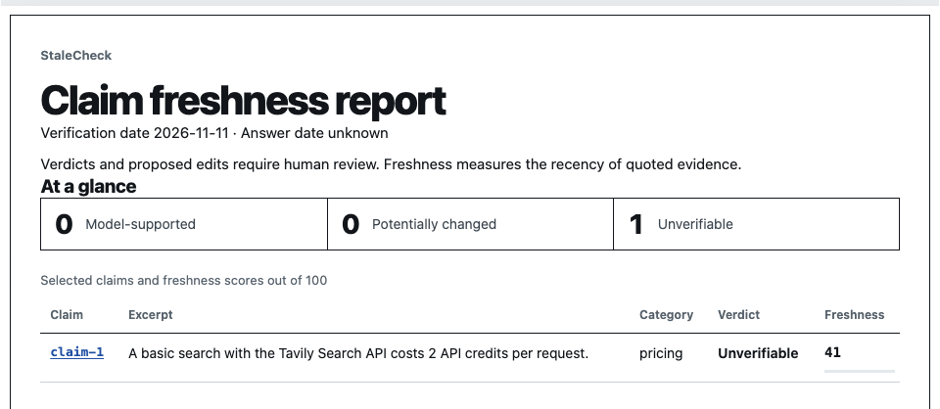
STALECHECK
A freshness score for each claim
Freshness describes quoted evidence. Verdicts still require human review.
Notes:
The live report retained three quotations. It recorded conflicting evidence and an Unverifiable verdict. The newest quoted source was estimated to be 215 days old.

Slide 5
STALECHECK
What has been verified
Browser walkthrough
Load the four-claim sample, decline or approve searches, review quotations and download verified artifacts.
Bifrost in Docker
28 integration checks passed with local stand-ins for the model and Tavily. Covered routing, relay authorization and budgets.
Live browser run
Bifrost routed two signed-in Copilot calls and one Tavily search. StaleCheck retained three quotes and verified the run artifacts.
Scope limits
A run caps claims, attempts and time. The verifier checks artifact consistency and the user reviews any proposed edits.
Notes:
Current application checks include Python, React and Chrome. The Docker gateway check used local stand-ins. The live Chrome run completed and verified its artifacts. Bifrost carried two real Copilot calls and one real Tavily search. No claim about benchmark accuracy is made.

Slide 6
STALECHECK
Run the prototype
Offline demo
python -m pip install .
mkdir -p runs
python -m stalecheck serve-assessment --output runs/demo
Live Bifrost and Tavily
bash scripts/copilot-check/run.sh
The runner uses a Tavily key and GitHub Copilot sign-in. Open the printed local URL.
github.com/vishwateja8483/Tavily-StaleCheck
Notes:
Python 3.12 or later. The repository includes packaged React assets. See README and docs/COPILOT-BIFROST-SETUP.md for setup. The GitHub URL must be publicly accessible before submission.

