Slide 1
Geek Room Global AI Hackathon · PS-06
StaleCheck
A stale-answer detector for AI applications
“Python 3.14.8 is still the latest Python 3.14 maintenance release.”
StaleCheck finds the claim, asks before searching and shows the source that contradicts it.
@vishwateja8483
Notes:
Open with an answer that was once plausible: Python 3.14.8 was the latest release before a newer patch shipped. The publisher now lists it as superseded.
https://www.python.org/downloads/release/python-3148/
https://github.com/vishwateja8483/Tavily-StaleCheck/blob/main/docs/LIVE-PROOF.md

Slide 2
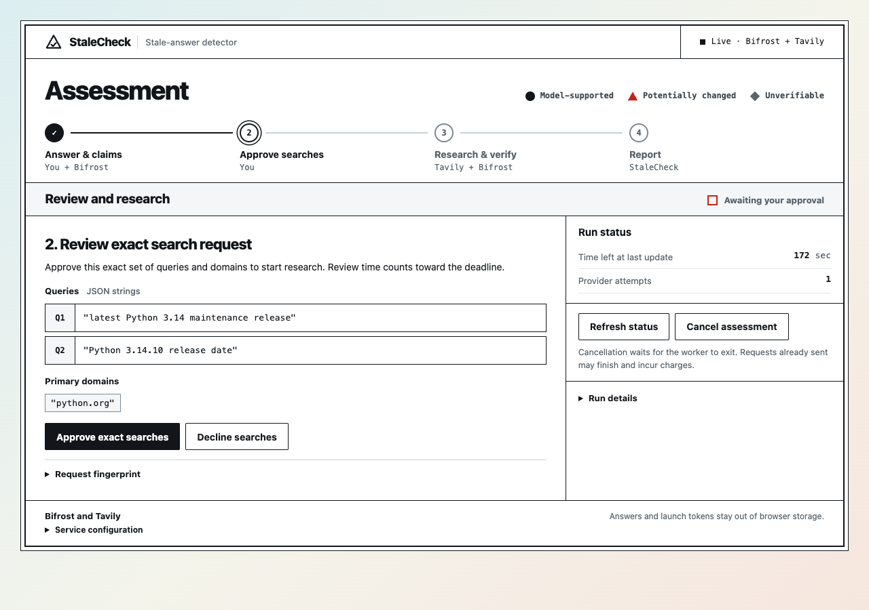
Search approval in Chrome
Before the first search
Bifrost routes the extraction request to GitHub Copilot.
The user reviews two proposed queries and the python.org domain.
After approval, Bifrost relays the searches to Tavily.
27 seconds, 3 model calls and 2 searches
Notes:
This screenshot comes from the real Python run on 11 November 2026. The full answer goes to the model after answer-processing consent. Only the approved queries and domains are sent to Tavily.
https://github.com/vishwateja8483/Tavily-StaleCheck/blob/main/docs/LIVE-PROOF.md

Slide 3
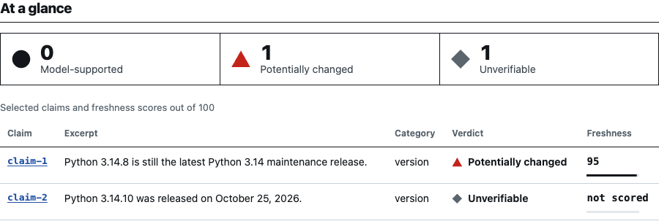
Two claims, two different outcomes
Potentially changed
Unverifiable
The source identifies a newer Python release. Its quoted evidence scored 95/100 for recency.
Python confirms the release date. The retrieved quote omitted the version number, so the tool withheld a verdict.
Notes:
Both rows are from the same recorded Python assessment. The screenshot was rendered from the verified run files. Independently, Python confirms the release date. The retained Tavily quote gave the date but not the version number.
https://www.python.org/downloads/release/python-3148/
https://www.python.org/downloads/release/python-31410/
https://github.com/vishwateja8483/Tavily-StaleCheck/blob/main/docs/LIVE-PROOF.md

Slide 4
What each component contributes
Bifrost
Routes claim extraction and evidence assessment to the configured model. Records routing and token usage.
Tavily
Retrieves source excerpts and estimated publication dates from the approved domains.
StaleCheck
Checks quotes against the retrieved excerpts, calculates evidence freshness and exports the complete run.
The freshness score measures the recency of dated evidence.
Notes:
Bifrost handles extraction and evidence assessment through its model gateway. The live launcher uses a virtual key and relays approved searches to Tavily. StaleCheck verifies the excerpt match and records which evidence was retained.
https://docs.getbifrost.ai/overview
https://docs.tavily.com/documentation/api-reference/endpoint/search
https://github.com/vishwateja8483/Tavily-StaleCheck/blob/main/docs/LIVE-PROOF.md

Slide 5
Live checks against primary sources
Case | Stale claim | Publisher-confirmed claim
Python releases | Potentially changed | Unverifiable
Node.js support | Potentially changed | Model-supported
GitHub Actions quota | Unverifiable | Model-supported
GitHub artifact API | Potentially changed | Model-supported
IOC leadership | Potentially changed | Model-supported
10 claims reviewed. Eight aligned with primary sources. Two abstentions.
Small, selected set. Open the evidence guide for claim-level results and sources.
Notes:
The evaluation includes every planned claim, including any unselected claims or abstentions. Reference outcomes came from the official Python, Node.js, GitHub, and IOC sources listed in the evidence guide. The case set is small and hand-picked.
https://github.com/vishwateja8483/Tavily-StaleCheck/blob/main/docs/LIVE-PROOF.md

Slide 6
Documentation and support teams
Check an AI answer before it goes into docs or a support reply.
Review the suggested edits beside the original text. Share the HTML report or export the full run for offline verification.
Open the live evidence and replay guide
github.com/vishwateja8483/Tavily-StaleCheck
Notes:
A documentation or support team can use the CLI to check AI-generated copy, consume the JSON output and send flagged claims to an editor. Show the full run ZIP and verify-artifacts. Current prototype is local and single-user.
https://github.com/vishwateja8483/Tavily-StaleCheck/blob/main/docs/LIVE-PROOF.md

