Slide 1
STALECHECK · STALE-ANSWER DETECTOR
StaleCheck: find the stale claims in an LLM answer
Paste an answer. Get every time-sensitive claim re-checked against today's sources.
Each claim: supported, potentially changed or unverifiable, with a 0-100 freshness score.
Every verdict rests on a verbatim quote and a source link. Edits are suggested, never applied.
One integrated project: Bifrost for every model call, Tavily for live research.
Maxim Bifrost + Tavily · Geek Room AI Global Hackathon 2026
1
Notes:
StaleCheck is a stale-answer detector. You give it an answer from a language model. It finds the claims that can go out of date, checks each one against current sources, and tells you which ones still hold, which may have changed, and which it could not verify. It is one integrated project that uses Maxim Bifrost for the model calls and Tavily for the live research.

Slide 2
STALECHECK · STALE-ANSWER DETECTOR
The problem: confident answers go out of date
Prices, versions, support windows and laws change after a model's training data ends.
The answer still sounds certain, and never says when its facts were true.
A reader cannot tell which sentence went stale.
Checking every claim by hand does not scale.
Maxim Bifrost + Tavily · Geek Room AI Global Hackathon 2026
2
Notes:
Here is the problem. A model answer mixes stable facts with facts that expire, like prices, software versions and support dates. It states all of them with the same confidence. A reader has no way to tell which sentence went stale, and checking every claim by hand does not scale.

Slide 3
STALECHECK · STALE-ANSWER DETECTOR
How a check runs
01
02
03
04
Bifrost extracts time-sensitive claims as exact spans of the answer
You approve the exact Tavily queries and domains
Tavily searches reviewed domains; Bifrost reads the excerpts
Host checks quotes verbatim, scores freshness, writes the report
Maxim Bifrost + Tavily · Geek Room AI Global Hackathon 2026
3
Notes:
A check runs in four steps. First, Bifrost extracts the time-sensitive claims, and each one must be an exact span of the original answer. Second, you see the literal search queries and approve or decline them; nothing goes to Tavily before that. Third, Tavily searches only the reviewed domains, and Bifrost reads the excerpts. Fourth, the host checks every quote verbatim, scores freshness and writes a replayable report.

Slide 4
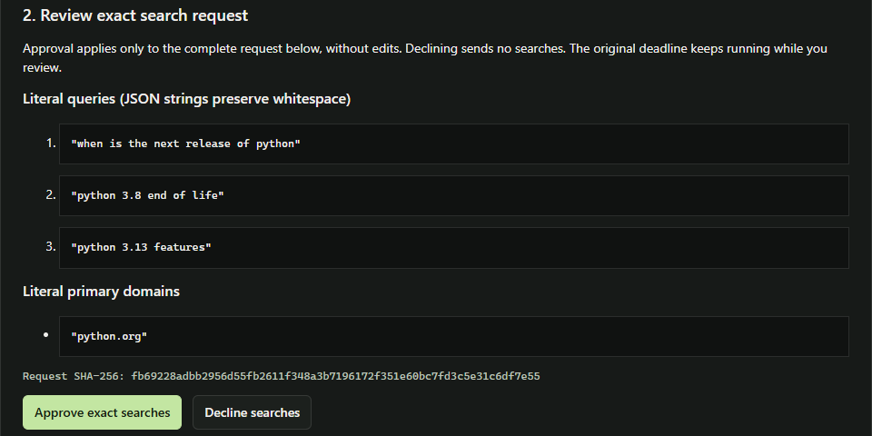
STALECHECK · STALE-ANSWER DETECTOR
Step 2: nothing is searched until you approve it
Live run: the exact Tavily queries the model proposed, for python.org only. Declining sends nothing.
Maxim Bifrost + Tavily · Geek Room AI Global Hackathon 2026
4
Notes:
This is the approval step from a live run. The model, called through Bifrost, proposed three searches. You see the exact queries and the reviewed domain, python dot org, tied together by a hash. Approve sends exactly these searches to Tavily. Decline sends none.

Slide 5
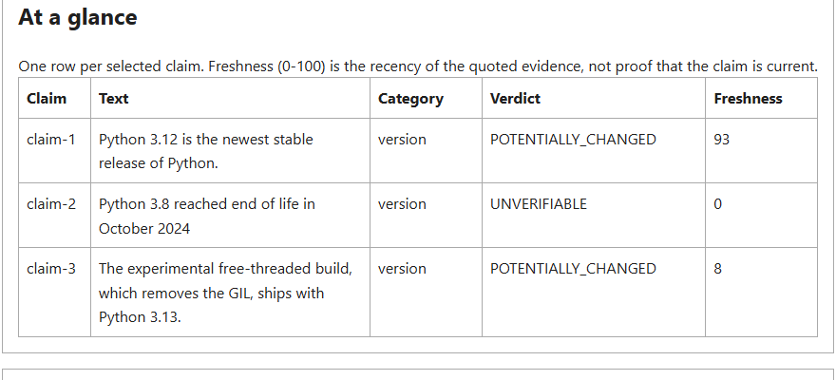
STALECHECK · STALE-ANSWER DETECTOR
Live result: real claims, real sources, real verdicts
Real Bifrost 2.4.0 gateway, local Qwen2.5-3B model, real Tavily API (2026-11-02).
Maxim Bifrost + Tavily · Geek Room AI Global Hackathon 2026
5
Notes:
This is a real run, not a mock. A Bifrost gateway routed the model calls to a small local model, and Tavily searched python dot org. Two claims about Python releases were flagged as potentially changed, backed by verbatim quotes from python dot org. The third came back unverifiable: the model said it had changed, but its quotes did not contradict the claim, so the host refused to pass that verdict on. The whole journey took about eighty seconds, four model calls and three Tavily credits.

Slide 6
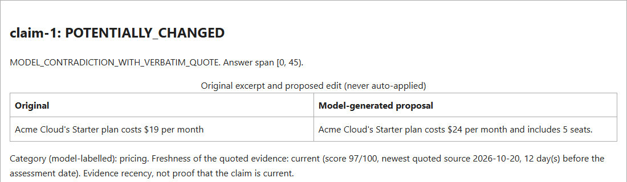
STALECHECK · STALE-ANSWER DETECTOR
Evidence, not opinion
Demo data: the original sentence beside a model-proposed edit, labelled and never auto-applied.
Maxim Bifrost + Tavily · Geek Room AI Global Hackathon 2026
6
Notes:
Each claim shows the original sentence next to a proposed edit. The edit is labelled as model-generated and is never applied for you. Below it, the report shows the verbatim quote from the source, the link, and the source's publication date, so a reader can check the evidence themselves.

Slide 7
STALECHECK · STALE-ANSWER DETECTOR
How Maxim Bifrost and Tavily are used
Bifrost: the single gateway for claim extraction and assessment, via /v1/chat/completions with a virtual key.
Bifrost: requested fallbacks, plus the routing and token usage it reports, recorded for every call.
Tavily: one Search per approved query, restricted to reviewed domains.
Tavily: its excerpts are the only text a quote can come from; its dates drive the freshness score.
Maxim Bifrost + Tavily · Geek Room AI Global Hackathon 2026
7
Notes:
Bifrost is the only route to a model. Both model steps, extraction and assessment, go through its OpenAI-compatible endpoint with a virtual key, so budgets and rate limits are enforced at the gateway. The routing and token usage Bifrost reports are recorded per call. Tavily is the live research step. Each approved query is one search on reviewed domains, its excerpts are the only place a quote can come from, and its publication dates drive the freshness score.

Slide 8
STALECHECK · STALE-ANSWER DETECTOR
What the live run proved
End to end on real services: Bifrost 2.4.0 and the Tavily API, about 80 s and 3 credits per answer.
The guard works: a model verdict without a contradicting quote became unverifiable.
Failures stay safe: a gateway timeout was recorded, not retried, and the report still verified.
Still open: a hosted model and an accuracy evaluation. One answer is not a benchmark.
Maxim Bifrost + Tavily · Geek Room AI Global Hackathon 2026
8
Notes:
The live run showed three things. The whole pipeline works on real services, in about eighty seconds per answer. The evidence guard works: when the model claimed a change without a contradicting quote, the verdict became unverifiable. And failures stay safe: a gateway timeout was recorded, not retried, and the report still verified. What is still open is a run with a hosted model and a proper accuracy evaluation.

Slide 9
STALECHECK · STALE-ANSWER DETECTOR
What makes it different
Model output is untrusted: a verdict changes only on a quote found verbatim in a source.
Two consent steps, bounded attempts and time, no automatic retries.
Runs are hashed and replayable; tampering is detected on verification.
Honest limits: unverifiable is shown, never guessed.
Maxim Bifrost + Tavily · Geek Room AI Global Hackathon 2026
9
Notes:
What makes it different is that it does not trust the model. A verdict can only change when the quote appears word for word in a retrieved source, and supporting quotes must repeat the claim's figures. Spending is bounded by attempt and time ceilings with no automatic retries. Every run is hashed and replayable, so tampering is caught. And when the evidence is not there, it says unverifiable instead of guessing.

Slide 10
STALECHECK · STALE-ANSWER DETECTOR
Try it
Offline demo, no keys: python -m stalecheck stale-check --demo-v4 --output runs/demo
Web app: python -m stalecheck serve-assessment --output runs/session
Live: your Bifrost virtual key and Tavily key, plus --live --confirm-outbound
Stack: Python 3.12 stdlib, React + TypeScript, pytest and Vitest, GitHub Actions CI
Maxim Bifrost + Tavily · Geek Room AI Global Hackathon 2026
10
Notes:
You can try it in a minute. The offline demo needs no keys and makes no network calls. The web app runs the whole journey in your browser. For a live run, point it at your Bifrost gateway with a virtual key and add your Tavily key. Thanks for watching.

