Slide 1
Prediction Markets as Macro Data
15.S06 AI AND ML RESEARCH IN FINANCE · KALSHI VS. FED FUNDS FUTURES
Are Kalshi’s prices on FOMC decisions good forecasts, and how do they compare with fed funds futures?
Andres Blanco Prada · Panos Koutsoukos · Connor Rippert · Vish
MIT Sloan School of Management | Progress update, October 2026

Slide 2
Kalshi has become a deep market for Fed decisions
MOTIVATION
Contracts traded per month, all Kalshi Fed-decision markets (log scale)
~10×
jump in monthly volume in spring 2025
620M
contracts traded on FOMC decisions since 2023
1¢
median bid–ask spread
01_eda_kalshi.py
1 / 10

Slide 3
Are prediction markets good macro forecasts?
ROADMAP
Three research questions, taken in order: one part of the talk each
Kalshi’s prices are a new, real-time read on macro expectations.
1
RQ1 Calibration
Slides 3–7 · first results
Are Kalshi prices rational forecasts? Favorite–longshot bias? Better than futures and surveys?
Each Kalshi contract pays $1 if its outcome (e.g. “cut 25bp”) happens, so its price in ¢ reads as a probability. Are these good forecasts? We answer in three parts; the tag at the top right of every slide shows the part.
2
RQ2 Price discovery
Slide 8 · started
How fast do prices absorb CPI, payrolls and FOMC news vs. futures?
Data
3
RQ3 Forecasting
Slides 9–10 · for feedback
Every Kalshi trade and 1-minute quote since 2021; Bloomberg fed funds futures daily since 2021.
Use Kalshi distributions to predict policy and macro surprises, starting with where Kalshi and options disagree.
2 / 10

Slide 4
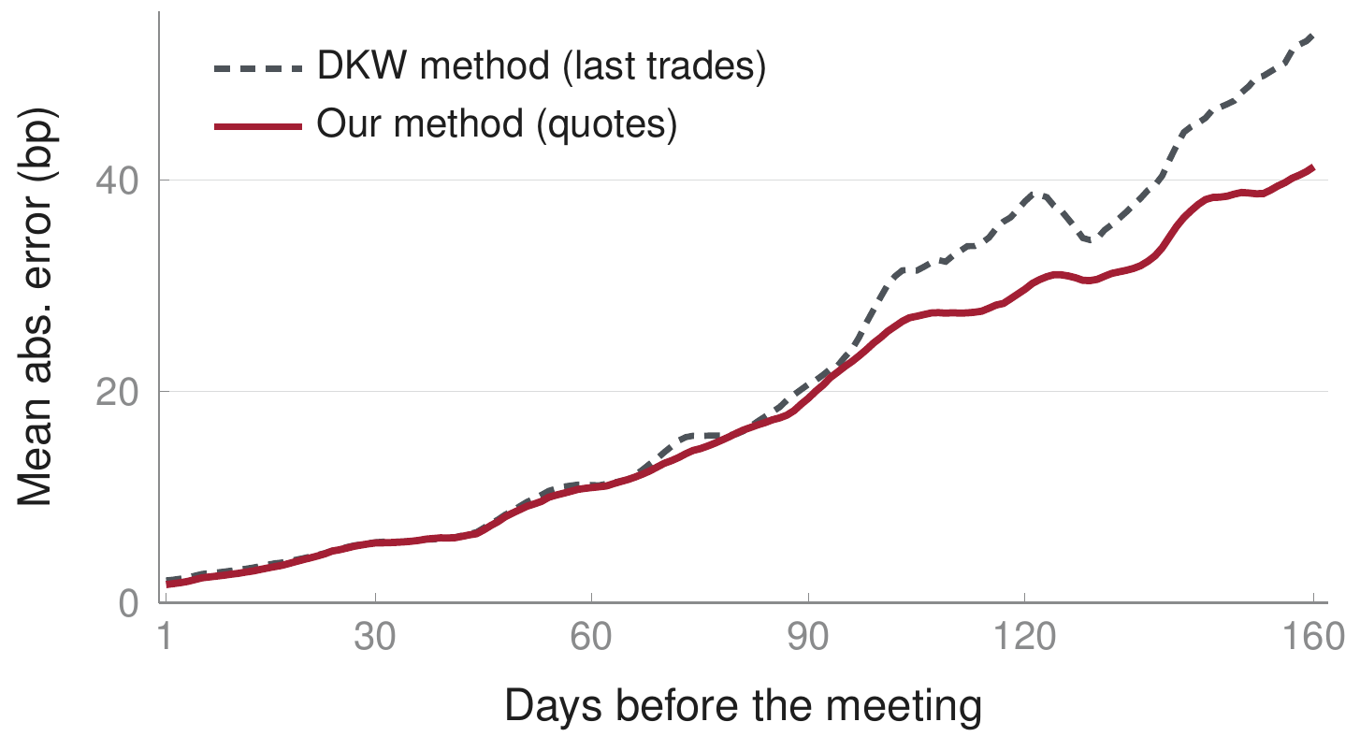
Data check: we reproduce a Fed study, with smaller errors
PART 1 · CALIBRATION · DATA CHECK
1 Calibration
2 Price discovery
3 Forecasting
Error of the Kalshi-implied fed funds rate vs. the rate the FOMC set; 41 meetings, 2021–2026
What is DKW? Diercks, Katz & Wright (2026), a Federal Reserve Board working paper (FEDS 2026-010). They turn Kalshi’s FOMC contracts into a daily probability distribution for the fed funds rate at each meeting, and find it about as accurate as fed funds futures and surveys.
Why this slide: before testing whether Kalshi’s probabilities are right, we check that our data and method reproduce their result. DKW use last trades; we use bid–ask quotes.
41/41
meetings called correctly the day before
−14%
lower average error than the DKW method, 1–160 days out (17.9 vs. 20.8bp)
Why quotes win: 40–45% of last trades are over a week old.
kalshi_fed/
3 / 10

Slide 5
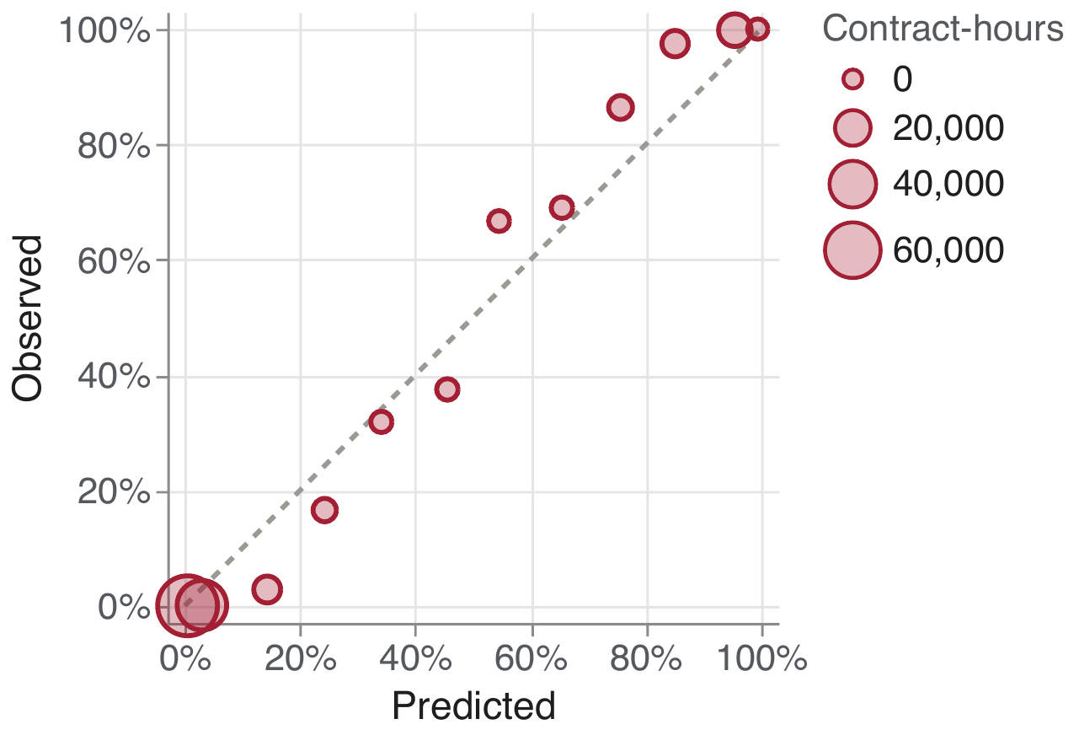
Fed-decision prices show a favorite–longshot pattern
PART 1 · CALIBRATION
1 Calibration
2 Price discovery
3 Forecasting
Share of contracts that paid out, by price; quotes every minute, 0–60 days before the meeting
0.1%
payout rate of contracts priced 1–10¢
99.8%
payout rate of contracts priced 90–99¢
Calibrated = on the dashed line: a 30¢ contract pays out 30% of the time. Cheap longshots pay out even less often than priced; favorites more often.
02_calibration_kalshi.py
4 / 10

Slide 6
A calibration regression confirms the pattern
PART 1 · CALIBRATION
1 Calibration
2 Price discovery
3 Forecasting
Logistic regression of the outcome on logit(price): β = 1 means calibrated, β > 1 means prices are too timid
1.75
calibration slope β at 1–21 days (SE 0.45; bootstrap 95% CI 1.22–3.54)
p = 0.01
joint test that α = 0 and β = 1 (cluster bootstrap)
β > 1: favorites win more than priced, longshots less.
02_calibration_kalshi.py
5 / 10

Slide 7
Benchmark: fed funds futures give odds for every meeting
PART 1 · CALIBRATION · BENCHMARK
1 Calibration
2 Price discovery
3 Forecasting
RQ1 also asks if Kalshi beats existing markets, so we turn futures into the same probabilities
Futures price
FF1–FF13, daily
Avg. rate per month
100 − P
Rate after meeting
strip the pre-meeting days out of that month
Expected move x
in 25bp units
Example: 30 Jul 2024, for the 18 Sep meeting.
x = −1.09 steps ⇒ 91% cut 25bp, 9% cut 50bp.
All mass sits on the two outcomes next to x, so the futures can never price the tails.
FF1–FF13: CME 30-day fed funds futures for this month (FF1) through 12 months ahead (FF13). Each settles at 100 minus that month’s average effective fed funds rate.
WIRP: Bloomberg’s World Interest Rate Probability screen, the standard way traders read meeting odds off these futures. We rebuild its method (appendix A11).
03_fedfunds_vs_kalshi.py
6 / 10

Slide 8
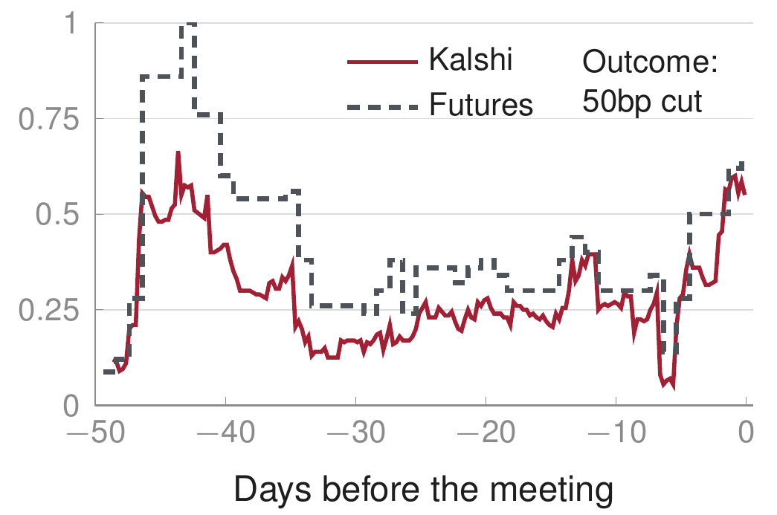
Kalshi tracks futures and edges them up to 30 days out
PART 1 · CALIBRATION · KALSHI VS. FUTURES
1 Calibration
2 Price discovery
3 Forecasting
Both read at 15:00 ET each day and scored against the actual decision
One meeting: Sep 2024, P(50bp cut)
All meetings: Brier score (lower is better)
y-axis: probability of a 50bp cut; the outcome was a 50bp cut
Brier = average of (p − Y)² over hold and ±25bp contracts; p = forecast probability, Y = 1 if the outcome happened. 0 is perfect; always saying 50% scores 0.25. Fewer meetings at 45–60 days.
03_fedfunds_vs_kalshi.py
7 / 10

Slide 9
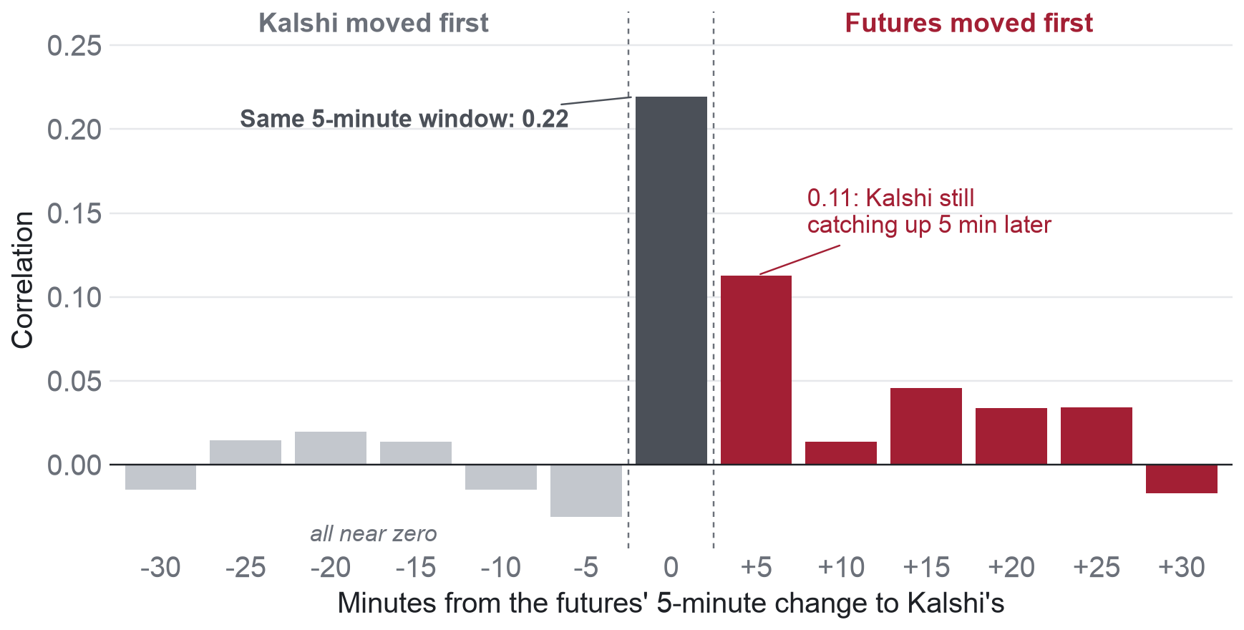
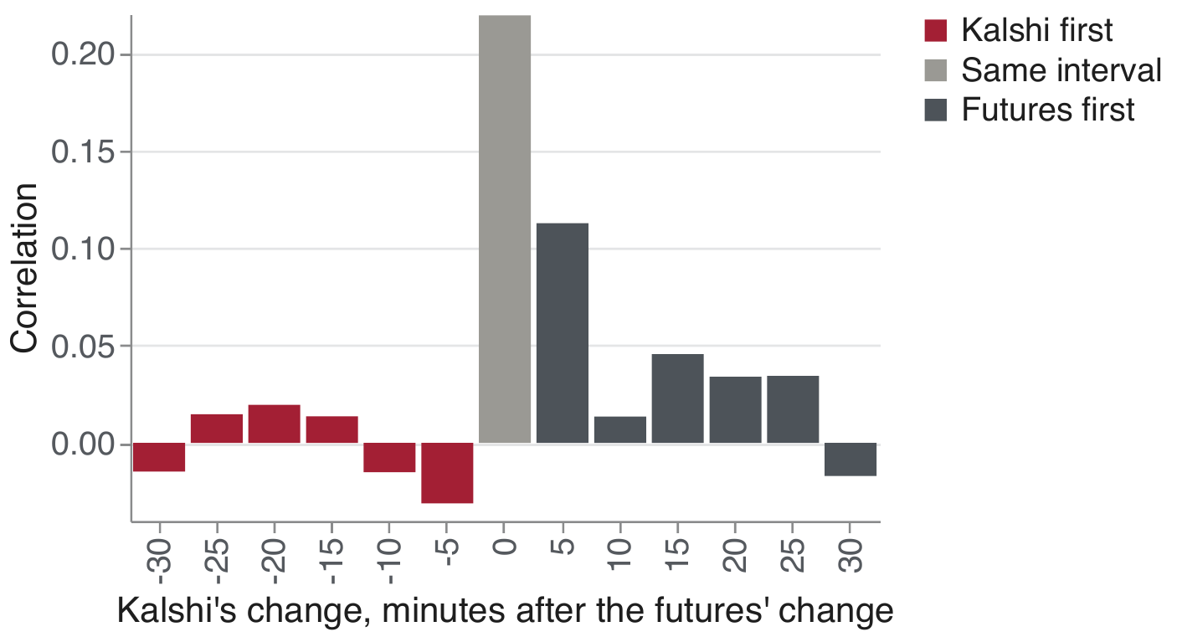
Intraday, futures lead Kalshi by about five minutes
PART 2 · PRICE DISCOVERY
1 Calibration
2 Price discovery
3 Forecasting
Who reacts first to news? Minute-by-minute quotes, Mar–Oct 2026, 140 trading days, 5 FOMC meetings
What each bar shows
0.22
Both markets imply an expected rate change at the next meeting (bp). Each bar: correlation of the futures’ change in one 5-minute window with Kalshi’s change k minutes later.
same 5-minute window: most co-movement is simultaneous
p < 0.001
past futures moves help predict Kalshi’s next move (Granger test); the reverse is weaker (p = 0.06)
16%
of a large futures move is matched by Kalshi within 15 minutes: it follows only partly
04_leadlag_fedfunds_kalshi.py
8 / 10

Slide 10
Futures only see the mean
PART 3 · NEXT STEPS · WHY WE NEED OPTIONS
1 Calibration
2 Price discovery
3 Forecasting
Part 3 needs full distributions, but our futures benchmark (slide 6) only pins down the mean x
Usually fine
Most meetings are hold vs. 25bp; everything else is near zero.
Breaks on splits
When the market is split (Sep 2024), one mean hides two very different beliefs.
Tails are never priced
So Kalshi’s extra weight beyond 25bp (appendix A12) is partly mechanical.
Fix: options
Same mean: x = −1 step
Fed funds and SOFR option strikes give the full distribution per meeting.
9 / 10

Slide 11
Next: the MacroTron
PART 3 · FORECASTING
1 Calibration
2 Price discovery
3 Forecasting
Our planned ML model: read the macro state, predict where Kalshi and options disagree
Macro state
Last CPI, core CPI, payrolls: surprise and days since; EFFR and target range
MacroTron
Target
Return on the spread between Kalshi and option-implied probabilities of the same Fed outcome
Market expectations
Fed funds futures path, CPI fixings, TIPS breakevens
Kalshi expectations
Fed, CPI and payroll distributions
Our questions for you: Is the spread tradable? How far back do options go? Which model fits ~30 meetings?
10 / 10

Slide 12
Appendix
Data · Literature · Replication · Calibration · CPI & payrolls · Futures · Lead–lag

Slide 13
Dataset: every Kalshi trade and 1-minute quote
APPENDIX · DATA
Series | Events | Contracts | Trades | Volume | Since
Fed decision (KXFEDDECISION) | 40 | 200 | 770,571 | 620M | Apr 2023
CPI m/m (KXCPI) | 67 | 552 | 204,598 | 25.5M | Jul 2021
Core CPI m/m (KXCPICORE) | 56 | 500 | 33,259 | 7.7M | Jul 2022
CPI y/y (KXCPIYOY) | 49 | 713 | 241,413 | 37.9M | Dec 2022
Payrolls (KXPAYROLLS) | 45 | 422 | 116,507 | 19.6M | Mar 2023
Fed funds ladders (KXFED) | 52 | 660 | ~222,000 | 59M | Jul 2021
Quotes
Futures
Fed outcomes
10.4M one-minute candles. 100% of 2,155 settled contracts match Kalshi’s reported volume within ±1%.
Bloomberg FF1–FF13, EFFR and target range, daily 2000–2026; 1-minute bid/ask bars Mar–Oct 2026.
19 holds, 5 cuts of 25bp, 1 cut of 50bp (Sep 2024), 3 hikes of 25bp.
00_fetch_data_kalshi.py
A1

Slide 14
Literature: what is known and what we add
APPENDIX · LITERATURE
Paper | Finding | Gap we target
Diercks, Katz & Wright (2026) | Kalshi distributions for fed funds, CPI, GDP; CPI beats Bloomberg consensus | No Brier/log scores, no bias test, daily only
Bürgi, Deng & Whelan (2026) | Strong favorite–longshot bias overall; weak in economics contracts | Test on macro with clean specification
Bartlett & O’Hara (2026) | Microstructure of 41.6M Kalshi trades | No forecast evaluation
Wolfers & Zitzewitz (2004) | Contract design reveals mean, median, distribution | Early evidence: 16 obs.
Kelly et al. (2026) | Transformer stochastic discount factor | Only regularized ideas fit our sample (RQ3)
A2

Slide 15
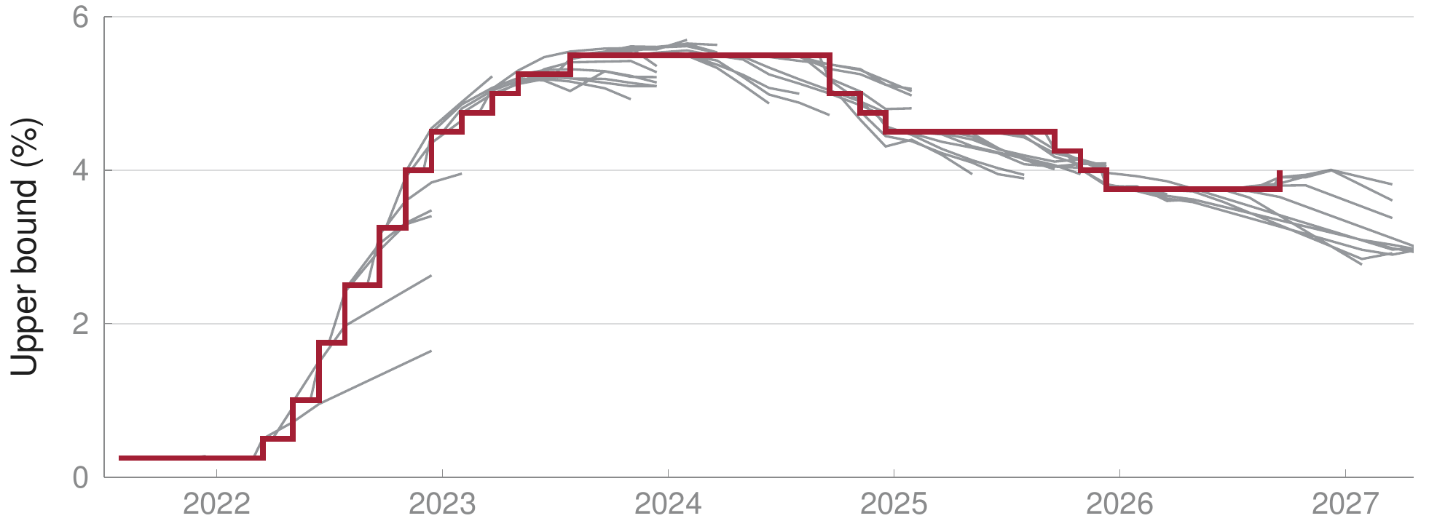
Kalshi-implied rate paths vs. the realized target
APPENDIX · REPLICATION
Each line: the path the market implied on one date; red steps: the actual upper bound
kalshi_fed/
A3

Slide 16
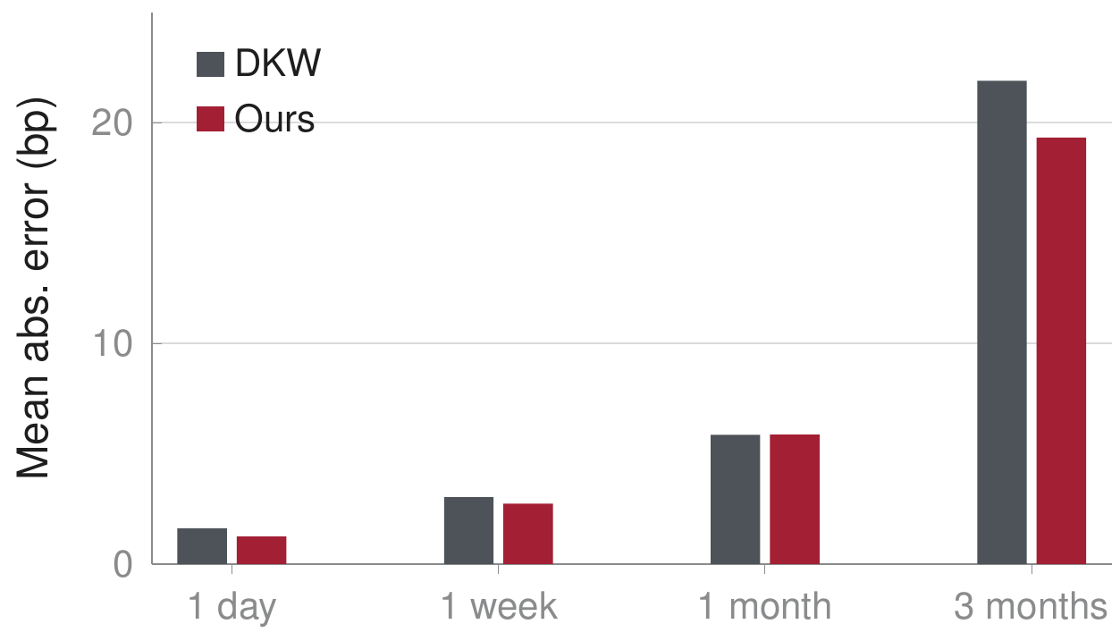
Replication accuracy by horizon
APPENDIX · REPLICATION
vs. NY Fed dealer survey
132 forecasts, 37 meetings: survey 19.1bp, Kalshi mode 17.0bp.
Method
Mid quote if spread ≤ 20¢, else last trade (20–40¢) or dropped; weighted isotonic fit across strikes.
On DKW’s 2022–25 window
19.9 vs. 22.7bp (1–160 days).
kalshi_fed/data/validation.json
A4

Slide 17
Calibration regression: estimates
APPENDIX · CALIBRATION
Logit of outcome on logit of price; meeting-clustered SEs; 999-draw cluster bootstrap
Horizon | Obs. / meetings | α (SE) | β (SE) | β 95% CI (boot) | p(β = 1) | p joint (boot)
1–21 days (main) | 454 / 28 | 0.141 (0.030) | 1.751 (0.453) | [1.22, 3.54] | 0.097 | 0.010
30 days | 78 / 27 | 0.165 (0.062) | 1.723 (0.533) | [1.11, 2.77] | 0.175 | 0.008
45–60 days | 100 / 18 | 0.445 (0.186) | 3.133 (1.058) | [1.97, 13.66] | 0.044 | 0.189
β > 1 at every horizon
α > 0 is significant
Under-confident prices: the favorite–longshot pattern.
The YES side of the normalized buckets pays slightly more than priced.
Sample: normalized prices at 16:00 ET, tick-floor contracts excluded; 632 of 1,384 forecasts.
02_calibration_kalshi.py
A5

Slide 18
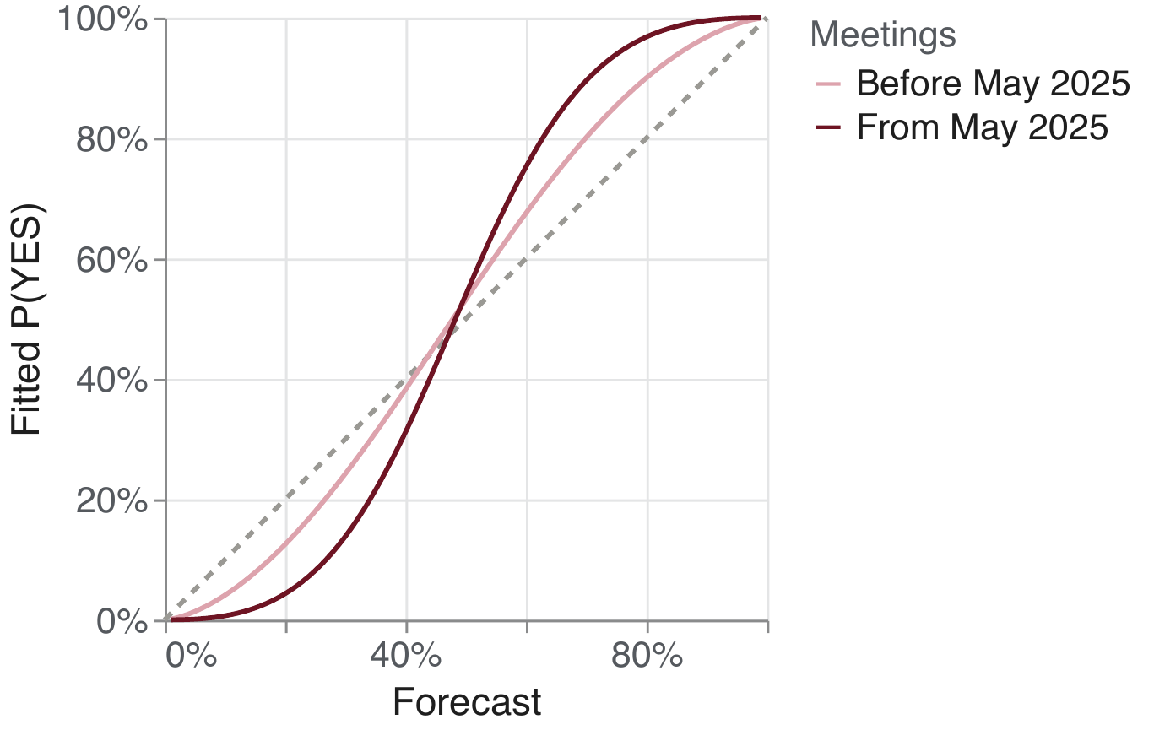
No detectable change after the liquidity jump
APPENDIX · CALIBRATION
Fitted calibration curves, 1–21 days: 16 meetings before May 2025, 12 from May 2025
1.49 → 2.35
β before vs. from May 2025
p = 0.19
difference in β (joint test p = 0.36, bootstrap)
A large p-value means no detectable change, not no change. The regimes also differ in policy: mostly holds before, cuts after.
02_calibration_kalshi.py
A6

Slide 19
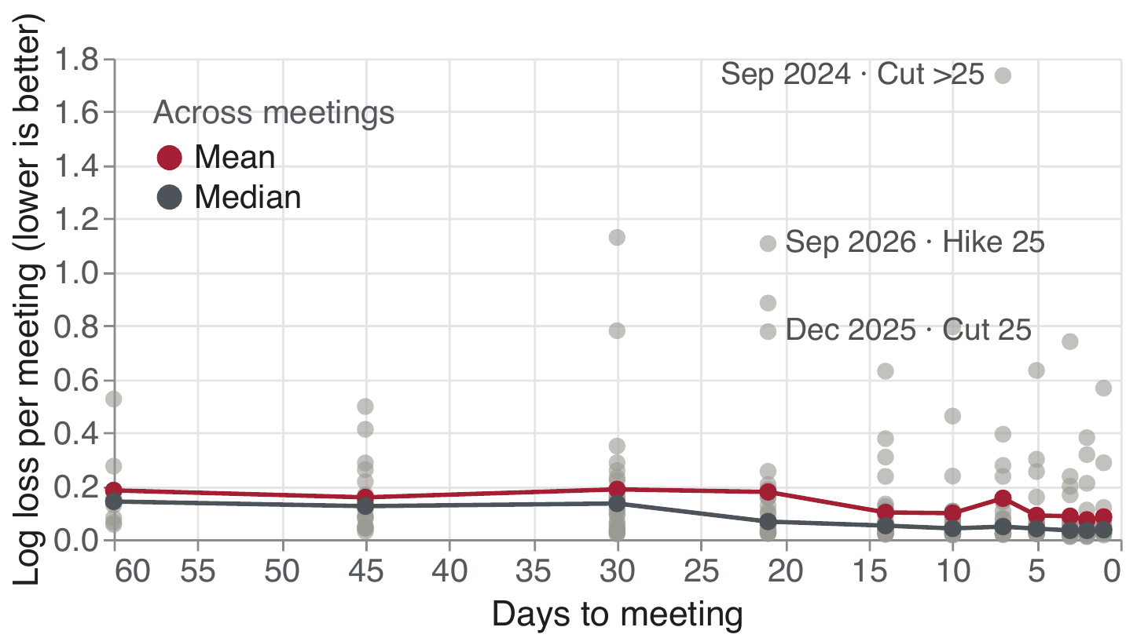
Accuracy fades with horizon, and single surprises dominate
APPENDIX · CALIBRATION
Log loss per meeting by days to meeting; labelled points are the largest misses
Mean log score 0.07 at 1 day, 0.28 at 30 days; median at 1–21 days 0.05 vs. mean 0.14.
02_calibration_kalshi.py
A7

Slide 20
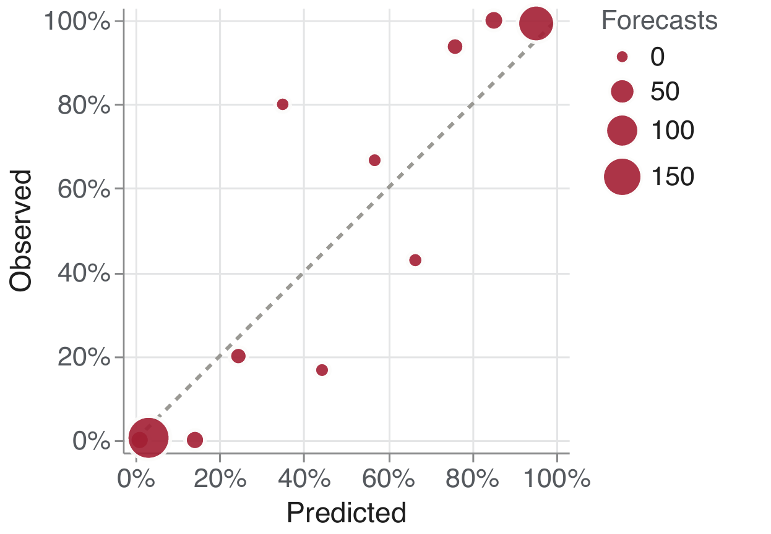
Daily snapshots show the same S-shape
APPENDIX · CALIBRATION
Main specification: 16:00 ET mid, normalized, 1–21 days; 632 forecasts, 28 meetings
0.5%
payout rate of contracts priced 1–10¢ (avg. price 3.1¢)
99.3%
payout rate of contracts priced 90–99¢ (avg. 95.3¢)
Bubble size = forecasts. Middle bins hold 2–6 meetings each. This sample feeds the calibration regression.
02_calibration_kalshi.py
A8

Slide 21
Specification fixed before any significance test
APPENDIX · CALIBRATION
Forecast
16:00 ET bid–ask mid, h ∈ {1, 2, 3, 5, 7, 10, 14, 21, 30, 45, 60} days before.
Horizon groups
1–21 days (main), 30, 45–60.
Normalization
Fed buckets normalized to sum to 1 (overround ≈ 1.5%); raw as robustness.
Tick floor
Quotes below 1¢ (0¢ bid) excluded; included as robustness.
Stale quotes
Kept and flagged; drop-stale as robustness. No spread filter.
Scores
Per contract (log loss, calibration regression) and per meeting (log score, Brier).
Minute data
Minute-level results are descriptive only.
Exclusions
Voided contracts and one untraded duplicate Fed event dropped.
Why: with about 28 meetings the test has low power, so the specification is fixed in advance.
A9

Slide 22
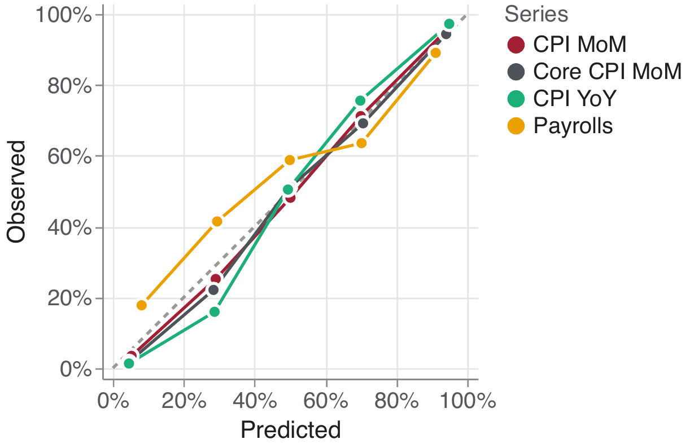
CPI is under-confident, payrolls over-confident
APPENDIX · CPI & PAYROLLS
1–21 days before the release; 18,049 forecasts, 203 releases; SEs clustered by release date
Series | β (SE) | p(β = 1)
CPI m/m | 1.20 (0.10) | 0.043
Core CPI m/m | 1.25 (0.11) | 0.025
CPI y/y | 1.40 (0.19) | 0.033
Payrolls | 0.75 (0.10) | 0.015
CPI pooled | 1.28 (0.10) | 0.005
All series | 1.11 (0.07) | 0.123
Every α is insignificant. Ladder contracts are not exclusive, so prices are not normalized.
03_calibration_macro.py
A10

Slide 23
How futures-implied probabilities are computed
APPENDIX · FUTURES
1
Monthly average
FFn settles on the average EFFR of month n − 1, so the implied average for month j is r̄_{j} = 100 − P_{j+1}.
Checks
2,909
2
Un-blend the meeting month
A meeting on day d of an N-day month splits it: r̄_{j} = (d/N) r_{pre} + ((N − d)/N) r_{post}.
Method A solves for r_{post} and amplifies noise by N/(N − d).
Method B (preferred) takes r_{post} from the next meeting-free month.
(meeting, date) pairs, all summing to 1
1.4bp
3
Chain meetings
The start rate is the range midpoint plus a 10-day median EFFR spread.
median gap between Methods A and B
4
Expected move → probabilities
x in 25bp steps; with n = floor(x) and p = x − n, the move is n steps w.p. 1 − p and n + 1 steps w.p. p.
Literature/fed_funds_implied_probabilities.pdf
A11

Slide 24
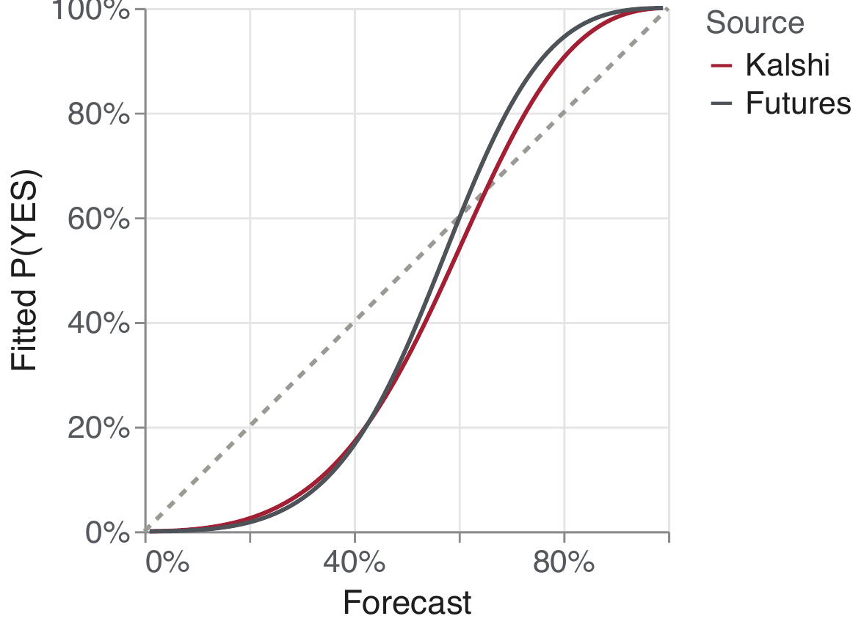
Kalshi and futures are similarly under-confident
APPENDIX · FUTURES
Hold and ±25bp outcomes, both read at 15:00 ET and scored against the decision
2.14 vs. 2.48
calibration slope β, Kalshi vs. futures (1–21 days): both under-confident
0.039 vs. 0.046
Brier score at 30 days, Kalshi vs. futures
Kalshi scores better at 1–30 days, futures at 45–60 days (few meetings). Kalshi prices moves beyond 25bp higher.
03_fedfunds_vs_kalshi.py
A12

Slide 25
Kalshi and futures agree closely near the meeting
APPENDIX · FUTURES
Mean absolute gap in probability, hold and ±25bp outcomes; 14,513 contract-days
Correlation falls from 0.998 (1 day) to 0.928 (121+ days).
03_fedfunds_vs_kalshi.py
A13

Slide 26
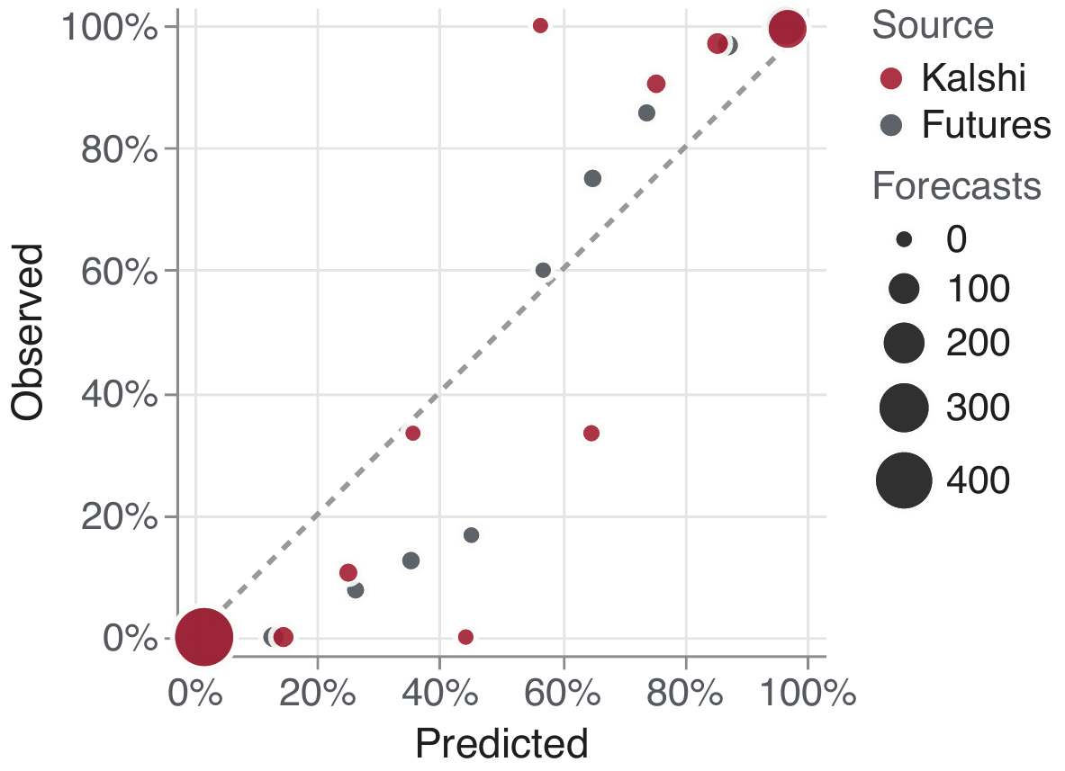
Reliability: futures vs. Kalshi
APPENDIX · FUTURES
Hold and ±25bp outcomes, 1–30 days pooled; bins from 0.3 to 0.6 hold 2–5 meetings
03_fedfunds_vs_kalshi.py
A14

Slide 27
Scores: Kalshi vs. futures by horizon
APPENDIX · FUTURES
Red: the lower (better) score at each horizon
Days before | 1 | 7 | 21 | 30 | 45 | 60
Brier, futures | 0.0049 | 0.0198 | 0.0425 | 0.0459 | 0.0222 | 0.0532
Brier, Kalshi | 0.0044 | 0.0191 | 0.0383 | 0.0392 | 0.0310 | 0.0755
Log loss, futures | 0.035 | 0.081 | 0.148 | 0.170 | 0.113 | 0.192
Log loss, Kalshi | 0.030 | 0.084 | 0.138 | 0.153 | 0.142 | 0.253
28 meetings at 1–21 days, 8 at 60 days. Probabilities clipped to [0.005, 0.995].
03_fedfunds_vs_kalshi.py
A15

Slide 28
Lead–lag: data and method
APPENDIX · LEAD–LAG
Futures
Bloomberg 1-minute bid/ask bars, 30 Mar – 12 Oct 2026, contracts Mar–Dec 2026; expected move per minute with the daily method (A or B per meeting). Median spread 0.5bp.
Kalshi
Expected move Σ_{k} q_{k} · move_{k} from 1-minute bucket mids, rescaled to sum to 1, carried onto the CME minute grid.
Alignment
Bloomberg bars are labelled by start minute, so they are shifted one minute to match Kalshi. Without it the futures appear to lead by exactly one minute.
Validation
At 15:00 the minute series matches daily settlements: 135 days, correlation 0.998, median gap 0.27bp.
Tests
On 5-minute changes (95% of futures and 92% of Kalshi changes are zero): cross-correlations, Granger regressions with 6 lags clustered by session, and paths after the largest 0.1% of 1-minute moves.
04_leadlag_fedfunds_kalshi.py
A16

Slide 29
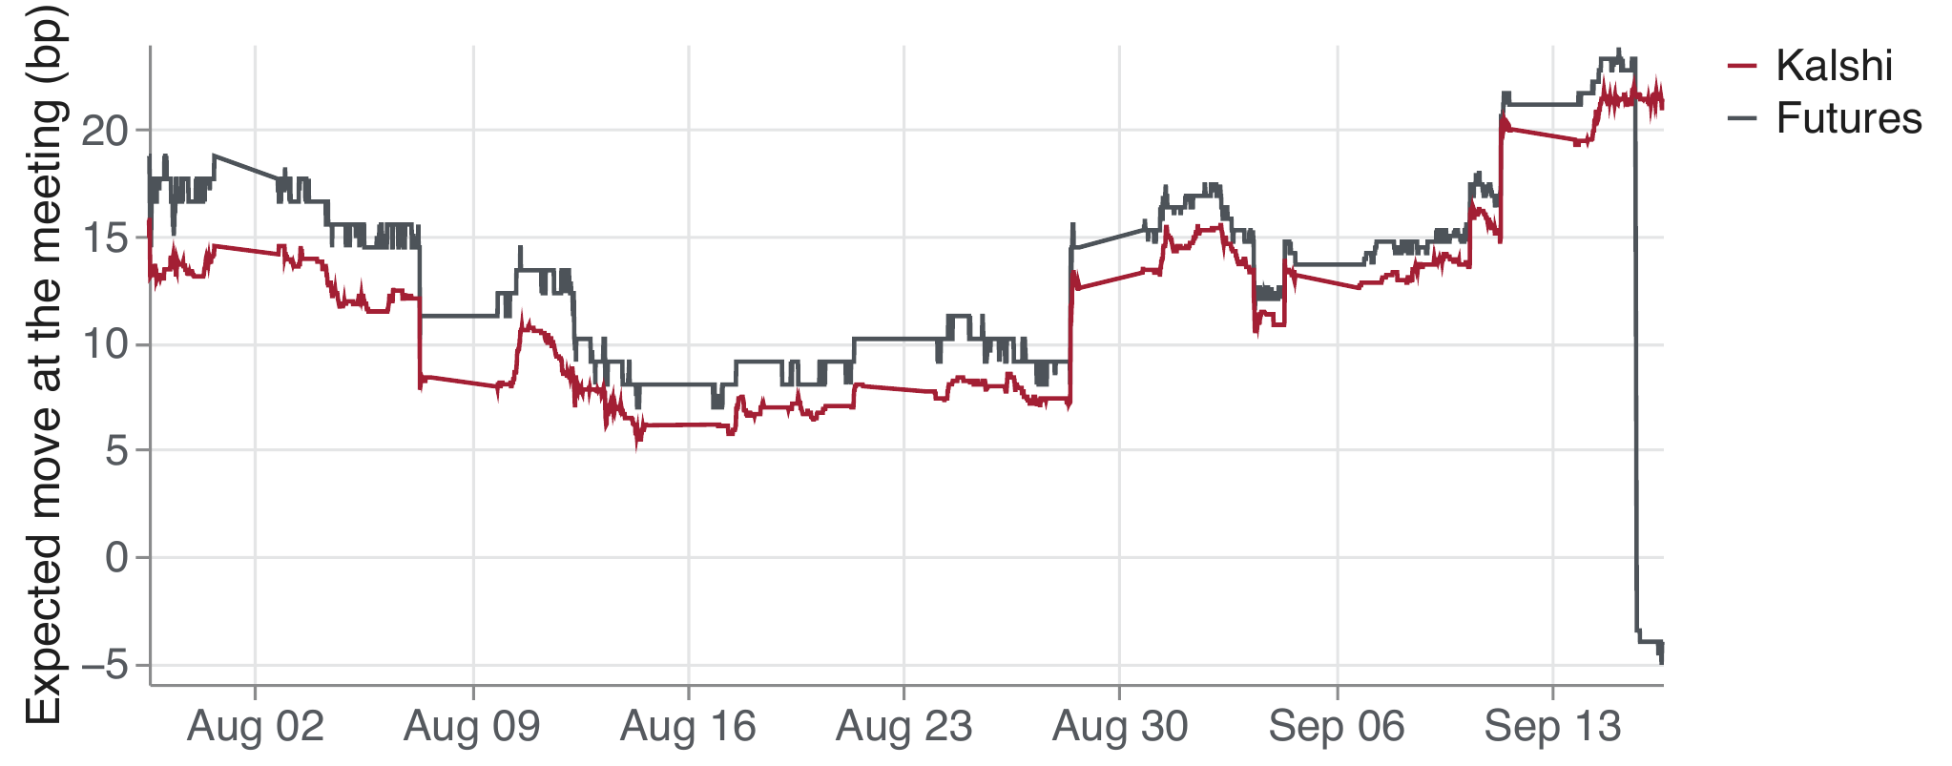
The two markets track the same expectations
APPENDIX · LEAD–LAG
Expected move at the 16 Sep 2026 meeting, every 15 minutes (CME hours)
04_leadlag_fedfunds_kalshi.py
A17

Slide 30
Granger tests: futures predict Kalshi, much less the reverse
APPENDIX · LEAD–LAG
Question | Wald χ² (6 df) | p-value | Sum of cross lags (SE)
Do past futures moves predict Kalshi? | 30.30 | <0.001 | 0.133 (0.030)
Do past Kalshi moves predict futures? | 12.02 | 0.062 | 0.279 (0.090)
37,632 five-minute changes, 140 sessions (all CME hours), 6 lags = 30 minutes, SEs clustered by session.
Caveats
About 140 days and five meetings; mostly-zero changes; different tick sizes (futures 0.25–0.5bp, Kalshi 0.25bp per cent); quotes, not trades.
04_leadlag_fedfunds_kalshi.py
A18

Slide 31
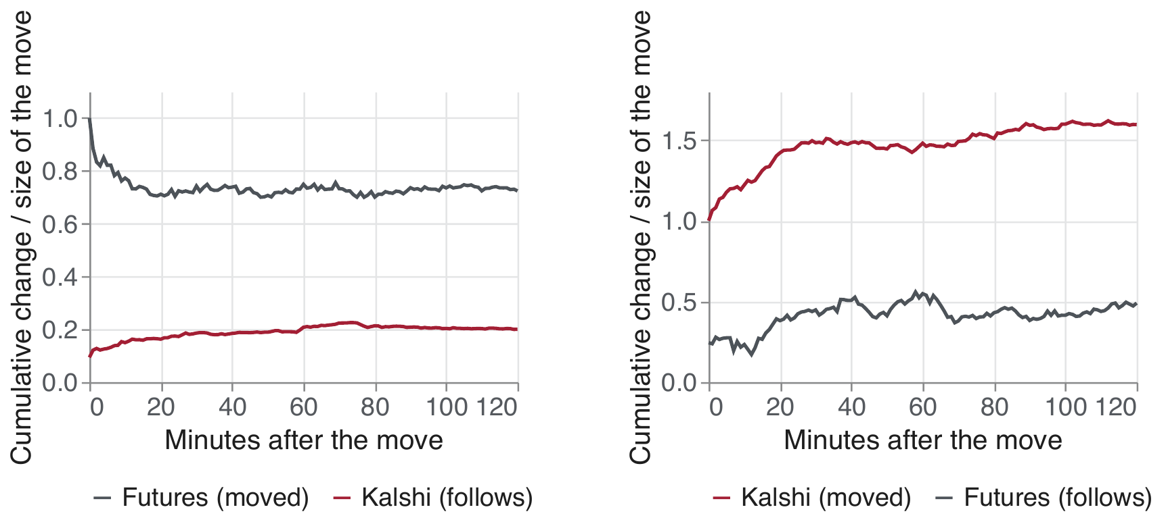
After a large move, the other market follows only partly
APPENDIX · LEAD–LAG
Cumulative change divided by the size of the move, top 0.1% of 1-minute moves
Futures moves (210, avg. 1.29bp): Kalshi follows 16% within 15 minutes, 20% within 2 hours.
Kalshi moves (195, avg. 0.58bp): Kalshi builds to 160% and futures follow 49% within 2 hours.
04_leadlag_fedfunds_kalshi.py
A19

