Slide 1
grep
globally search for regular expression and print out

Slide 2
Research
man grep
grep searches for patterns in each file
https://www.geeksforgeeks.org/grep-command-in-unixlinux/
<regex.h> - for regular expressions
getopt() – for parsing command line arguments
glob() – for file globbing (e.g. *.c *.h *.txt)

Slide 3
Functionalities Done
-c : This prints only a count of the lines that match a pattern
-h : Display the matched lines, but do not display the filenames.
-H: display filenames always
-i : Ignores, case for matching
-l : Displays list of a filenames only.
-n : Display the matched lines and their line numbers.
-v : This prints out all the lines that do not matches the pattern
-w : Match whole word
-r : recursively searches for the pattern in all subdirectories
-x: Match entire line
-G: basic Regexp
-E: extended Regexp
-F: fixed string
-L: print filenames which don’t match

Slide 4
Task-1
Usage of <regex.h>
./grep “PATTERN” “STRING”
Search for PATTERN in the STRING
If Pattern is found, then print the string, with the matched part in a specific color
If pattern is incorrect, then print error message
If pattern is not found, then print an error message

Slide 5
Task-2
Usage of getopt_long()
./grep –G,--basic_regexp | -E,--extended_regexp | -F,--fixed-string “PATTERN” “STRING”
| here stands for OR. Both –E and –G and -F aren’t allowed
./grep –E –E –E …. However, is allowed
Example of difference between Basic and Extended Regexp:
Operators like +, ?, etc. are not there in Basic but are in Extended
-G,--basic_regexp is default
-- for long option and - for short option. Both are equivalent
Options can be given in any order
./grep “PATTERN” –G “STRING” or ./grep “PATTERN” “STRING” –E
-i,--ignore-case
--no-ignore-case

Slide 6
Task-3
File handling, glob(),
./grep FLAGS “PATTERN” <filename> (filename of ‘–’ indicates stdin)
./grep FLAGS “PATTERN” <file1> <file2> …. <filen>
./grep FLAGS “PATTERN” *.c *.txt
./grep FLAGS “PATTERN” …(As no file is mentioned, take input from stdin)
./grep –r … (Recursive subdirectory searching)
-r or –recursive can be used

Slide 7
Task-4
Flags : 1. -n | --line-number
2. -l | --files-with-matches
3. –w | --word-regexp
4. –x | --line-regexp
5. –v | --invert-match
6. –L | --files-without-match
7. –c | --count
8. –M | --my-regexp

Slide 8
My Regex Library (-M option)
Operations done:
. - concatenation
| - or
* - 0 or more
+ - 1 or more
? – 0 or 1
Converted Regular Expression to epsilon-NFA(Non-Deterministic Finite Automata) (Compilation step)
Simulated epsilon-NFA over input strings (execution step)
NFA is represented using Linked representation (structure-pointer) of States.
References: https://swtch.com/~rsc/regexp/regexp1.html

Slide 9
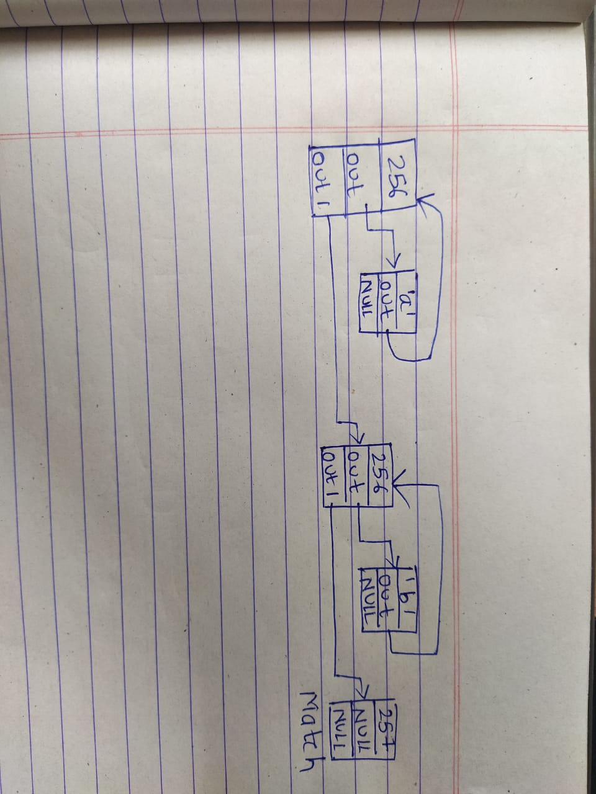
Example of a*b*

Slide 10
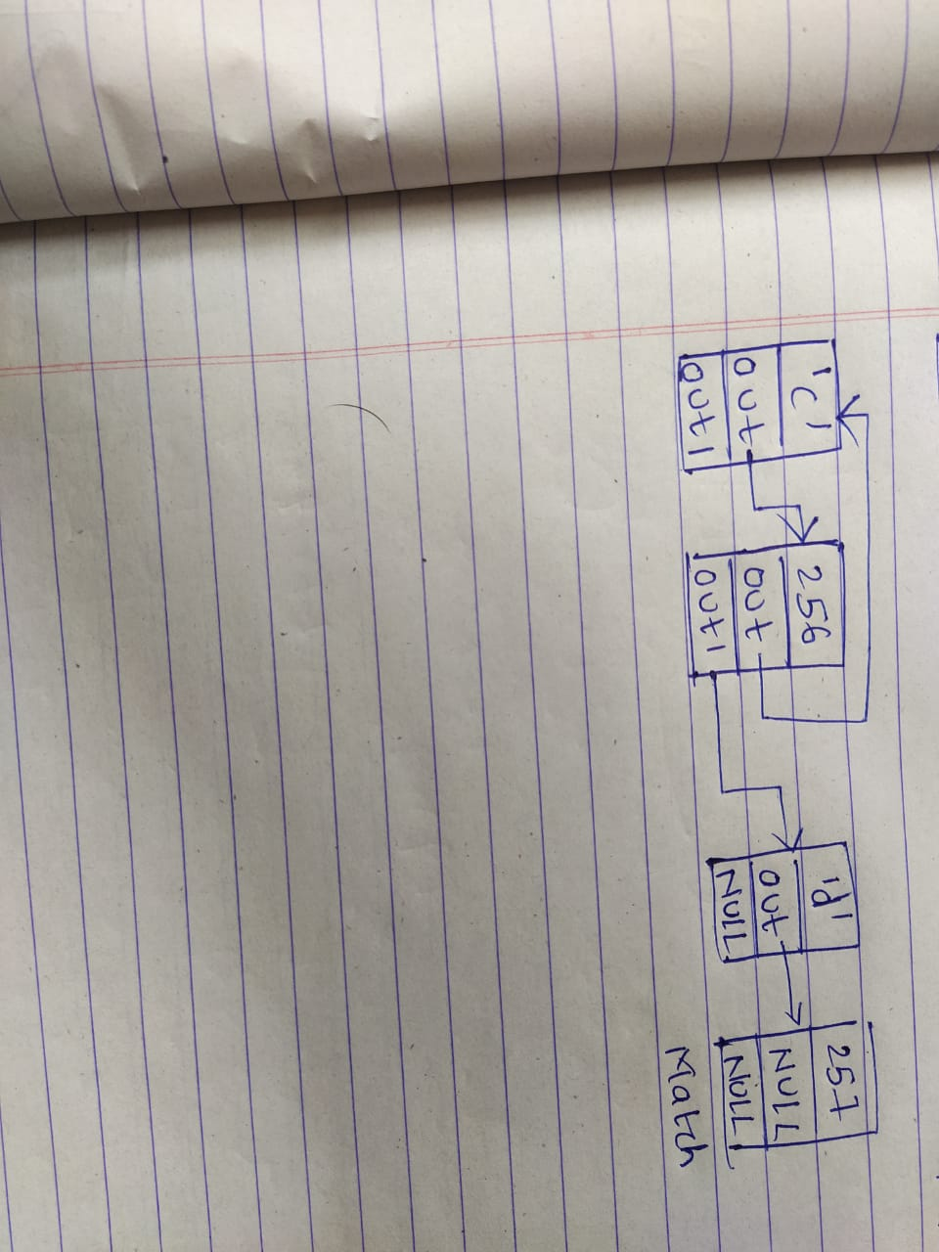
Example of c+d

Slide 11
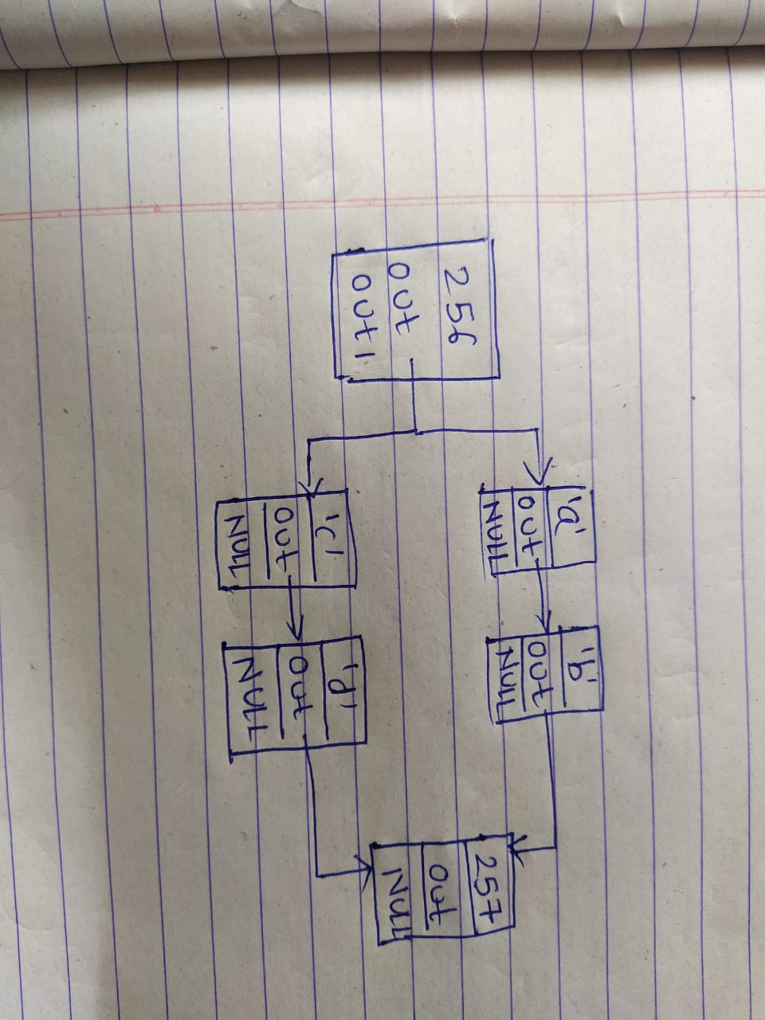
Example of ab|cd

