Slide 1
Predicting “Call Type” for Fire Department Calls in city of San Francisco
CMPE 256 (Large Scale Analytics)
Guided By: Prof. Sanket Tavarageri
Group 10
Monank Savaliya (012415260)
Umang Kakaiya (012449515)
Vishweshkumar Patel (012461371)

Slide 2
Goal
The project focuses to using historical records from Year 2000 to Year 2018 of Fire Department Calls of city of San Francisco to predict(classify) “Call Type” for a specific location for certain day and time of week.
The main goal of the project is to predict(classify) “Call Type” from different types such as ‘Explosion’, ‘Fuel Spill’, ‘Gas Leak’, ‘Outside Fire’, ‘Water Rescue’, ‘Traffic Collision’ etc for a call to Fire Department of San Francisco.
The use-case will provide more insights to respective fire departments to take important decisions to improve their services and save more lives by predicting “Call Type” for future calls.

Slide 3
Dataset Description
Dataset Source Type:
Public Dataset from “Fire Department Calls For Service” from DataSF
Dataset Size:
Rows: 4.61 million
Columns: 34
Size in GB: 1.5 GB
Data Source:
https://data.sfgov.org/Public-Safety/Fire-Department-Calls-forService/nuek-vuh 3/data

Slide 4
Steps
We have followed KDD (Knowledge Based Data Discovery) process.
KDD involves six steps namely:
Data Preprocessing
Data Exploration
Feature Engineering
Model Training
Model Evaluation
Knowledge Mining

Slide 5
Data Preprocessing & Exploration
According to our use case, found out irrelevant features and removed them, such as - 'call_number', 'unit_id', 'rowid’ etc.
Attribute such as - ‘city’ contains values with different representation for same values such as ‘San Francisco’, ‘SAN FRANCISCO’, ‘SF’ for city of San Francisco. So we have retained only single representation for those values.
Attributes such as - 'Supervisor_district', ‘Box’ and 'Station_area' contains string representation as well as numeric representation for same values. So we have retained only string representation for 'supervisor_district', ‘box’ and ‘station_area'.

Slide 6
Data Preprocessing & Exploration
Understood the context of features and removed features which can only be known after providing response to a call and do not contribute to predict 'call_type' - such as 'dispatch_dttm', 'entry_dttm', 'hospital_dttm', 'on_scene_dttm', 'response_dttm', 'transport_dttm', 'available_dttm', 'call_final_disposition', 'final_priority', 'priority', 'als_unit', 'unit_type', 'unit_sequence_in_call_dispatch'.
Understood the context of features and removed repetitive features (duplicate features) such as - 'call_date', 'watch_date' which can be combinely represented using 'received_dttm'.

Slide 7
Data Preprocessing & Exploration
Considered following 14 attributes for further exploration: - 'Incident_number' - 'call_type_group' - 'received_dttm' - ‘address’ - 'zipcode_of_incident' - 'battalion' - 'station_area' - 'box' - 'original_priority' 8 - 'number_of_alarms' - 'location' - 'fire_prevention_district' - 'supervisor_district' - 'neighborhoods_analysis_boundaries'.
Removed the duplicate instances involved in refined dataset after removing the irrelevant features. Also, eliminated the missing values, null values for remaining 14 attributes. After removing those samples, still we have nearly 2 Millions of samples to train model.

Slide 8
Feature Engineering
Identified that ‘Box’ and ‘Supervisor District’ includes float, int and string data types making it hard for using as feature. Converted all instances of ‘Box’ and ‘Supervisor District’ to string.
Converted 'Received DtTm' feature into weekday, hour and month using user defined function. Defined three functions namely convert_ date_to_weekday, convert_date_to_hour, convert_date_to_month.
Utilized ‘Station Area’ feature initially, but due to sparse distribution and less variable importance of ‘Station Area’, we finally removed the feature.

Slide 9
Feature Engineering
Tried to apply “One hot encoding” for “Address” attribute. Nearly 27000 unique values of “Address” attribute caused “Memory Error” while creating dense data frame while applying “One hot encoding”. So, used Compressed Sparse Row Matrix data structure to efficiently utilize the memory.
Using “Address”, “Box”, “Month”, ”Weekday”, “Hour”, and “​Neighborhoods_ analysis_boundaries​” created a CSR sparse matrix that can efficiently utilize the memory.
Applied dimensionality reduction technique namely “Truncated SVD” on CSR matrix. Plotted explained variance versus number of components graph to figure out inflection point and to choose n_components parameter.

Slide 10
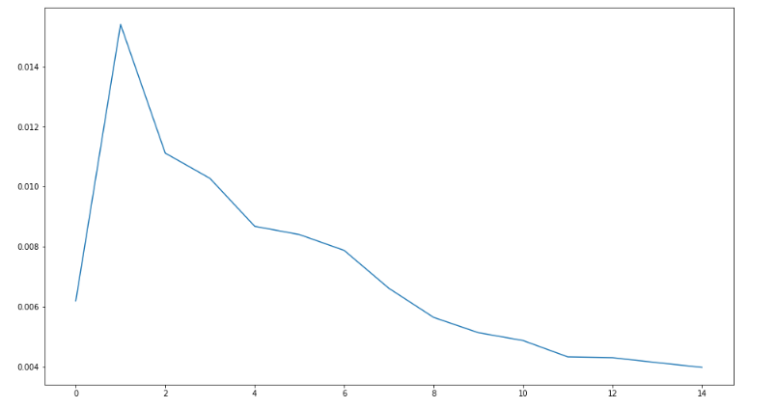
Feature Engineering
Components vs explained Variance graph
Thus chose, n_components = 10

Slide 11
Model Training and Testing
Divided the dataset into,
Training Dataset - 1.80 M
Testing dataset - 0.26 M
Trained and tested following models:
Random Forest
MLP Classifier
XGBoost (Extreme Gradient Boosting)
SVM (Support Vector Machine)

Slide 12
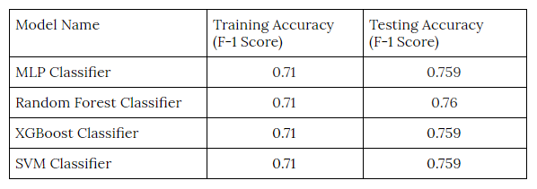
Results

Slide 13
Challenges Faced
Due to the real life dataset collected from SF Fire Department website, the need for preprocessing was crucial. Data preprocessing required precise understanding of importance of features and what kind of inputs are accepted by classification algorithm.
Due to the large size of the dataset - 2.08 million rows, we couldn’t apply one hot encoding directly to all the categorical variables. So, we had to utilize CSR matrix to handle the large sized sparse data.

Slide 14
Challenges Faced
Even after converting the rows into CSR matrix form we couldn’t directly provide it to model. So, we had to apply dimensionality reduction technique namely “Truncated SVD” which supports CSR data structure. Choosing the right number of components was a big challenge in this technique, with consideration of preserving the characteristics of sparse data.
Even though applying different models and choosing different combinations of features with the different number of component selection from “Truncated SVD”, we were not able to tune the model. We tried to perform “Grid Search” to tune the hyper parameters, but it lead to Memory Error due to large sized dataset.

Slide 15
Conclusion
Achieved 76% accuracy for Testing dataset in predicting the ‘call type’ for incoming calls for San Francisco Fire department.
Learned the importance of Data Preprocessing and Feature engineering (Feature Extraction, Feature Transformation, Feature Reduction) in case of real life dataset.
Understood importance of Compressed Sparse Row matrix data structure to handle large amount of sparse data in memory efficient way.
The prediction of “Call Type” may help respective Fire Department of city of San Francisco to predict the type of situation beforehand at the place of incident. So, they can allocate resources optimizely and can manage more than one incidents in their area efficiently, to save precious lives of people.

