Slide 1
Determining Threshold in an Active Learning setting for Disambiguation
Group R1
Mustafa Bandukwala
Sujana Jonnagadla
Umang Kakaiya
Vishweshkumar Patel

Slide 2
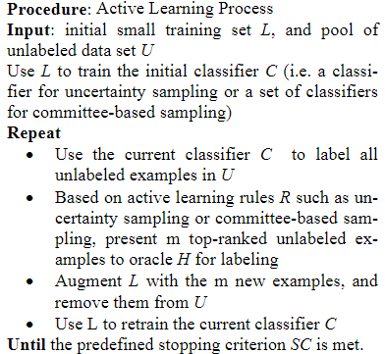
What is Active Learning?

Slide 3
Problem Statement
In an active learning setting, the oracle or domain expert is presented with candidate data points for disambiguation.
The quality of label deteriorates when the annotator's efficiency reduces.
To combat this problem, we determine the threshold to select the candidate points, and update the threshold in each iteration.
We propose efficient method for determining the threshold in each iteration for selecting the best candidates.

Slide 4
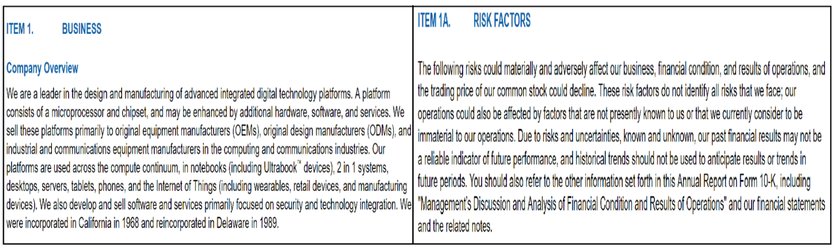
Data Ingestion
Used 10K report of fortune companies - Apple, Dell, Alphabet, Samsung, etc for binary text classification (either ‘Business’ or ‘Risk Factor’) labeling.
Collected contents in two text files - ‘Business.txt’ & ‘Risk_Factor.txt’.

Slide 5
Pre-Processing
Load Business and Risk Factors - Sentences data from text files.
Clean sentences using regular expressions and tokenize them.
Pad all sentences to the same length. The length is defined by the longest sentence. (Used ‘<PAD/>’)
Build a vocabulary mapping from word to index based on the sentences.
Maps sentences and labels to vectors based on a vocabulary.
Perform same preprocessing on test data as well using same vocabulary.

Slide 6
Approach
Build word2vec model using preprocessed sentence vectors and vocabulary.
Generate Word embeddings to provide them as input to CNN.
Build model using Convolutional Neural Network using conv1D and Lenet architecture. Monitor training accuracy and validation accuracy.
Following is same for conv1D and Lenet architecture:
4. Predict confidence for test sentences using trained model.
5. Define threshold strategy and based on that update the training data by appending above threshold sentences and build model again.
6. Provide only ambiguous (below threshold) test sentences to annotator and update the training data by appending those ambiguous sentences after annotator labels it and build model again.
7. Check for accuracy for different threshold measures.

Slide 7
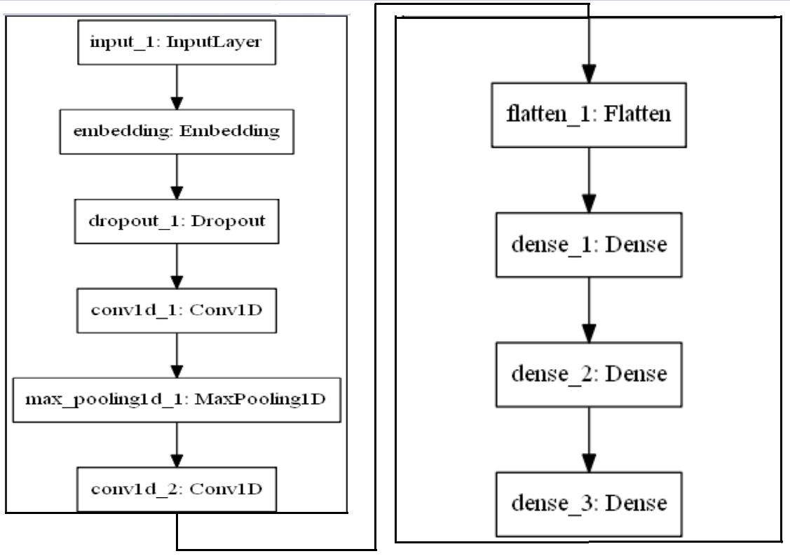
LeNet
Architecture

Slide 8
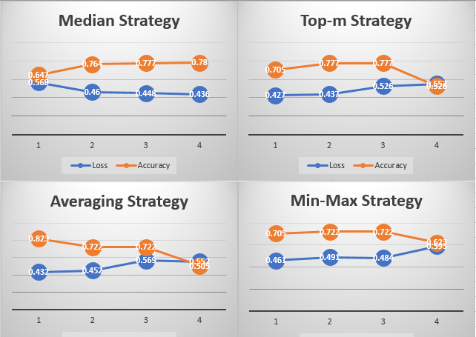
Results and Conclusion

