Slide 1



A Study of Graph Analytics for Massive Datasets on Distributed Multi-GPUs
Vishwesh Jatala^{1,2}, Roshan Dathathri^{1,3}, Gurbinder Gill^{1,3}, Loc Hoang^{1,3},
V. Krishna Nandivada^{4,5}, and Keshav Pingali^{1,3}
¹The University of Texas at Austin, USA
²vishwesh.jatala@austin.utexas.edu
³{loc,roshan,gill,pingali}@cs.utexas.edu
⁴Indian Institute of Technology Madras, India
⁵nvk@iitm.ac.in
IEEE International Parallel and Distributed Processing Symposium (IPDPS) 2020

Slide 2
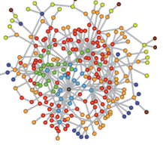


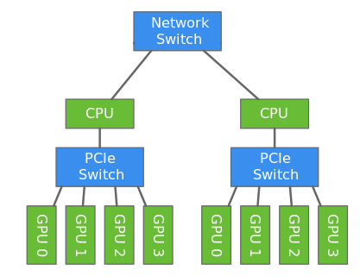
Motivation
Data Growth!
Clueweb is ~ 1 TB
42.5 B edges
Limited GPU Memory
NVIDIA P100 has
16 GB memory
Graph Analytics
Partition?
Compute?
Synchronize?
Distributed Multi-GPUs
Images Source: Internet

Slide 3
Study of Graph Analytics on Distributed GPUs
Limitations of Prior Studies
Contributions of Our Study
Customized for few applications
Scalable BFS [Pan et al. IPDPS’18]
Shows impact of partitioning, computation, and communication
Focused only for CPUs
Partitioning study [Gill et al. PVLDB’18 ]
Analyzes massive graphs using state-of-the-art D-IrGL
Restricted for single GPUs
Graph survey [Shi et al.Comput.’18]
Provides key suggestions
for designers
Not exhaustive
[Gluon PLDI’18, Lux PVLDB’17]
Identifies scope for improvements
3

Slide 4
Distributed Graph Analytics
Input Graph G
Partition Graph
G₁
G₂
G₃
G₄
GPU₁
GPU₂
GPU₃
GPU₄
(2) Compute
Device Memory
Device Memory
Device Memory
Device Memory
Memory
CPU
Memory
CPU
Node₁
Network
Node₂
(3) Synchronize

Slide 5
Evaluated Techniques in The Study
Partitioning
Computation
Synchronization
CuSP [Hoang et al. IPDPS’19]
Incoming Edge Cut^{1,2} (IEC)
Outgoing Edge Cut^{2,3} (OEC)
Cartesian Vertex Cut^{2,4} (CVC)
Hybrid Vertex Cut⁵ (HVC)
Thread/Warp/CTA Distribution^{3,6,7} (TWC)
Adaptive Load Balancer (ALB)⁸
Execution Model
Bulk-Synchronous Parallel^{1,2,9} (BSP)
Bulk-Asynchronous Parallel¹⁰ (BASP)
Communication
Update-Only²
All-Shared¹
¹Lux PVLDB’17, ²Gluon PLDI’18, ³Gunrock IPDPS’17, ⁴Boman et al. SC’13, ⁵PowerLyra EuroSys’ 15, ⁶IrGL OOPSLA’16,
⁷Merill et al. PPOPP’12, ⁸Jatala et al. Arxiv’19, ⁹Valiant CACM’90, ¹⁰Gluon-Async PACT’19,

Slide 6
Experimental Setup
Bridges Supercomputer
32 (machines) * 2 (NVIDIA P100 GPUs)
Hardware
Benchmarks
bfs, sssp, cc, pagerank, and kcore
Frameworks
D-IrGL and Lux (Distributed Multi-GPU Frameworks)
Inputs (Medium) | |V| | |E| | Input (Large) | |V| | |E|
twitter50 | 51 M | 1,963 M | clueweb12 | 978 M | 42.5 B
friendster | 66 M | 1,806 M | uk14 | 788 M | 47.6 B
uk07 | 106 M | 3,739 M | wdc14 | 1725 M | 64.4 B
Inputs

Slide 7
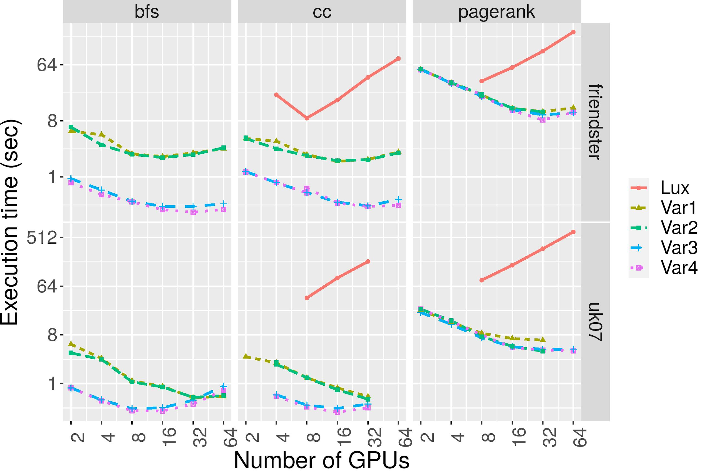
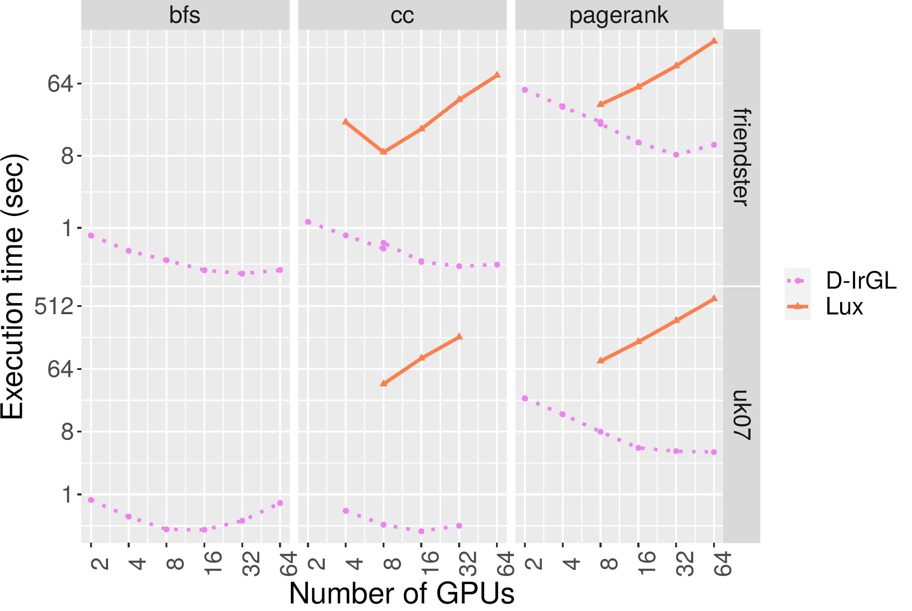
Results: Computation and Synchronization
Variant | Optimizations
Var1 | TWC + All Shared + Sync
Var2 | ALB + All Shared + Sync
Var3 | ALB + Update Only + Sync
Var4 (default) | ALB + Update Only + Async
All variants (even Lux) use same partitioning policy (IEC).

Slide 8
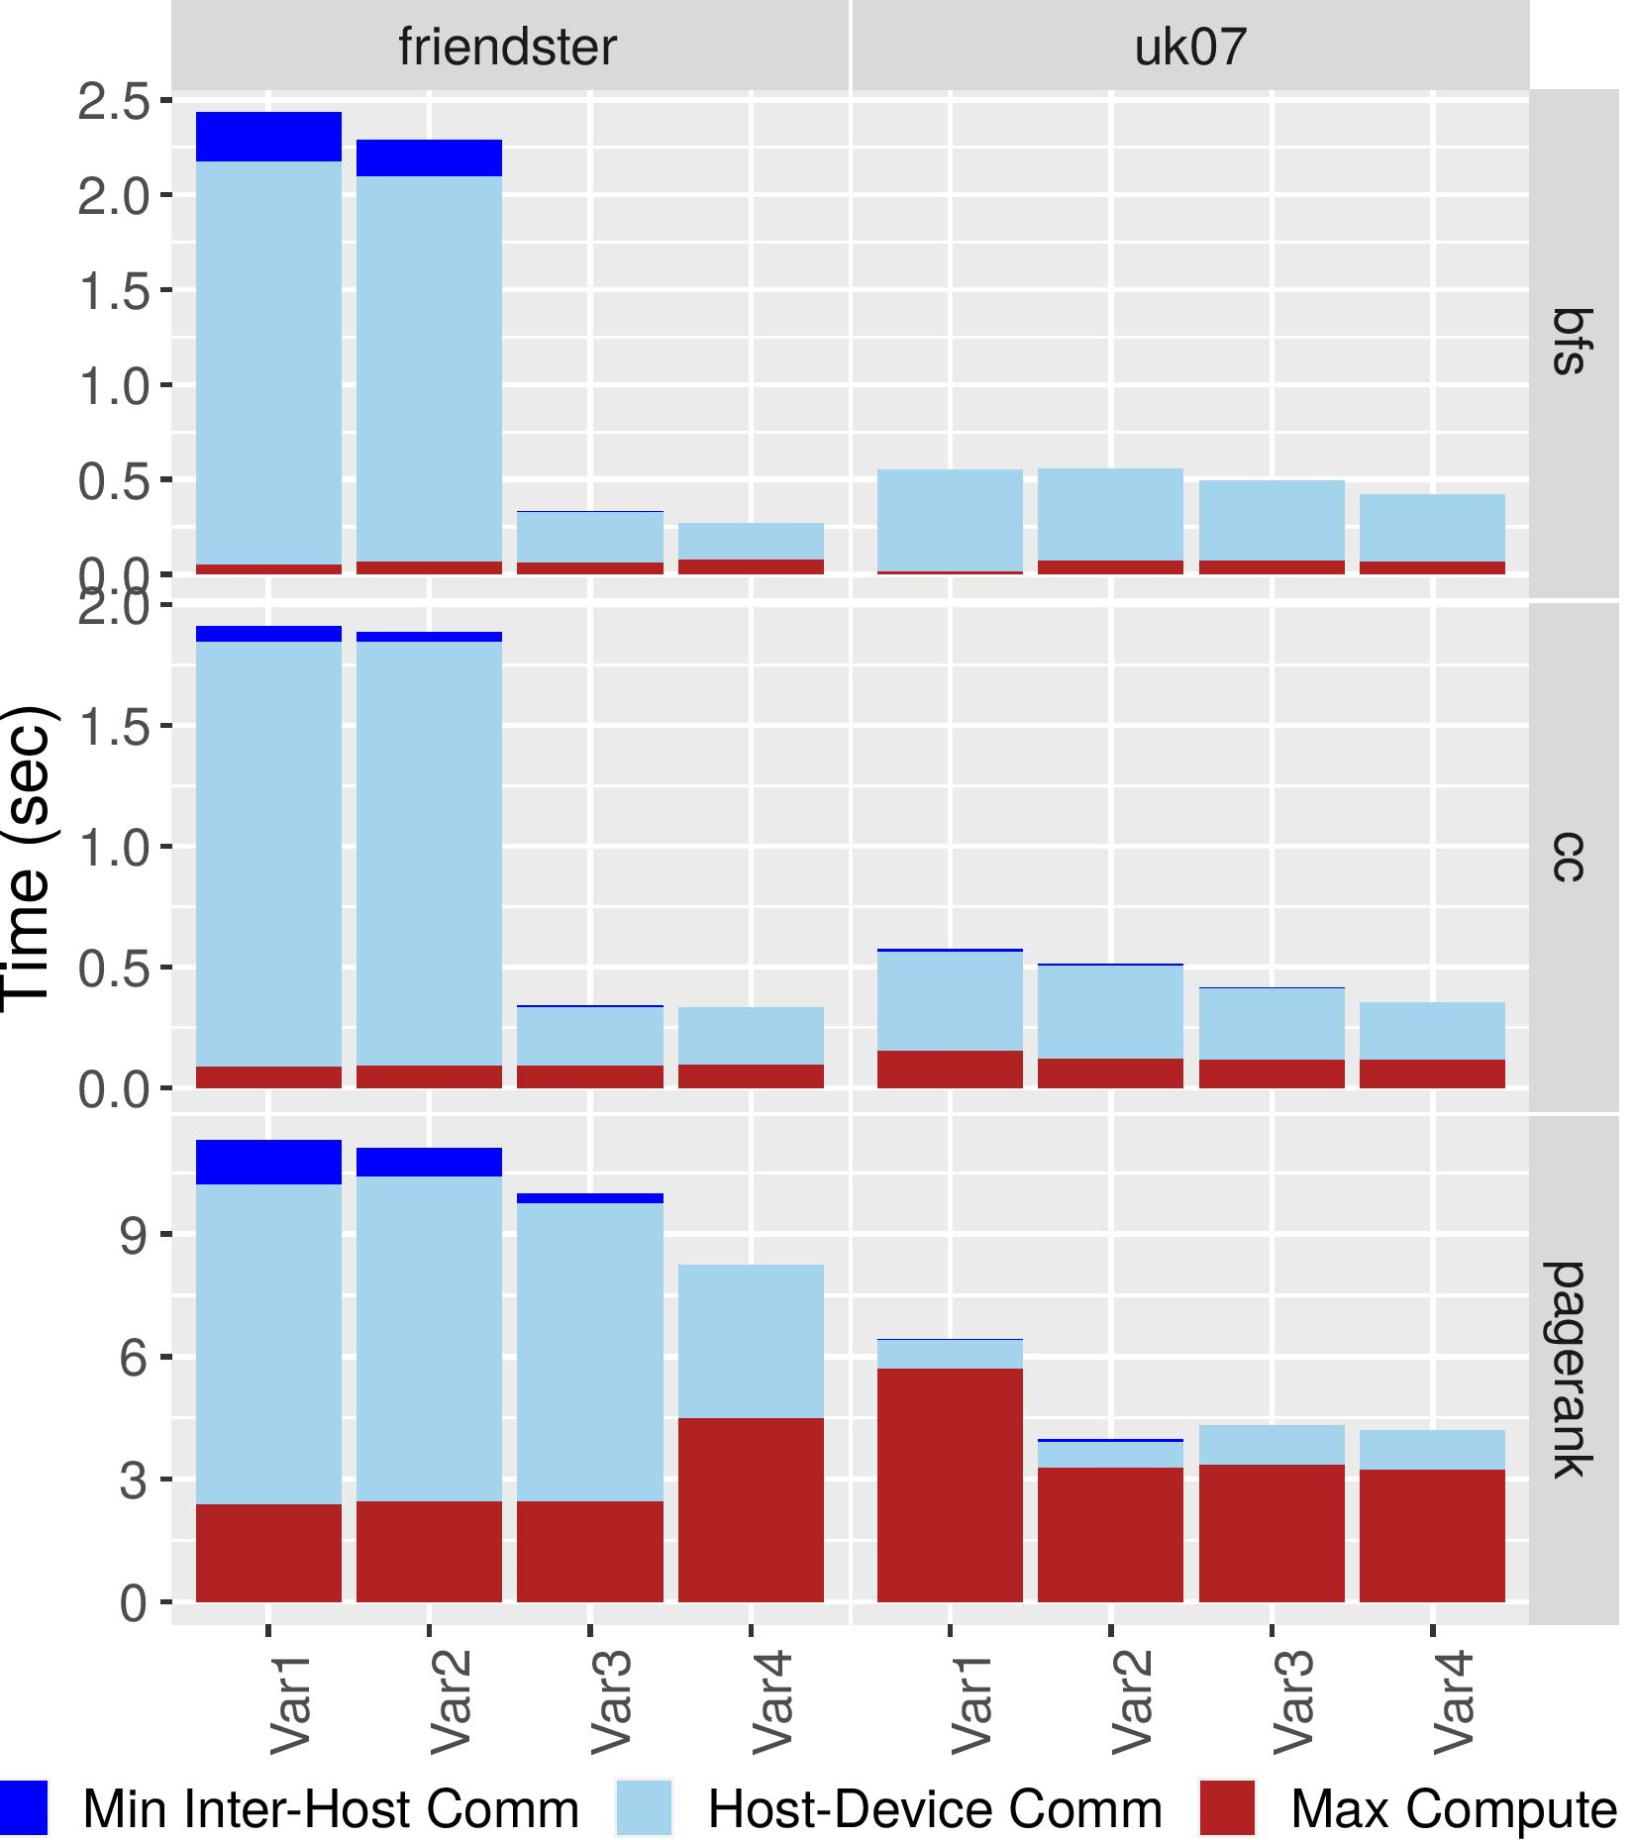
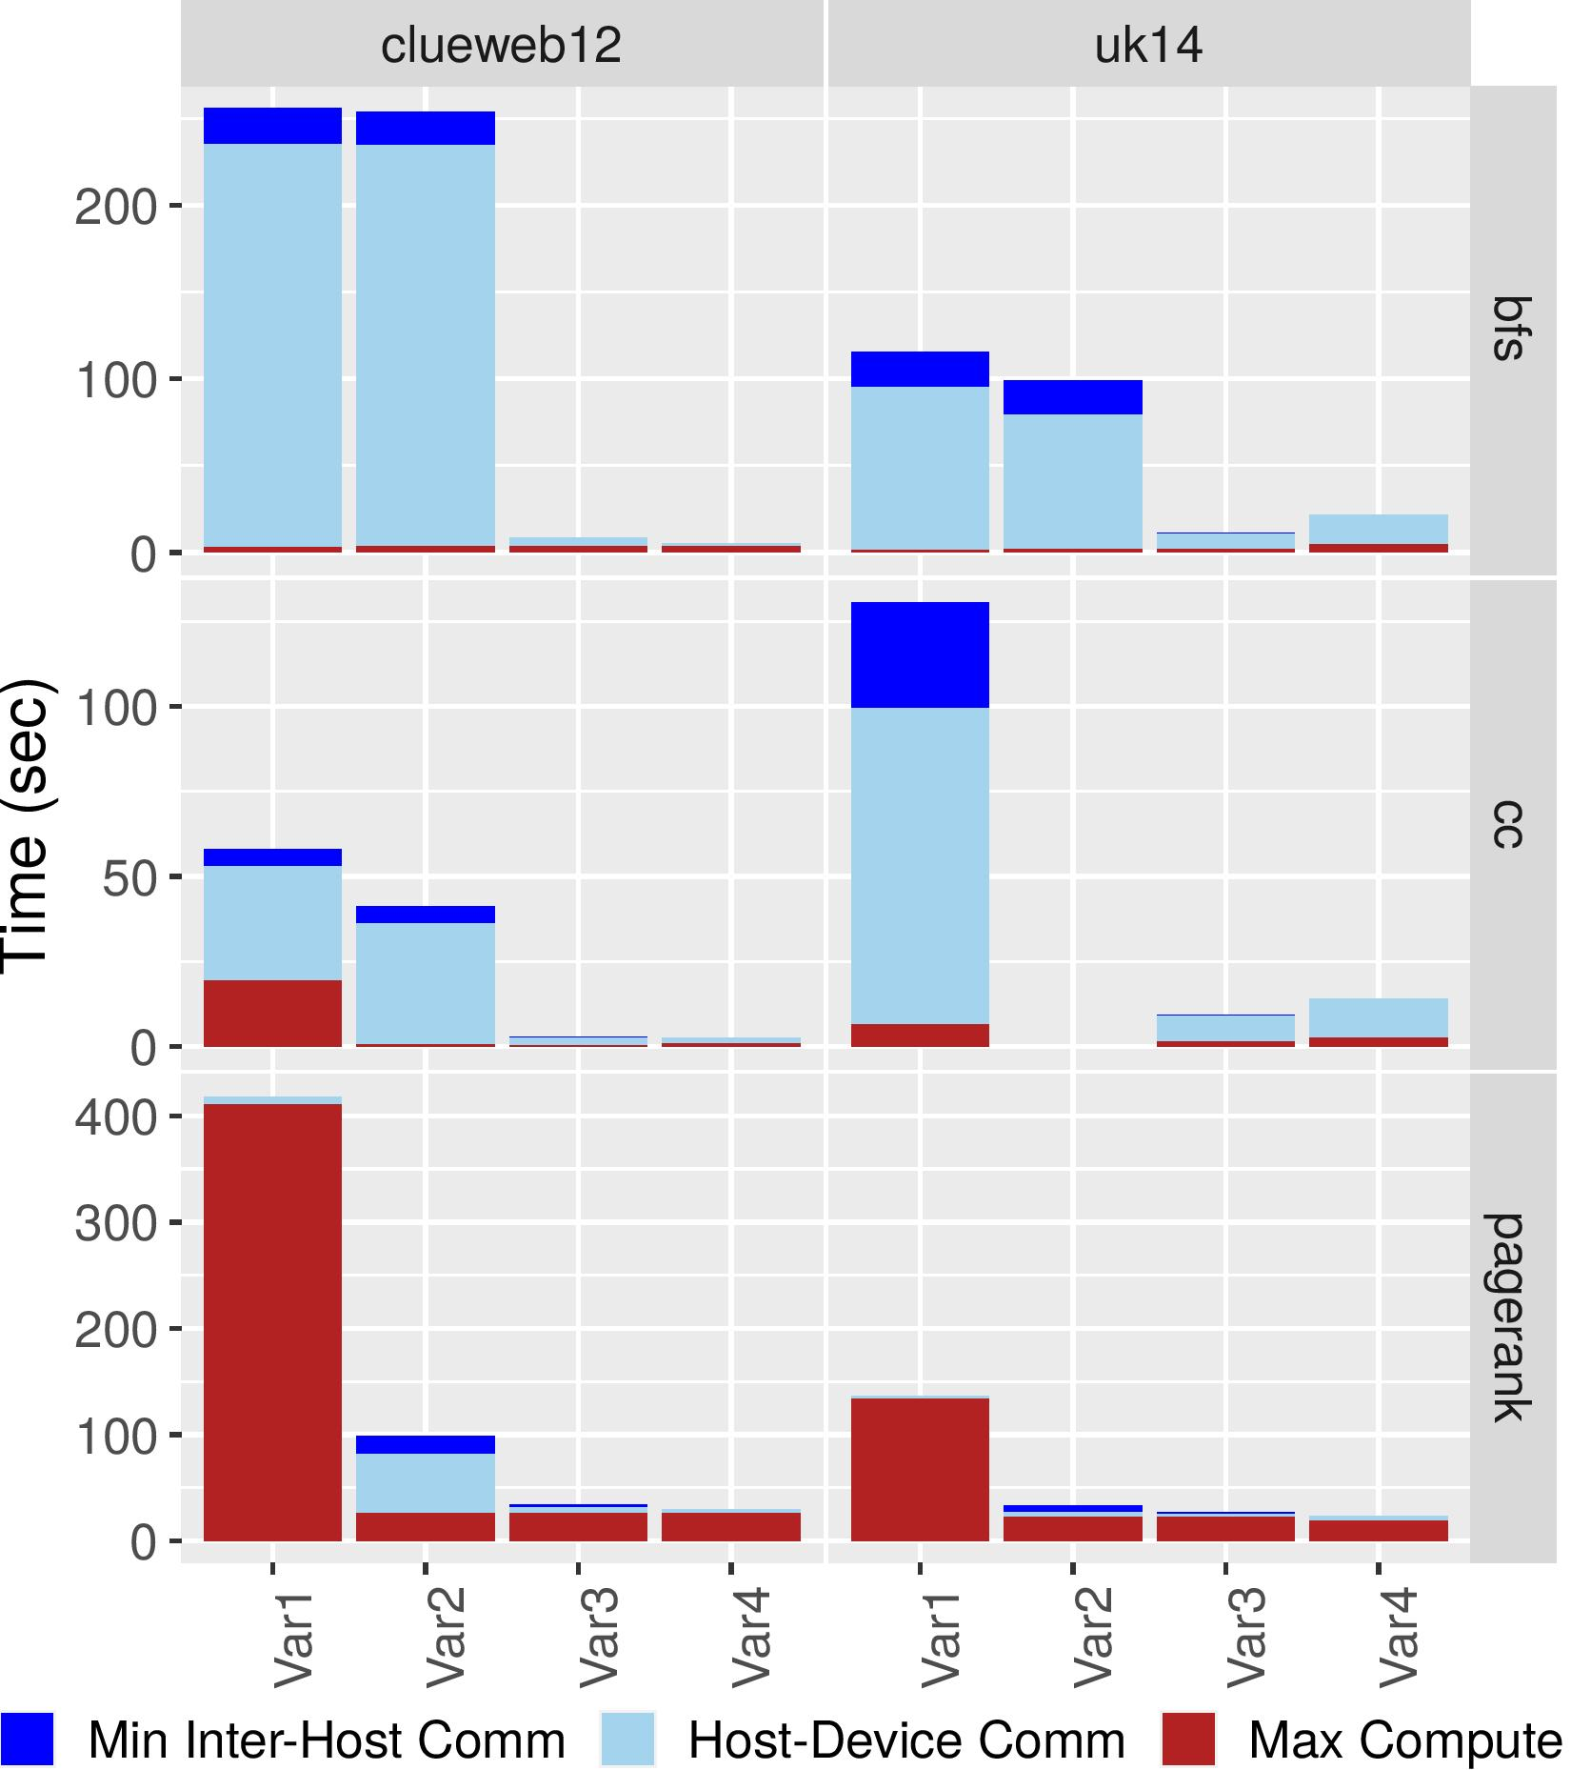
Analyzing Computation and Synchronization
32 GPUs
64 GPUs
Host-device time is significant
Asynchronous behavior should be throttled
Notes:
32 P100 GPUs

Slide 9
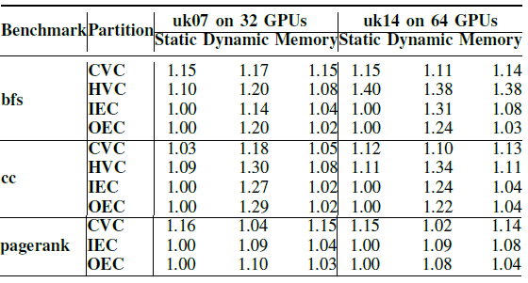
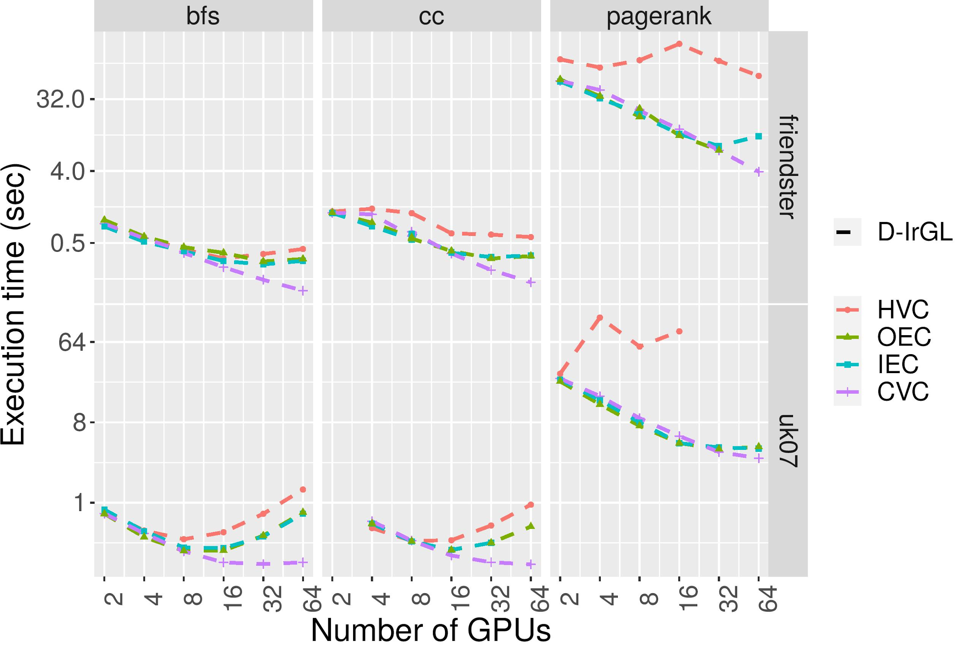
Analyzing Partitioning Schemes
Static load imbalance not correlated to dynamic load imbalance
CVC outperforms other schemes
on 16 or more GPUs
fewer communication partners
Static load imbalance is correlated to memory usage
Critical for GPUs due to limited memory

Slide 10
Conclusion
Detailed analysis of distributed multi-GPU graph analytics
Lessons:
CVC is crucial for scaling
Static load balance is important for GPUs
Scope for Improvements:
Reduce host-device communication time through GPUDirect
Control asynchrony in Bulk-Asynchronous execution
Please contact authors for any questions. Thank you!

