Slide 1
SEARCH & RESCUE DECISION SUPPORT
RescueGrid
An explainable, offline-first decision intelligence platform that turns scattered clues into prioritized search missions during the critical first 72 hours of a natural disaster.
✓ Offline-First (IndexedDB) ✓ Explainable 5-Factor Scoring ✓ Contradiction Detection ✓ Human-in-the-Loop Safe
RescueGrid • Disaster Search & Rescue Intelligence Slide 1 of 13

Slide 2
01 / THE PROBLEM
What Happens in the First 72 Hours
In earthquakes, landslides, and flash floods, response teams face severe operational failure modes.
The Critical 72h Window
Survival probability drops drastically with every hour trapped under rubble or mud deposits. Responders cannot afford to waste time searching unpopulated or low-probability sectors.
Key takeaway: Time is the limiting constraint
Complete Network Outages
Cell towers collapse, power lines sever, and roads are cut off. Cloud-only dashboards, online APIs, and remote databases fail at the exact moment coordinators need them.
Key takeaway: Must operate 100% offline
The Information Fog
Emergency call centers receive hundreds of duplicated reports, contradictory rumors, and delayed messages. Double-counting victims misdirects limited rescue personnel.
Key takeaway: Bad data leads to wrong decisions
RescueGrid • Disaster Search & Rescue Intelligence Slide 2 of 13

Slide 3
02 / THE CHALLENGE
Why Existing Software Fails on the Ground
Generic emergency dashboards were built for conference rooms, not disaster zones.
1. Double-Counting Trapped Victims
When 4 relatives and 2 neighbors report the same 3 trapped people, conventional tools sum them up to 18 victims. This diverts an entire battalion to a location that only needs a single squad.
2. Contradictions Are Silently Hidden
If an evacuation team reports a school 'cleared' while a resident SMS reports 4 children trapped in the attic, standard databases overwrite the older record. The trapped children are forgotten.
3. Black-Box AI & Hallucinations
Deep learning models give opaque probability scores without explaining why. Worse, LLMs may hallucinate exact GPS coordinates or falsely declare unsearched zones as 'safe'.
4. Heavy Map Tile Dependencies
Most web mapping libraries crash or show blank grey screens when disconnected from OpenStreetMap or Google tile servers. Teams lose tactical awareness immediately.
RescueGrid • Disaster Search & Rescue Intelligence Slide 3 of 13

Slide 4
03 / THE SOLUTION
RescueGrid: Core Architecture Pillars
Built from the ground up for zero-connectivity environments and explainable human decision-making.
1. Clue Fusion & Deduplication
Extracts victim counts, acoustic signals, and battery status from text. Merges duplicate reports and flags contradictions loudly.
2. Explainable Prioritization
Ranks search sectors with an open 5-factor mathematical formula. Explains why a sector is ranked high and allows coordinator override.
3. Safe Capability Dispatch
Matches canine units to rubble and hydraulic cutters to concrete slabs. Enforces hazard-aware routing around blocked roads.
4. Offline-First Operation
Stores the full dataset in browser IndexedDB. Field teams record clues offline and sync automatically upon reconnection.
RescueGrid • Disaster Search & Rescue Intelligence Slide 4 of 13

Slide 5
04 / CLUE FUSION
Handling Messy, Duplicated & Conflicting Clues
Transforming noisy raw text into verified situational intelligence without expensive APIs.
Duplicate Detection (Preventing Victim Inflation)
When multiple witnesses report the same victims, RescueGrid calculates spatial-semantic token similarity (Jaccard index >= 0.35 within the same building footprint).
Report 1: '3 people trapped under quarter 2 roof'
Report 2: 'Family of 3 at quarter 2 needs help'
✓ Result: Automatically linked as a duplicate. Corroborates evidence confidence without double-counting trapped headcounts.
Contradiction Detection (Flagging Clashes)
When reports for the same sector contain conflicting status claims (e.g., 'all evacuated' vs 'people trapped'), RescueGrid refuses to quietly overwrite.
Report A: 'All residents evacuated to temple'
Report B: '4 people trapped in attic with low battery'
⚠️ Result: Flagged as High-Visibility Conflict. The incident commander is alerted to physically verify before lowering search priority.
RescueGrid • Disaster Search & Rescue Intelligence Slide 5 of 13

Slide 6
05 / PRIORITIZATION
Transparent 5-Factor Scoring Formula
Zero black-box AI. Every priority score can be inspected, explained, and overridden by commanders.
Priority Score = (0.30 × Evidence) + (0.25 × Occupancy) + (0.25 × Urgency) + (0.15 × Recency) - (0.05 × Access Penalty)
Evidence Strength (30%)
Sensor signals (acoustic knock, thermal) and physical responder confirmations. Unverified rumors receive low weight.
Potential Occupancy (25%)
Verified headcounts, vulnerable populations (children, elderly), and medical dependencies.
Threat Urgency (25%)
Active environmental hazards (mudflow advancing, secondary collapse risks, low phone battery).
Temporal Recency (15%)
Elapsed time since last confirmed contact. Does NOT assume trapped victims are deceased.
Access Penalty (-5%)
Impedance penalty reflecting blocked roads or bridge washouts requiring foot access.
🛡️ Humanitarian Principle: An area with 0 reports is NEVER marked 'safe'. Coordinators can override any score with a logged reason.
RescueGrid • Disaster Search & Rescue Intelligence Slide 6 of 13

Slide 7
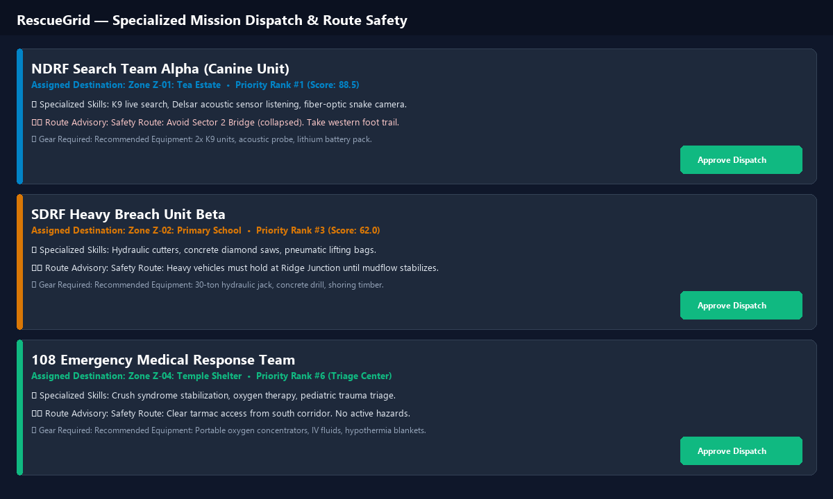
06 / MISSION DISPATCH
Matching Skills & Enforcing Route Safety
Never routes rescue personnel through active hazards merely to minimize travel time.
RescueGrid • Disaster Search & Rescue Intelligence Slide 7 of 13

Slide 8
07 / OFFLINE ARCHITECTURE
Full Functionality with Zero Internet Connection
Tested and proven under simulated network failure conditions.
1. Browser Local Cache
The full incident database (zones, clues, missing persons, teams, roads) is cached locally in browser IndexedDB on initial load.
✓ Zero network reads required for map viewing
2. Offline Mutation Queue
When field responders submit clues or register missing persons while disconnected, updates are stored in an IndexedDB queue and appear immediately in the UI.
✓ Responders never lose submitted data
3. Conflict-Free Sync
Upon reconnection, one click syncs all queued records via batch REST endpoints with timestamp validation. Newer command changes are never overwritten.
✓ Automatic reconciliation in < 1 second
4. Vector Grid Fallback
If external OpenStreetMap tiles fail to load, RescueGrid switches seamlessly to an embedded SVG tactical vector grid showing all 20 building footprints.
✓ 100% visual awareness maintained
RescueGrid • Disaster Search & Rescue Intelligence Slide 8 of 13

Slide 9
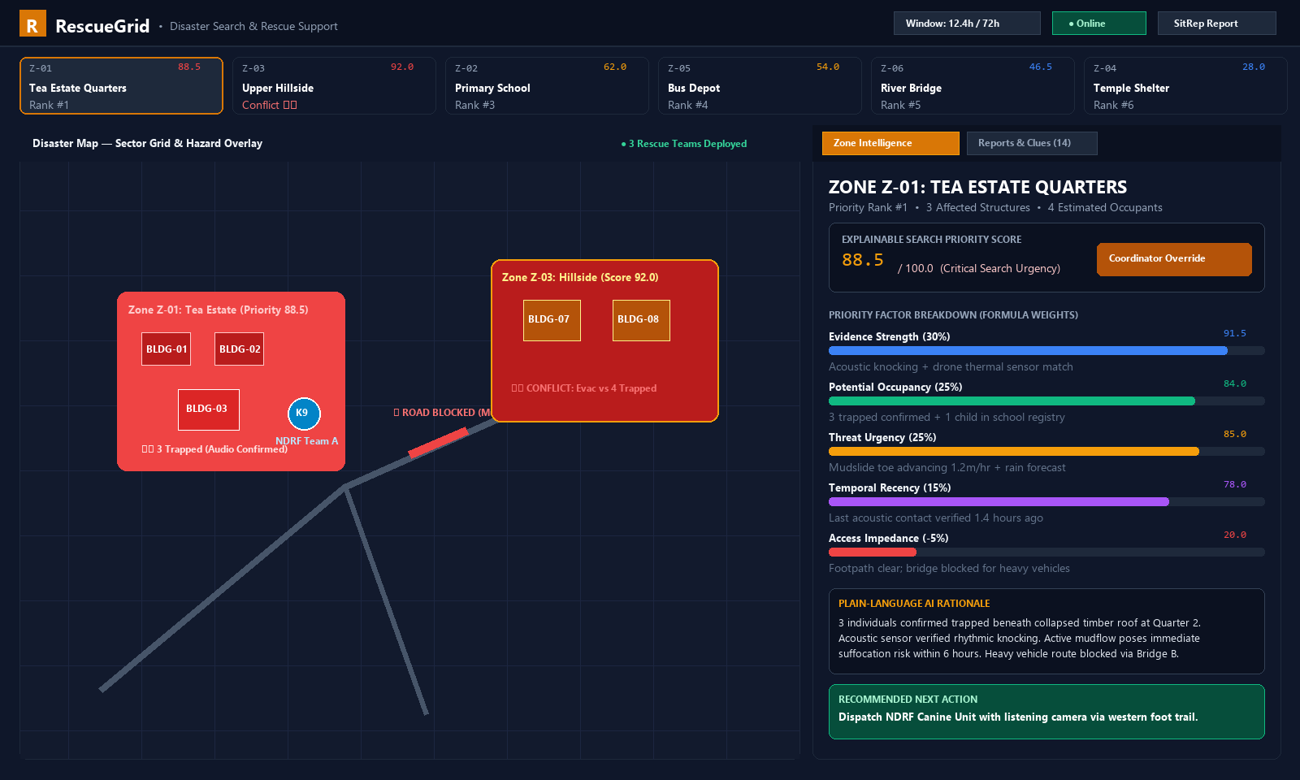
08 / PROTOTYPE WALKTHROUGH
Live Operational Cockpit & Inspector Interface
Designed for zero vertical scrolling on field tablets and incident command laptops.
RescueGrid • Disaster Search & Rescue Intelligence Slide 9 of 13

Slide 10
09 / TECHNICAL STACK
Realistic, Maintainable Open-Source Stack
Engineered for high reliability, instant responsiveness, and zero recurring cloud costs.
Frontend Application
• React 18 & TypeScript (Type-safe UI)
• Tailwind CSS (Fast, responsive styling)
• Leaflet + SVG Tactical Fallback Map
• Lucide Icons (Accessible UI elements)
• Bundle size < 350 KB for quick load
Client Storage & Sync
• IndexedDB via 'idb' promise wrapper
• Client-side mutation queue
• Optimistic UI state updates
• Network state listener & simulator
• Timestamp conflict resolution
Backend & AI Engine
• Python 3.10+ with FastAPI
• Rule-based NLP entity extractor
• Jaccard spatial deduplication
• Explainable 5-factor scoring model
• Capability-matching mission planner
Database & Testing
• SQLite with WAL mode (high concurrency)
• Foreign key constraints & audit logging
• 17 Automated Pytest backend tests
• 100% test pass rate on all modules
• Ready for Docker / edge deployment
RescueGrid • Disaster Search & Rescue Intelligence Slide 10 of 13

Slide 11
10 / DEMONSTRATION
Simulated Landslide Incident (Western Ghats)
A fully reproducible, multi-faceted disaster scenario with 20 structures and 14 clues.
20
Affected Buildings
14
Multi-Source Clues
3
Specialized Teams
3
Road Obstructions
What We Demonstrate Live in 3 Minutes:
1. Real-Time Clue Ingestion: Submitting a new survivor clue and extracting headcounts and distress sounds in under 5ms.
2. Duplicate & Conflict Resolution: Relative's phone call matches eyewitness report without inflating headcount; WhatsApp rumor triggers conflict alert.
3. Prioritization & Rationale: Inspecting Zone Z-01 factor breakdown and overriding priority score with mandatory commander justification.
4. Safe Mission Dispatch: Approving NDRF Canine unit dispatch routed safely around active mudflows and collapsed bridges.
5. Offline Resilience: Toggling into Offline Mode, recording clues in IndexedDB, and syncing cleanly once reconnected.
RescueGrid • Disaster Search & Rescue Intelligence Slide 11 of 13

Slide 12
11 / FEASIBILITY
Operational Viability in the Indian Context
Designed specifically for state and national disaster management authorities (NDMA, SDRF, NDRF).
Zero Recurring API Costs
Does not depend on paid cloud LLMs (OpenAI, Anthropic). All NLP and scoring run locally on the edge device in under 5ms without token fees or recurring charges.
Runs on Modest Hardware
Optimized for standard ₹15,000–₹20,000 Android tablets and government-issued field laptops. Small bundle footprint ensures rapid loading even over 2G/3G.
Standard SitRep Compliance
Generates structured situation reports matching standard NDMA Incident Command System (ICS) formats, ready for immediate district magistrate briefings.
RescueGrid • Disaster Search & Rescue Intelligence Slide 12 of 13

Slide 13
CONCLUSION & IMPACT
RescueGrid
A dependable, explainable, and offline-first decision system that helps emergency responders save lives during the first 72 hours.
✓ Explainable AI
Every priority score is transparent; no hallucinated coordinates
✓ 100% Offline-Ready
Full local IndexedDB database and SVG vector map fallback
✓ Human Authority
Commanders can override scores with mandatory audit logging
✓ Fully Tested
17 automated test suites verified and passing cleanly
Live Working Prototype: http://127.0.0.1:8000 • Download PPTX: http://127.0.0.1:8000/api/download/pptx
RescueGrid • Disaster Search & Rescue Intelligence Slide 13 of 13

